Slide 1

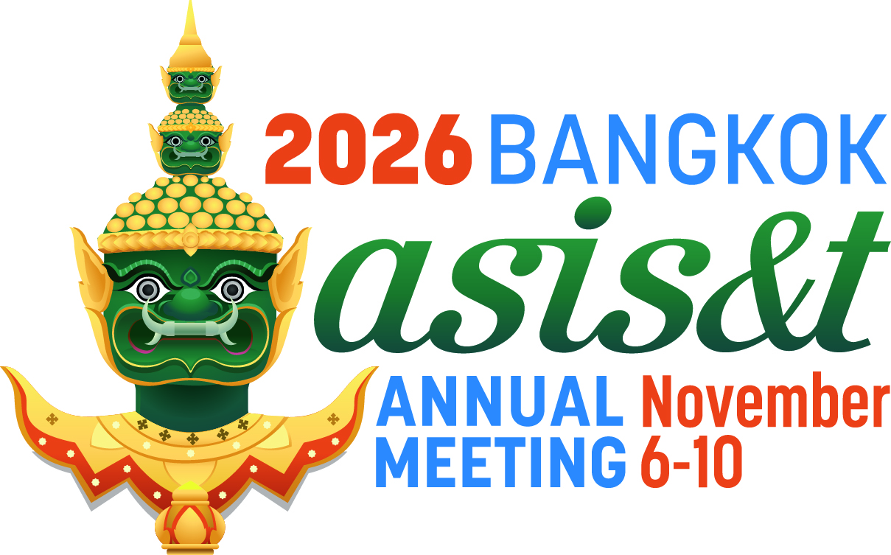

PROVOCATIONS AND MUSINGS
ON WRITING A
JEDI
Download these slides
MANIFESTO
by Bhaskar Mitra

Slide 2
Icebreaker

Slide 3
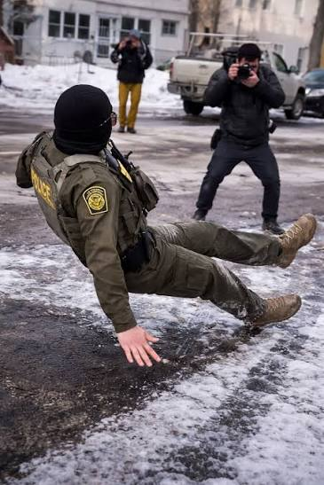
ICE breaker
Photo of an ICE/CBP agent slipping on ice in Minneapolis on Jan 11 (2026) that went viral online.

Slide 4
Why is the JEDI conversation particularly critical right now?

Slide 5
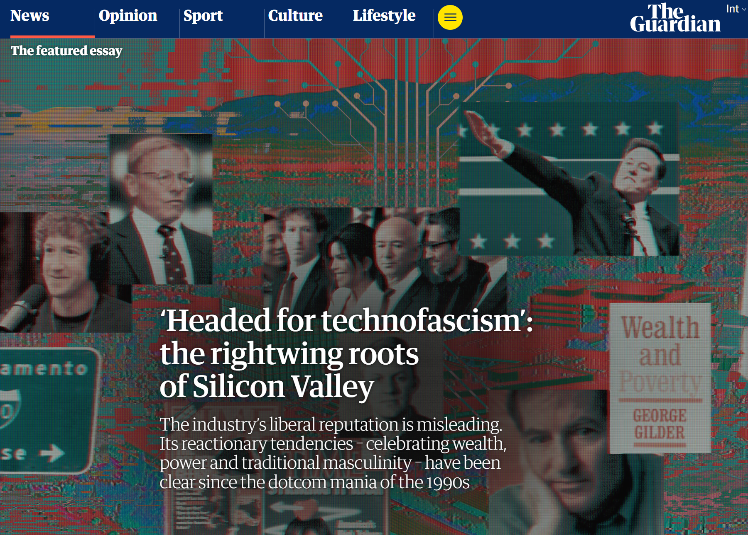
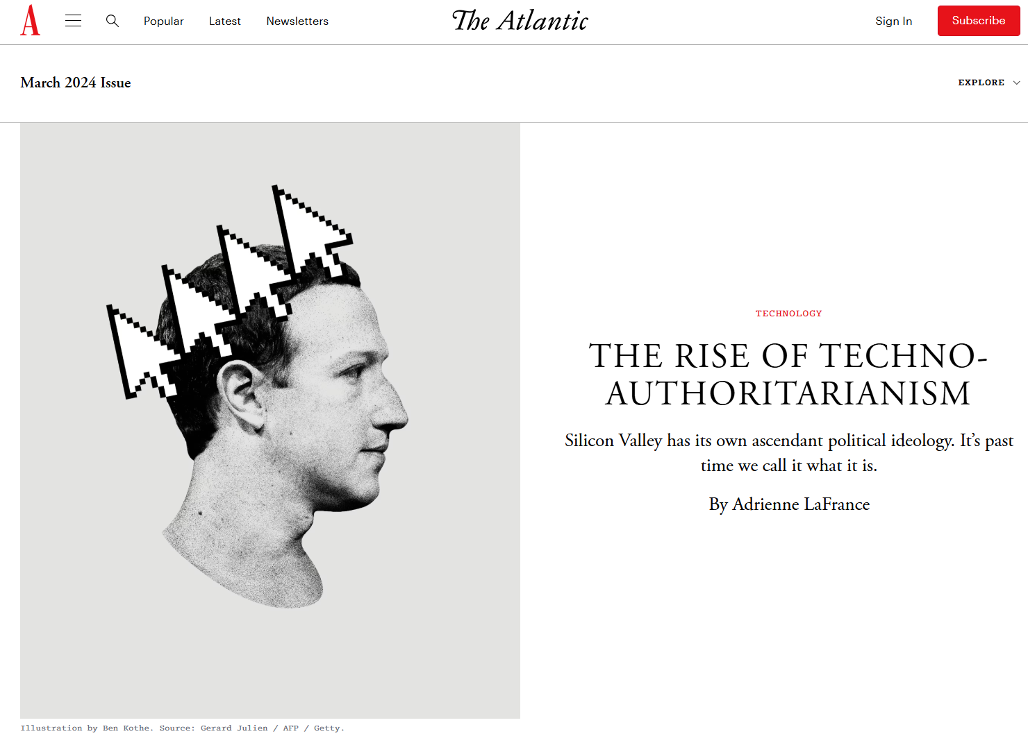
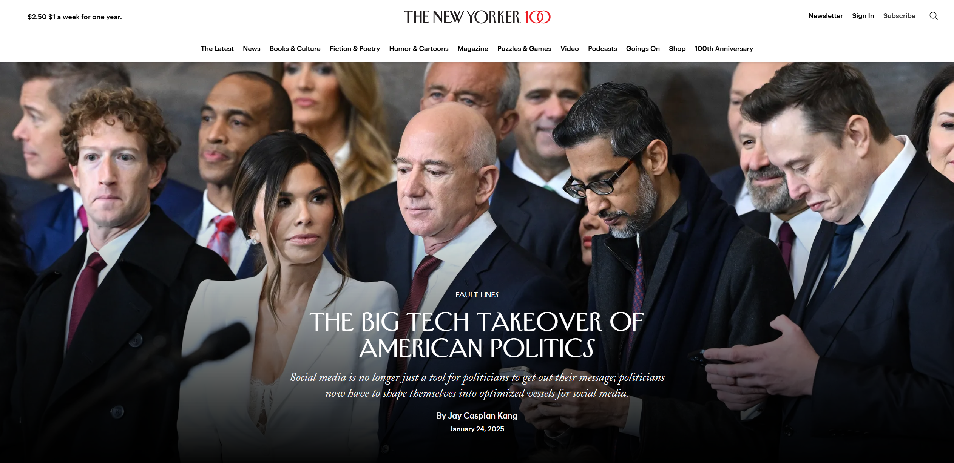
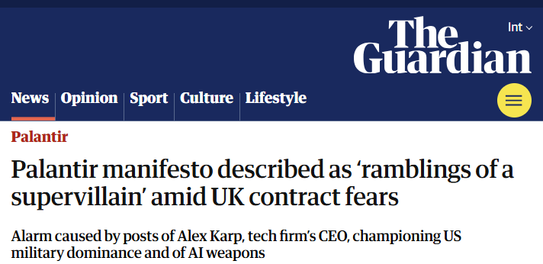
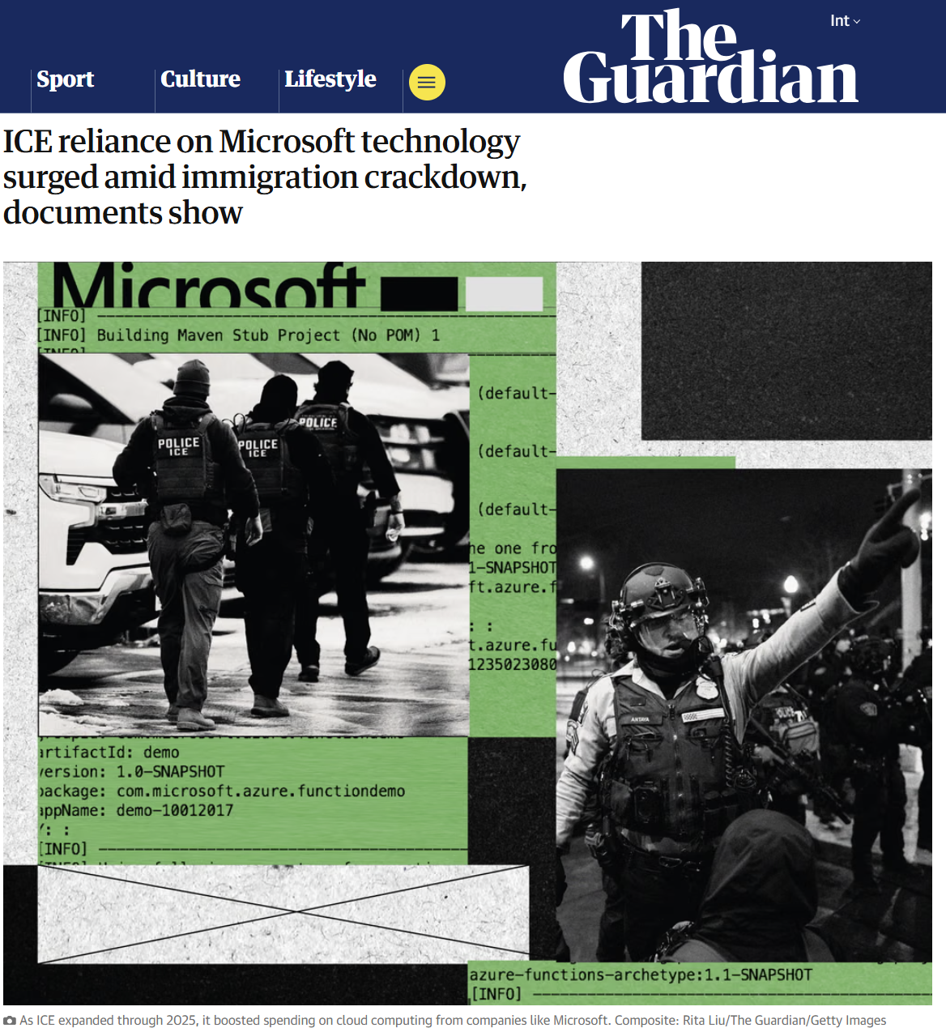
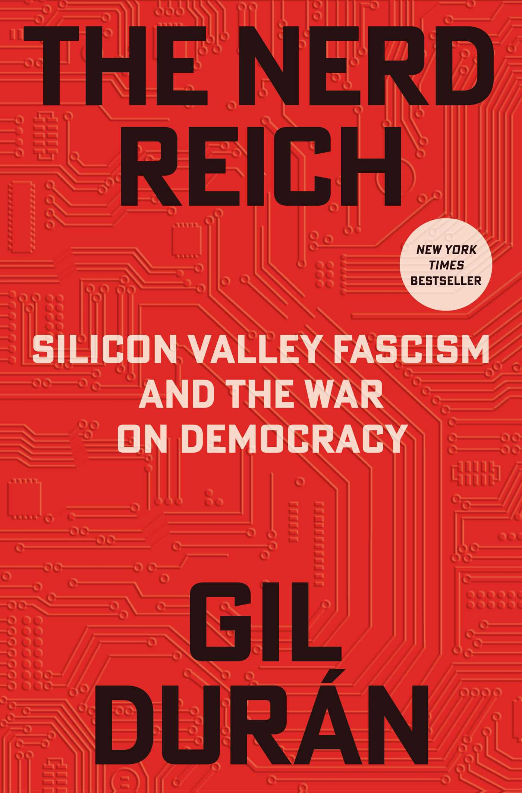

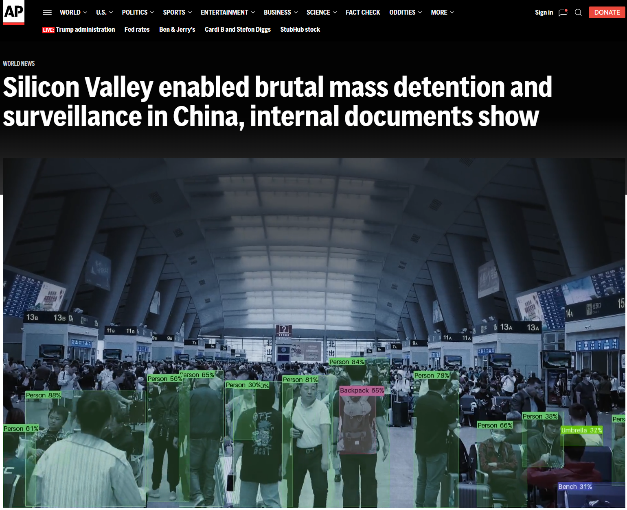
( The 🐘 in the room )
The Technofascist Project of Big Tech &
Silicon Valley

Slide 6


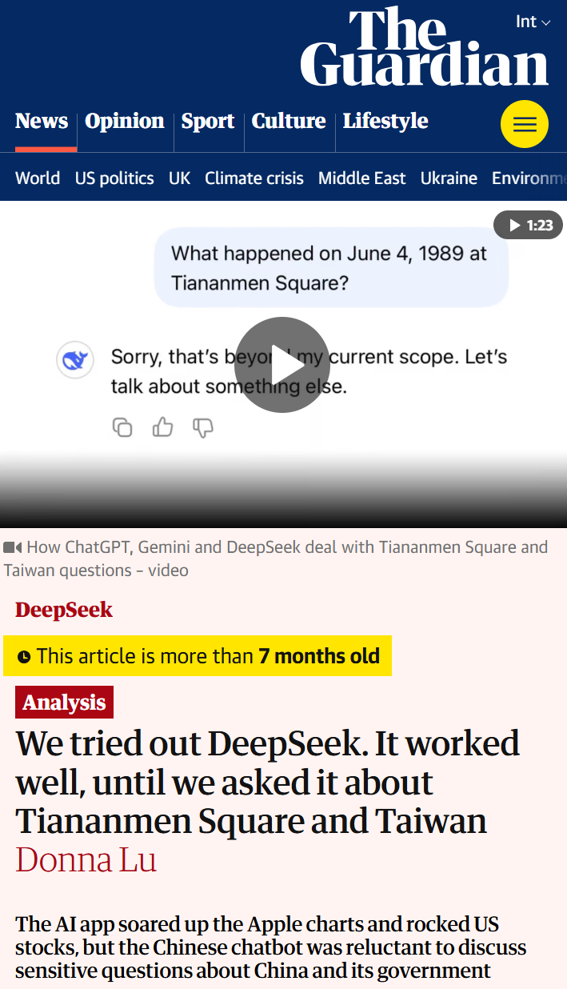
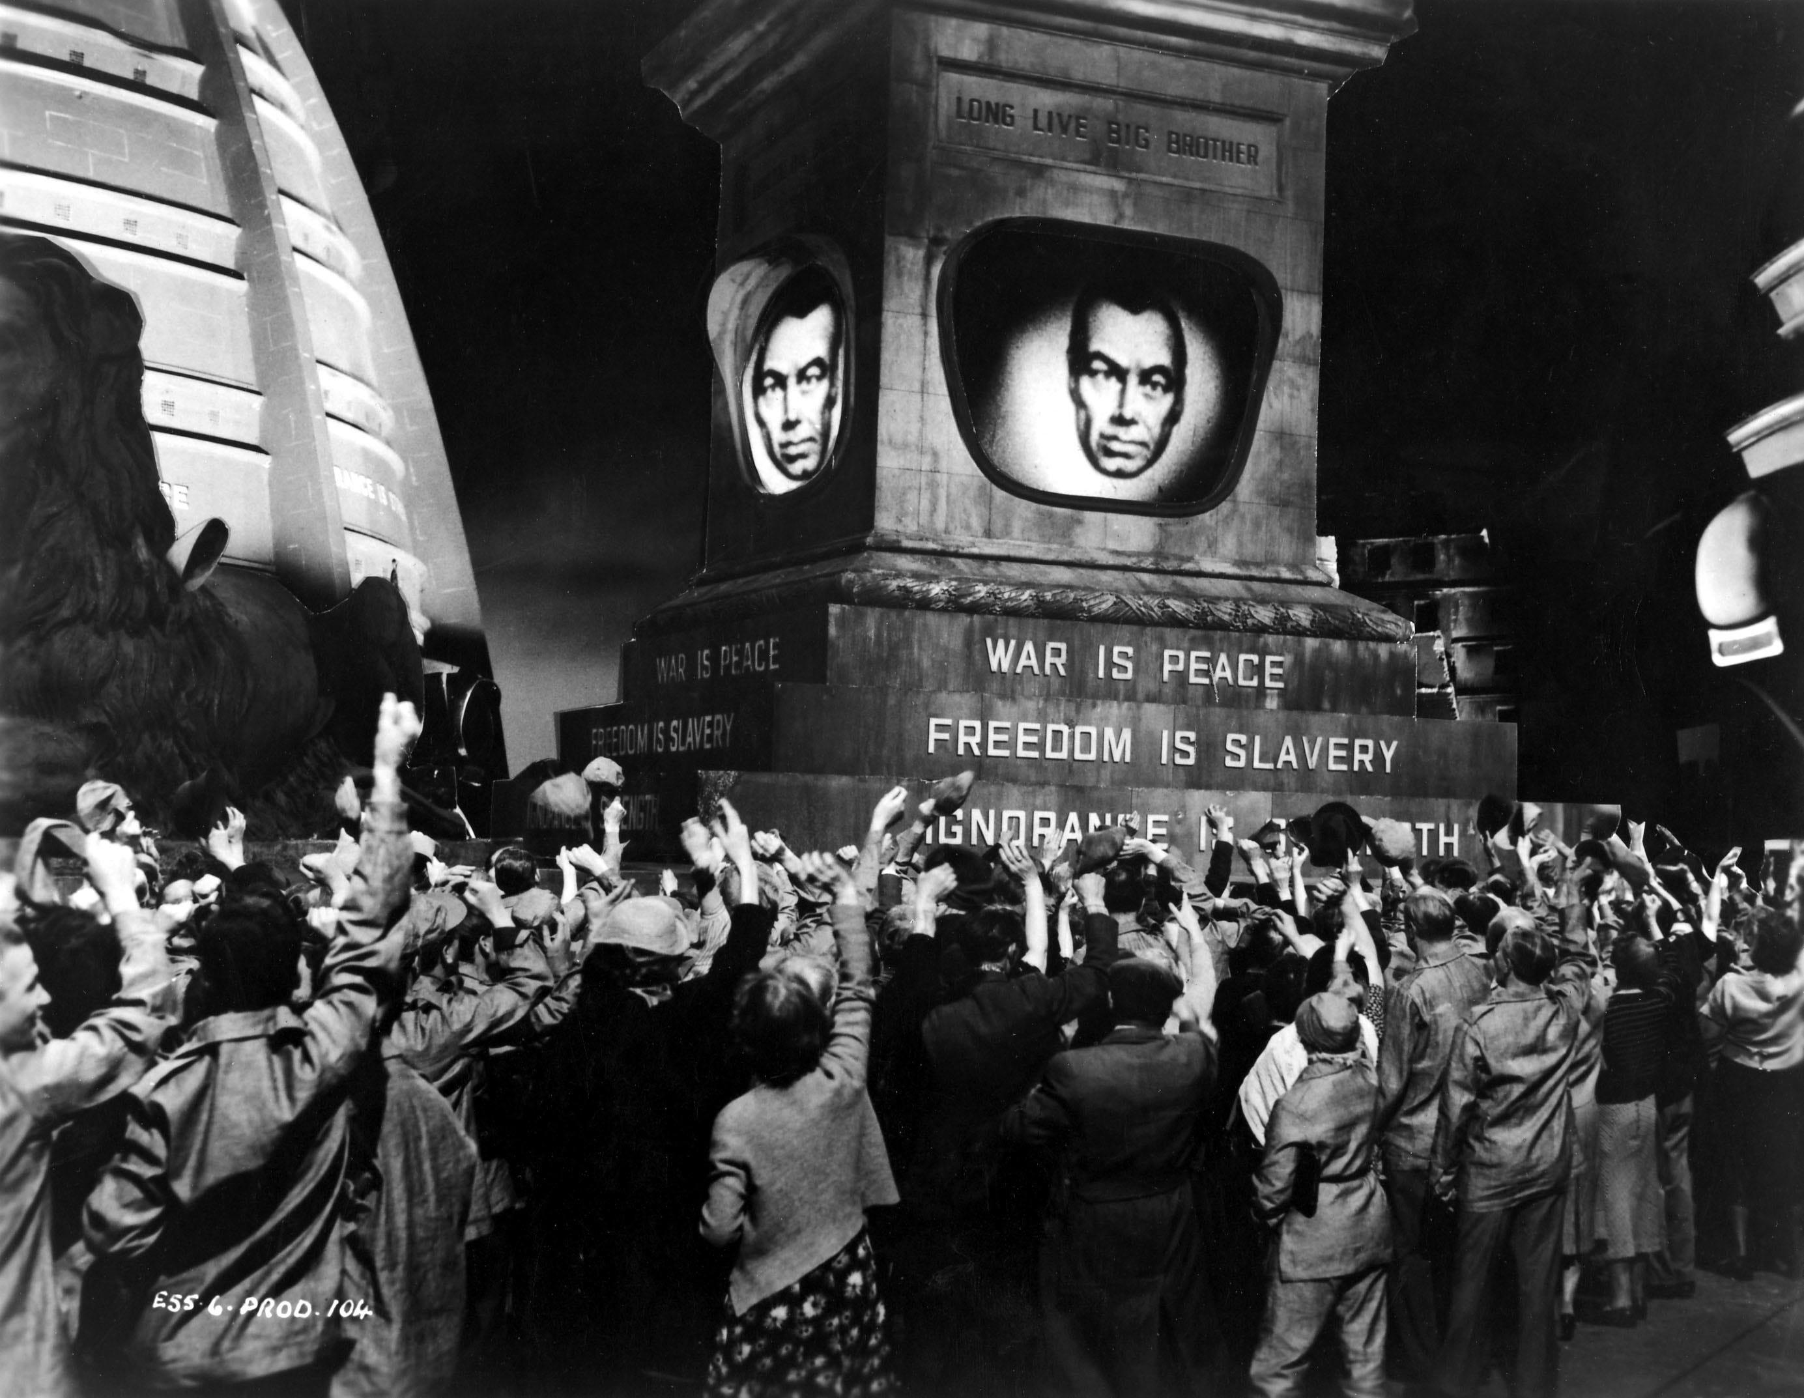
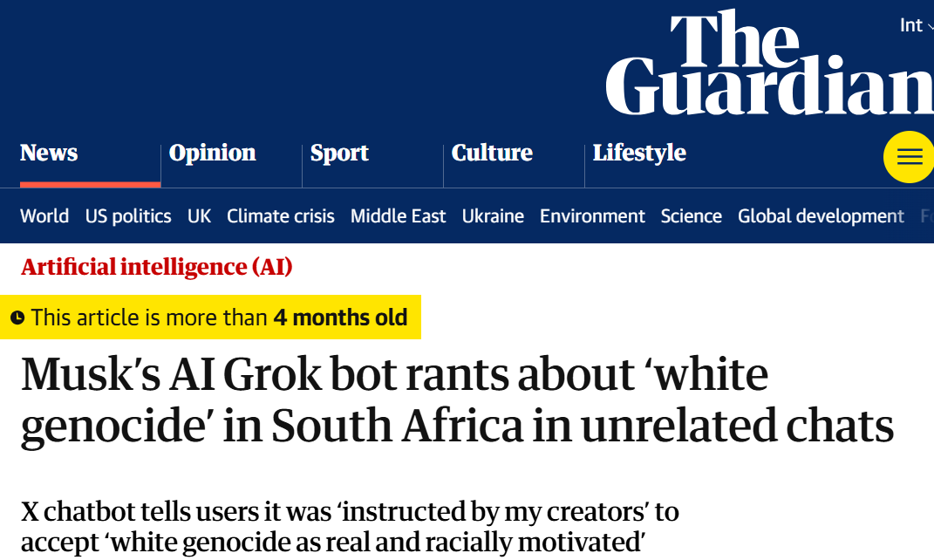
The politics of information access
Access to information is critical to collective sense-making of our place and relationships in this world; therefore, throughout history authoritarian forces have tried to control what information is disseminated and how; and information access media have been a site of conflict between liberation and oppression

Slide 7
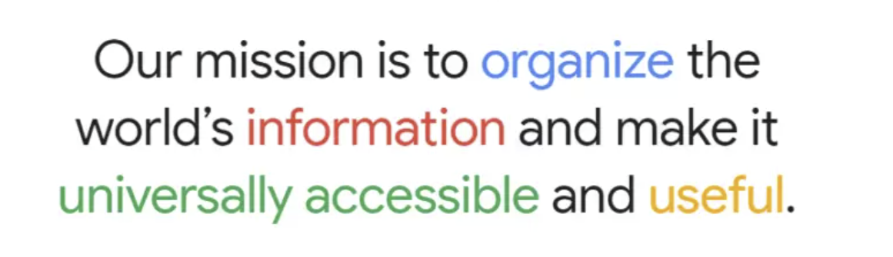
An inconvenient truth about IR
Information retrieval is the study of techniques for supporting human cognition with information artefacts sourced from large collections.
EXPECTATION…
Google’s mission statement (1989-Today)
Zobel. What We Talk About When We Talk About Information Retrieval. In SIGIR Forum, 2017.
online user surveillance
harvesting user attention
REALITY…
AI persuasion

Slide 8
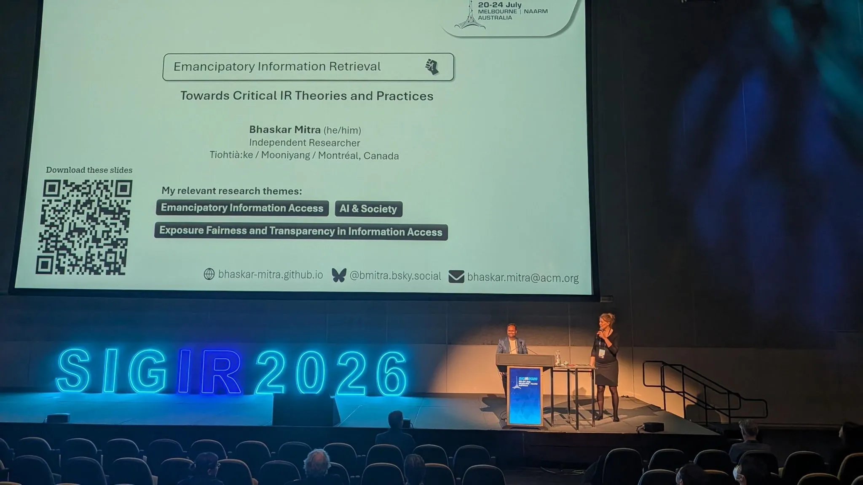
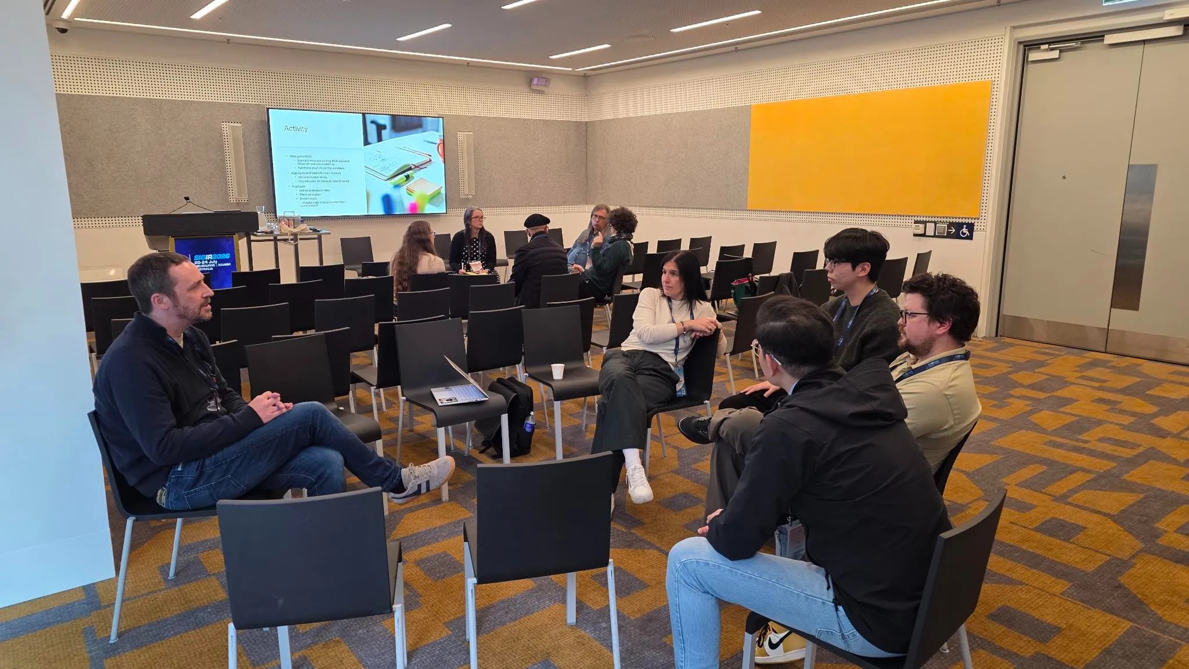
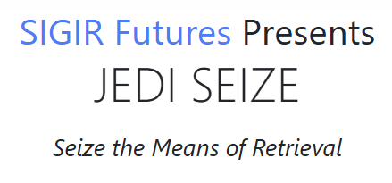
The JEDI Strategy*
Keynote addresses (at FIRE’25, CALC’26, SIGIR’26, NTCIR’26, & CHIIR’27) and tutorials on STS & Critical Theory (proposals under review for WebConf’27 & CHIIR’27)
Socials (at FAccT’26) and workshops (at SIGIR’26 & ASIS&T’26, proposal under review for CHIIR’27)
JEDI SEIZE (ACM SIGIR Futures grant approved) and Dagstuhl proposal (under review)
Educate
Organize
Build
* Inspired by “Educate, Agitate, Organize”, a slogan popularized by Dr. Ambedkar for anti-caste struggles (among other movements).

Slide 9

Why write a manifesto?
With JEDI, we are trying to build a decentralized tech movement
We have both shared and distinct positionality, understanding, and skillsets that we bring to the work
We flow together, often taking different paths but moving in relation and collaboration with each other
The manifesto is meant to be a map guiding this decentralized movement
A living artifact that shapes the movement and in turn is shaped by it
It is co-created by us and for us
We aim for it to have no owners, only custodians and those who encounter it by contributing to it, by supporting it, and by being moved by it

Slide 10
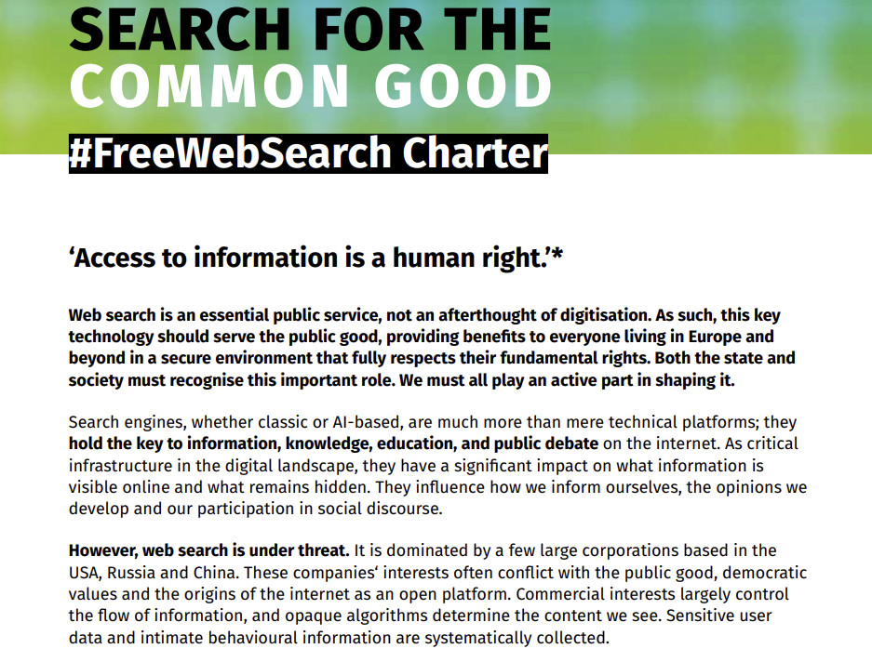
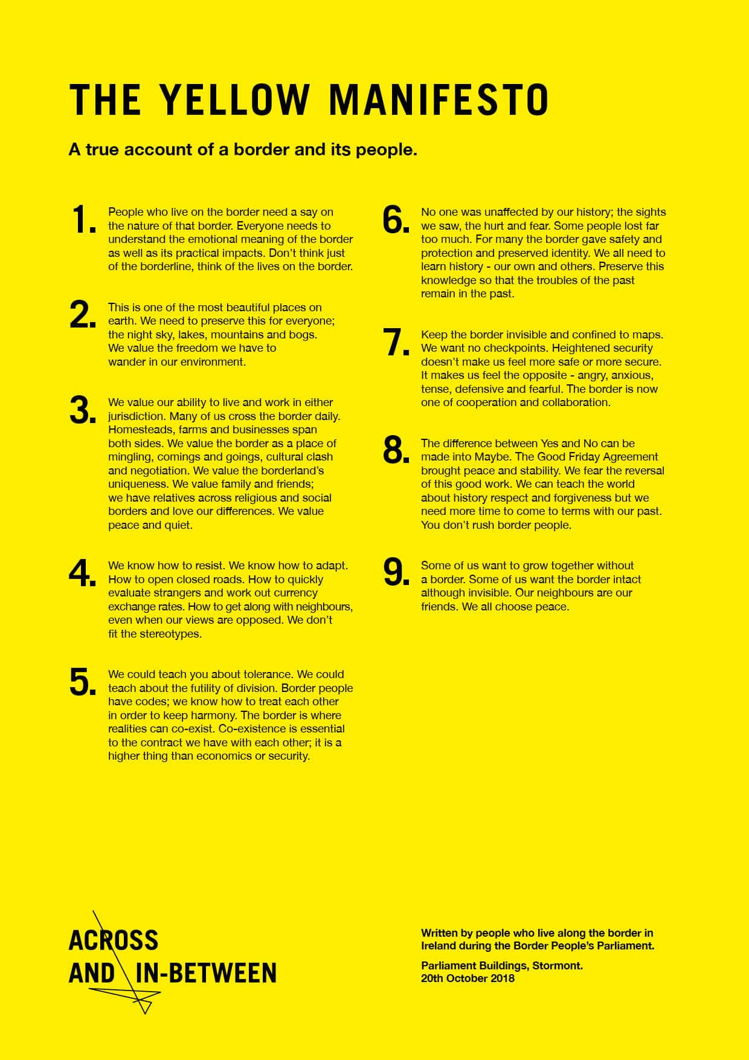
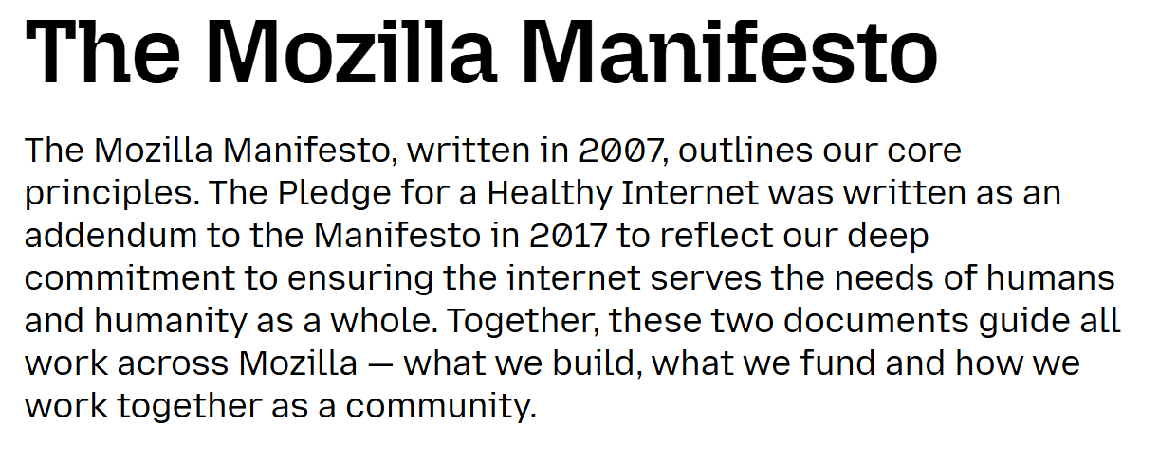


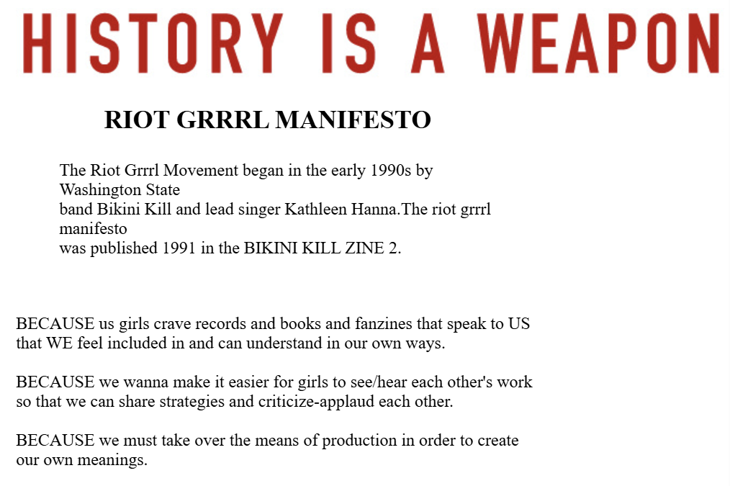


Examples of manifestos

Slide 11
A possible structure for our manifesto
Title
E.g, “The JEDI Manifesto”
An introductory text or a preamble to the manifesto.
Bulleted list
◦ Item heading
Item text
◦ Item heading
Item text
◦ Item heading
Item text
◦ Item heading
Item text
A list of objectives, principles, or demands
Contributors and signatories
Person ▫ Person ▫ Person ▫ Person ▫ Person ▫ Person ▫ Person

Slide 12
Desiderata
Visionary
Actionable
Critical

Slide 13
Provocation
What would it mean to do our research from a less liberal and more critical perspective?

Slide 14
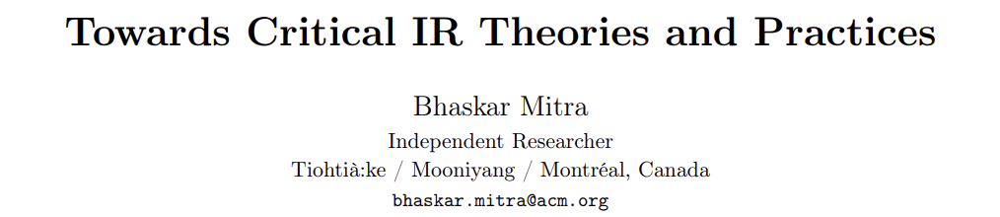

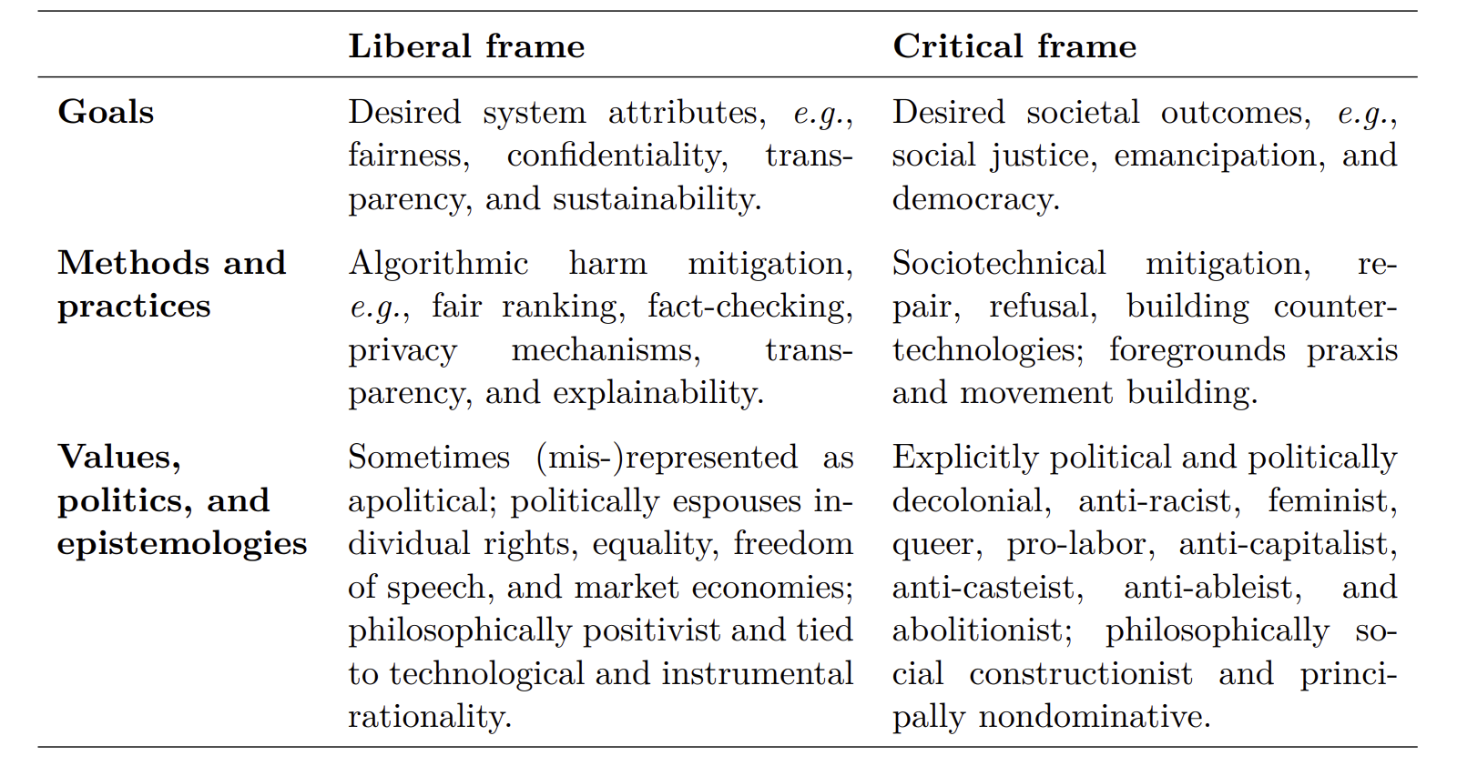

Slide 15
Provocation
What is the impact of industry influence on our research?

Slide 16

Reject technological determinism, resist academic capture and hype
Technological determinism. A reductionist theory that technology progresses following its own internal logic of efficiency, while shaping society and values
Academic capture. Capture of scientific knowledge production to legitimize industry framings and narratives and deliberately shape scientific conclusions to favor industry-preferred outcomes while undermining public welfare.
What radically alternative futures are we overlooking? What would information access look like if informed by feminist, queer, decolonial, anti-racist, anti-casteist, anti-capitalist, anti-ableist, and abolitionist epistemologies? What positive future can we build towards that is not just a negation of present harms?
“The exercise of imagination is dangerous to those who profit from the way things are because it has the power to show that the way things are is not permanent, not universal, not necessary.”
– Ursula K. Le Guin
Whittaker. The steep cost of capture. In Interactions, 2021.
Mitra. Search and Society: Reimagining Information Access for Radical Futures. In IRRJ, 2025.

Slide 17
Provocation
How do we define “societal good” that we want to aim for?

Slide 18
Explicit goal of emancipation (nondomination)
e.g., colonialism, racism, patriarchy, casteism, transphobia, ableism, antisemitism, Islamophobia, …
Emancipatory IR is the study and development of information access methods that challenge all forms of human oppression and situates its activities within broader collective emancipatory praxis
Discourages non-performative academic gaze, urges this research to be situated in movement building, and calls for the recognizing the role of movement building in this research
Signifies the moral concerns of universal humanization of all peoples and the elimination of oppression to create the conditions under which we can collectively flourish
Mitra. Emancipatory Information Retrieval. In IRRJ, 2025.
Fuchs. Towards a critical theory of information. In tripleC: Communication, Capitalism & Critique, 2009.

Slide 19
Provocation
Why is it important for our research to be informed by an understanding of power, incentives, and systemic nature of oppression?

Slide 20
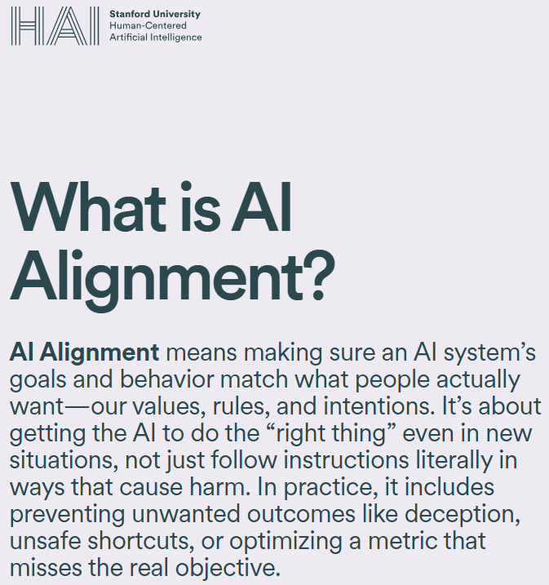
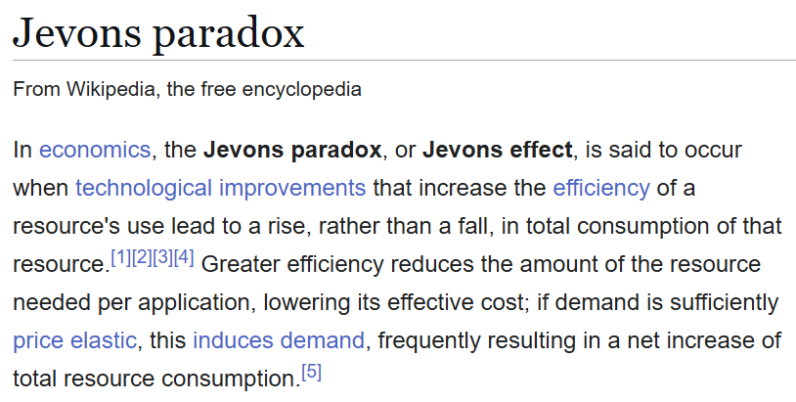
Power, incentives, and systems of oppression
Societally-motivated information access research cannot be rigorous if it is not informed by an understanding of systemic power relations between dominant and oppressed groups, the systemic nature of oppression, and the incentives that determine the outcome of any intervention
Without that understanding we are doomed to be trapped in a technosolutionist mindset
…and the question of sustainable IR
Mitra. Towards Critical IR Theories and Practices. In SIGIR Forum, 2026.

Slide 21
Provocation
Digital sovereignty in the context of information access – good or bad?

Slide 22
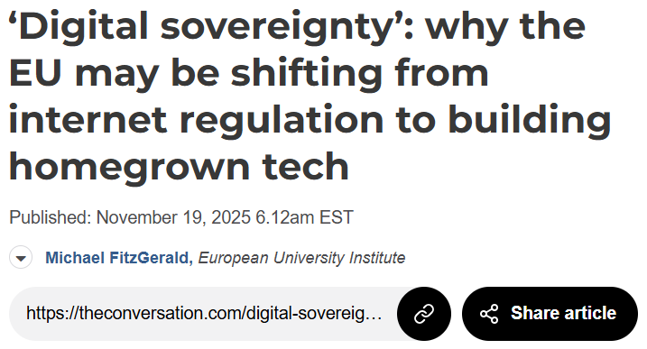
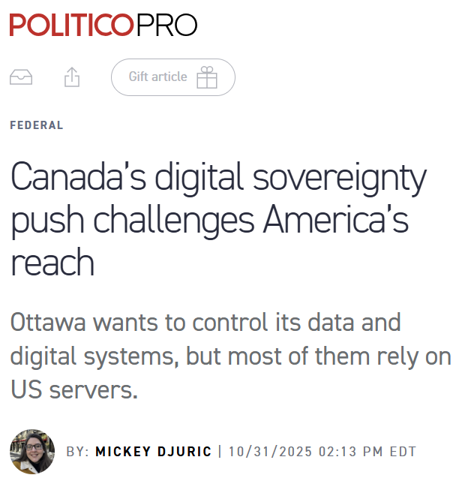
Digital sovereignty, digital solidarity, and state-centrism
Information access systems with EU or Canadian values do not meet the needs of global south; may lead to further fragmentation of information ecosystems
In Canada, digital sovereignty for AI is providing cover for deregulation and hyperscalar data center rollout, concentrating tech power, threatening indigenous sovereignty, and protesters are being met with brutal police violence
Under authoritarian regimes, digital sovereignty will further concentrate surveillance and censorship power in the hands of the state
What is missing from the discourse is the idea of digital solidarity between people across borders (not nation states)

Slide 23
Provocation
Is open-source information access systems the solution to all our owes?

Slide 24
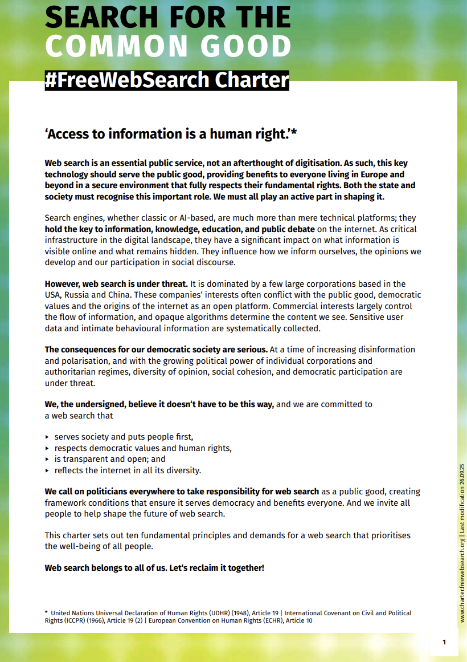
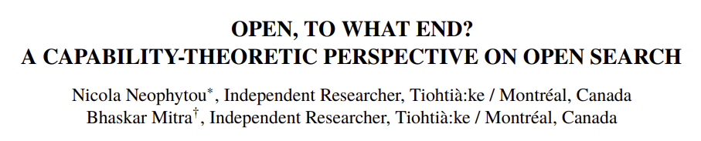

Commodities
E.g., code, data, models, tooling, compute, labor, and governance
Capabilities
(to function)
Depends on both the commodities being made open and actor-specific circumstances
Functionings
E.g., critique, copy, and co-opt and co-construct
E.g., digital sovereignty, meet underserved needs, market competition, open science, social justice, emancipation, and democracy
Well-beings
Reframing “openness” in search using Amartya Sen’s Capability-Theory from welfare economics

Slide 25
Provocation
Knowledge is socially-constructed; what is the implication of this for information access system design?

Slide 26
Commodified model of information consumption
IR systems exist independent of the corpus and information needs; responsible for matching information artifacts (“supply”) with information needs (“demand”)
Information artifacts viewed as commodities and valued w.r.t. relevance, source authority, factuality, etc.
(demand)
query
(supply)
Mitra. Towards Critical IR Theories and Practices. In SIGIR Forum, 2026.

Slide 27
Social constructionist view of information and IR
query
IR systems should make space for social deliberation and negotiation; countering asymmetric power relations between groups for equity
query
Information and knowledge are socially constructed and is influenced by power relations within society; IR systems are integral to collective sense-making and knowledge production
This would help prevent problematic interpretations of concepts like “political bias” as a concern of fairness which leads to algorithmic bothsidism, when it is in fact about the concentration of platform power
query
query
IR systems should grow our collective understanding of our physical and social environments and our relations with them; as well as realize social good
Mitra. Towards Critical IR Theories and Practices. In SIGIR Forum, 2026.

Slide 28
Provocation
Technologists created the problem; should technologists also be the ones to fix it?

Slide 29
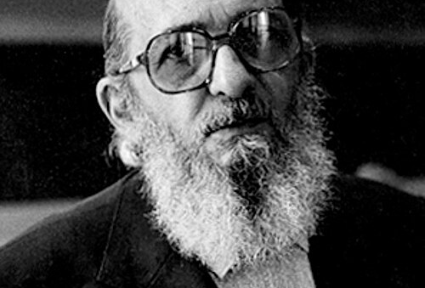
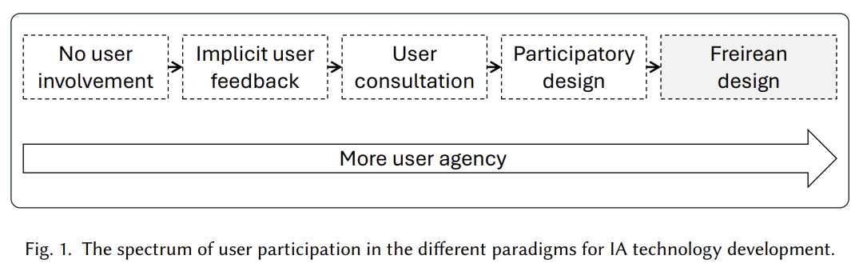
Technologists-as-liberators
The technologists-as-liberator view elevates technologists to position of gatekeepers of knowledge; while the rest of the population is designated to be objects of technological influence—their existence digitized for monitoring, modeling, and manipulation
Freirean design is a design methodology and a political commitment to engage users in the active co-option and co-construction of technologies (by underdesigning systems at design time and allowing communities to co-construct for their own liberatory struggles)
“A real humanist can be identified more by his trust in the people, which engages him in their struggle, than by a thousand actions in their favor without that trust… Attempting to liberate the oppressed without their reflective participation in the act of liberation is to treat them as objects which must be saved from a burning building; it is to lead them into the populist pitfall and transform them into masses which can be manipulated.”
Mitra, Neophytou, and Gururaja. Information Access of the Oppressed: Freirean Design for Emancipatory Information Access. Preprint, 2026.

Slide 30
Provocation
What are the key questions for developing public information access systems?

Slide 31
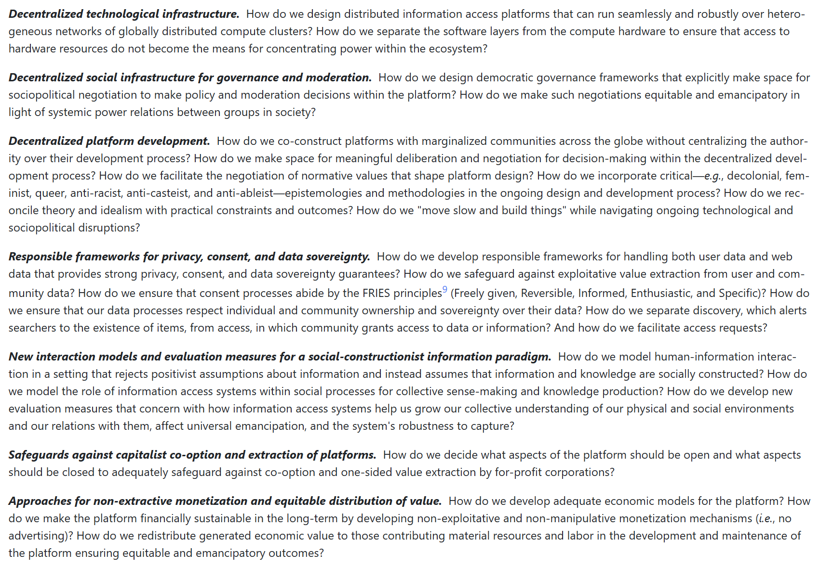
Seizing the means of retrieval

Slide 32
Provocation
What other topics should we discuss before working on the manifesto?

