Slide 1



Neural Learning to Rank
Bhaskar Mitra (he/him)
Independent Researcher
Tiohtià:ke / Montréal, Canada
bhaskar-mitra.github.io
@bmitra.bsky.social
bhaskar.mitra@acm.org

Slide 2


Reading materials
https://www.emerald.com/ftinr/article-abstract/3/3/225/1326502/Learning-to-Rank-for-Information-Retrieval
https://www.emerald.com/ftinr/article-abstract/13/1/1/1328679/An-Introduction-to-Neural-Information-Retrieval

Slide 3


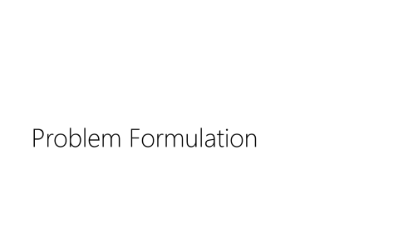



Agenda

Slide 4
Problem Formulation

Slide 5





Most information retrieval (IR) systems present a ranked list of retrieved artifacts

Slide 6
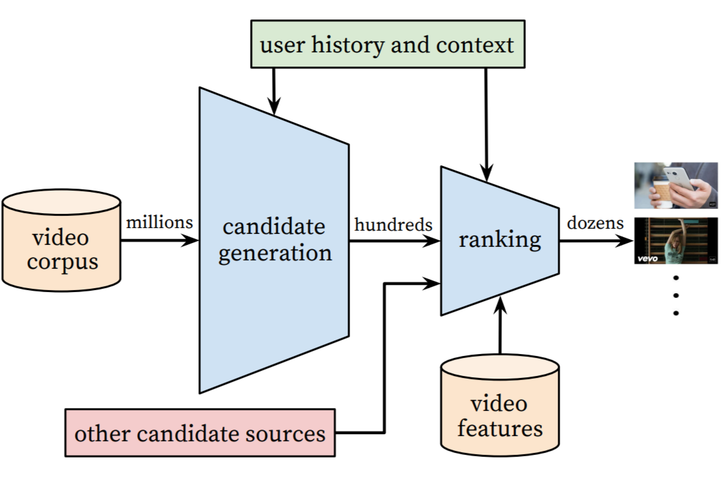
Learning to Rank (LTR)
”... the task to automatically construct a ranking model using training data, such that the model can sort new objects according to their degrees of relevance, preference, or importance.”
- Liu [2009]
Tie-Yan Liu. Learning to rank for information retrieval. Foundation and Trends in Information Retrieval, 2009.
Image source: https://storage.googleapis.com/pub-tools-public-publication-data/pdf/45530.pdf

Slide 7
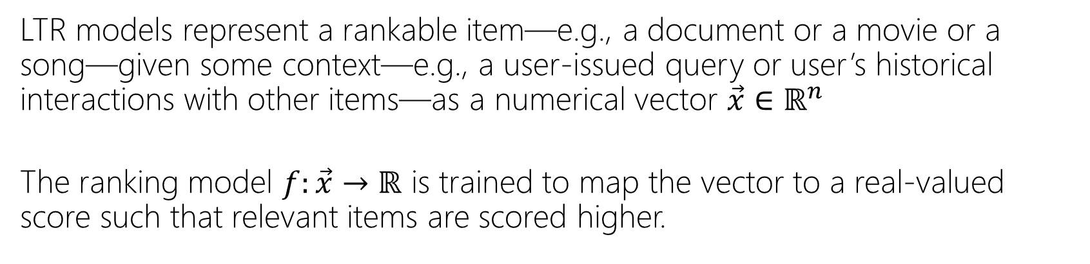
Problem formulation
LTR models represent a rankable item—e.g., a document or a movie or a song—given some context—e.g., a user-issued query or user’s historical interactions with other items—as a numerical vector $\vec{x}∈ℝ^{n}$
The ranking model $f:\vec{x}→ℝ$ is trained to map the vector to a real-valued score such that relevant items are scored higher.

Slide 8
Features
They can often be categorized as:
Query-independent or static features
e.g., incoming link count and document length
Query-dependent or dynamic features
e.g., BM25
Query-level features
e.g., query length
Traditional L2R models employ hand-crafted features that encode IR insights

Slide 9
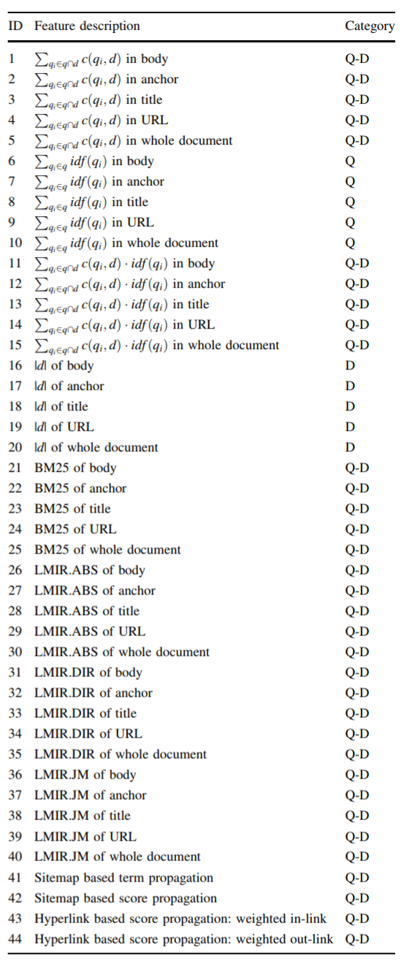
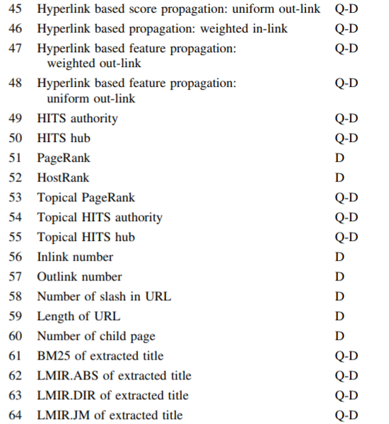
Features
Tao Qin, Tie-Yan Liu, Jun Xu, and Hang Li. LETOR: A Benchmark Collection for Research on Learning to Rank for Information Retrieval, Information Retrieval Journal, 2010

Slide 10


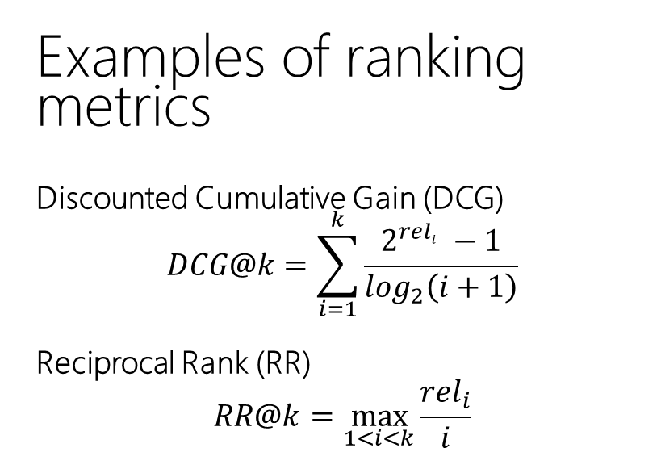
Why is ranking challenging?
Examples of ranking metrics
Discounted Cumulative Gain (DCG)
$$DCG@k=\sum_{i=1}^{k}{\frac{2^{{rel}_{i}^{}}−1}{\log_{2}\left(i+1\right)}}$$
Reciprocal Rank (RR)
$$RR@k=\max_{1<i<k}{\frac{{rel}_{i}}{i}}$$
Rank based metrics, such as DCG and MRR, are non-smooth / non-differentiable

Slide 11
Machine Learning Preliminaries

Slide 12
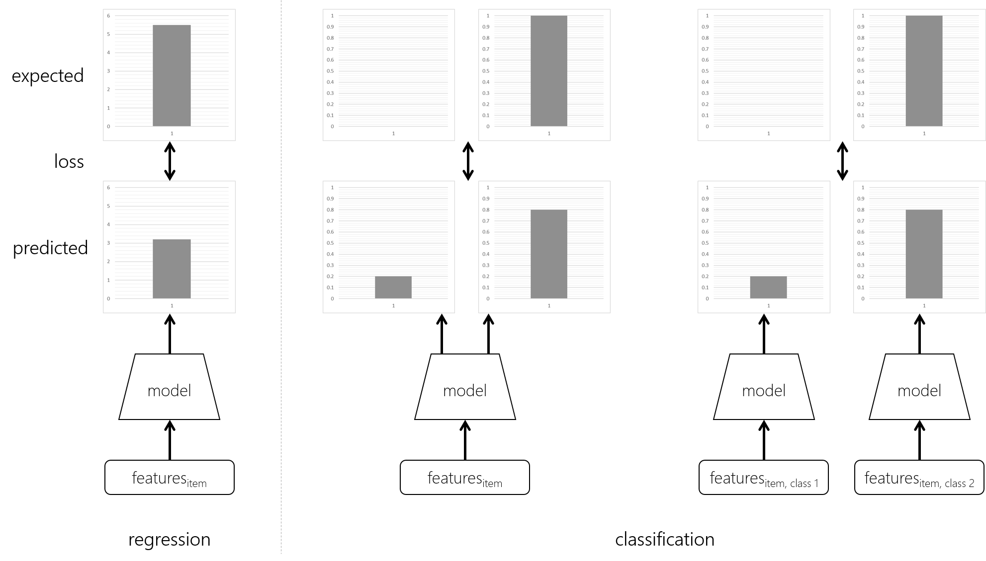
Basic machine learning tasks

Slide 13

Squared loss
The squared loss is a popular loss function for regression tasks

Slide 14
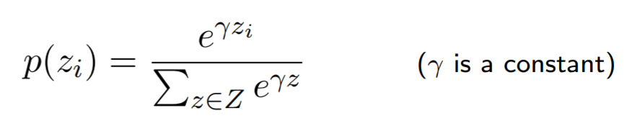
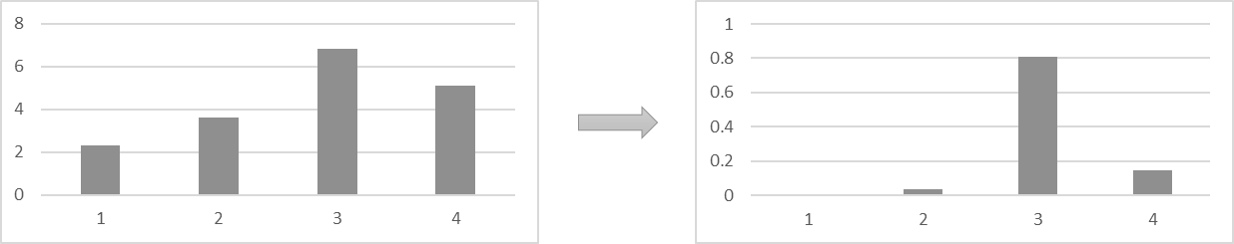
The softmax function
In neural classification models, the softmax function is popularly used to normalize the neural network output scores across all the classes

Slide 15
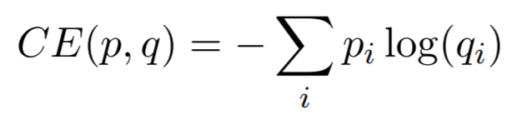
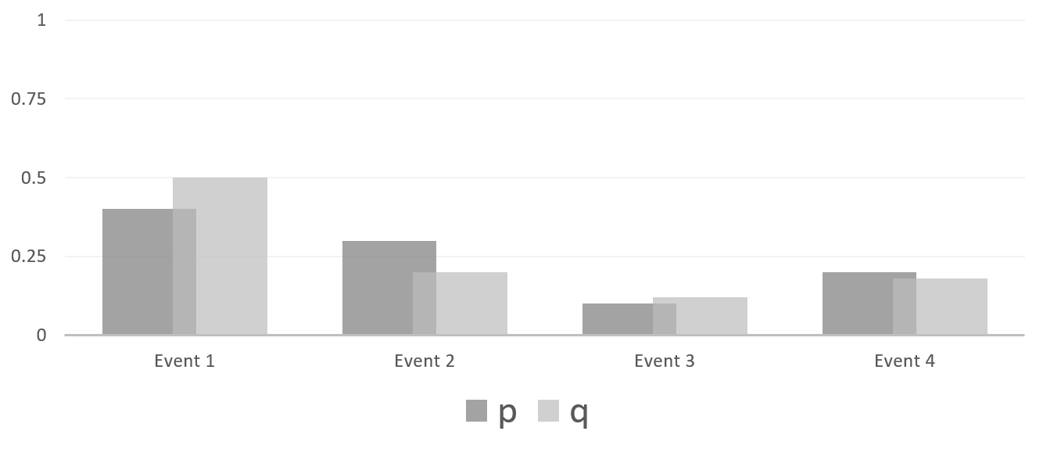



Cross entropy
The cross entropy between two probability distributions $p$ and $q$ over a discrete set of events is given by,
If $p_{correct}=1$and $p_{i}=0$ for all other values of $i$ then,

Slide 16
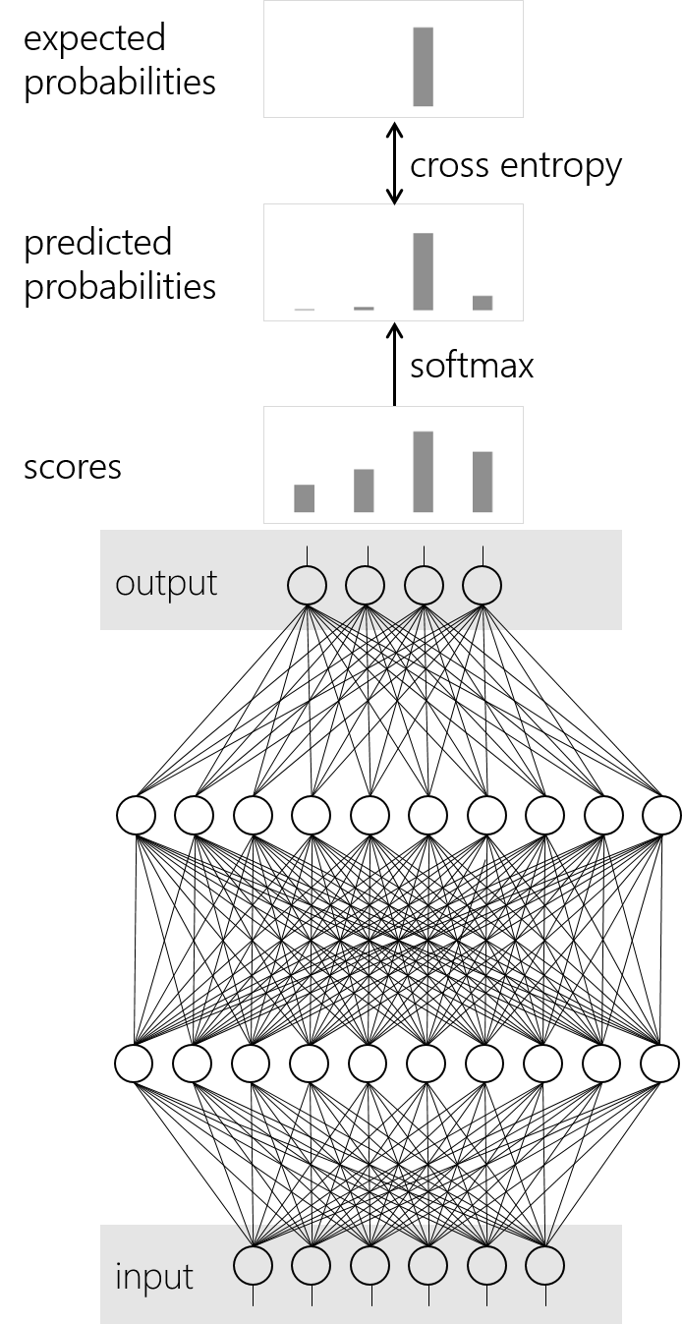
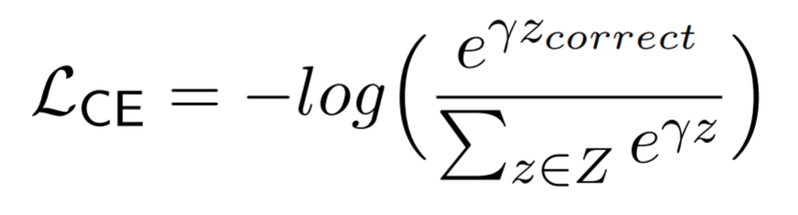
Cross entropy with softmax loss
Cross entropy with softmax is a popular loss function for classification

Slide 17
Learning to Rank

Slide 18
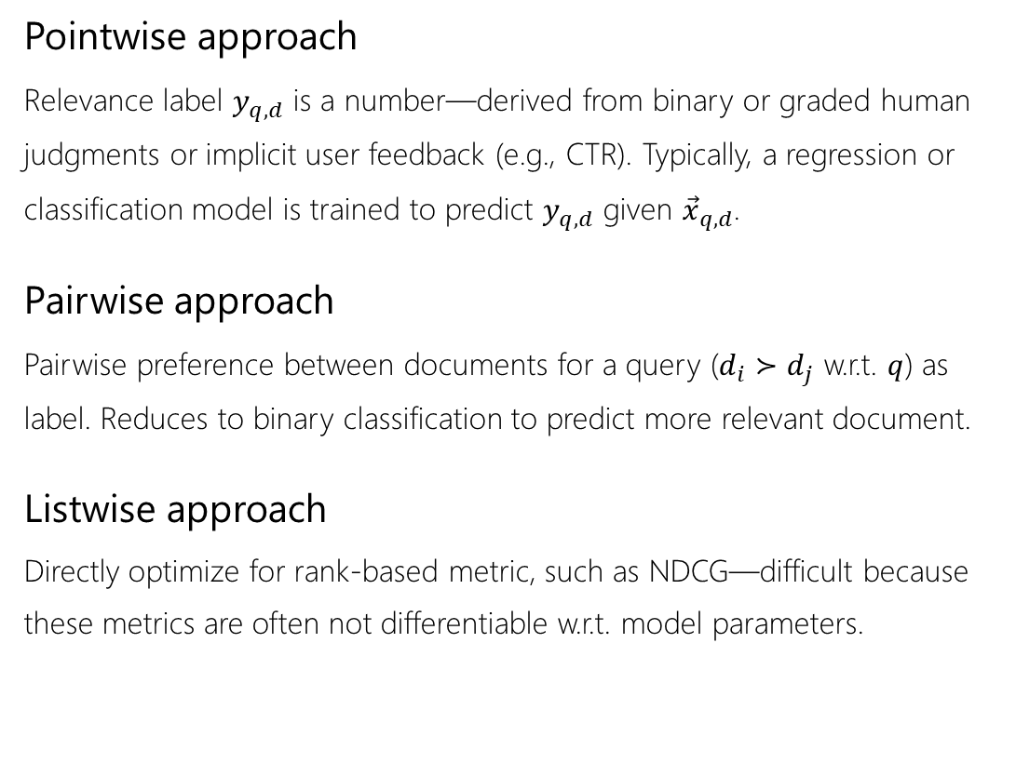
Approaches
Pointwise approach
Relevance label $y_{q,d}$ is a number—derived from binary or graded human judgments or implicit user feedback (e.g., CTR). Typically, a regression or classification model is trained to predict $y_{q,d}$ given ${\vec{x}}_{q,d}$.
Pairwise approach
Pairwise preference between documents for a query ($d_{i}≻d_{j}$ w.r.t. $q$) as label. Reduces to binary classification to predict more relevant document.
Listwise approach
Directly optimize for rank-based metric, such as NDCG—difficult because these metrics are often not differentiable w.r.t. model parameters.
Liu [2009] categorizes different LTR approaches based on training objectives:
Tie-Yan Liu. Learning to rank for information retrieval. Foundation and Trends in Information Retrieval, 2009.

Slide 19

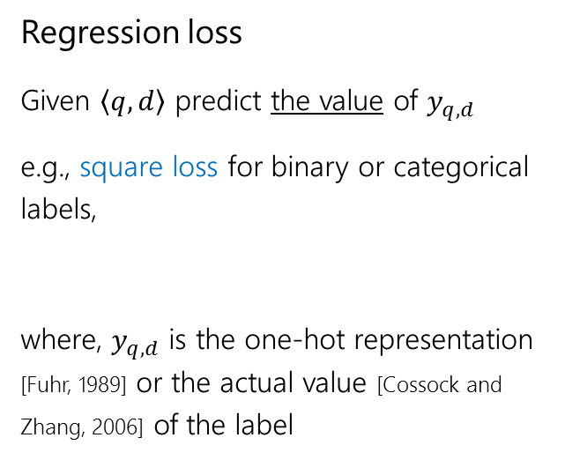
Pointwise objectives
0
1
1
labels
Regression loss
Given $\left\langle q,d\right\rangle$ predict the value of $y_{q,d}$
e.g., square loss for binary or categorical labels,
where, $y_{q,d}$ is the one-hot representation [Fuhr, 1989] or the actual value [Cossock and Zhang, 2006] of the label
prediction
Norbert Fuhr. Optimum polynomial retrieval functions based on the probability ranking principle. ACM TOIS, 1989.
David Cossock and Tong Zhang. Subset ranking using regression. In COLT, 2006.

Slide 20
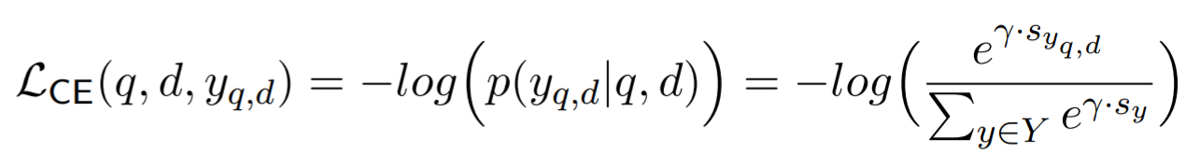
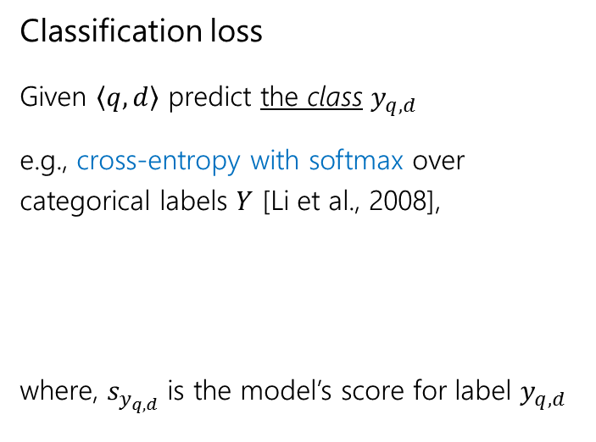
Pointwise objectives
0
1
labels
Classification loss
Given $\left\langle q,d\right\rangle$ predict the class $y_{q,d}$
e.g., cross-entropy with softmax over categorical labels $Y$ [Li et al., 2008],
where, $s_{y_{q,d}}$ is the model’s score for label $y_{q,d}$
prediction
Ping Li, Qiang Wu, and Christopher J Burges. Mcrank: Learning to rank using multiple classification and gradient boosting. In NIPS, 2008.

Slide 21
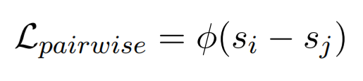
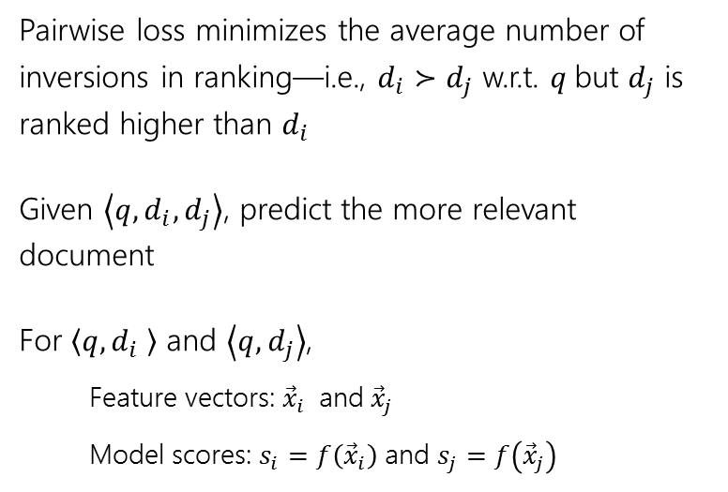
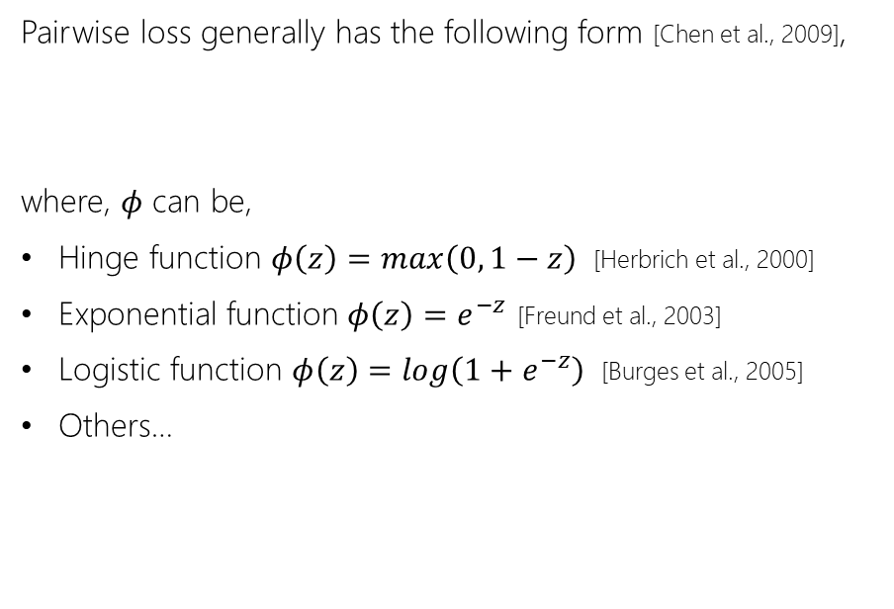
Pairwise objectives
Pairwise loss generally has the following form [Chen et al., 2009],
where, $φ$ can be,
Hinge function $φ\left(z\right)=max\left(0, 1−z\right)$ [Herbrich et al., 2000]
Exponential function $φ\left(z\right)=e^{−z}$ [Freund et al., 2003]
Logistic function $φ\left(z\right)=log\left(1+e^{−z}\right)$ [Burges et al., 2005]
Others…
Pairwise loss minimizes the average number of inversions in ranking—i.e., $d_{i}≻d_{j}$ w.r.t. $q$but $d_{j}$ is ranked higher than $d_{i}$
Given $\left\langle q,d_{i},d_{j}\right\rangle$, predict the more relevant document
For $\left\langle q,d_{i} \right\rangle$ and $\left\langle q, d_{j}\right\rangle$,
Feature vectors: ${\vec{x}}_{i}$ and ${\vec{x}}_{j}$
Model scores: $s_{i}=f\left({\vec{x}}_{i}\right)$ and $s_{j}=f\left({\vec{x}}_{j}\right)$
Wei Chen, Tie-Yan Liu, Yanyan Lan, Zhi-Ming Ma, and Hang Li. Ranking measures and loss functions in learning to rank. In NIPS, 2009.
Ralf Herbrich, Thore Graepel, and Klaus Obermayer. Large margin rank boundaries for ordinal regression. 2000.
Yoav Freund, Raj Iyer, Robert E Schapire, and Yoram Singer. An efficient boosting algorithm for combining preferences. In JMLR, 2003.
Chris Burges, Tal Shaked, Erin Renshaw, Ari Lazier, Matt Deeds, Nicole Hamilton, and Greg Hullender. Learning to rank using gradient descent. In ICML, 2005.

Slide 22
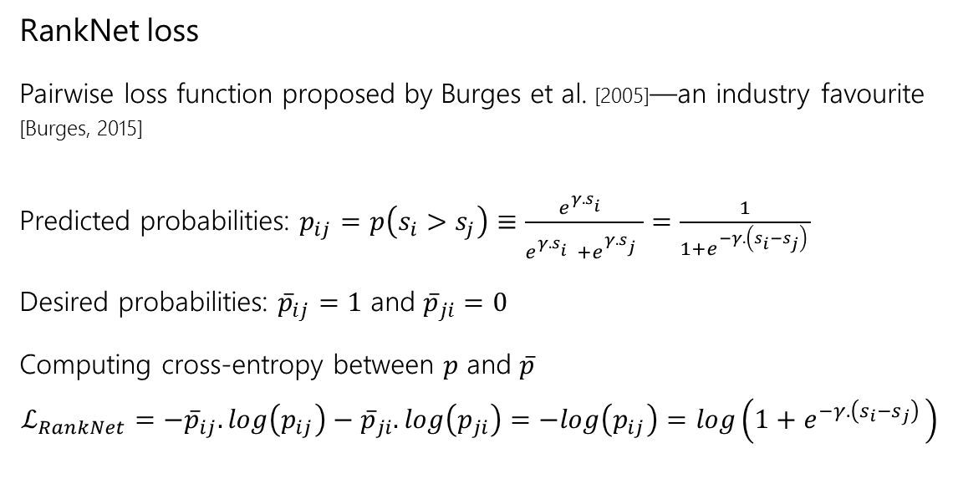
Pairwise objectives
0
1
pairwise preference
RankNet loss
Pairwise loss function proposed by Burges et al. [2005]—an industry favourite [Burges, 2015]
Predicted probabilities: $p_{ij}=p\left(s_{i}>s_{j}\right)≡\frac{e^{γ.s_{i}^{}}}{e^{γ.s_{i}^{}}+e^{γ.s_{j}^{}}}=\frac{1}{1+e^{−γ.\left(s_{i}−s_{j}\right) }}$
Desired probabilities: ${\overline{p}}_{ij}=1$ and ${\overline{p}}_{ji}=0$
Computing cross-entropy between $p$ and $\overline{p}$
$$ℒ_{RankNet}=−{\overline{p}}_{ij}.log\left(p_{ij}\right)−{\overline{p}}_{ji}.log\left(p_{ji}\right)=−log\left(p_{ij}\right)=log\left(1+e^{−γ.\left(s_{i}−s_{j}\right) }\right)$$
score
Chris Burges, Tal Shaked, Erin Renshaw, Ari Lazier, Matt Deeds, Nicole Hamilton, and Greg Hullender. Learning to rank using gradient descent. In ICML, 2005.
Chris Burges. RankNet: A ranking retrospective. https://www.microsoft.com/en-us/research/blog/ranknet-a-ranking-retrospective/. 2015.

Slide 23
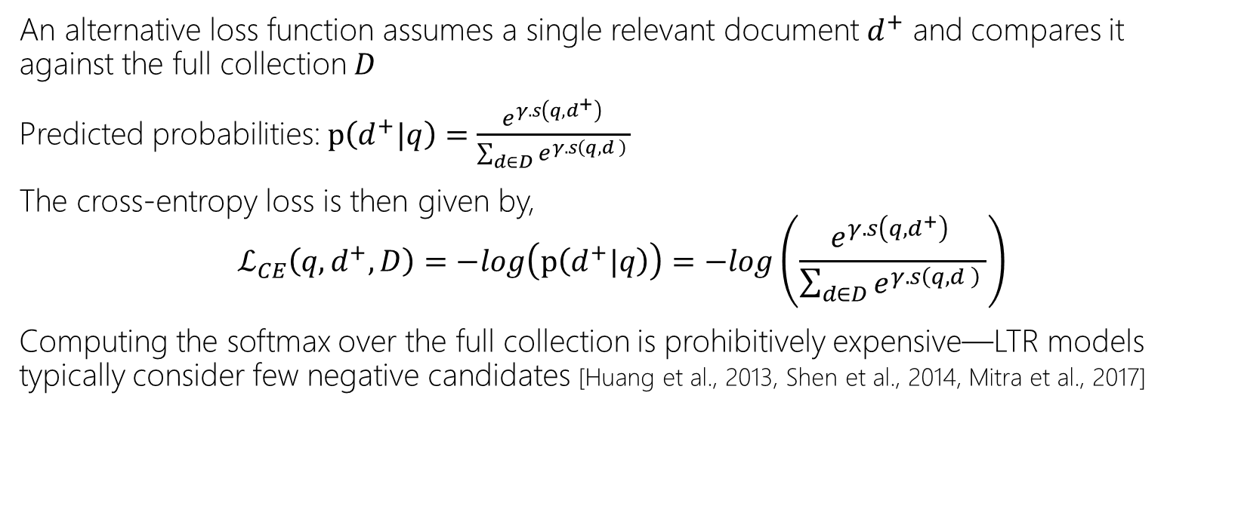
A generalized cross-entropy loss
An alternative loss function assumes a single relevant document $d^{+}$ and compares it against the full collection $D$
Predicted probabilities: $p\left(d^{+}|q\right)=\frac{e^{γ.s\left(q,d^{+}\right) }}{\sum_{d∈D}{e^{γ.s\left(q,d \right) }}}$
The cross-entropy loss is then given by,
$$ℒ_{CE}\left(q,d^{+},D\right)=−log\left(p\left(d^{+}|q\right)\right)=−log\left(\frac{e^{γ.s\left(q,d^{+}\right) }}{\sum_{d∈D}{e^{γ.s\left(q,d \right) }}}\right)$$
Computing the softmax over the full collection is prohibitively expensive—LTR models typically consider few negative candidates [Huang et al., 2013, Shen et al., 2014, Mitra et al., 2017]
Po-Sen Huang, Xiaodong He, Jianfeng Gao, Li Deng, Alex Acero, and Larry Heck. Learning deep structured semantic models for web search using clickthrough data. In CIKM, 2013.
Yelong Shen, Xiaodong He, Jianfeng Gao, Li Deng, and Gregoire Mesnil. A latent semantic model with convolutional-pooling structure for information retrieval. In CIKM, 2014.
Bhaskar Mitra, Fernando Diaz, and Nick Craswell. Learning to match using local and distributed representations of text for web search. In WWW, 2017.

Slide 24
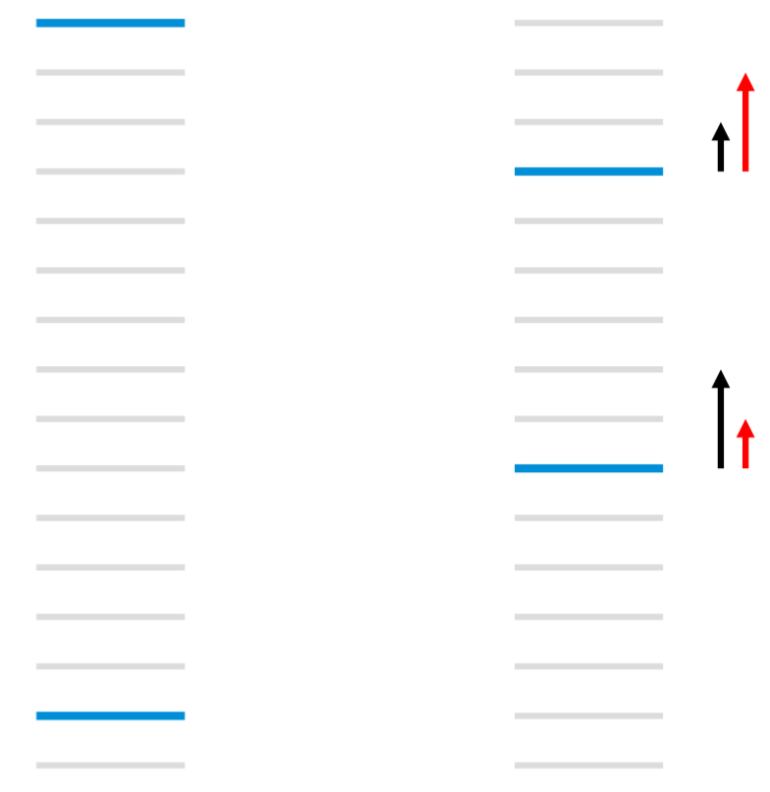
Listwise objectives
Blue: relevant Gray: non-relevant
NDCG and ERR higher for left but pairwise errors less for right
Due to strong position-based discounting in IR measures, errors at higher ranks are much more problematic than at lower ranks
But listwise metrics are non-continuous and non-differentiable
[Burges, 2010]
Christopher JC Burges. From ranknet to lambdarank to lambdamart: An overview. Learning, 2010.

Slide 25

Listwise objectives
Burges et al. [2006] make two observations:
To train a model we don’t need the costs themselves, only the gradients (of the costs w.r.t model scores)
It is desired that the gradient be bigger for pairs of documents that produces a bigger impact in NDCG by swapping positions
LambdaRank loss
Multiply actual gradients with the change in NDCG by swapping the rank positions of the two documents
Christopher JC Burges, Robert Ragno, and Quoc Viet Le. Learning to rank with nonsmooth cost functions. In NIPS, 2006.

Slide 26
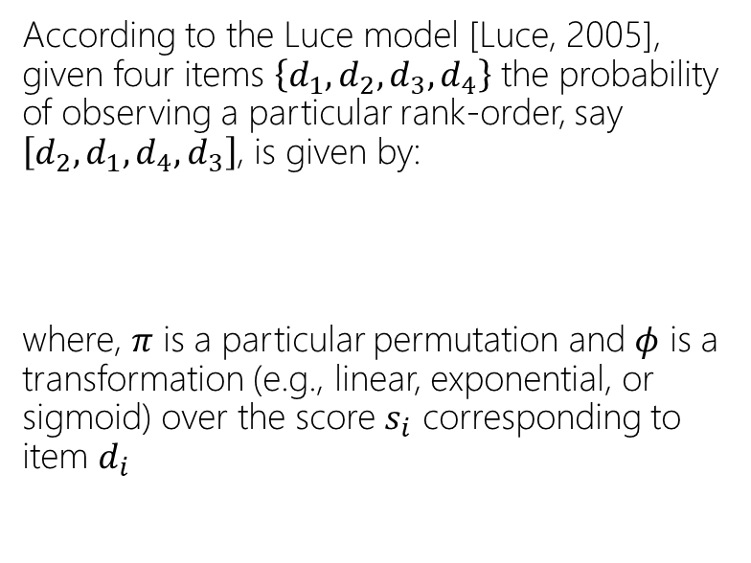
Listwise objectives
ListNet loss
Cao et al. [2007] propose to compute the probability distribution over all possible permutations based on model score and ground-truth labels. The loss is then given by the K-L divergence between these two distributions.
This is computationally very costly, computing permutations of only the top-K items makes it slightly less prohibitive.
ListMLE loss
Xia et al. [2008] propose to compute the probability of the ideal permutation based on the ground truth. However, with categorical labels more than one permutation is possible.
According to the Luce model [Luce, 2005], given four items $\left\{d_{1},d_{2},d_{3},d_{4}\right\}$ the probability of observing a particular rank-order, say $\left[d_{2},d_{1},d_{4},d_{3}\right]$, is given by:
where, $π$ is a particular permutation and $φ$ is a transformation (e.g., linear, exponential, or sigmoid) over the score $s_{i}$ corresponding to item $d_{i}$
R Duncan Luce. Individual choice behavior. 1959.
Zhe Cao, Tao Qin, Tie-Yan Liu, Ming-Feng Tsai, and Hang Li. Learning to rank: from pairwise approach to listwise approach. In ICML, 2007.
Fen Xia, Tie-Yan Liu, Jue Wang, Wensheng Zhang, and Hang Li. Listwise approach to learning to rank: theory and algorithm. In ICML, 2008.

Slide 27
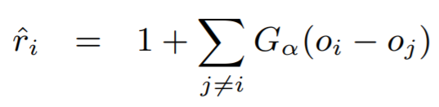
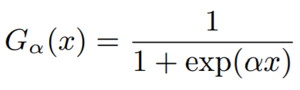
Listwise objectives
Smooth DCG
Wu et al. [2009] compute a “smooth” rank of documents as a function of their scores
This “smooth” rank can be plugged into a ranking metric, such as MRR or DCG, to produce a smooth ranking loss
Mingrui Wu, Yi Chang, Zhaohui Zheng, and Hongyuan Zha. Smoothing DCG for learning to rank: A novel approach using smoothed hinge functions. In CIKM, 2009.

Slide 28
Advanced Topic Deep Learning to Rank

Slide 29
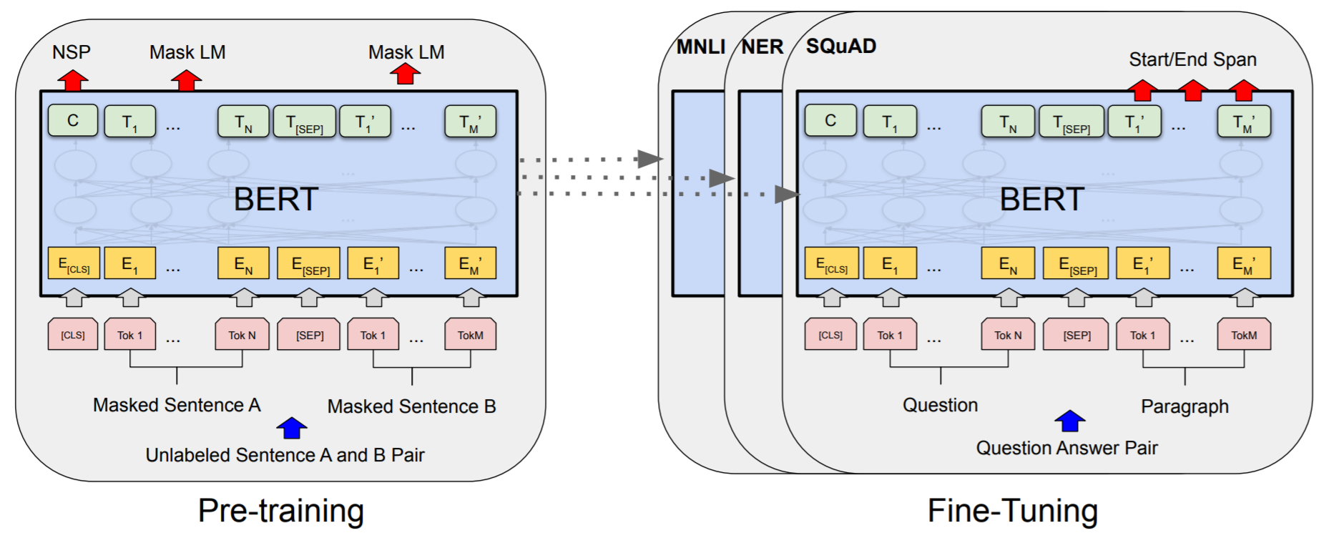
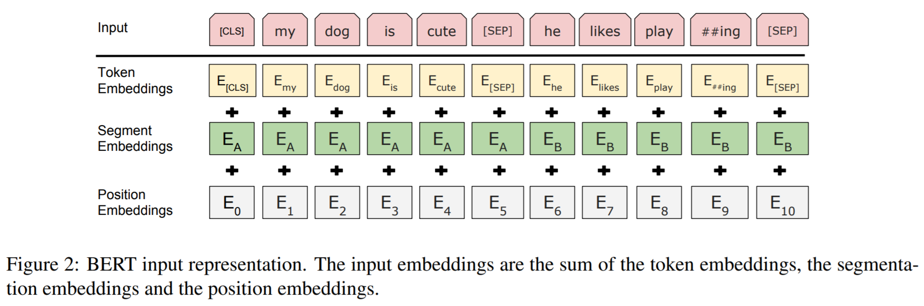
BERT
Stacked transformer layers
Pretrained on two tasks:
Masked language modeling
Next sentence prediction
Input: WordPiece embedding + position embedding + segment embedding
Jacob Devlin, Ming-Wei Chang, et al. Bert: Pre-training of deep bidirectional transformers for language understanding. In NAACL, 2018.

Slide 30
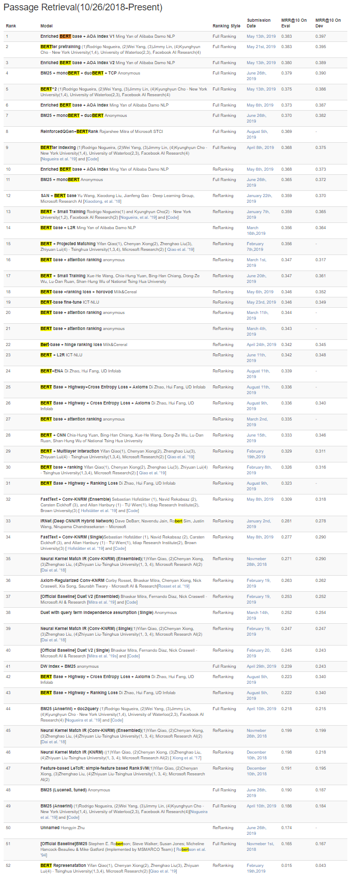







BERT for Ranking
BERT (and other large-scale unsupervised language models) are demonstrating dramatic performance improvements on many IR tasks
MS MARCO
score
Query
Passage
Query Passage Pair
Rodrigo Nogueira, and Kyunghyun Cho. Passage Re-ranking with BERT. In arXiv, 2019.

Slide 31
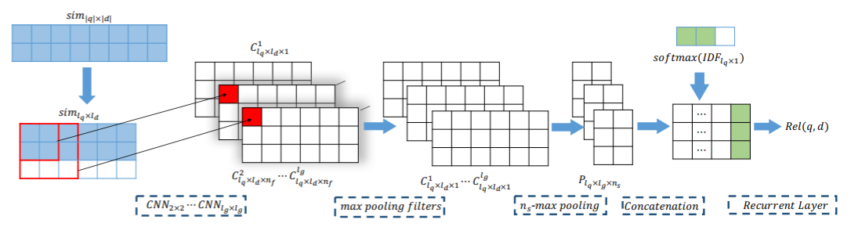
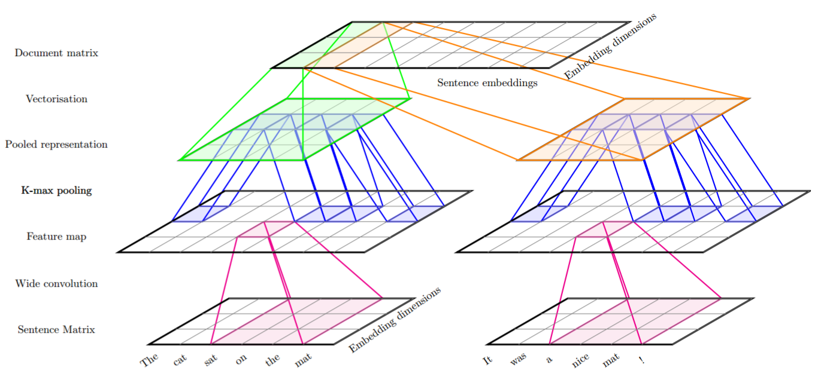
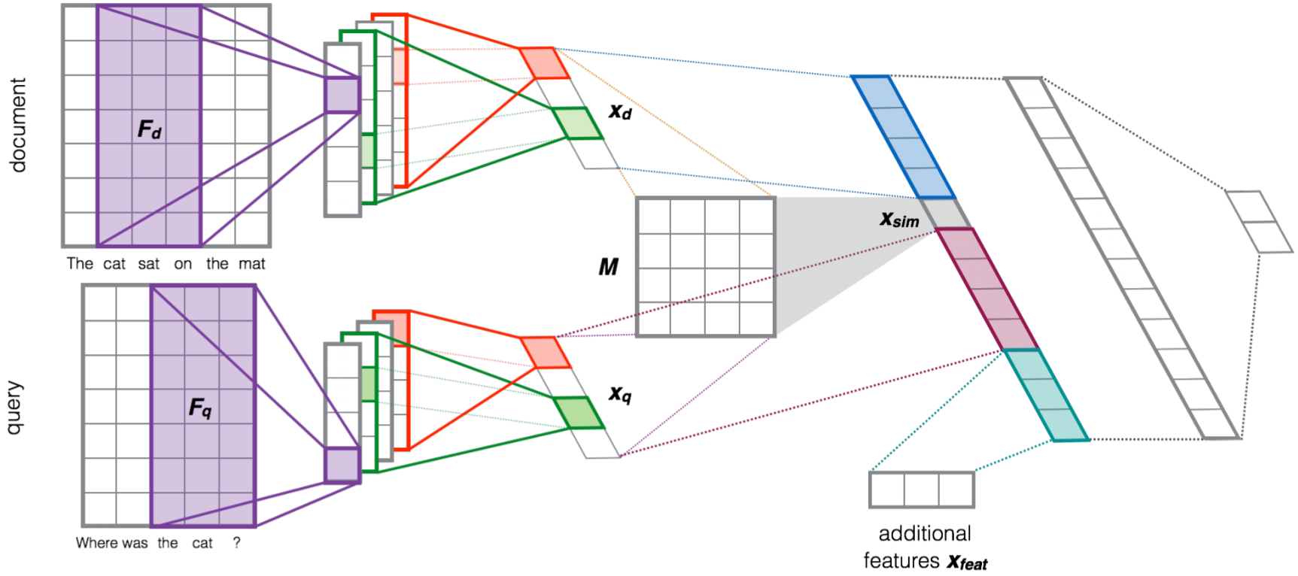
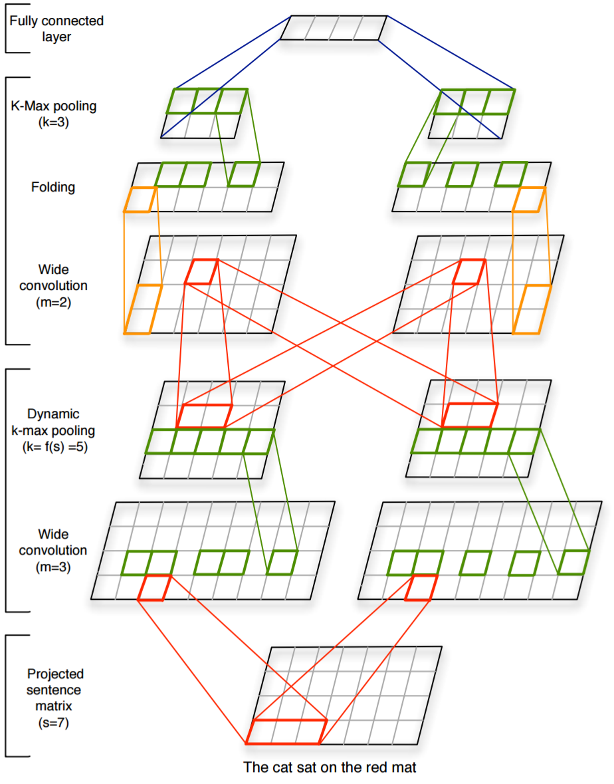
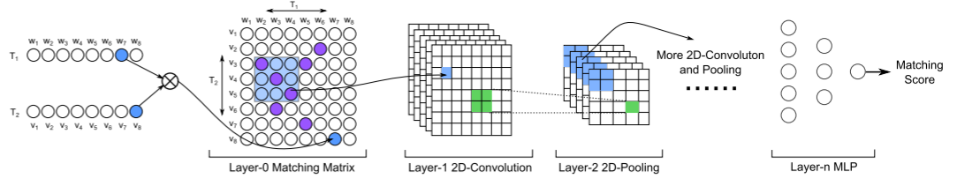
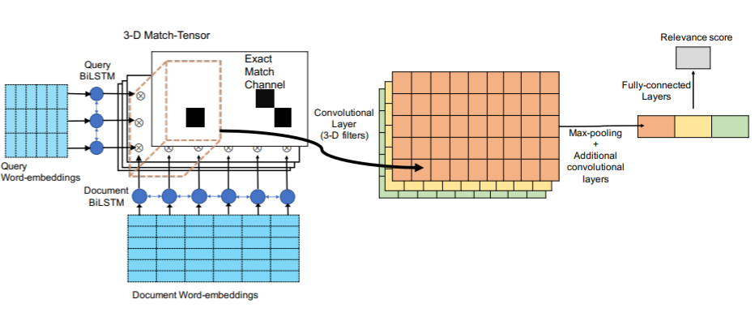
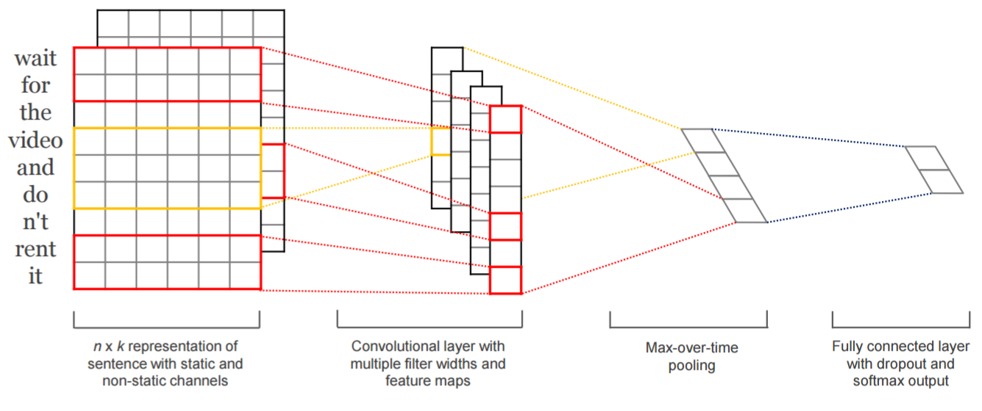
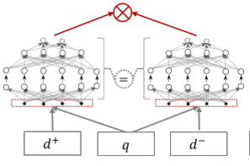
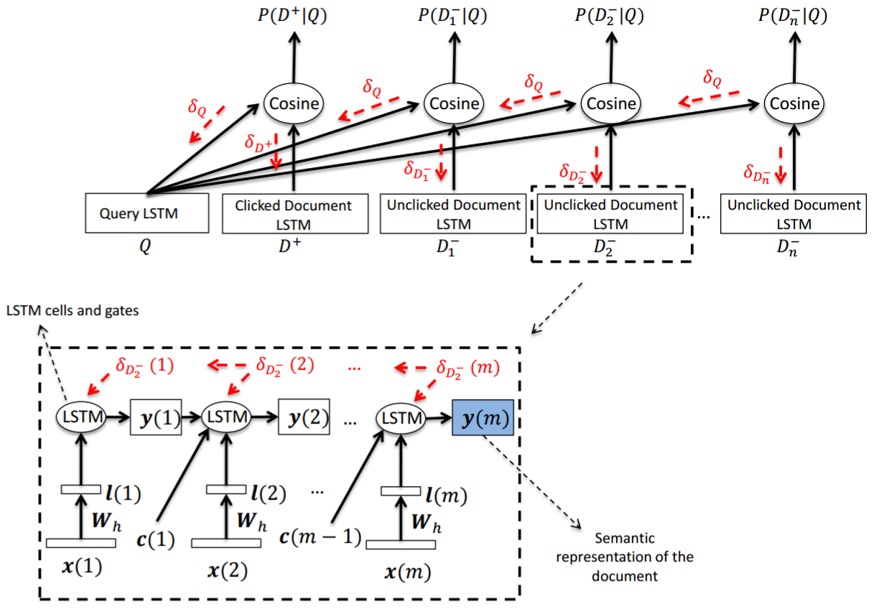
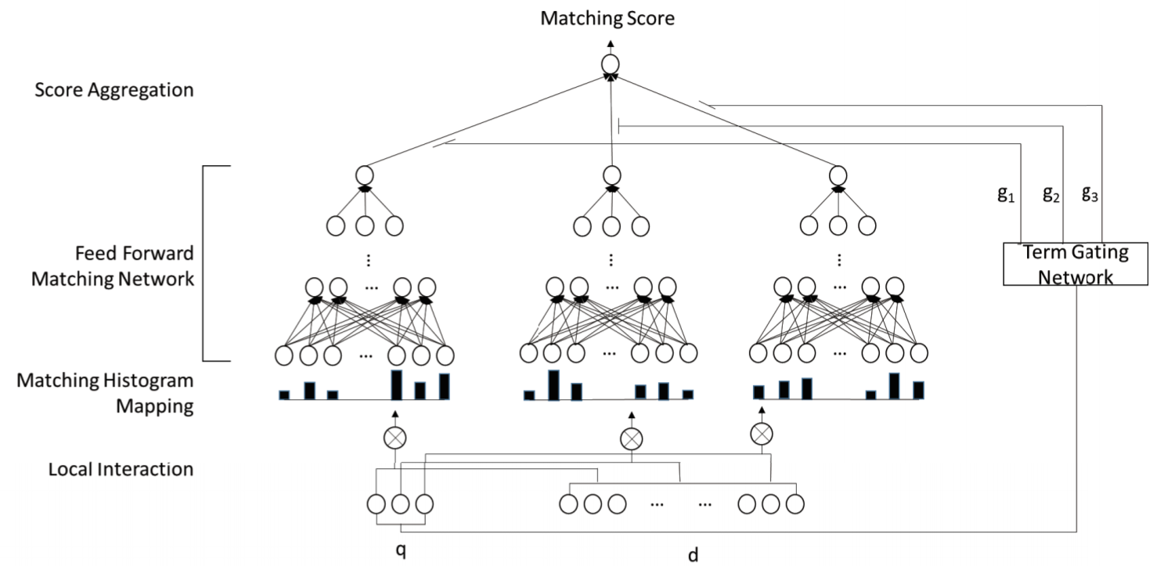
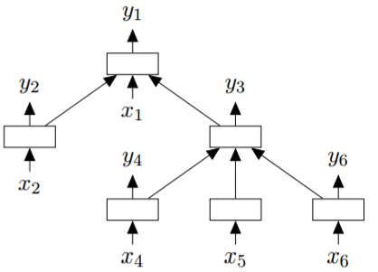
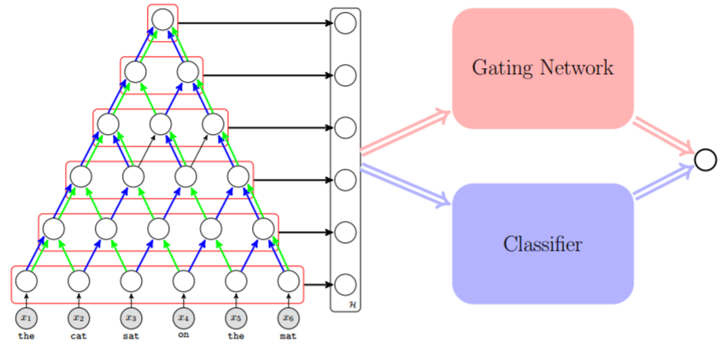
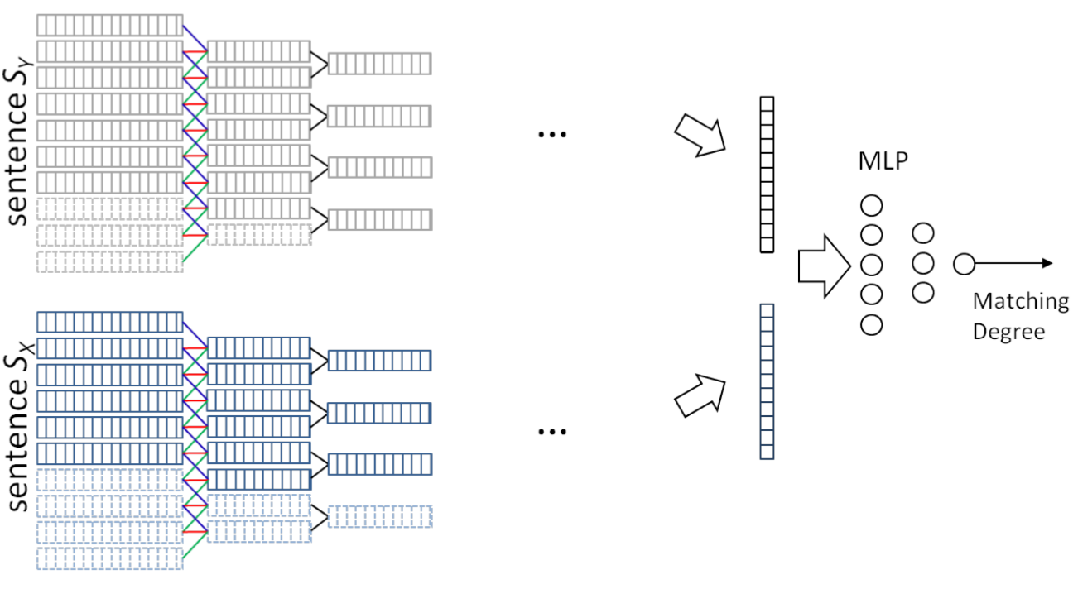
Many older neural architectures
(Hui et al., 2017)
(Pang et al., 2017)
(Denil et al., 2014)
(Severyn and Moschitti, 2015)
(Jaech et al., 2017)
(Kalchbrenner et al., 2014)
(Dehghani et al., 2017)
(Kim, 2014)
(Guo et al., 2016)
(Zhao et al., 2015)
(Palangi et al., 2015)
(Hu et al., 2014)
(Tai et al., 2015)

Slide 32
Advanced Topic Stochastic Learning to Rank

Slide 33






Stochastic ranking
A stochastic ranking model samples a ranking from a probability distribution over all possible permutations of items in the collection—i.e., for the same intent it returns a slightly different ranking on each impression
Given a static ranking policy, we can generate a stochastic equivalent using Plackett-Luce sampling—for example, given items $\left\{d_{1},d_{2},d_{3},d_{4}\right\}$ the probability of sampling a particular ranking $\left[d_{2},d_{1},d_{4},d_{3}\right]$ is:
$π$: a ranking, $φ$: a transformation, e.g., exponential over score $s_{i}$ for document $d_{i}$
Equivalent to sequentially sampling documents without replacement with probability $φ\left(s_{i}\right)$
restaurants in montreal
restaurants in montreal
restaurants in montreal
restaurants in montreal
Luce. Individual Choice Behavior. (1959)
Plackett. The Analysis of Permutations. Journal of the Royal Statistical Society: Series C (Applied Statistics). (1975)

Slide 34
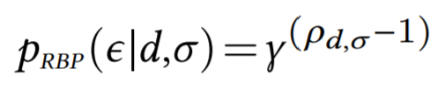
User browsing models and exposure
User browsing models are simplified models of how users inspect and interact with retrieved results
It estimates the probability that the user inspects a particular item in a ranked list of items—i.e., the item is exposed to the user
In IR, user models have been implicitly and explicitly employed in metric definitions and for estimating relevance from historical logs of user behavior data
For example, let’s consider the RBP user model…
RBP
NDCG
Probability of exposure at different ranks according to NDCG and RBP user browsing models
exposure event
rank of the item in the ranked list
an item
patience factor
a ranked list of items
Diaz, Mitra, Ekstrand, Biega, and Carterette. Evaluating stochastic rankings with expected exposure. In CIKM, ACM. (2020)

Slide 35
System, target, and random exposure
System exposure. The user-item expected exposure distribution corresponding to a stochastic ranking policy 𝜋. Correspondingly, we can define a |U|×|D| matrix E, such that E_{𝑖𝑗} = 𝑝(𝜖|D_{𝑗} ,𝜋_{U𝑖}).
Target exposure. The user-item expected exposure distribution corresponding to an ideal stochastic ranking policy 𝜋*, as defined by some desirable principle (e.g., the equal expected exposure principle). We denote the corresponding expected exposure matrix as E*.
The deviation of E from E* gives us a quantitative measure of the suboptimality of the retrieval system under consideration.
Diaz, Mitra, Ekstrand, Biega, and Carterette. Evaluating stochastic rankings with expected exposure. In CIKM, ACM. (2020)

Slide 36

Stochastic ranking and expected exposure
In recommendation, Diaz et al. (2020) define a stochastic ranking policy 𝜋_{𝑢}, conditioned on user 𝑢 ∈ U, as a probability distribution over all permutations of items in the collection
The expected exposure of an item 𝑑 for user 𝑢 can then be computed as follows:
Here, 𝑝(𝜖|𝑑,𝜎) can be computed using a user browsing model like RBP as discussed previously
Note: The above formulation can also be applied to search by replacing user with query
Diaz, Mitra, Ekstrand, Biega, and Carterette. Evaluating stochastic rankings with expected exposure. In CIKM, ACM. (2020)

Slide 37
Gradient-based optimization for target exposure
Approach
Challenges and solutions
Use the target model to score the items
Compute PL sampling probability as a function of the item scores
Sample multiple rankings
Compute expected system exposure across sampled rankings
Compute the loss as a difference between system and target exposure
Backpropagate!
The key challenge is the proposed approach is that both the sampling and the ranking steps are non-differentiable!
For sampling, we can use Gumbel sampling as a differentiable approximation
For ranking, we can employ SmoothRank / ApproxRank as differentiable approximations of the ranking step
,
Wu, Chang, Zheng, and Zha. Smoothing DCG for learning to rank: A novel approach using smoothed hinge functions. In Proc. CIKM, ACM. (2009)
Qin, Liu, and Li. A general approximation framework for direct optimization of information retrieval measures. Information retrieval. (2010)
Bruch, Han, Bendersky, and Najork. A stochastic treatment of learning to rank scoring functions. In Proc. WSDM, ACM. (2020)

Slide 38








Gradient-based optimization for target exposure
items
neural scoring function
add independently sampled Gumbel noise
compute smooth rank value
compute exposure using user model
compute average exposure
compute loss with target exposure
target exposure
Diaz, Mitra, Ekstrand, Biega, and Carterette. Evaluating stochastic rankings with expected exposure. In CIKM, ACM. (2020)

Slide 39
Advanced Topic Generative Learning to Rank

Slide 40


Discriminative LTR
Generative LTR
The model learns the conditional distribution of the label given features
The model learns the full joint distribution of features and labels
In discriminative LTR, an over-parameterized model may find different ways to fit to the training data; in the presence of a choice between alternative solutions, the solution that fits the full joint distribution under the generative setting produces a more robust ranking model
Ebrahimi, Mitra, Arabzadeh, Yuan, Wu, Zarrinkalam, and Bagheri. From Noise to Order: Learning to Rank via Denoising Diffusion. Preprint. (2026)

Slide 41
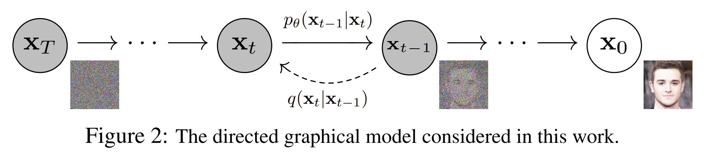
Denoising Diffusion Probabilistic Models
Ho, Jain, and Abbeel. Denoising Diffusion Probabilistic Models. Preprint. In NeurIPS. (2020)

Slide 42
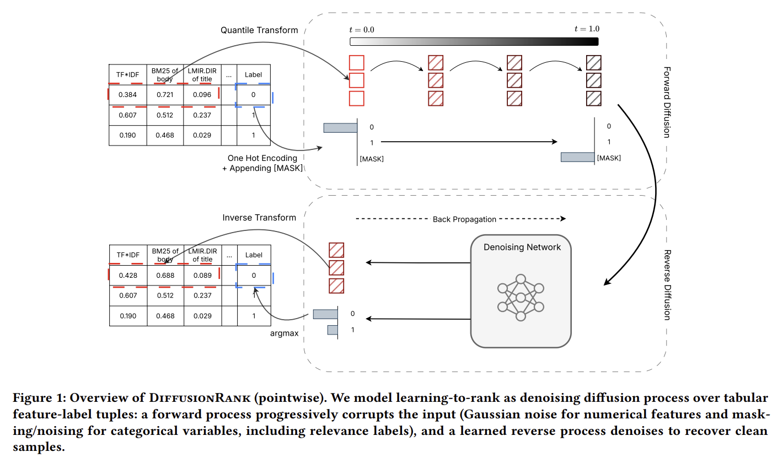
DiffusionRank
Ebrahimi, Mitra, Arabzadeh, Yuan, Wu, Zarrinkalam, and Bagheri. From Noise to Order: Learning to Rank via Denoising Diffusion. Preprint. (2026)

Slide 43
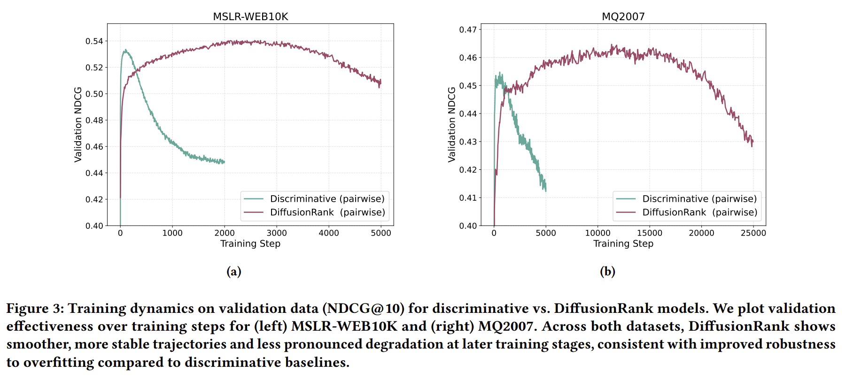
Generative vs. Discriminative LTR
Ebrahimi, Mitra, Arabzadeh, Yuan, Wu, Zarrinkalam, and Bagheri. From Noise to Order: Learning to Rank via Denoising Diffusion. Preprint. (2026)

Slide 44
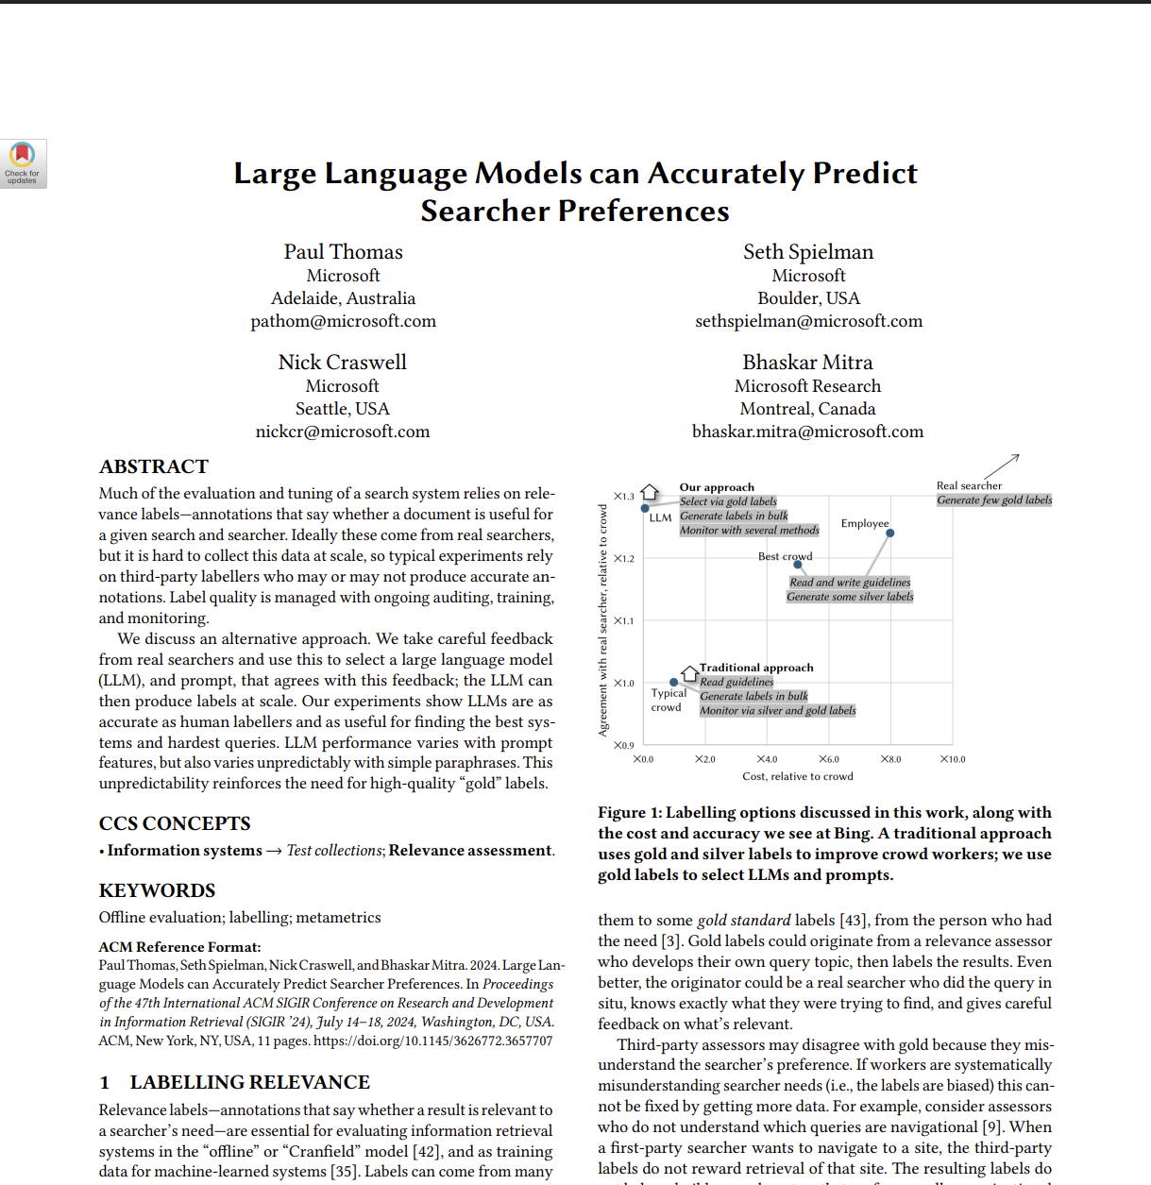
Large language models for ranking
LLMs are zero-shot rankers
LLMs can be prompted to compute similarity between a query and a document (pointwise), compare pairs of documents and predict which document is more relevant for a query (pairwise), or rank an entire list of documents with respect to the query (listwise)
However, this does not involve learning-to-rank—i.e., the model is not trained for the ranking task

Slide 45
THANK YOU
bhaskar-mitra.github.io
@bmitra.bsky.social
bhaskar.mitra@acm.org

