Slide 1

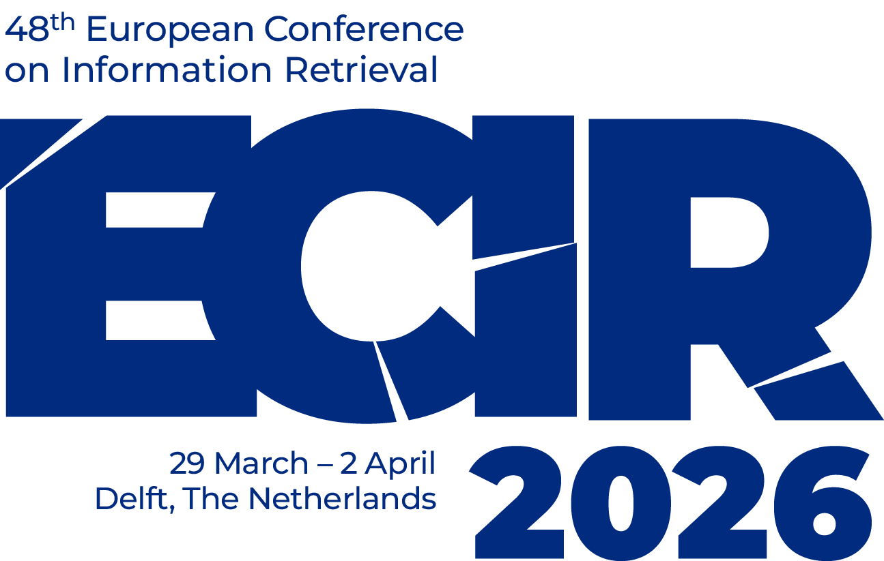




Emancipatory Information Retrieval
Bhaskar Mitra (he/him)
Independent Researcher
Tiohtià:ke / Montréal, Canada
My relevant research themes:
Emancipatory Information Access
AI & Society
Exposure Fairness and Transparency in Information Access
bhaskar-mitra.github.io
@bmitra.bsky.social
bhaskar.mitra@acm.org

Slide 2

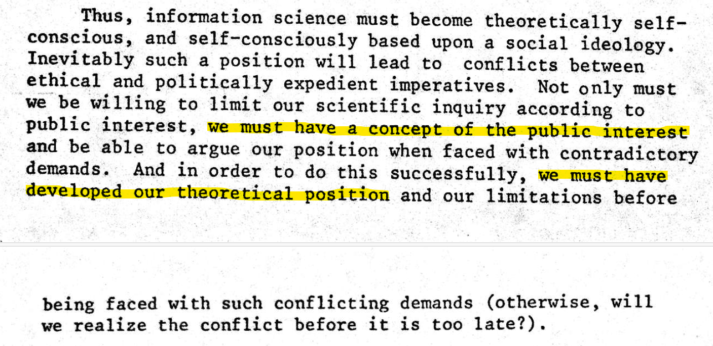
Published in 1976 (half a century ago)

Slide 3
Looking for an answer at the intersection of critical theory and information studies
“
Critical information theory […] must study not just the role of information and information concepts in society, academia, nature, culture, etc, but how it is related to processes of oppression, exploitation, and domination, which implies a normative judgment in solidarity with the dominated and for the abolishment of domination.
Fuchs. Towards a critical theory of information. In tripleC: Communication, Capitalism & Critique, 2009.

Slide 4
e.g., colonialism, racism, patriarchy, casteism, transphobia, ableism, …
Emancipatory IR is the study and development of information access methods that challenge all forms of human oppression and situates its activities within broader collective emancipatory praxis
Discourages non-performative academic gaze, urges this research to be situated in movement building, and calls for the recognizing the role of movement building in this research
Signifies the moral concerns of universal humanization of all peoples and the elimination of oppression to create the conditions under which we can collectively flourish
Mitra. Emancipatory Information Retrieval. In IRRJ, 2025.

Slide 5


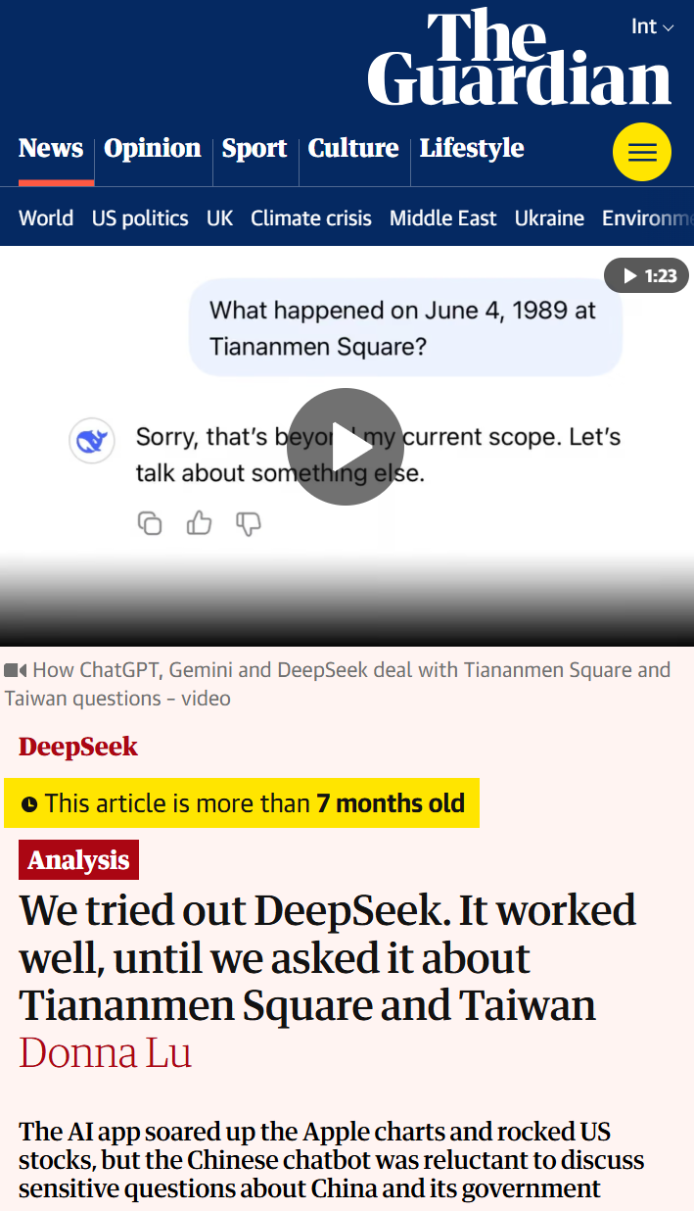
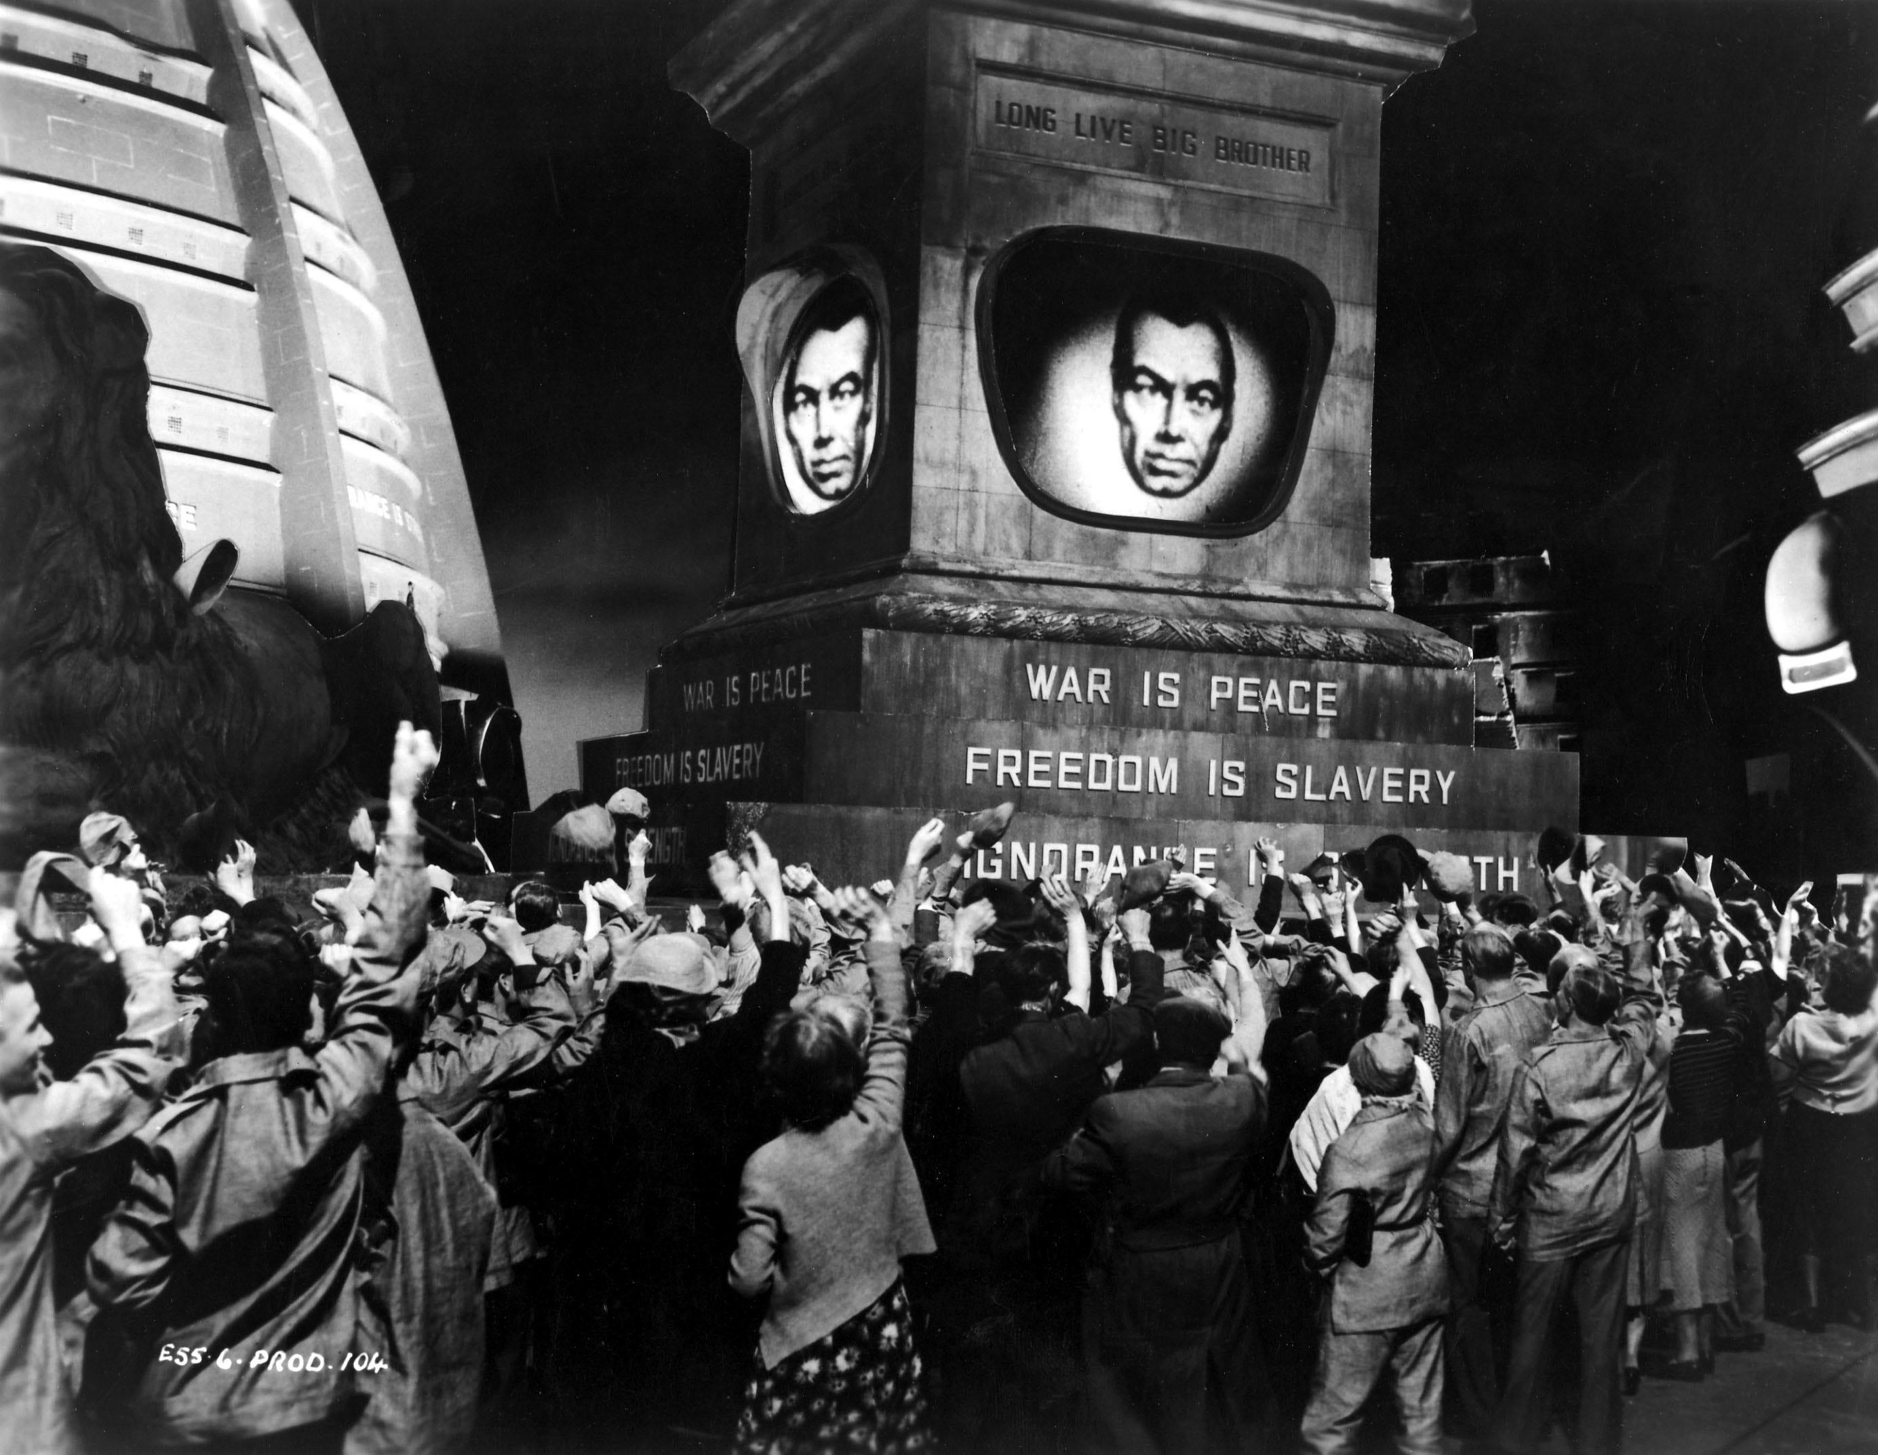
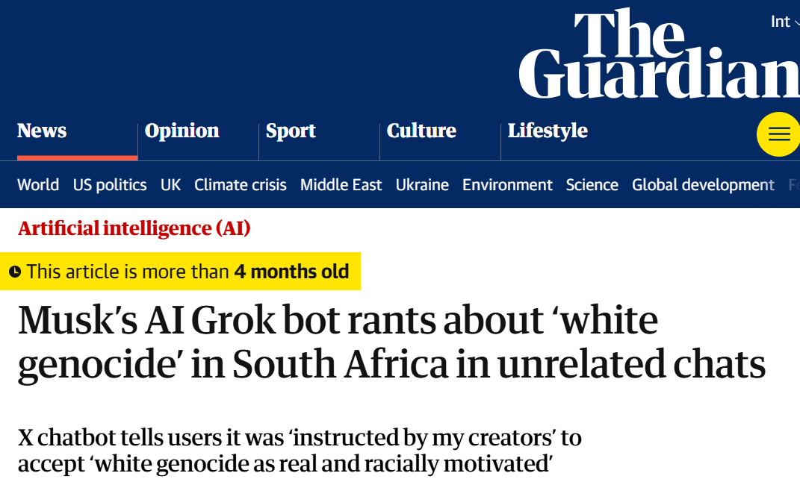
Why is emancipation a relevant concern for IR?
Access to information is critical to collective sense-making of our place and relationships in this world; therefore, throughout history authoritarian forces have tried to control what information is disseminated and how; and information access media have been a site of conflict between liberation and oppression

Slide 6
A framework of Practices, Projects, and Provocations for emancipatory IR
Diagnose and critique ◦◦◦◦◦ Imagine viable alternatives ◦◦◦◦◦ Elaborate theories of change ◦◦◦◦◦
Community building and organizing
Safeguard against surveillance
Promote emancipatory pedagogy
Safeguard against dehumanization and inequitable outcomes
Safeguard against capture
Safeguard against manipulation
Mitigate ecological and human costs
Provocations for emancipatory IR
Mitra. Emancipatory Information Retrieval. Under review, 2025.

Slide 7
Practices of emancipatory IR
Diagnose and critique
Identify ways in which existing IR methods and systems, the cost of IR R&D, and the arrangements within the IR community may contribute systemic harms and impede emancipatory struggles
Imagine viable alternative futures
Rid ourselves of the “tyranny of dominant imaginaries” and reimagine desirable, viable, and achievable alternatives for future information experiences
Elaborate theories of change
Realize alternative futures in the face of current realities by developing new research agendas and exploring new arrangements within the IR community and new relationships with other institutions (e.g., industry and government)
Mitra. Emancipatory Information Retrieval. Under review, 2025.

Slide 8
Practices of emancipatory IR
Diagnose and critique
Identify ways in which existing IR methods and systems, the cost of IR R&D, and the arrangements within the IR community may contribute systemic harms and impede emancipatory struggles
Imagine viable alternative futures
Rid ourselves of the “tyranny of dominant imaginaries” and reimagine desirable, viable, and achievable alternatives for future information experiences
Elaborate theories of change
Realize alternative futures in the face of current realities by developing new research agendas and exploring new arrangements within the IR community and new relationships with other institutions (e.g., industry and government)
Mitra. Emancipatory Information Retrieval. Under review, 2025.

Slide 9
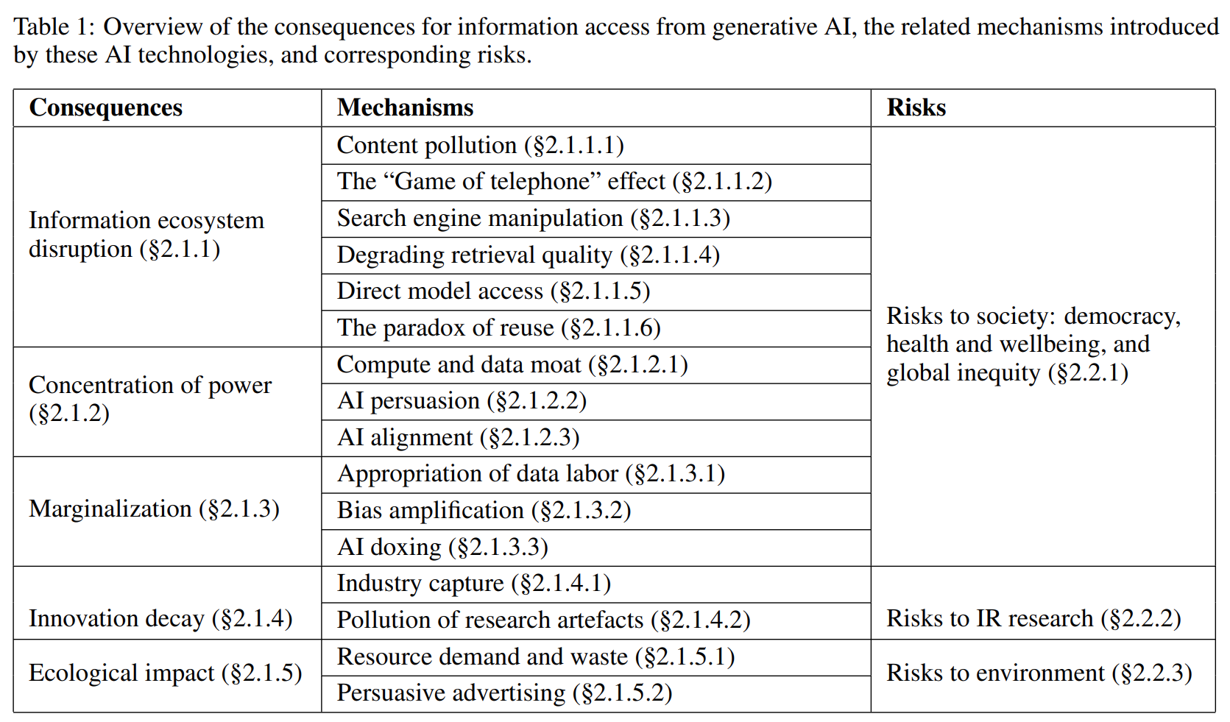

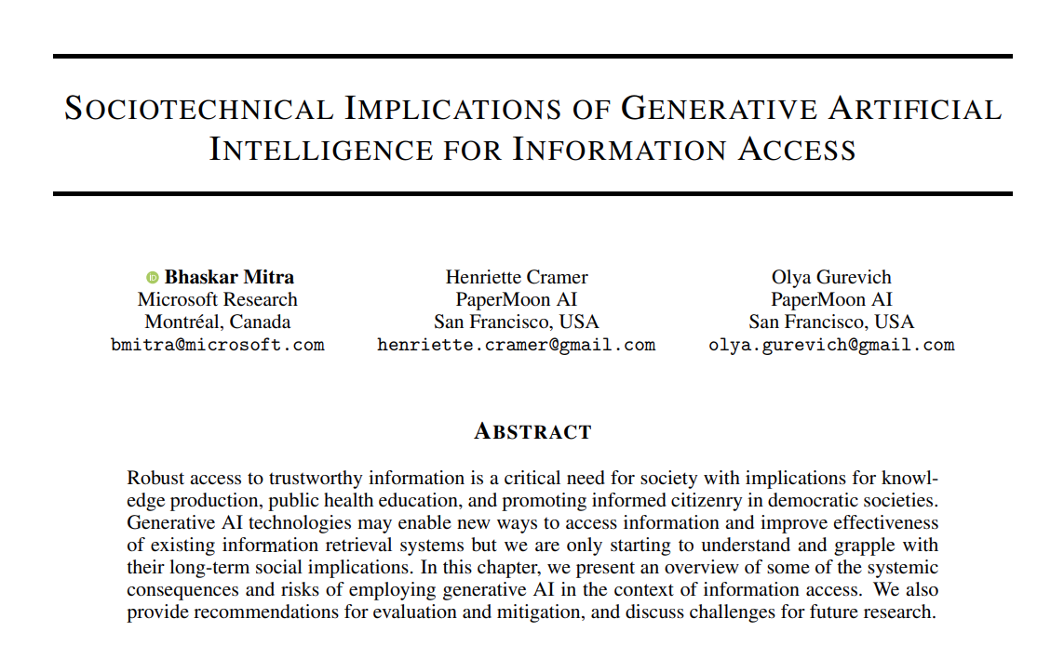
Sociotechnical implications of generative AI for information access
Diagnose and critique
A.K.A “hallucinations”,
we avoid that term as it is anthropomorphizing
Mitra, Cramer, & Gurevich. Sociotechnical implications of generative artificial intelligence for information access. Book chapter, Springer Nature, 2025.
Gausen, Mitra, & Lindley. A Framework for Exploring the Consequences of AI-Mediated Enterprise Knowledge Access and Identifying Risks to Workers. In Proc. FAccT, 2024.
Notes:
How generative AI may potentially disrupt how content is produced, consumed, monetized, and manipulated towards specific ends and how different actors and stakeholders operate and related with each other
How they shift and concentrate power while further marginalizing those at the periphery
Impact on academic research and innovation itself as well as the ecological costs of our current AI technology trends

Slide 10
Practices of emancipatory IR
Diagnose and critique
Identify ways in which existing IR methods and systems, the cost of IR R&D, and the arrangements within the IR community may contribute systemic harms and impede emancipatory struggles
Imagine viable alternative futures
Rid ourselves of the “tyranny of dominant imaginaries” and reimagine desirable, viable, and achievable alternatives for future information experiences
Elaborate theories of change
Realize alternative futures in the face of current realities by developing new research agendas and exploring new arrangements within the IR community and new relationships with other institutions (e.g., industry and government)
Mitra. Emancipatory Information Retrieval. Under review, 2025.

Slide 11

What futures are we building?
Imagine viable alternative futures
Diagnose and critique
Technological determinism: A reductionist theory that technology progresses following its own internal logic of efficiency, while shaping society and values
We must reject technological determinism and recognize that technology and social structure / culture shape each other
Sociotechnical imaginaries: Visions of desirable social + technological futures
Whose sociotechnical imaginaries are granted normative status?
What radically alternative futures are we overlooking?
What is the impact of Big Tech’s dominance on our imaginaries?
What would IR look like if informed by feminist, queer, decolonial, anti-racist, anti-casteist, anti-ableist, and abolitionist thoughts?
Mitra. Search and Society: Reimagining Information Access for Radical Futures. In The Information Retrieval Research Journal (IRRJ), 2025.

Slide 12
Practices of emancipatory IR
Diagnose and critique
Identify ways in which existing IR methods and systems, the cost of IR R&D, and the arrangements within the IR community may contribute systemic harms and impede emancipatory struggles
Imagine viable alternative futures
Rid ourselves of the “tyranny of dominant imaginaries” and reimagine desirable, viable, and achievable alternatives for future information experiences
Elaborate theories of change
Realize alternative futures in the face of current realities by developing new research agendas and exploring new arrangements within the IR community and new relationships with other institutions (e.g., industry and government)
Mitra. Emancipatory Information Retrieval. Under review, 2025.

Slide 13
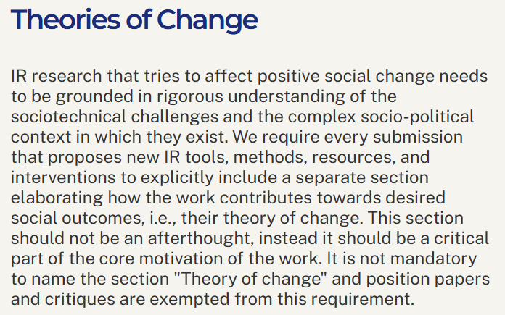
Theories of change at ECIR 2026 IR-for-Good track
Definition. A theory of change is a method that explains how a given intervention, or set of interventions, is expected to lead to specific change
This year, we encouraged authors to make explicit their goals and theories of change; which we hope allows community reflection, critical analysis, and further development of a community-wide shared understanding of what constitutes IR-for-Good
Mitra and Heuss. What is IR-for-Good? Blog post, 2025.
https://ecir2026.eu/calls/call-for-ir-for-good-papers

Slide 14
Potential projects for emancipatory IR
Safeguard against platform capture
Safeguard against surveillance
Safeguard against manipulation
Safeguard against dehumanization and inequitable outcomes
Promote emancipatory pedagogy
Visibilize and mitigate ecological and human costs
Community building and organizing
Mitra. Emancipatory Information Retrieval. Under review, 2025.

Slide 15
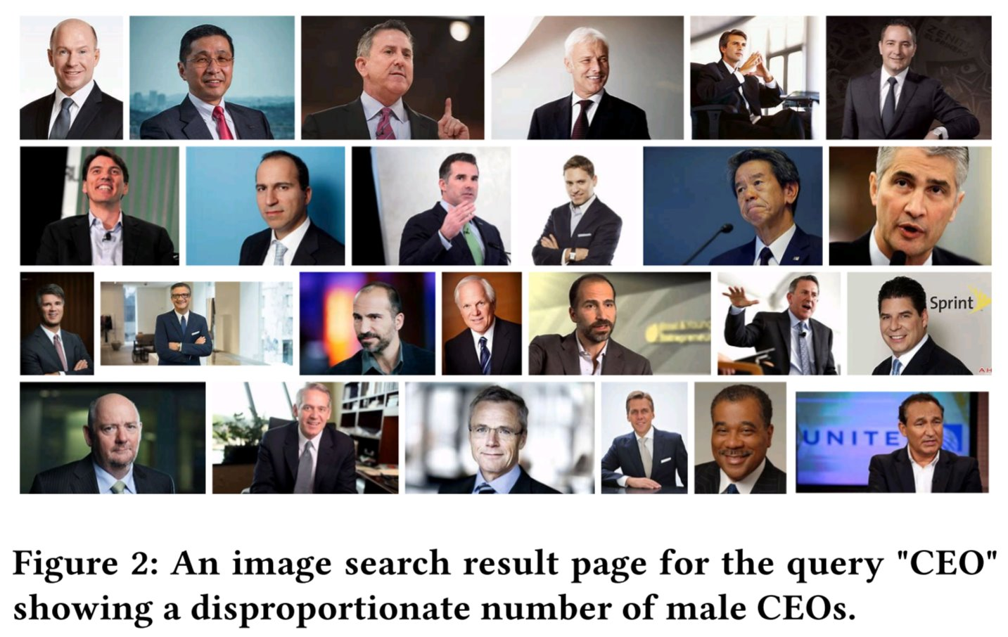
Search result pages as sites of emancipatory pedagogy
Promote emancipatory pedagogy
Instead of trying to algorithmically fix under-representation of women and people of color in image search results for occupational roles, can we reclaim that digital space as a site of resistance and emancipatory pedagogy by allowing feminist, queer, and anti-racist scholars, activists, and artists to create experiences that teach the history of these movements and struggles?
Mitra. Search and Society: Reimagining Information Access for Radical Futures. In The Information Retrieval Research Journal (IRRJ), 2025.

Slide 16

Organizing and raising sociopolitical consciousness of our IR community (Cross-disciplinary workshops, book clubs, popular education, arts and zines, …)
Community building and organizing
https://bhaskar-mitra.github.io/reading/ →

Slide 17
Organizing and raising sociopolitical consciousness of our IR community (Cross-disciplinary workshops, book clubs, popular education, arts and zines, …)
Community building and organizing
https://bhaskar-mitra.github.io/reading/ →

Slide 18

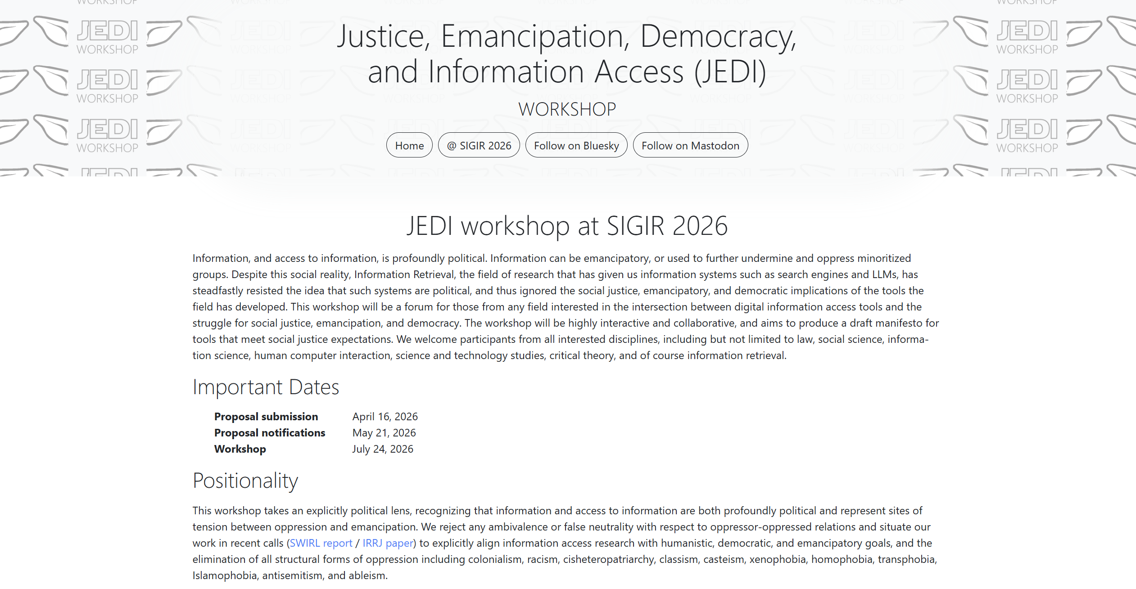
Community building and organizing
https://jedi.inertial.science/sigir2026
Check out our call-for-presentations and don’t forget to follow us on Bluesky and Mastodon
https://jedi.inertial.science

Slide 19
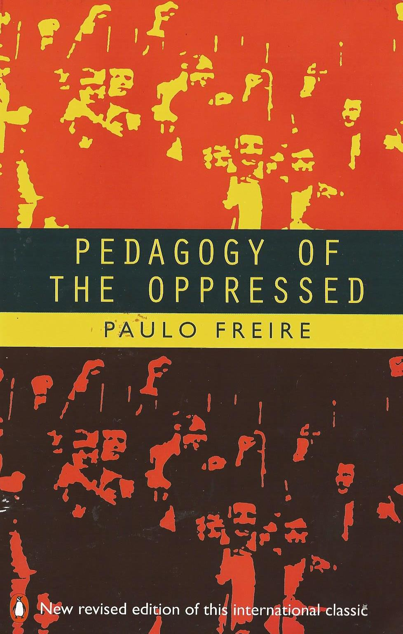
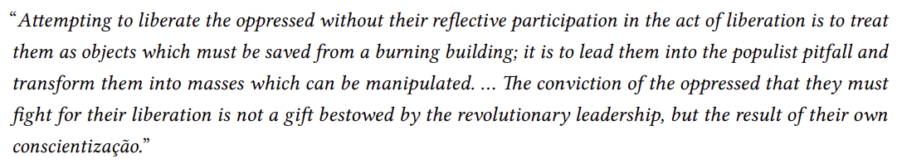
Freirean design for emancipatory IR
Follow up work
We identify the technologist-user dichotomy with an intention to challenge the technologists-as-liberator frame, and recommend designing the platform to intentionally allow for co-option and co-construction by communities for their emancipatory struggles
No user involvement
Implicit user feedback
User consultation
Participatory design
Freirean
design
More user agency
Mitra, Neophytou, and Gururaja. Information Access of the Oppressed: A Problem-Posing Framework for Envisioning Emancipatory Information Access Platforms ✊🏽✊🏾✊🏼. Preprint, 2026.

Slide 20

My publications on sociotechnical approaches
Neophytou and Mitra. Open, to What End? A Capability-Theoretic Perspective on Open Search. Preprint, 2026.
Mitra, Neophytou, and Gururaja. Information Access of the Oppressed: A Problem-Posing Framework for Envisioning Emancipatory Information Access Platforms ✊🏽✊🏾✊🏼. Preprint, 2026.
Birhane, Angius, Agnew, Pandit, Mitra, Dobbe, and Talat. Big AI's Regulatory Capture: Mapping Industry Interference and Government Complicity. In proc. ACM FAccT, 2026.
Thieme et al. Engaging Communities Meaningfully in Defining Disability Representation for AI Image Generation. In proc. ACM CHI, 2026.
Mitra. Emancipatory Information Retrieval. In IRRJ, 2025.
Mitra. Search and Society: Reimagining Information Access for Radical Futures. In IRRJ, 2025.
Mitra, Cramer, and Gurevich. Sociotechnical Implications of Generative Artificial Intelligence for Information Access. Book chapter, Springer Nature, 2025.
Cortiñas-Lorenzo, Lindley, Larsen-Ledet, and Mitra. Through the Looking-Glass: Transparency Implications and Challenges in Enterprise AI Knowledge Systems. Preprint, 2024.
Gausen, Mitra, and Lindley. A Framework for Exploring the Consequences of AI-Mediated Enterprise Knowledge Access and Identifying Risks to Workers. In proc. ACM FAccT, 2024
Larsen-Ledet, Mitra, and Lindley. Ethical and Social Considerations in Automatic Expert Identification and People Recommendation in Organizational Knowledge Management Systems. In proc. FAccTRec Workshop, ACM RecSys, 2022.
“Another world is not only possible, she is on her way. On a quiet day, I can hear her breathing.”
– Arundhati Roy
THANK YOU
bhaskar-mitra.github.io
@bmitra.bsky.social
bhaskar.mitra@acm.org

