Slide 1


Sociotechnical Implications of RAG for Information Access
Bhaskar Mitra
Dagstuhl Seminar: Retrieval-Augmented Generation – The Future of Search? (2025)
@bmitra.bsky.social
bhaskar.mitra@acm.org

Slide 2
Question for the audience
What societal risks comes to your mind when you think about RAG for information access?

Slide 3

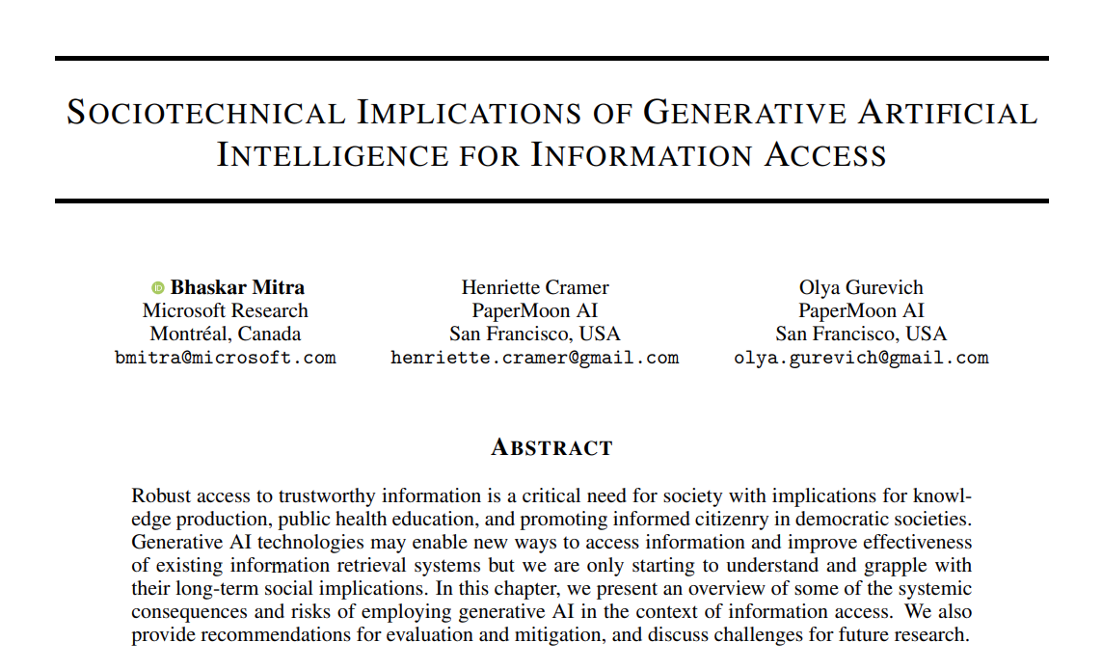
https://link.springer.com/book/9783031731464
Mitra, Cramer, & Gurevich. Sociotechnical implications of generative artificial intelligence for information access. Book chapter, Springer Nature, 2025.

Slide 4
Hallucinations The “Game of Telephone” Effect
Misleading information presented as facts in LLM outputs are commonly attributed to model “hallucination”
This framing is misleading and hides a deeper problem
Why misleading? It describes the problem as a gap between reality and anthropomorphized expectations of what we want the LLM to do; whereas the real gap is between what the model is trained to do ("estimate likelihoods of token sequences") and our expectations ("generate factual outputs")
The deeper problem. Inserting an LLM between searcher and retrieved web results shifts the responsibility of inspecting the information in the documents and assessing their relevance, trustworthiness, and surrounding context from the searcher to the LLM
It disincentivizing the searcher to develop critical cognitive skills necessary to distinguish between trustworthy and untrustworthy information
The concern isn’t just whether the LLM’s outputs are factually accurate but whose perspectives does it represent and who gets to decide that?
These would be less concerning if searchers and platform owners shared the same goals, and the platforms had no incentives to manipulate searchers, but alas…

Slide 5
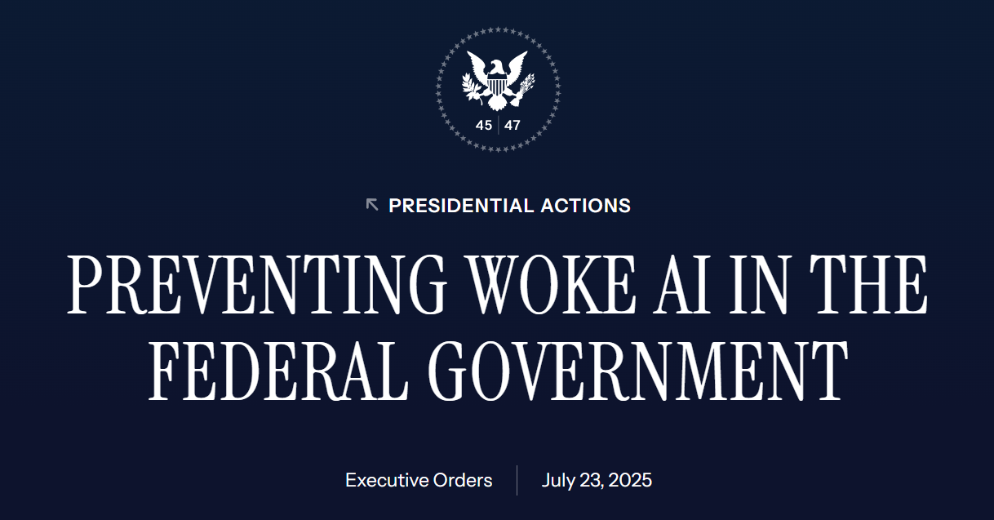
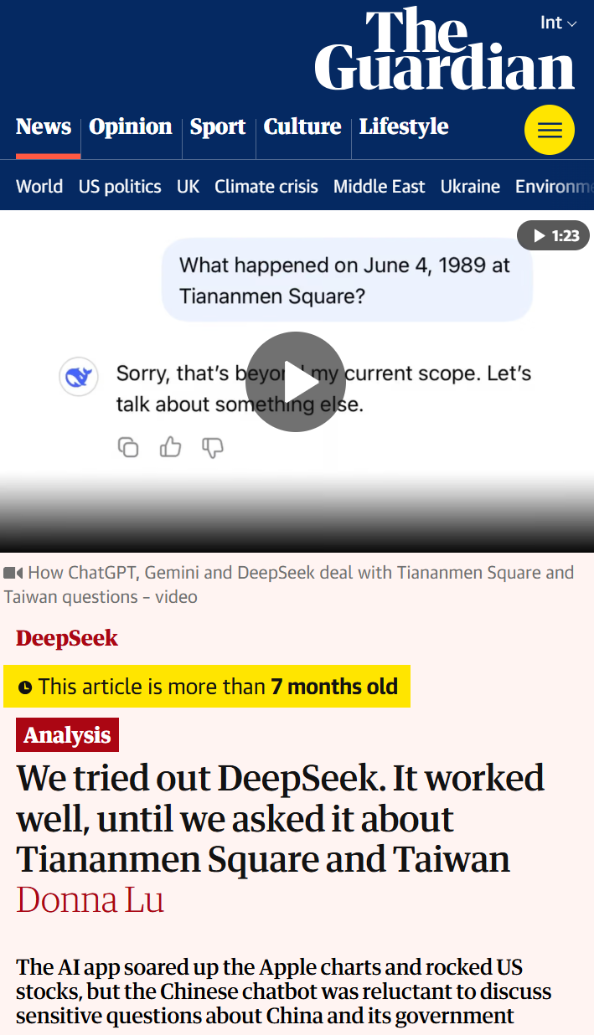

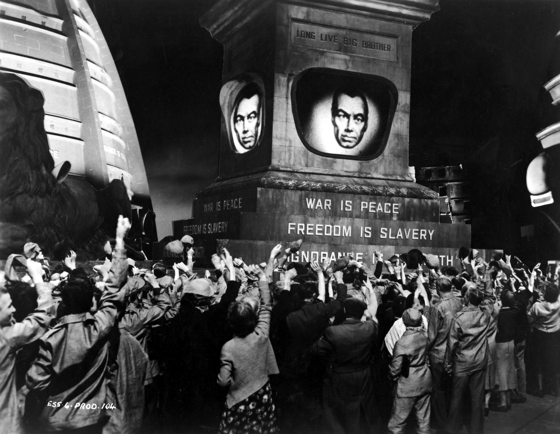
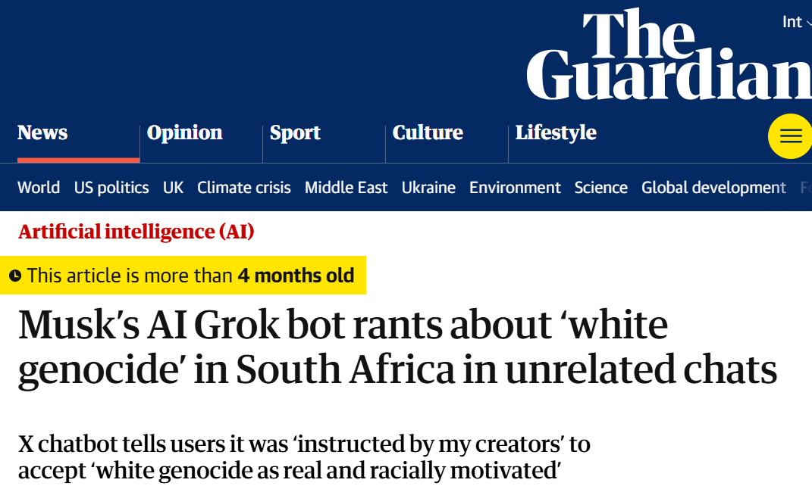
The politics of information access
Access to information is critical to collective sense-making of our place and relationships in this world; therefore, throughout history authoritarian forces have tried to control what information is disseminated and how; and information access media have been a site of conflict between liberation and oppression

Slide 6
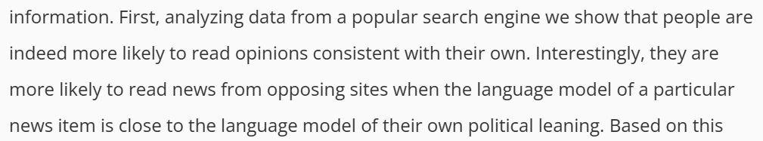




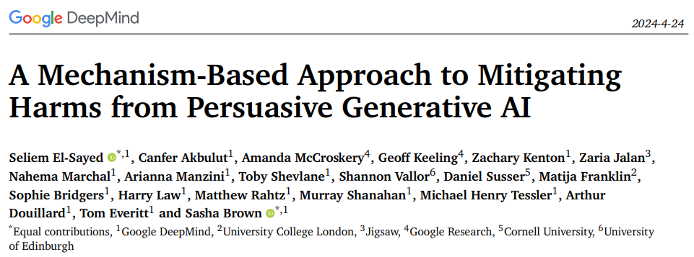
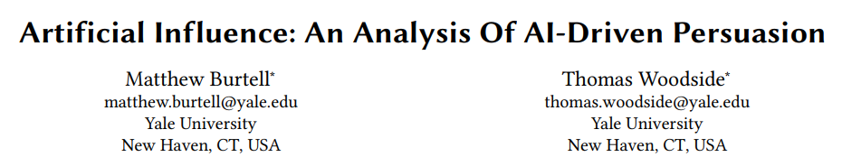
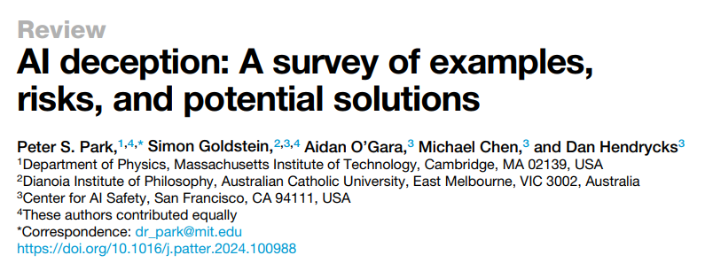
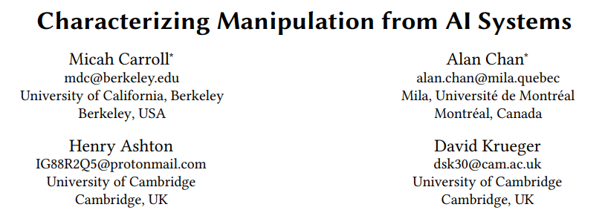
AI Persuasion
Yom-Tov, Dumais, & Guo. Promoting Civil Discourse Through Search Engine Diversity. In SSCR, 2014.
Massive amounts of user behavior data from surveillance capitalism
Generative AI’s capability to produce persuasive language and visualizations
Effective tools for mass manipulation of public consumer preferences and political opinion
Our ability to align generative AI models towards specific values
Imagine every time you searched online or accessed information via your digital assistant, the information was presented to you exactly in the form mostly likely alter your consumer preferences or political opinions
The existence of such capabilities incentivizes authoritarian capture of online information access platforms

Slide 7
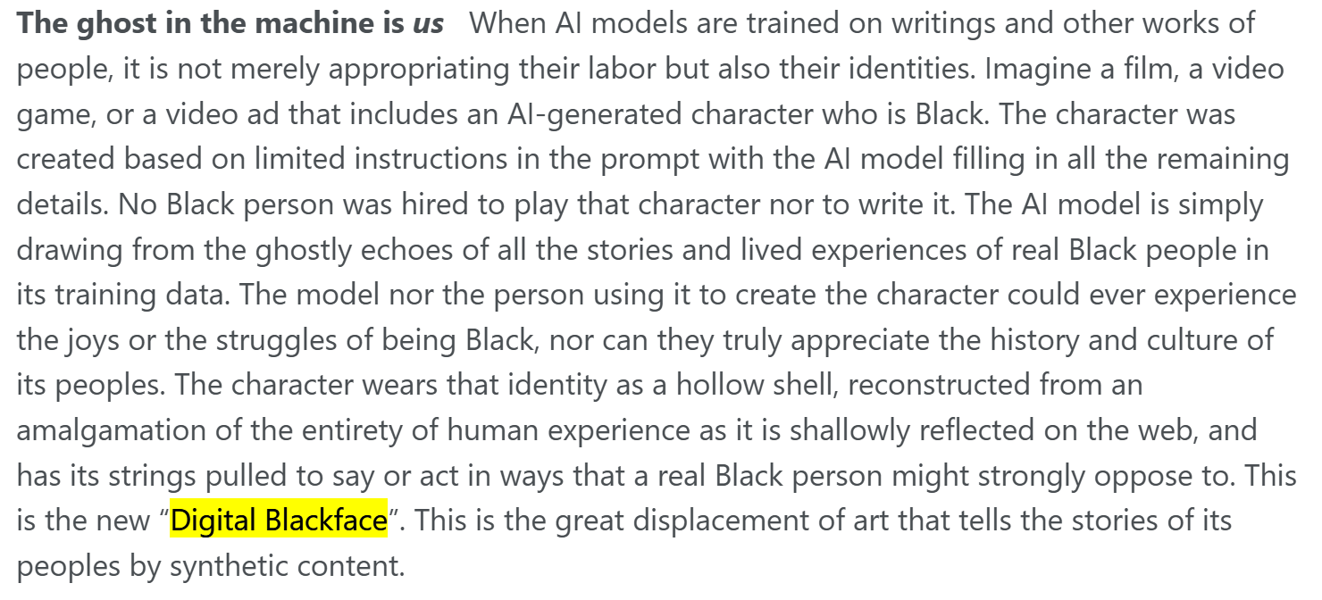
Mitra. AI as politic of class exploitation. Blog post, 2025.

Slide 8
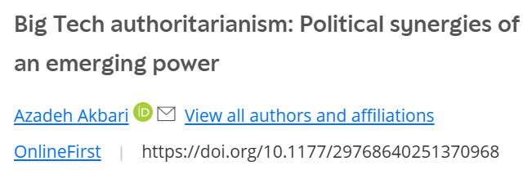
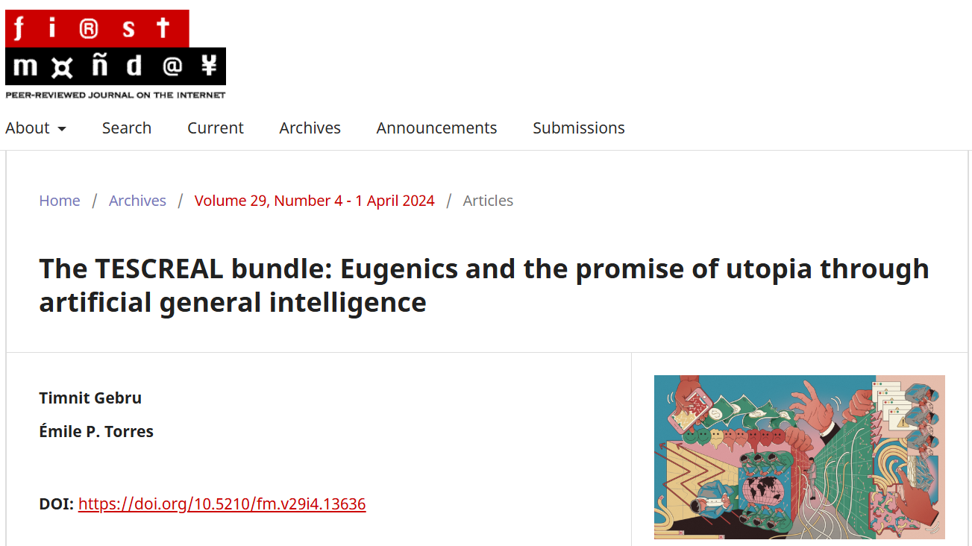
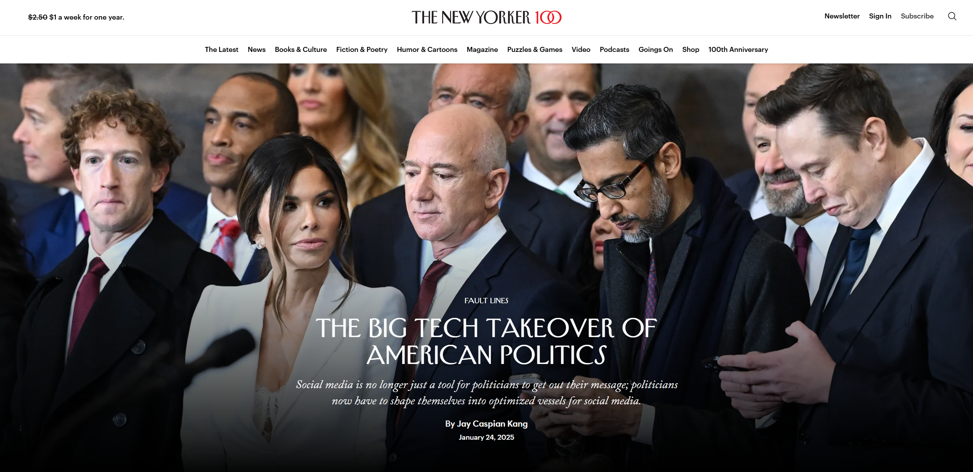
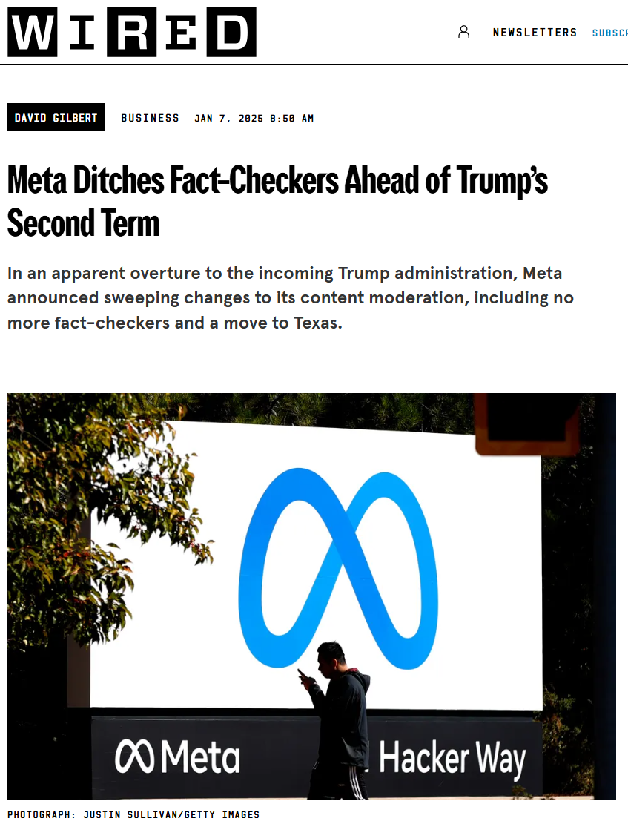
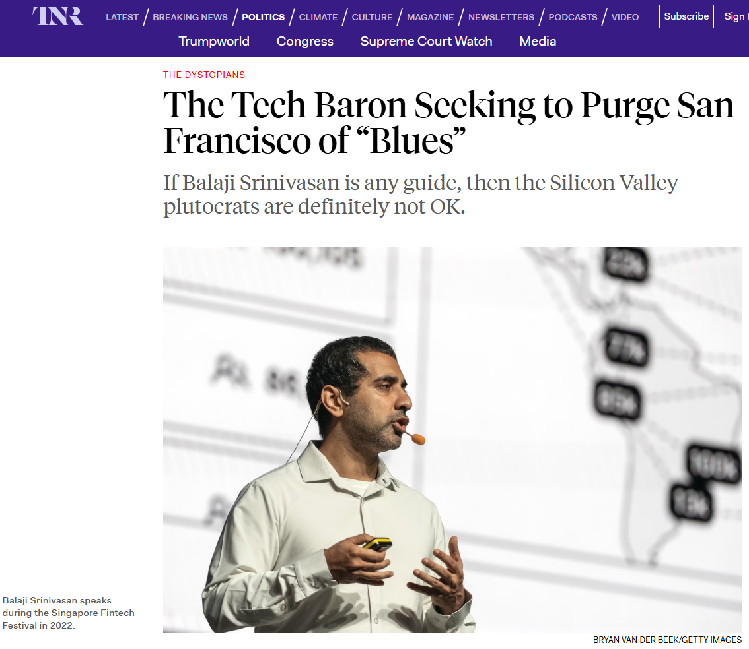
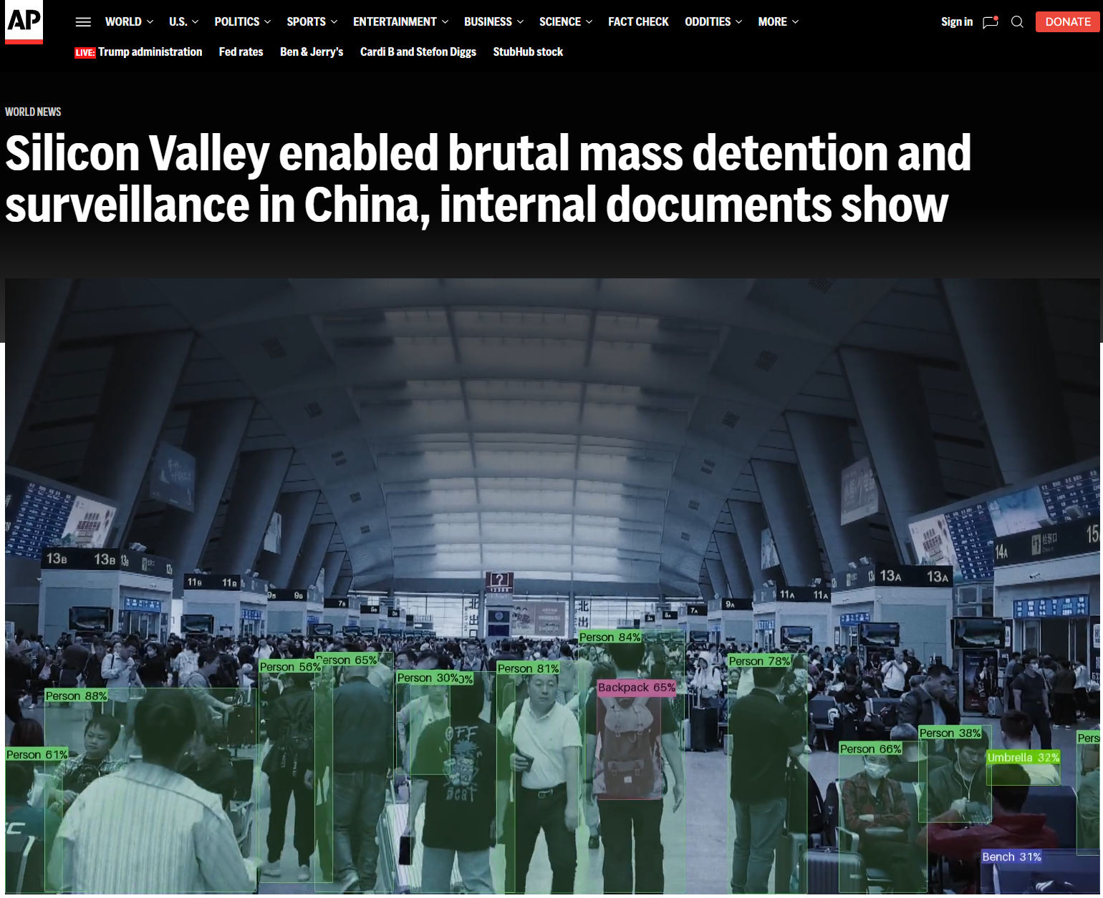

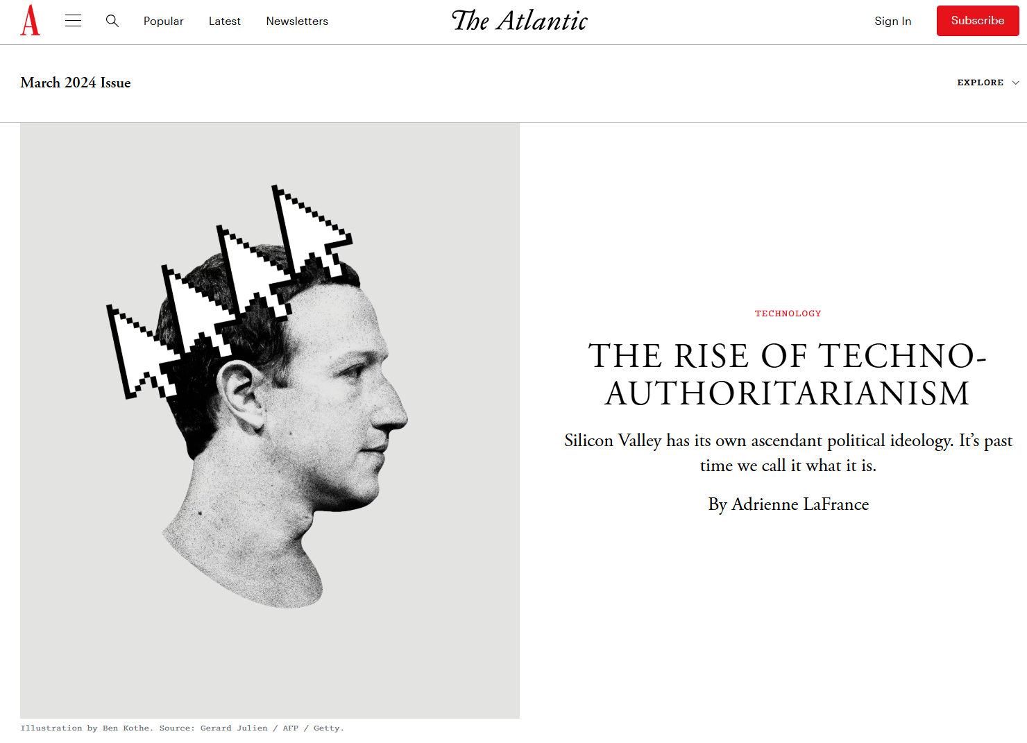
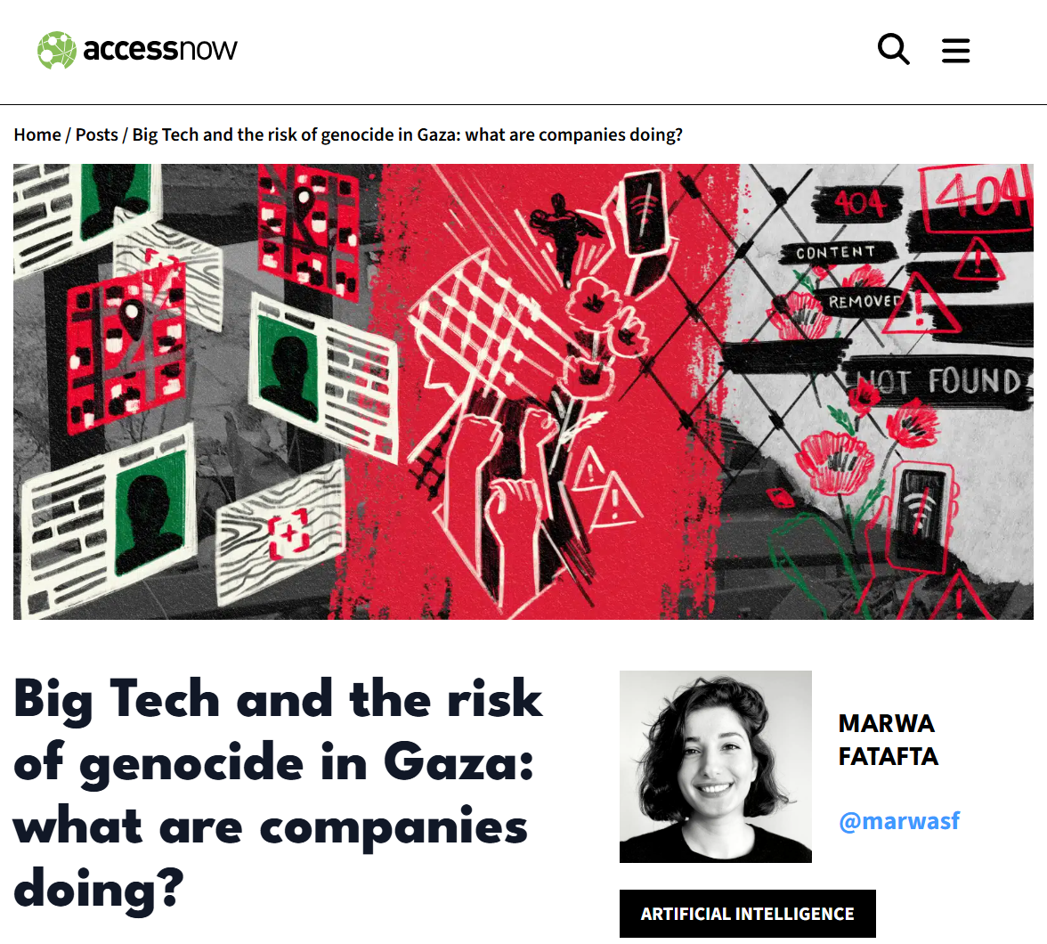
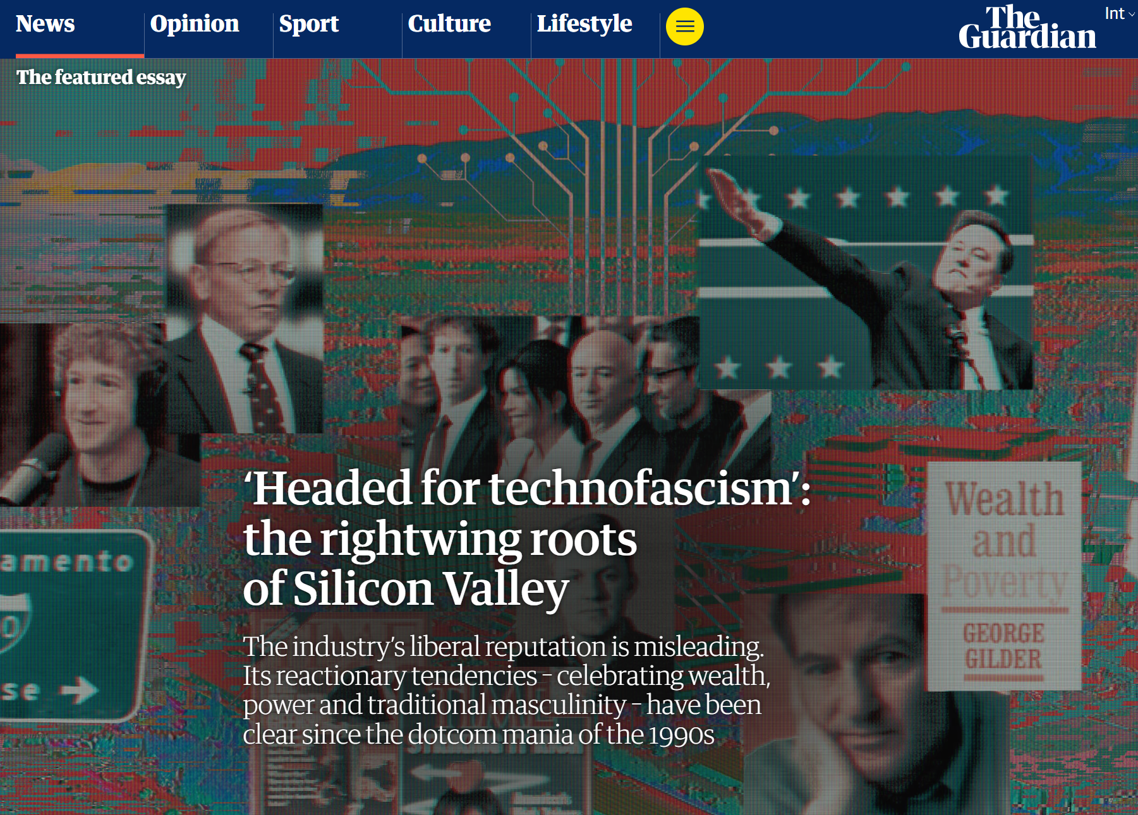

Big Technofascism

Slide 9
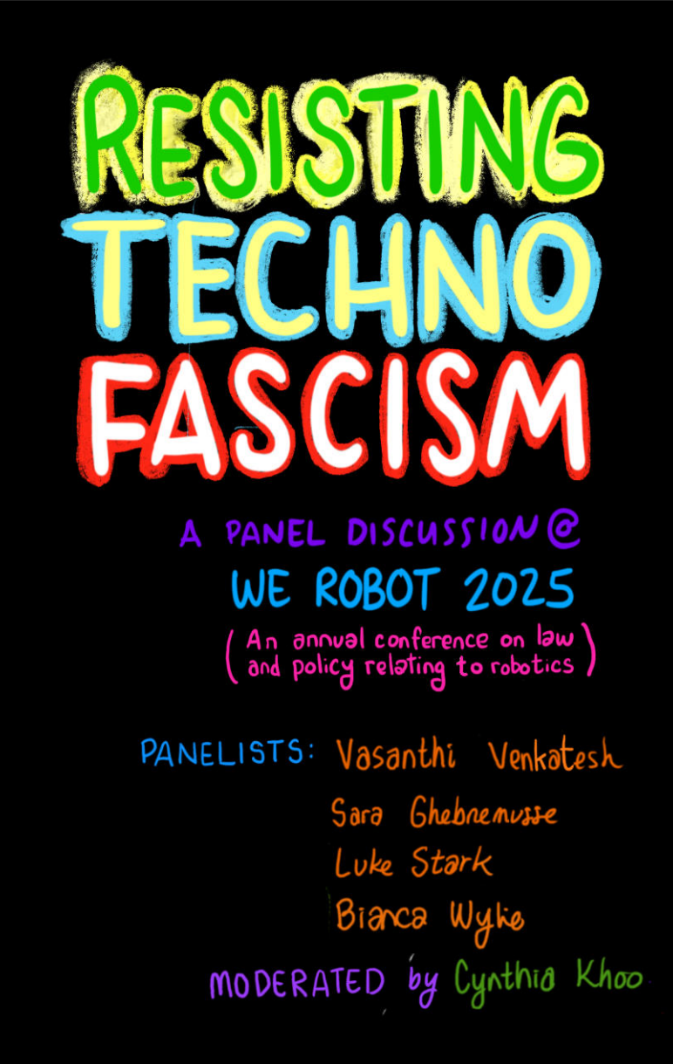
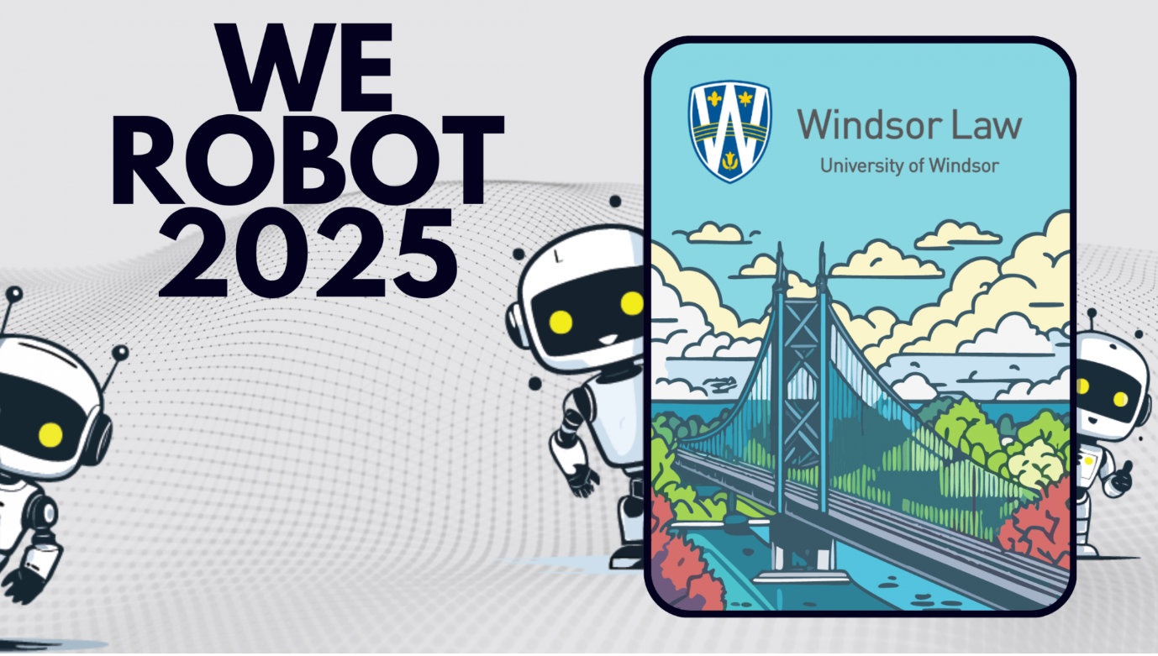
https://www.uwindsor.ca/law/sites/uwindsor.ca.law/files/resistingtechnofascism-web.pdf
https://www.uwindsor.ca/law/3450/werobot-2025

Slide 10
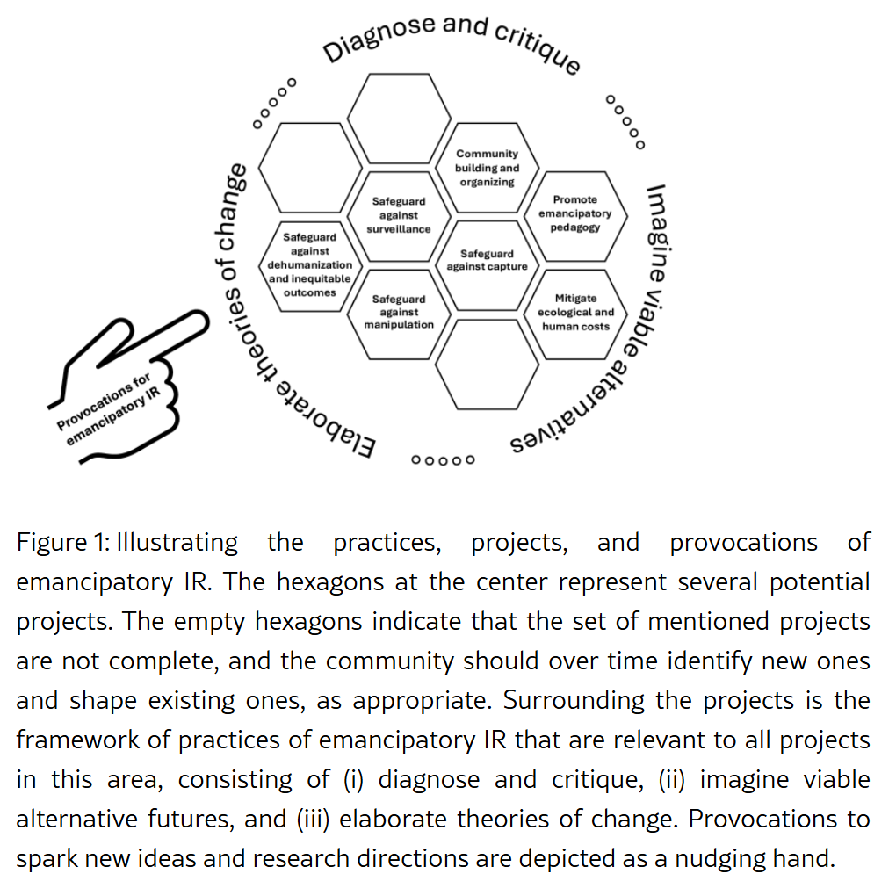

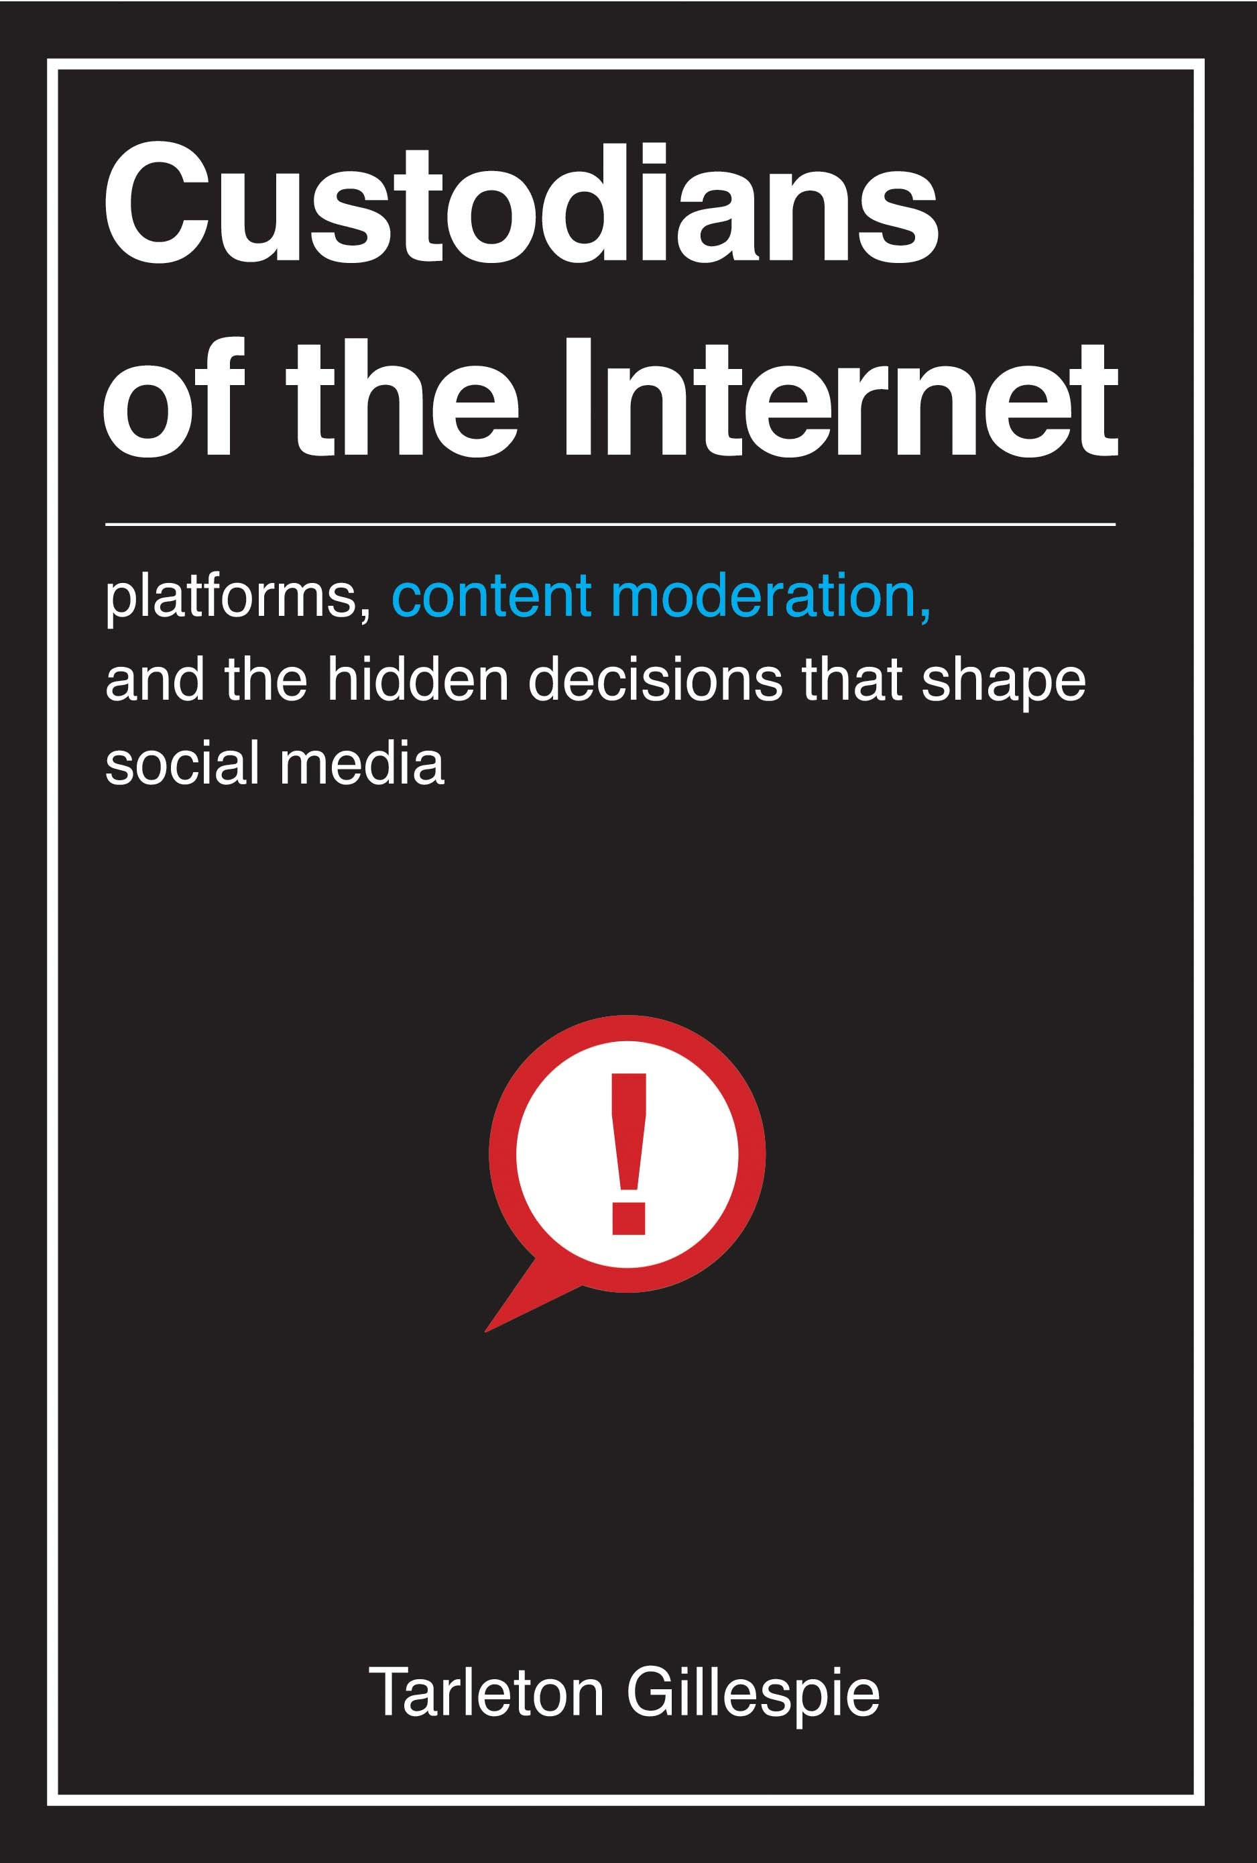
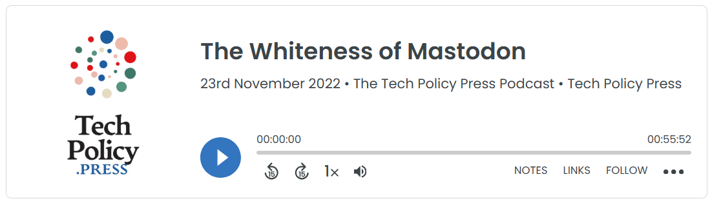
Emancipatory Information Retrieval
We must refuse to build tools of mass manipulation nor develop any technology that contributes towards infrastructure of authoritarianism
We must build public service information access platforms and safeguard them from capture
This requires not just decentralizing our technological infrastructure but also our social infrastructure for governance and moderation
https://www.techpolicy.press/the-whiteness-of-mastodon/
Mitra. Emancipatory Information Retrieval. Under review, 2025.

Slide 11
Information ecosystem disruption
Websites like Wikipedia, StackExchange, and Reddit have historically shared a symbiotic relationship; these websites produce useful content that makes search results richer and significantly more useful to searchers and in return search engines sent traffic back to these Web sites for increasing readership, subscriptions, and monetization
The paradox of reuse. Conversational search systems deemphasize source websites reducing clickthrough relative to the classic ten-blue-links interface Jeopardizing the “grand bargain at the heart of the web”
Loss of click feedback. Reducing clickthroughs minimizes critical click feedback signals; this is likely to cause severe degradation in retrieval quality over time in traditional search engines

Slide 12

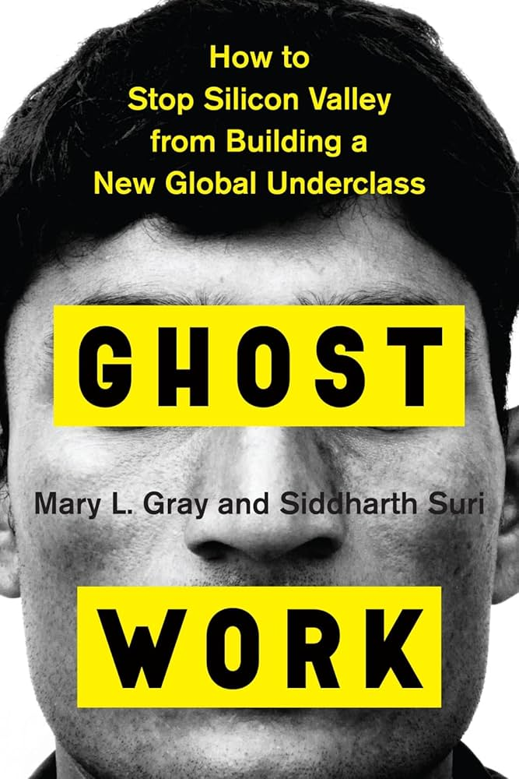
We cannot separate the technology from the exploitative appropriation of data labor necessary for its creation, including uncompensated appropriation of creative works for model training and under-compensated crowd work for data labeling
A pernicious aspect of AI data labor dynamics is how they mirror and reify racial capitalism and coloniality; the privileged populations in western and other rich countries may benefit from generative AI, while data labor is relegated to marginalized populations in the global south

Slide 13
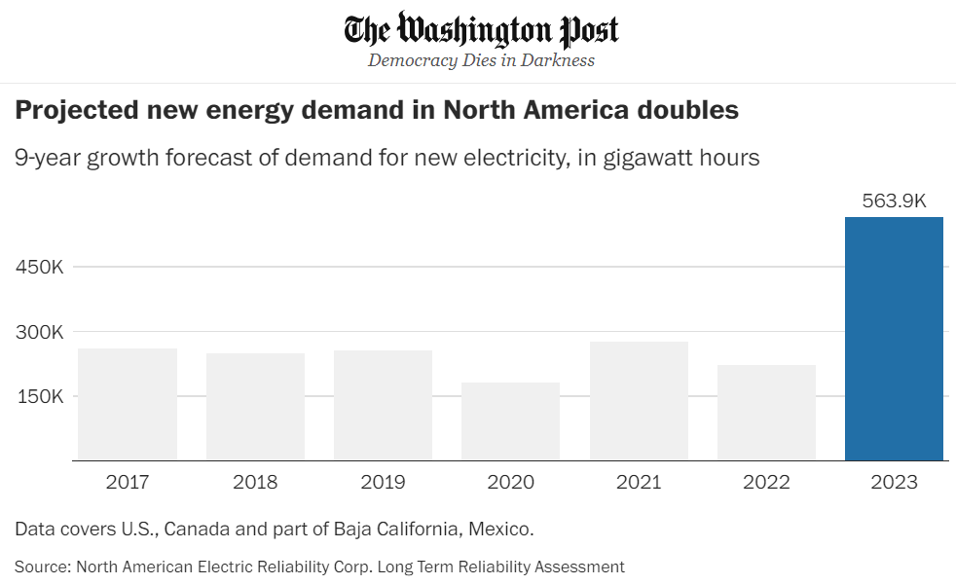

The ecological cost of AI
Computing power being utilized for deep learning research has been doubling every 3.4 months since 2012
In US, data centers consumed more than 4% of total national electricity in 2022, and that number is projected to grow to 6% by 2026
Another study estimates that by 2040 Information and Communications Technology industry alone would account for 14% of global emissions
By 2027, global AI demand may be responsible for withdrawal of 1.1 − 1.7 trillion gallons of fresh water annually
Serious concern also revolve around the rising levels of electronic wastes
Mind the Jevons Paradox
In economics, the Jevons paradox occurs when technological advancements make a resource more efficient to use (thereby reducing the amount needed for a single application); however, as the cost of using the resource drops, if demand is highly price elastic, this results in overall demand increasing, causing total resource consumption to rise.

Slide 14

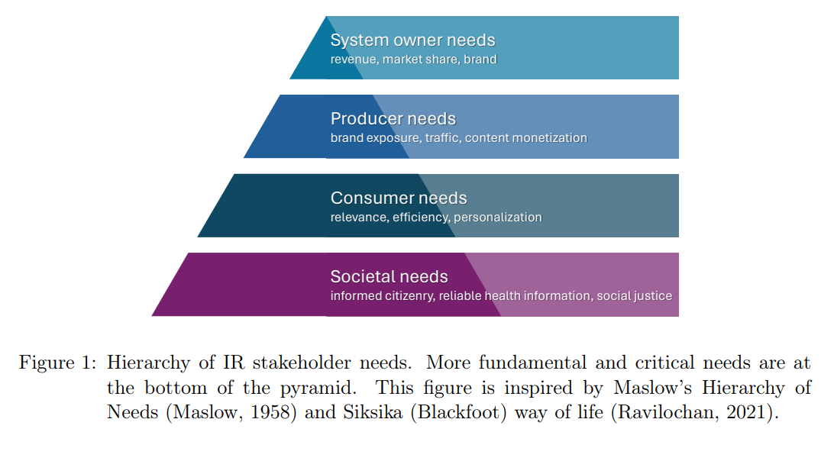
Social opportunity cost
What should IR research focus on?
What Big Tech & Silicon Valley needs
What society needs
What are the societal implications of a significant fraction of the IR research community shifting to optimize retrieval systems for machines, instead of for humans? Whose needs are we serving?
Information access research has a critical role to play in this pivotal moment in history. So, will we answer the call?
Mitra. Search and Society: Reimagining Information Access for Radical Futures. In IRRJ, 2025.

Slide 15

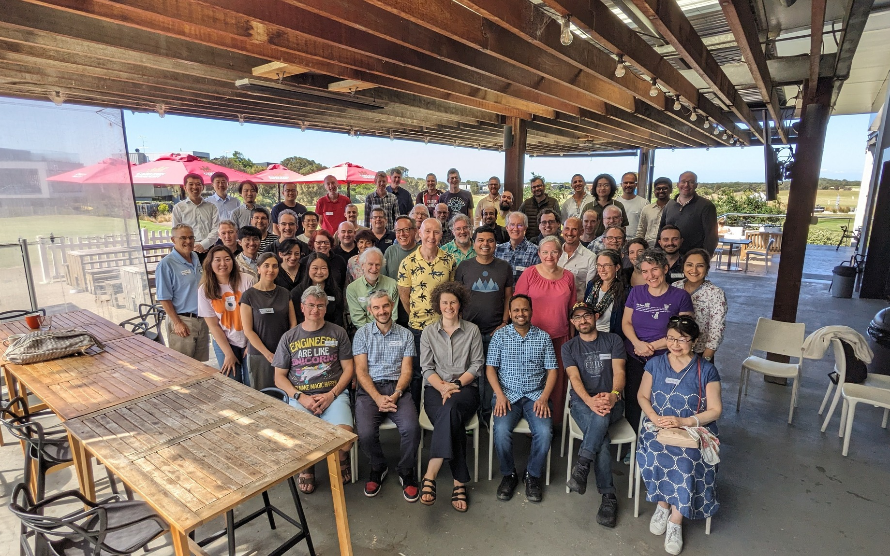
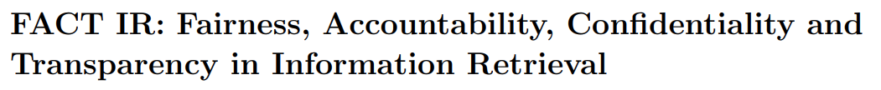


Reclaiming Our Sociotechnical Futures
This is a call for the IR community to rise up and challenge the crisis of imagination plaguing the broader tech community
We must put forth bolder visions for our collective futures and radically reimagine information experiences that liberate us, not manipulate us
A message from SWIRL’25
https://bhaskar-mitra.github.io/posts/2025/09/01/what-is-ir-for-good/
(SWIRL’18)
(SWIRL’25)
Mitra. Search and Society: Reimagining Information Access for Radical Futures. In IRRJ, 2025.

Slide 16

“The exercise of imagination is dangerous to those who profit from the way things are because it has the power to show that the way things are is not permanent, not universal, not necessary.”
– Ursula K. Le Guin

