Slide 1




Information Retrieval & Society
Bhaskar Mitra (he/him)
Independent Researcher
Tiohtià:ke / Montréal, Canada
My relevant research themes:
Exposure Fairness and Transparency in Information Access
Emancipatory Information Access
AI & Society
bhaskar-mitra.github.io
@bmitra.bsky.social
bhaskar.mitra@acm.org

Slide 2

Information retrieval (IR) is the study of tools and methods for satisfying people’s information need by finding relevant information—e.g., search engines, recommender systems, and chatbots
IR has roots in library and information science and linguistics
Societal implications. These systems affect what information receive exposure which shapes consumer behavior, political discourse, and culture, and influence economic outcomes

Slide 3
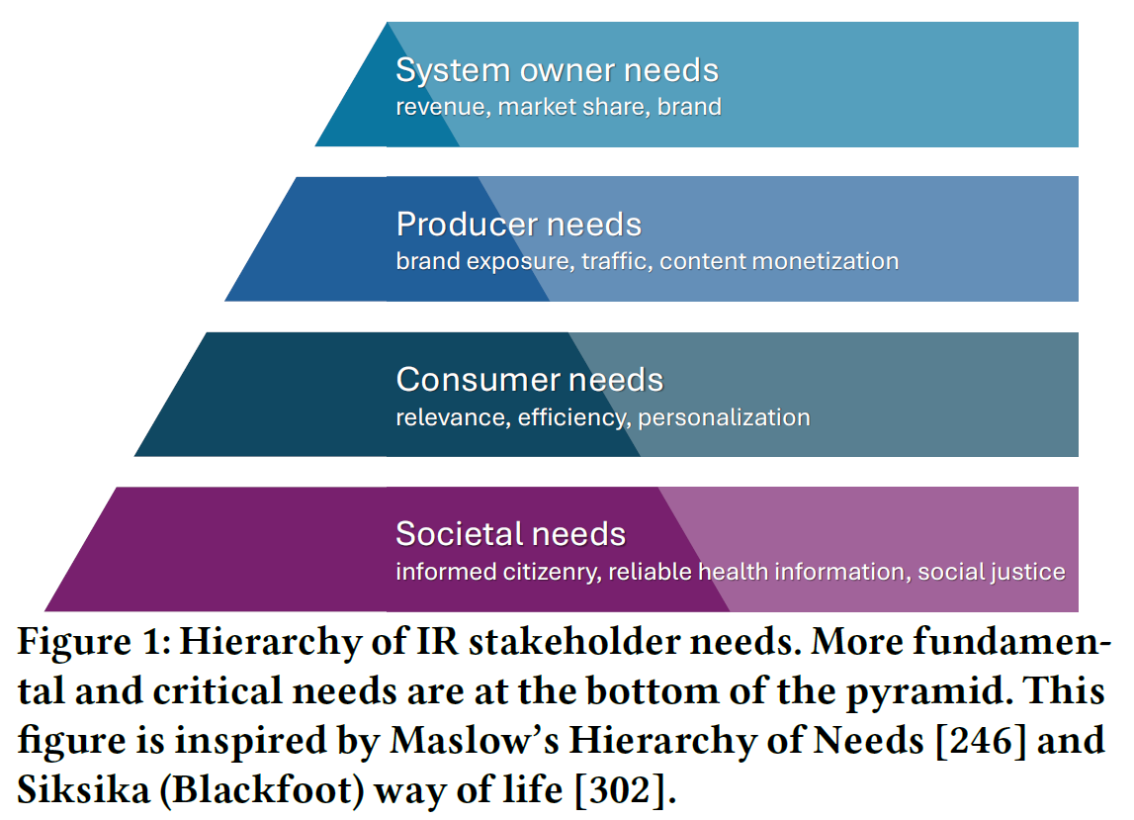
Whose needs is IR prioritizing?
IR places a strong emphasis on the user (consumer); focusing on understanding user needs (lab studies, log analysis, surveys, etc.), optimizing for user needs (e.g., relevance optimization, personalization, and efficiency), and validating user impact (online experiments and lab studies)
Recommender systems and search engines also concern with content producers and publishers, e.g., artists, web publishers, and search engine optimization (SEO) community
Salient in industry are the needs of the system owners—e.g., revenue, market share, and brand
But how should IR prioritize societal needs?
Mitra. Search and Society: Reimagining Information Access for Radical Futures. In IRRJ, 2025.

Slide 4

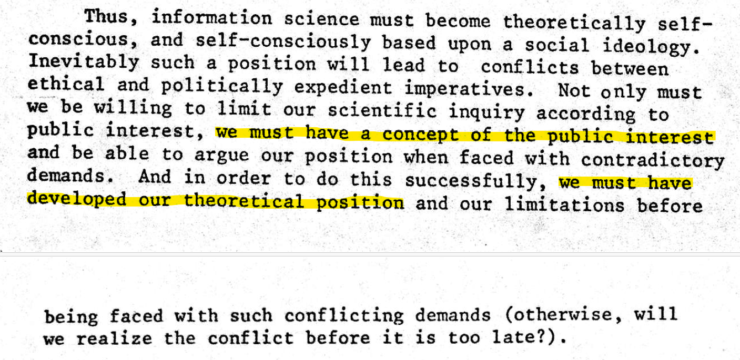
Published in 1976 (half a century ago)

Slide 5
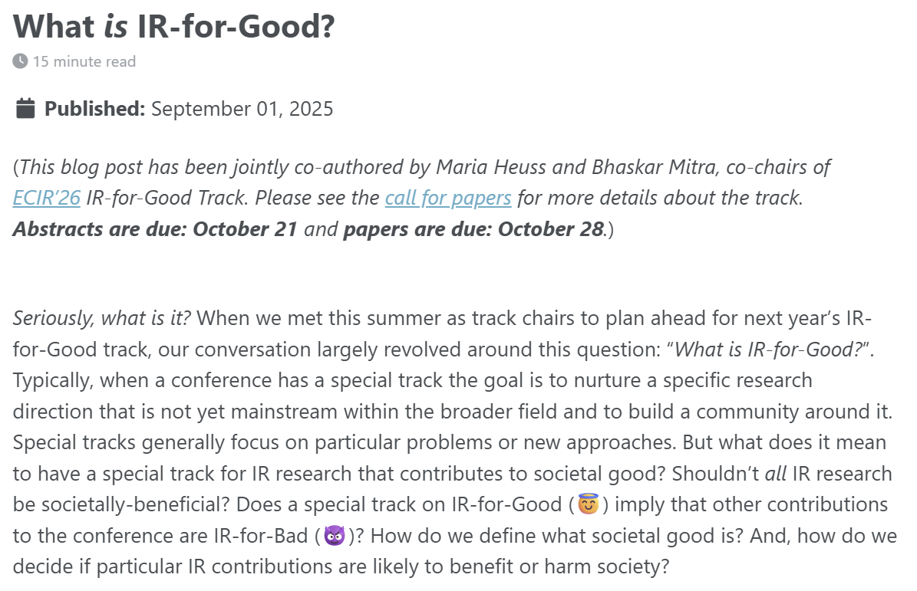
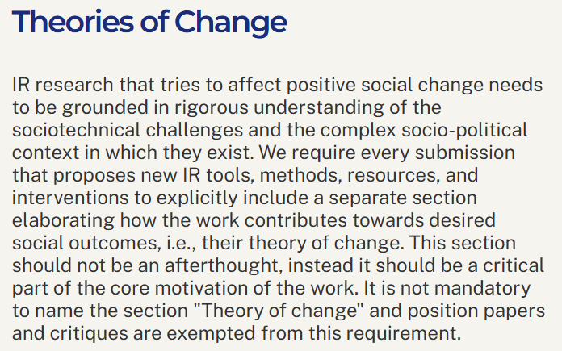
The boundaries of IR & Society
The topic of “IR for societal good” is currently undertheorized
As Belkin and Robertson (1976) point out, we must develop our position on what constitutes societal good to make appropriate progress and resist contradictory demands
Definition. A theory of change is a method that explains how a given intervention, or set of interventions, is expected to lead to specific change
Mitra and Heuss. What is IR-for-Good? Blog post, 2025.
Belkin and Robertson. Some Ethical and Political Implications of Theoretical Research in Information Science. In proc. ASIS, 1976.

Slide 6


The two frames of IR & Society

Slide 7
The Liberal Approach

Slide 8
The liberal approach
Towards what goal? There is an incredibly broad range of ways each of these concepts can be defined; how do we choose? How do we validate that they are having the desired societal impact without defining what we consider as social good?
Focus on desired attributes of the technology, e.g., fair, trustworthy, accountable, transparent, and ethical
Focus on technological harm mitigation (e.g., representational and allocative harms, misinformation) and support for privacy, transparency, and explainability
Sometimes (mis-)represented as apolitical; politically focused on individual rights, equality, freedom of speech, and free-market capitalism
What if the technology is fundamentally flawed or harmful in its goal and design? What if the right answer is to resist the development and deployment of said technology, or reimagine a principally different approach to address the same problem?
Politics is salient to social progress—e.g., civil rights and liberation movement; what do we lose when we refuse to engage with our history and the existing body of critical sociopolitical scholarship? What do we miss when our analysis is not informed by theories of power and incentive structures?

Slide 9
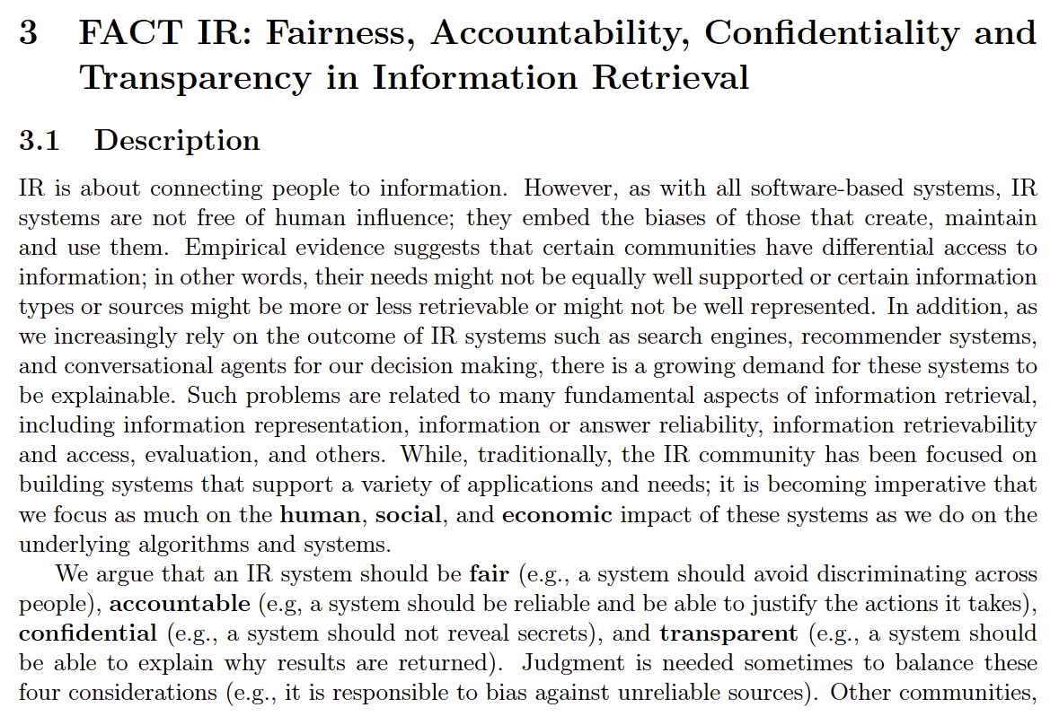
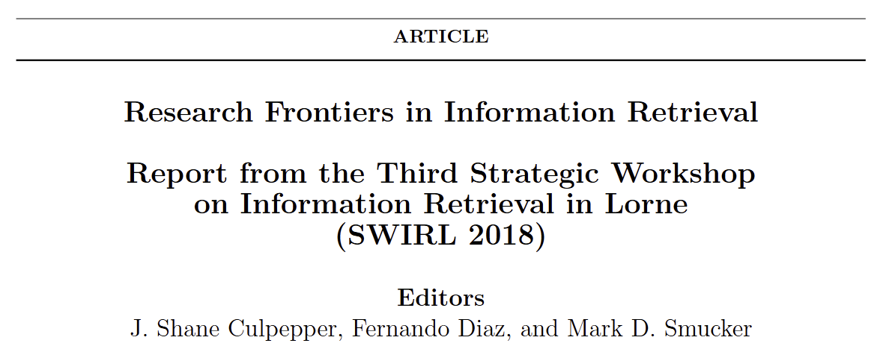

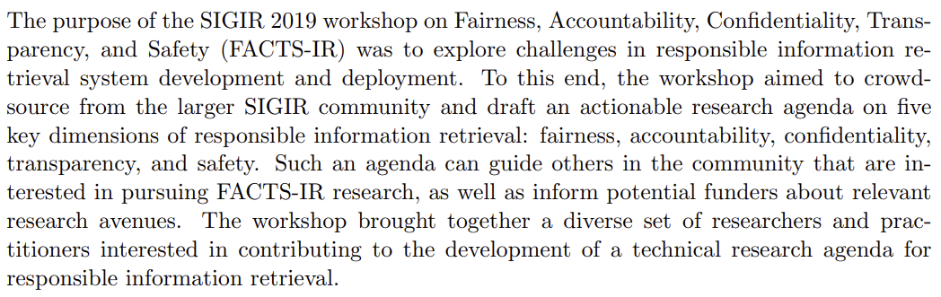
Culpepper et al. Research Frontiers in Information Retrieval: Report from the Third Strategic Workshop on Information Retrieval in Lorne (SWIRL 2018). In ACM SIGIR Forum, 2018.
Olteanu et al. FACTS-IR: fairness, accountability, confidentiality, transparency, and safety in information retrieval. In ACM SIGIR Forum, 2021.

Slide 10

Algorithmic fairness in ranking
“
When we refer to fairness, we are talking about the ways a system treats people, or groups of people, in a way that is considered “unfair” by some moral, legal, or ethical standard
Types of fairness
Exposure vs. quality-of-service. Given a fixed information need, exposure fairness aims to ensure no item is exposed more or less than any other item of the same relevance; Quality-of-service aims to ensure users have comparable experiences with the system
Individual vs. group. Individual fairness aims to treat similar individuals similarly; Group fairness is concerned with ensuring that different groups have comparable experiences with the system
Treatment vs. Outcome. Disparate treatment is when members of different groups are intentionally treated differently; Disparate impact is when different groups have different impact from the system’s decisions
Types of harms
Allocative harms arise when someone is denied a resource or benefit, e.g., a job search engine displays lower-paying jobs to women
Representational harms arise when the system represents groups or individuals incorrectly, e.g., image search results for “CEO” disproportionately shows white male CEOs, sexualization of women of color in search results
Ekstrand, Das, Burke, and Diaz. Fairness in Information Access Systems. In FnTIR, 2022.

Slide 11
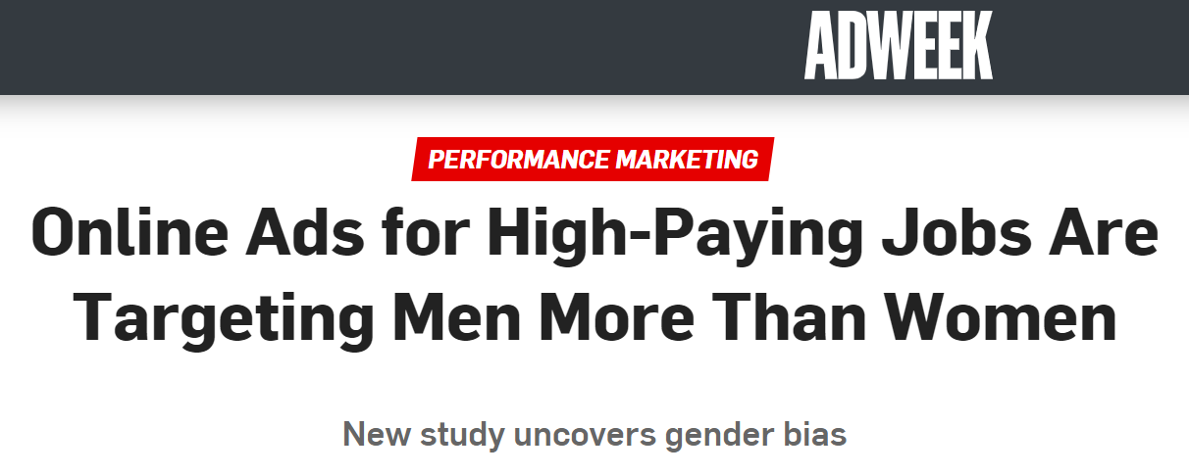
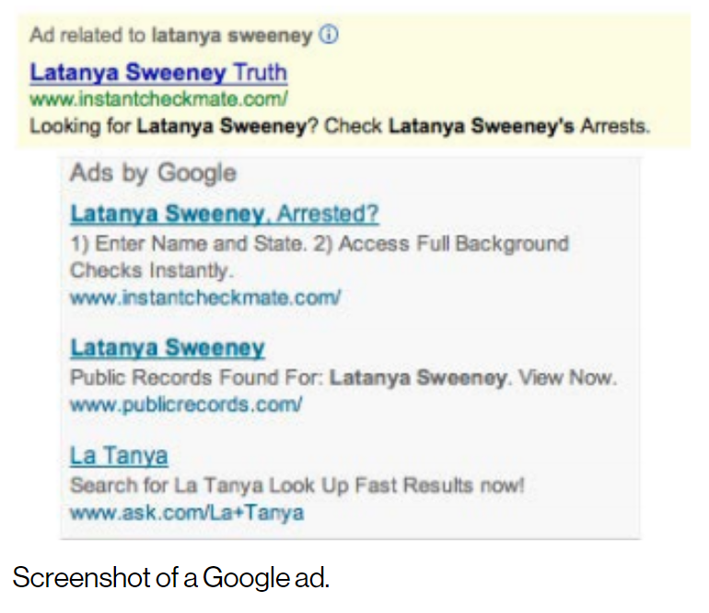
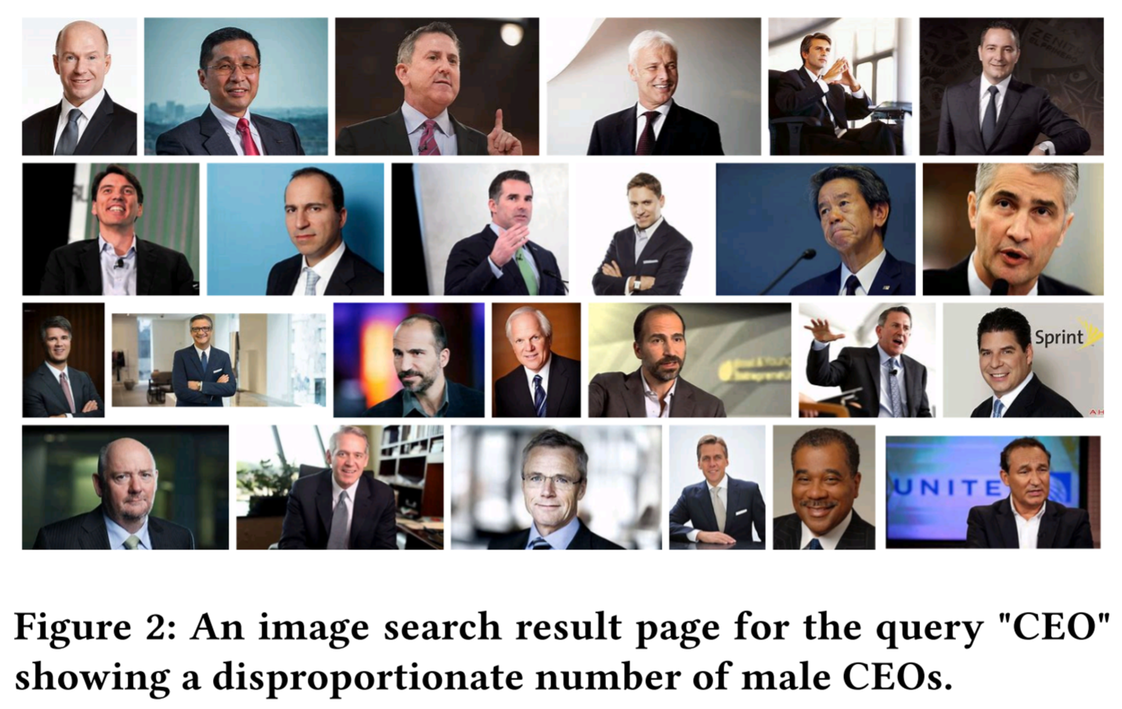
Harms of disparate exposure
Several past studies have pointed out representational and allocative harms from disparate exposure
In traditional IR, we have made progress in modeling, measuring, and optimizing for individual user satisfaction
A key challenge ahead is to model, measure, and optimize IR systems with respect to impact on populations of users and consider disparate impact across subpopulations
Sweeney. Discrimination in online ad delivery. Communications of the ACM, 2013.
Crawford. The Trouble with Bias. NeurIPS Keynote, 2017.
Singh and Joachims. Fairness of Exposure in Rankings. In proc. ACM KDD, 2018.

Slide 12
Exposure fairness is a multisided problem
It is important to ask not just whether specific content receives exposure, but who it is exposed to and in what context
Haolun, Mitra, Ma, and Liu. Joint Multisided Exposure Fairness for Recommendation. In proc. ACM SIGIR, 2022.

Slide 13
Exposure fairness is a multisided problem
Take the example of a job recommendation system
Individual-user-to-Individual-item fairness (II-F)
Are Individual items under/over-exposed to Individual users?
Individual-user-to-group-of-items fairness (IG-F)
Are groups of items under/over-exposed to individual users?
E.g., a specific user being disproportionately recommended low-paying jobs.
Group-of-users-to-Individual-item fairness (GI-F)
Are Individual items under/over-exposed to groups of users?
E.g., a specific job being disproportionately recommended to men and not to women and non-binary people.
Group-of-users-to-group-of-items fairness (GG-F)
Are groups of items under/over-exposed to groups of users?
E.g., men being disproportionately recommended high-paying jobs and women low-paying jobs.
All-users-to-Individual-item fairness (AI-F)
Are Individual items under/over-exposed to all users overall?
E.g., a specific job being disproportionately under-exposed to all users.
All-users-to-group-of-items fairness (AG-F)
Are groups of items under/over-exposed to all users overall?
E.g., jobs at Black-owned businesses being disproportionately under-exposed to all users.

Slide 14
Exposure fairness is a multisided problem
Take the example of a job recommendation system
Individual-user-to-Individual-item fairness (II-F)
Are Individual items under/over-exposed to Individual users?
Individual-user-to-group-of-items fairness (IG-F)
Are groups of items under/over-exposed to individual users?
E.g., a specific user being disproportionately recommended low-paying jobs.
Group-of-users-to-Individual-item fairness (GI-F)
Are Individual items under/over-exposed to groups of users?
E.g., a specific job being disproportionately recommended to men and not to women and non-binary people.
Group-of-users-to-group-of-items fairness (GG-F)
Are groups of items under/over-exposed to groups of users?
E.g., men being disproportionately recommended high-paying jobs and women low-paying jobs.
All-users-to-Individual-item fairness (AI-F)
Are Individual items under/over-exposed to all users overall?
E.g., a specific job being disproportionately under-exposed to all users.
All-users-to-group-of-items fairness (AG-F)
Are groups of items under/over-exposed to all users overall?
E.g., jobs at Black-owned businesses being disproportionately under-exposed to all users.

Slide 15
Exposure fairness is a multisided problem
Take the example of a job recommendation system
Individual-user-to-Individual-item fairness (II-F)
Are Individual items under/over-exposed to Individual users?
Individual-user-to-group-of-items fairness (IG-F)
Are groups of items under/over-exposed to individual users?
E.g., a specific user being disproportionately recommended low-paying jobs.
Group-of-users-to-Individual-item fairness (GI-F)
Are Individual items under/over-exposed to groups of users?
E.g., a specific job being disproportionately recommended to men and not to women and non-binary people.
Group-of-users-to-group-of-items fairness (GG-F)
Are groups of items under/over-exposed to groups of users?
E.g., men being disproportionately recommended high-paying jobs and women low-paying jobs.
All-users-to-Individual-item fairness (AI-F)
Are Individual items under/over-exposed to all users overall?
E.g., a specific job being disproportionately under-exposed to all users.
All-users-to-group-of-items fairness (AG-F)
Are groups of items under/over-exposed to all users overall?
E.g., jobs at Black-owned businesses being disproportionately under-exposed to all users.

Slide 16
Exposure fairness is a multisided problem
Take the example of a job recommendation system
Individual-user-to-Individual-item fairness (II-F)
Are Individual items under/over-exposed to Individual users?
Individual-user-to-group-of-items fairness (IG-F)
Are groups of items under/over-exposed to individual users?
E.g., a specific user being disproportionately recommended low-paying jobs.
Group-of-users-to-Individual-item fairness (GI-F)
Are Individual items under/over-exposed to groups of users?
E.g., a specific job being disproportionately recommended to men and not to women and non-binary people.
Group-of-users-to-group-of-items fairness (GG-F)
Are groups of items under/over-exposed to groups of users?
E.g., men being disproportionately recommended high-paying jobs and women low-paying jobs.
All-users-to-Individual-item fairness (AI-F)
Are Individual items under/over-exposed to all users overall?
E.g., a specific job being disproportionately under-exposed to all users.
All-users-to-group-of-items fairness (AG-F)
Are groups of items under/over-exposed to all users overall?
E.g., jobs at Black-owned businesses being disproportionately under-exposed to all users.

Slide 17
Exposure fairness is a multisided problem
Take the example of a job recommendation system
Individual-user-to-Individual-item fairness (II-F)
Are Individual items under/over-exposed to Individual users?
Individual-user-to-group-of-items fairness (IG-F)
Are groups of items under/over-exposed to individual users?
E.g., a specific user being disproportionately recommended low-paying jobs.
Group-of-users-to-Individual-item fairness (GI-F)
Are Individual items under/over-exposed to groups of users?
E.g., a specific job being disproportionately recommended to men and not to women and non-binary people.
Group-of-users-to-group-of-items fairness (GG-F)
Are groups of items under/over-exposed to groups of users?
E.g., men being disproportionately recommended high-paying jobs and women low-paying jobs.
All-users-to-Individual-item fairness (AI-F)
Are Individual items under/over-exposed to all users overall?
E.g., a specific job being disproportionately under-exposed to all users.
All-users-to-group-of-items fairness (AG-F)
Are groups of items under/over-exposed to all users overall?
E.g., jobs at Black-owned businesses being disproportionately under-exposed to all users.

Slide 18
Exposure fairness is a multisided problem
Take the example of a job recommendation system
Individual-user-to-Individual-item fairness (II-F)
Are Individual items under/over-exposed to Individual users?
Individual-user-to-group-of-items fairness (IG-F)
Are groups of items under/over-exposed to individual users?
E.g., a specific user being disproportionately recommended low-paying jobs.
Group-of-users-to-Individual-item fairness (GI-F)
Are Individual items under/over-exposed to groups of users?
E.g., a specific job being disproportionately recommended to men and not to women and non-binary people.
Group-of-users-to-group-of-items fairness (GG-F)
Are groups of items under/over-exposed to groups of users?
E.g., men being disproportionately recommended high-paying jobs and women low-paying jobs.
All-users-to-Individual-item fairness (AI-F)
Are Individual items under/over-exposed to all users overall?
E.g., a specific job being disproportionately under-exposed to all users.
All-users-to-group-of-items fairness (AG-F)
Are groups of items under/over-exposed to all users overall?
E.g., jobs at Black-owned businesses being disproportionately under-exposed to all users.

Slide 19
Exposure fairness is a multisided problem
Take the example of a job recommendation system
Individual-user-to-Individual-item fairness (II-F)
Are Individual items under/over-exposed to Individual users?
Individual-user-to-group-of-items fairness (IG-F)
Are groups of items under/over-exposed to individual users?
E.g., a specific user being disproportionately recommended low-paying jobs.
Group-of-users-to-Individual-item fairness (GI-F)
Are Individual items under/over-exposed to groups of users?
E.g., a specific job being disproportionately recommended to men and not to women and non-binary people.
Group-of-users-to-group-of-items fairness (GG-F)
Are groups of items under/over-exposed to groups of users?
E.g., men being disproportionately recommended high-paying jobs and women low-paying jobs.
All-users-to-Individual-item fairness (AI-F)
Are Individual items under/over-exposed to all users overall?
E.g., a specific job being disproportionately under-exposed to all users.
All-users-to-group-of-items fairness (AG-F)
Are groups of items under/over-exposed to all users overall?
E.g., jobs at Black-owned businesses being disproportionately under-exposed to all users.

Slide 20
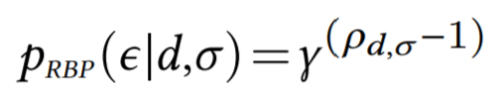
User browsing models and exposure
User browsing models are simplified models of how users inspect and interact with retrieved results
It estimates the probability that the user inspects a particular item in a ranked list of items—i.e., the item is exposed to the user
In IR, user models have been implicitly and explicitly employed in metric definitions and for estimating relevance from historical logs of user behavior data
For example, let’s consider the RBP user model…
RBP
NDCG
Probability of exposure at different ranks according to NDCG and RBP user browsing models
exposure event
rank of the item in the ranked list
an item
patience factor
a ranked list of items
Diaz, Mitra, Ekstrand, Biega, and Carterette. Evaluating stochastic rankings with expected exposure. In proc. ACM CIKM, 2020.

Slide 21

Stochastic ranking and expected exposure
In recommendation, Diaz et al. (2020) define a stochastic ranking policy 𝜋_{𝑢}, conditioned on user 𝑢 ∈ U, as a probability distribution over all permutations of items in the collection
The expected exposure of an item 𝑑 for user 𝑢 can then be computed as follows:
Here, 𝑝(𝜖|𝑑,𝜎) can be computed using a user browsing model like RBP as discussed previously
Note: The above formulation can also be applied to search by replacing user with query
Diaz, Mitra, Ekstrand, Biega, and Carterette. Evaluating stochastic rankings with expected exposure. In proc. ACM CIKM, 2020.

Slide 22
System, target, and random exposure
System exposure. The user-item expected exposure distribution corresponding to a stochastic ranking policy 𝜋. Correspondingly, we can define a |U|×|D| matrix E, such that E_{𝑖𝑗} = 𝑝(𝜖|D_{𝑗} ,𝜋_{U𝑖}).
Target exposure. The user-item expected exposure distribution corresponding to an ideal stochastic ranking policy 𝜋*, as defined by some desirable principle (e.g., the equal expected exposure principle). We denote the corresponding expected exposure matrix as E*.
The deviation of E from E* gives us a quantitative measure of the suboptimality of the retrieval system under consideration.
Diaz, Mitra, Ekstrand, Biega, and Carterette. Evaluating stochastic rankings with expected exposure. In proc. ACM CIKM, 2020.

Slide 23
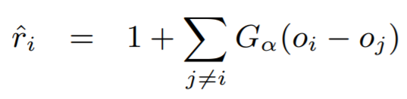
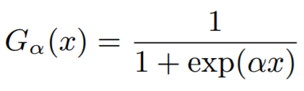
Gradient-based optimization for target exposure
Approach
Challenges and solutions
Use the target model to score the items
Compute PL sampling probability as a function of the item scores
Sample multiple rankings
Compute expected system exposure across sampled rankings
Compute the loss as a difference between system and target exposure
Backpropagate!
The key challenge is the proposed approach is that both the sampling and the ranking steps are non-differentiable!
For sampling, we can use Gumbel sampling as a differentiable approximation
For ranking, we can employ SmoothRank / ApproxRank as differentiable approximations of the ranking step
,
Wu, Chang, Zheng, and Zha. Smoothing DCG for learning to rank: A novel approach using smoothed hinge functions. In proc. ACM CIKM, 2009.
Qin, Liu, and Li. A general approximation framework for direct optimization of information retrieval measures. In Information retrieval, 2010.
Bruch, Han, Bendersky, and Najork. A stochastic treatment of learning to rank scoring functions. In proc. ACM WSDM, 2020.

Slide 24
Gradient-based optimization for target exposure
items
neural scoring function
add independently sampled Gumbel noise
compute smooth rank value
compute exposure using user model
compute average exposure
compute loss with target exposure
target exposure
Diaz, Mitra, Ekstrand, Biega, and Carterette. Evaluating stochastic rankings with expected exposure. In proc. ACM CIKM, 2020.

Slide 25
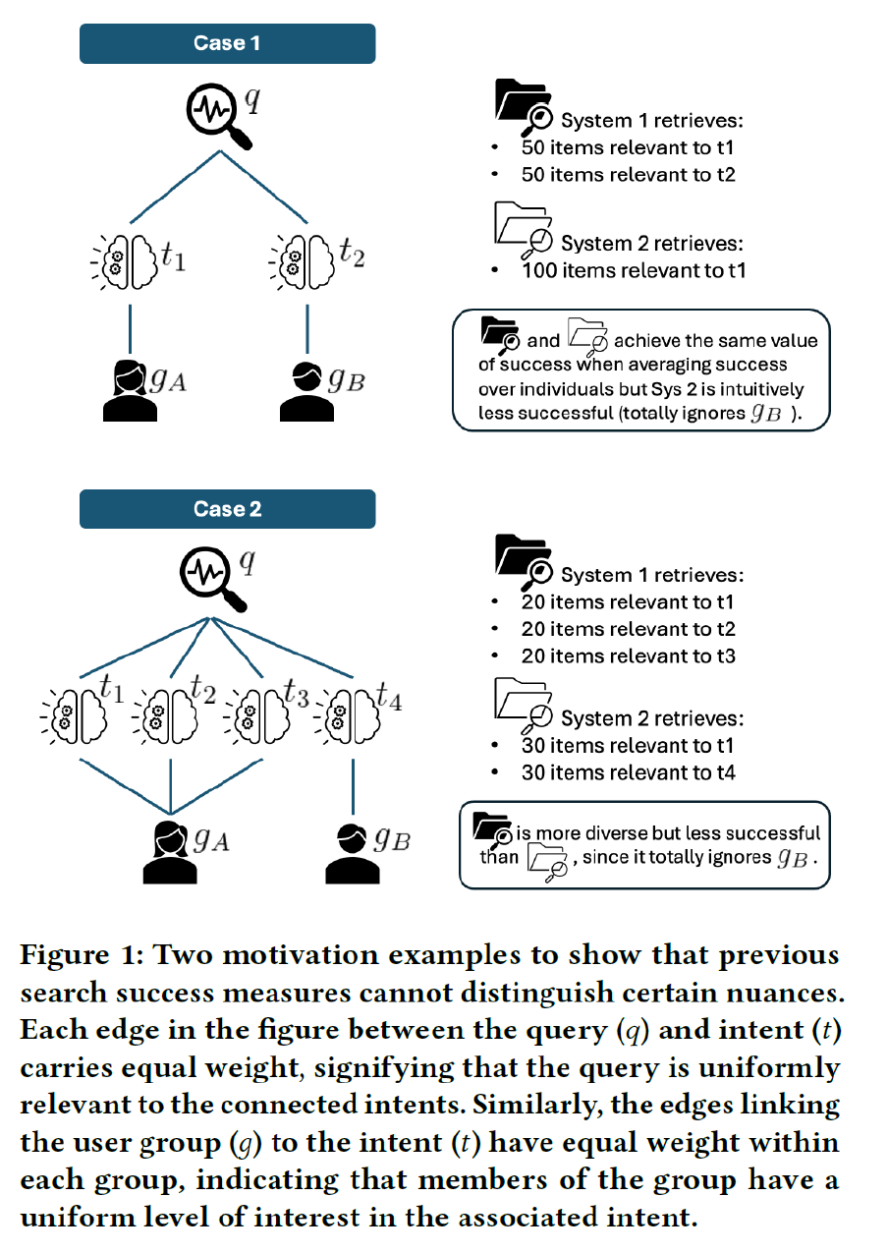
Group-aware search success Towards fairness of quality of service
Different groups may search for different queries and may have different information intents for the same query
Group-aware search success metrics consider the probability that search results satisfy all groups, not just success on average
Expected exposure can be used to develop group-aware search success metrics
Haolun, Mitra, and Craswell. Towards Group-aware Search Success. In proc. ACM ICTIR, 2024.

Slide 26
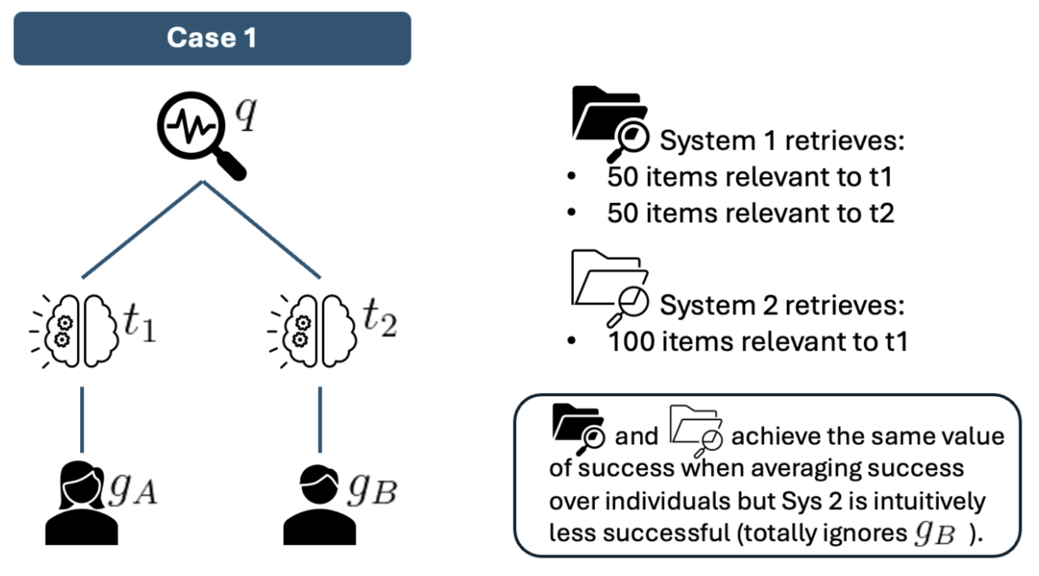
Haolun, Mitra, and Craswell. Towards Group-aware Search Success. In proc. ACM ICTIR, 2024.

Slide 27
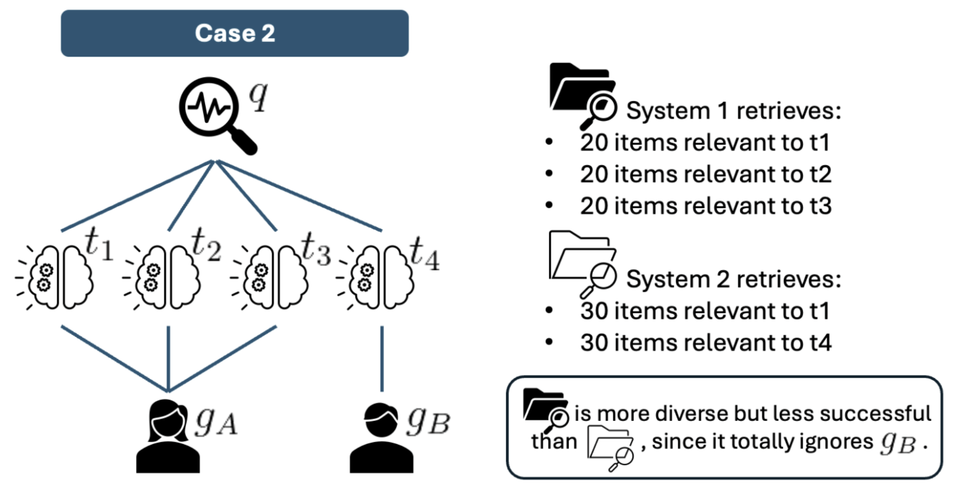
Haolun, Mitra, and Craswell. Towards Group-aware Search Success. In proc. ACM ICTIR, 2024.

Slide 28
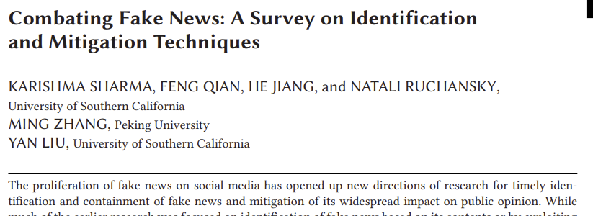
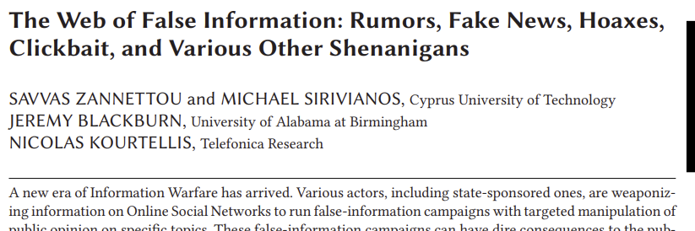
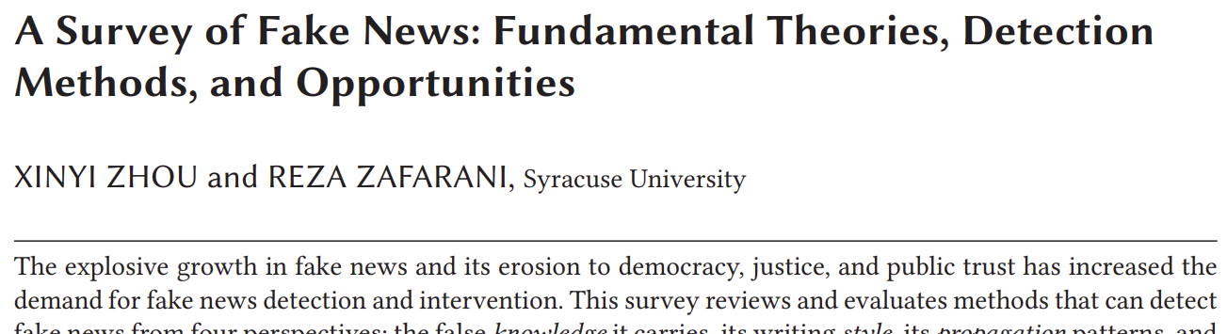
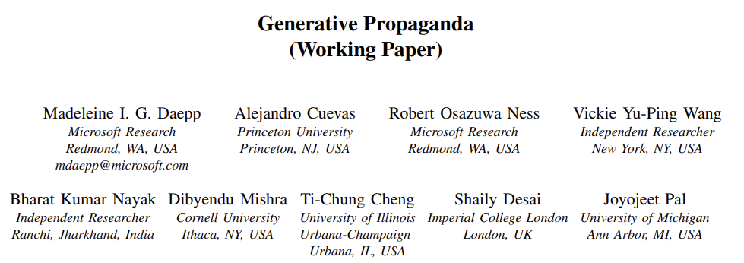
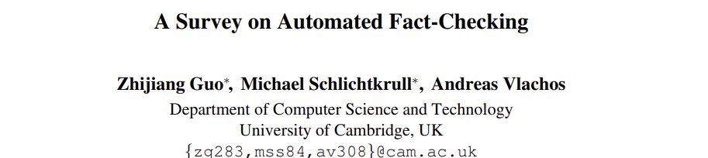
Misinformation and disinformation
Misinformation is defined as constituting claims that contradict or distort common understandings of verifiable facts
Disinformation is defined as the subset of misinformation that is deliberately propagated
Propaganda is defined as expression of opinion or action by individuals or groups deliberately designed to influence opinions or actions of other individuals or groups with reference to predetermined ends
Fact-checking is the task of assessing whether claims made in written or spoken language or visual communication are true
Sharma, Qian, Jiang, Ruchansky, Zhang, and Liu. Combating Fake News: A Survey on Identification and Mitigation Techniques. In TIST, 2019.
Zannettou, Sirivianos, Blackburn, and Kourtellis. The Web of False Information: Rumors, Fake News, Hoaxes, Clickbait, and Various Other Shenanigans. In JDIQ, 2019.
Zhou and Zafarani. A Survey of Fake News: Fundamental Theories, Detection Methods, and Opportunities. In CSUR, 2020.
Guo, Schlichtkrull, and Vlachos. A Survey on Automated Fact-Checking. In TACL, 2022.
Daepp, Cuevas, Ness, Wang, Nayak, Mishra, Cheng, Desai, Pal. Generative Propaganda. Preprint, 2025.

Slide 29

Explainability, interpretability, and transparency
Explainability is the ability to describe why the system made a certain prediction or generate a particular output
Interpretability is the ability for the system to expose its inner working in human understandable form
Transparency refers to openness in the design, development, and deployment of the system
Types of transparency
System transparency targets how the system is designed
Procedural transparency targets how the system works in socially embedded context
Transparency of outcomes makes visible the impacts and outcomes resulting from the system use
A key consideration
Interpretability, transparency, and explainability may increase user trust in the system, but is that trust warranted? How do we ensure that the system does not deceive the user into putting their trust in the system by being selective about what system details it exposes or providing explanations that do not reflect the reality of how the system functions?
only the sort of transparency that arises from critique—a method of theoretical examination that, by revealing pre-existing power structures, aims to challenge them—can help us produce technological systems that are less deceptive and more just. – Hollanek (2017)
“
Zhang and Chen. Explainable Recommendation: A Survey and New Perspectives. In FnTIR, 2018.
Cortiñas-Lorenzo, Lindley, Larsen-Ledet, and Mitra. Through the Looking-Glass: Transparency Implications and Challenges in Enterprise AI Knowledge Systems. Preprint, 2025.
Hollanek. AI transparency: a matter of reconciling design with critique. In AI & Society, 2017.
Miller. Are we measuring trust correctly in explainability, interpretability, and transparency research? Preprint, 2022.

Slide 30
The Critical Approach

Slide 31
Critical information theory
“
Critical information theory […] must study not just the role of information and information concepts in society, academia, nature, culture, etc, but how it is related to processes of oppression, exploitation, and domination, which implies a normative judgment in solidarity with the dominated and for the abolishment of domination.
“
“
Critical theory is intellectual class struggle. It is anti-capitalist and opposed to domination. It struggles for a classless, nondominative, co-operative, participatory democracy.
The ultimate goal should not be a division of academic labour with equal subfields based on liberal pluralism, but unified critical academic and public information studies within a unified critical academic and public science.
Fuchs. Towards a critical theory of information. In tripleC: Communication, Capitalism & Critique, 2009.

Slide 32
The liberal approach
The critical approach
Focus on desired attributes of the technology, e.g., fair, trustworthy, accountable, transparent, and ethical
Focus on technological harm mitigation (e.g., representational and allocative harms, misinformation) and support for privacy, transparency, and explainability
Sometimes (mis-)represented as apolitical; politically focused on individual rights, equality, freedom of speech, and free-market capitalism
Focus on desired societal outcomes, e.g., social justice, emancipation, and democracy
Reject techno-determinism; focus on sociotechnical mitigation, repair, refusal, building counter-technologies; challenge power and oppression
Explicitly political and politically decolonial, anti-racist, feminist, queer, pro-labor, anti-capitalist, anti-casteist, anti-ableist, and abolitionist; grounded in praxis, collective organizing, and movement building

Slide 33

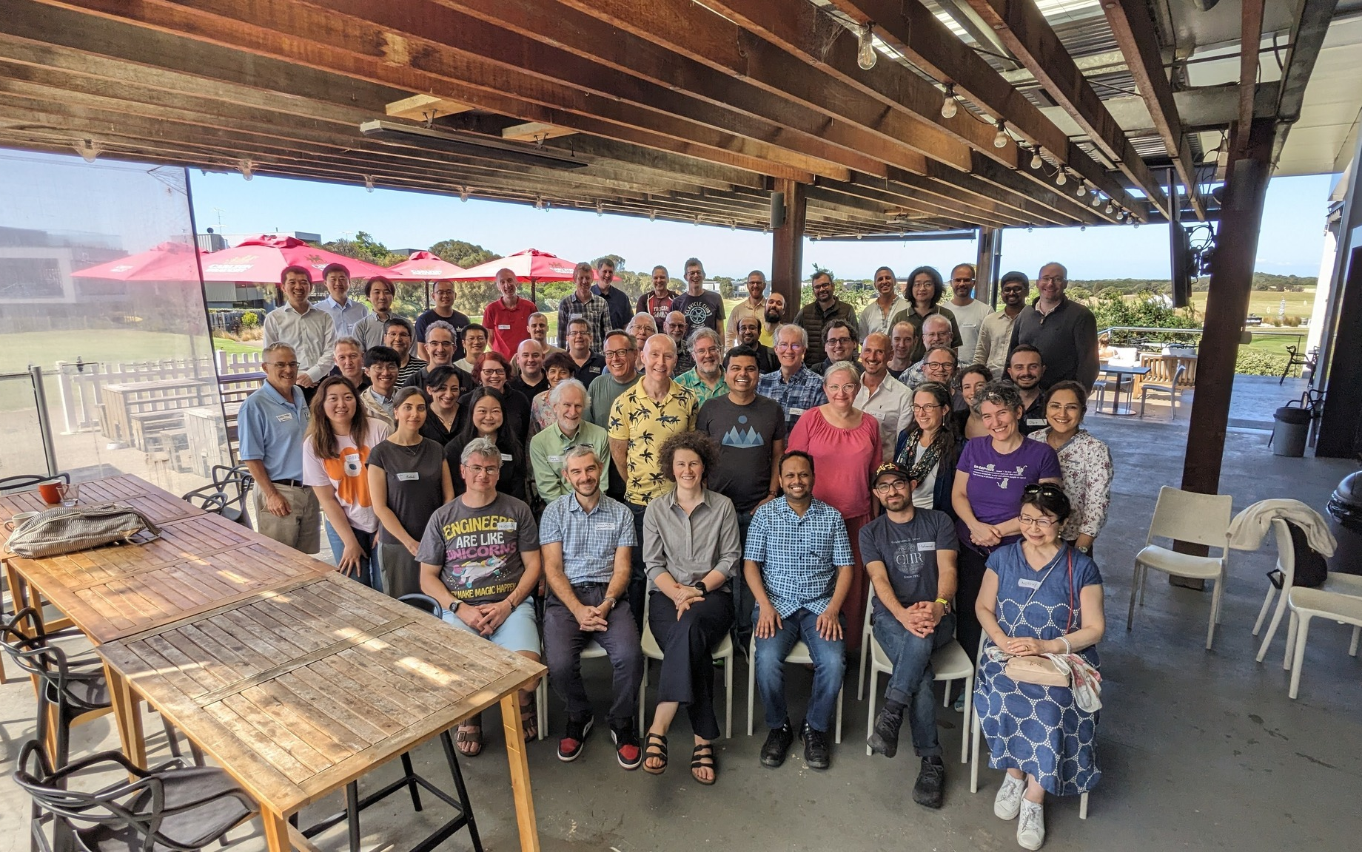
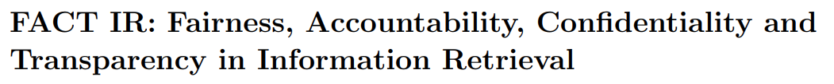

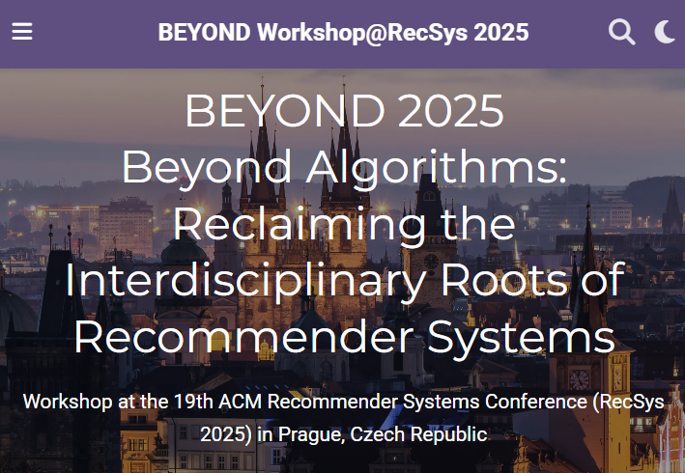
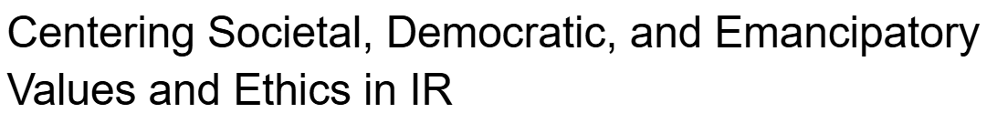
Shifting towards critical IR theories and practices
The 4th Strategic Workshop on Information Retrieval in Lorne (SWIRL)
https://jedi.inertial.science/sigir2026
(SWIRL’18)
(SWIRL’25)
Trippas et al. Report from the 4th Strategic Workshop on Information Retrieval in Lorne (SWIRL 2025). In ACM SIGIR Forum, 2015.

Slide 34

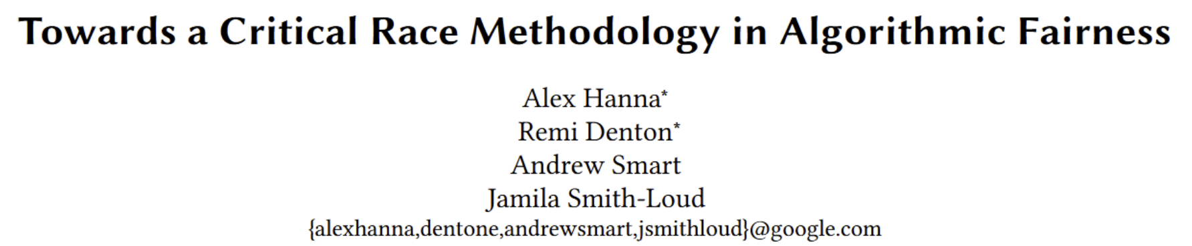

Rethinking fairness and algorithmic interventions
The social construction of race and gender
Beyond algorithmic fixes
https://when-not-to-build.github.io
Hanna, Denton, Smart, and Smith-Loud. Towards a Critical Race Methodology in Algorithmic Fairness. In proc. FAccT, 2020.
Pinney, Raj, Hanna, and Ekstrand. Much Ado About Gender: Current Practices and Future Recommendations for Appropriate Gender-Aware Information Access. In proc. CHIIR, 2023.
Barocas, Biega, Fish, Niklas, and Stark. When Not to Design, Build, or Deploy. In proc. FAccT, 2020.

Slide 35

Search result pages as sites of pedagogy
Instead of trying to algorithmically fix under-representation of women and people of color in image search results for occupational roles, can we reclaim that digital space as a site of resistance and emancipatory pedagogy by allowing feminist, queer, and anti-racist scholars, activists, and artists to create experiences that teach the history of erasure and representational injustice?
Mitra. Search and Society: Reimagining Information Access for Radical Futures. In IRRJ, 2025.

Slide 36
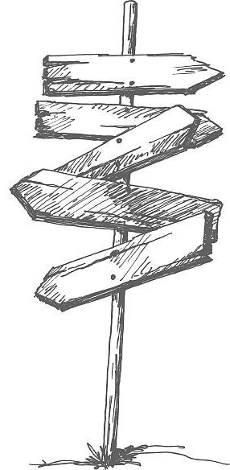
Sociotechnical imaginaries
“Visions of desirable futures, animated by shared understandings of forms of social life and social order attainable through, and supportive of, advances in science and technology”
~Jasanoff and Kim (2015)
Whose sociotechnical imaginaries are granted normative status and what myriad of radically alternative futures are we overlooking?
How does increasing dominance of established for-profit platforms over academic research influences and/or homogenizes the kinds of IR systems we build?
What would information access systems look like if designed for futures informed by feminist, queer, decolonial, anti-racist, anti-casteist, anti-ableist, and abolitionist thoughts?
Mitra. Search and Society: Reimagining Information Access for Radical Futures. In IRRJ, 2025.
Notes:
A salient question that is often ignored in these conversations is what futures are we building towards for our society and what role do we envision information access technologies will play towards those transformations?
Sociotechnical imaginaries: our visions of desirable sociotechnical futures
Theories of change articulate how our work and actions should take us closer towards those goals
Critically reflect on these implicit visions
Whose sociotechnical imaginaries are granted normative status and what myriads of radically alternative futures are we overlooking?
How does increasing dominance of established for-profit platforms over academic research influences and/or homogenizes the kinds of IR systems we build?
What would IR systems look like if designed for futures informed by feminist, queer, decolonial, anti-racist, anti-casteist, anti-ableist, and abolitionist thoughts, and if the focus of IR and AI research was to dismantle colonial cisheteropatriarchal capitalist structures and not to prop them up?
Shifting the frame from “how can current systems be less harmful” to “what social changes we want to affect and what systems should we build and how should we build them to make progress towards those goals”

Slide 37
e.g., colonialism, racism, patriarchy, casteism, transphobia, ableism, …
Emancipatory IR is the study and development of information access methods that challenge all forms of human oppression and situates its activities within broader collective emancipatory praxis
Discourages non-performative academic gaze, urges this research to be situated in movement building, and calls for the recognizing the role of movement building in this research
Signifies the moral concerns of universal humanization of all peoples and the elimination of oppression to create the conditions under which we can collectively flourish
Mitra. Emancipatory Information Retrieval. In IRRJ, 2025.

Slide 38
A framework of practices, projects, and provocations for emancipatory IR
Diagnose and critique ◦◦◦◦◦ Imagine viable alternatives ◦◦◦◦◦ Elaborate theories of change ◦◦◦◦◦
Community building and organizing
Safeguard against surveillance
Promote emancipatory pedagogy
Safeguard against dehumanization and inequitable outcomes
Safeguard against capture
Safeguard against manipulation
Mitigate ecological and human costs
Provocations for emancipatory IR
Mitra. Emancipatory Information Retrieval. In IRRJ, 2025.

Slide 39

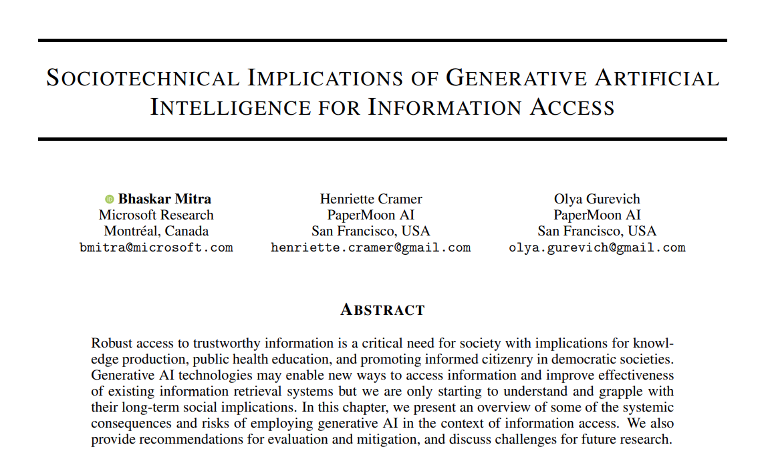
Diagnose and critique
https://link.springer.com/book/9783031731464
Mitra, Cramer, & Gurevich. Sociotechnical implications of generative artificial intelligence for information access. Book chapter, Springer Nature, 2025.

Slide 40
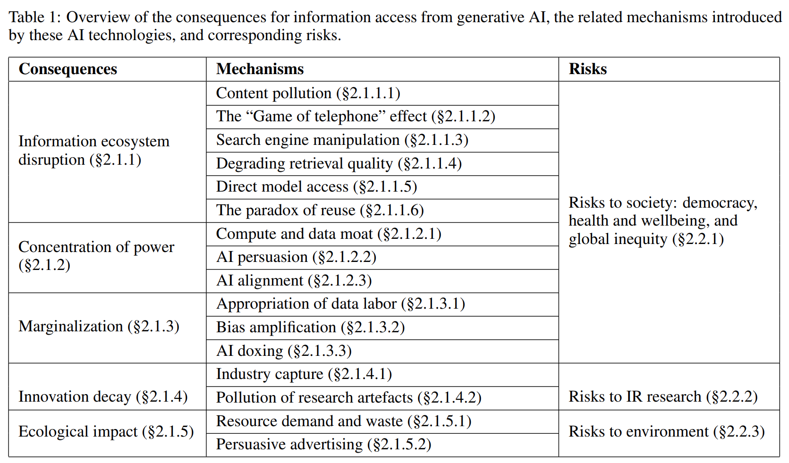
Sociotechnical implications of generative AI for information access
Diagnose and critique
A.K.A “hallucinations”,
we avoid that term as it is anthropomorphizing
Mitra, Cramer, & Gurevich. Sociotechnical implications of generative artificial intelligence for information access. Book chapter, Springer Nature, 2025.
Gausen, Mitra, & Lindley. A Framework for Exploring the Consequences of AI-Mediated Enterprise Knowledge Access and Identifying Risks to Workers. In Proc. FAccT, 2024.
Notes:
How generative AI may potentially disrupt how content is produced, consumed, monetized, and manipulated towards specific ends and how different actors and stakeholders operate and related with each other
How they shift and concentrate power while further marginalizing those at the periphery
Impact on academic research and innovation itself as well as the ecological costs of our current AI technology trends

Slide 41
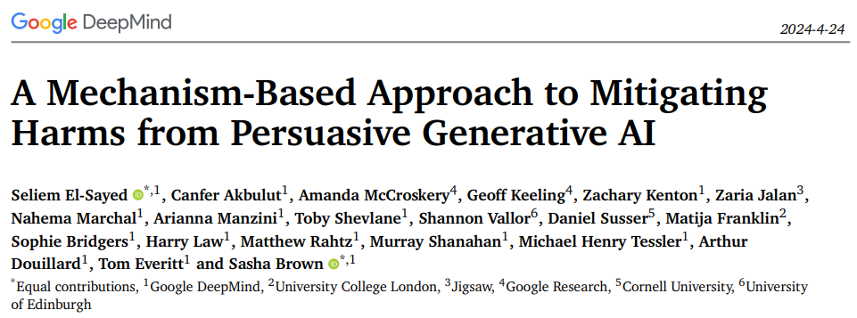
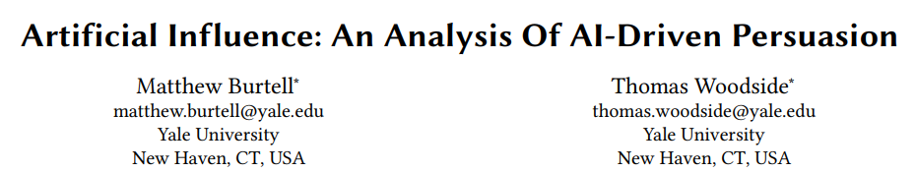
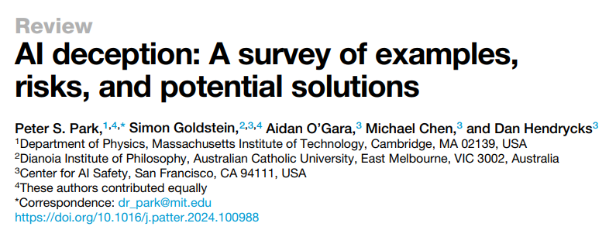
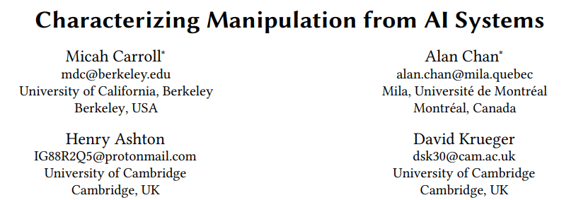
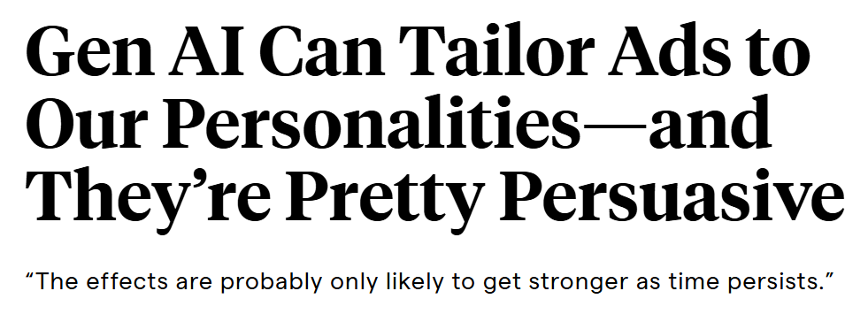
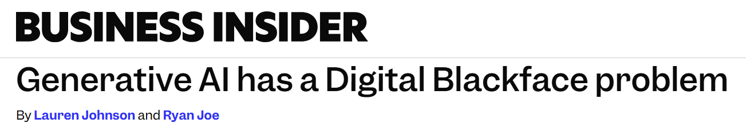
AI Persuasion
Imagine every time or accessed information online the information was presented to you in the form mostly likely to alter your political opinions or consumer preferences
The existence of such capabilities incentivizes authoritarian capture of online information access platforms
Massive amounts of user behavior data from surveillance capitalism
Generative AI’s capability to produce persuasive language and visualizations
Effective tools for mass manipulation of public consumer preferences and political opinion
Our ability to align generative AI models towards specific values
Mitra, Cramer, & Gurevich. Sociotechnical implications of generative artificial intelligence for information access. Book chapter, 2024.

Slide 42

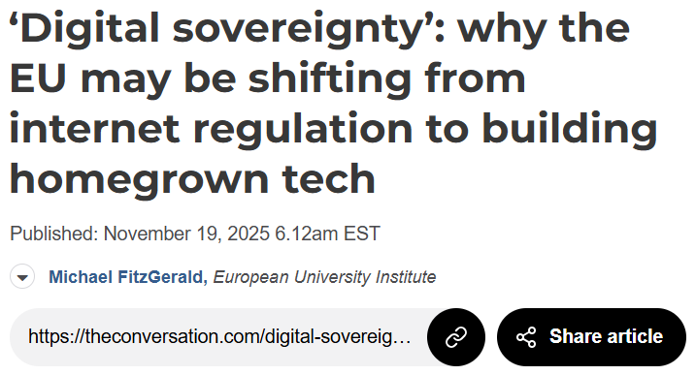
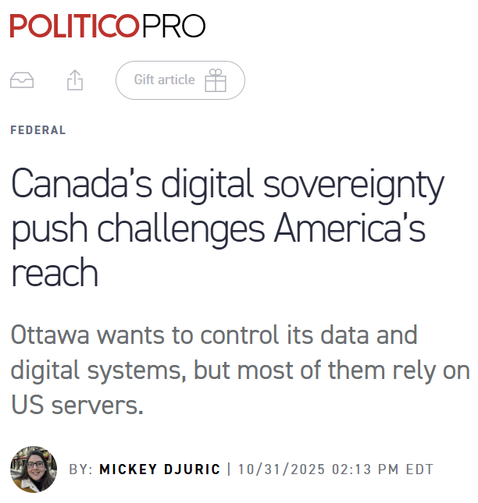
Calls for public platforms and digital sovereignty
However, Eurocentrism is not a meaningful antidote to American Exceptionalism
No search engine is truly open nor reflects the internet in all its diversity if it systemically erases the voices of the global south that represents 85% of the world’s population
Emancipatory IR seeks epistemic justice for the global south and marginalized populations within powerful nation-states
Mitra, Neophytou, and Gururaja. Information Access of the Oppressed: A Problem-Posing Framework for Envisioning Emancipatory Information Access Platforms ✊🏽✊🏾✊🏼. Preprint, 2026.

Slide 43
Open, to what end?
E.g., code, data, models, tooling, compute, labor, and governance
Commodities
Computing has a long tradition of pursuing openness to challenge tech oligopolies (e.g., open source, open AI models)
Within these movements, there is tension of values (e.g., free software vs. open source), and issues of co-option and open-washing by corporations defending their dominance
Openness should not be appraised w.r.t. what is being made open; but rather w.r.t. what capabilities and functionings it affords to those the system is being opened to
Formalized using Amartya Sen’s Capability-Theory from welfare economics
Depends on both the commodities being made open and actor-specific circumstances
Capabilities
(to function)
Functionings
E.g., critique, copy, and co-opt and co-construct
E.g., digital sovereignty, meet underserved needs, market competition, open science, social justice, emancipation, and democracy
Well-beings
Sen. Commodities and Capabilities. Oxford university press, 1999.
Neophytou and Mitra. Open, to What End? A Capability-Theoretic Perspective on Open Search. Preprint, 2026.

Slide 44
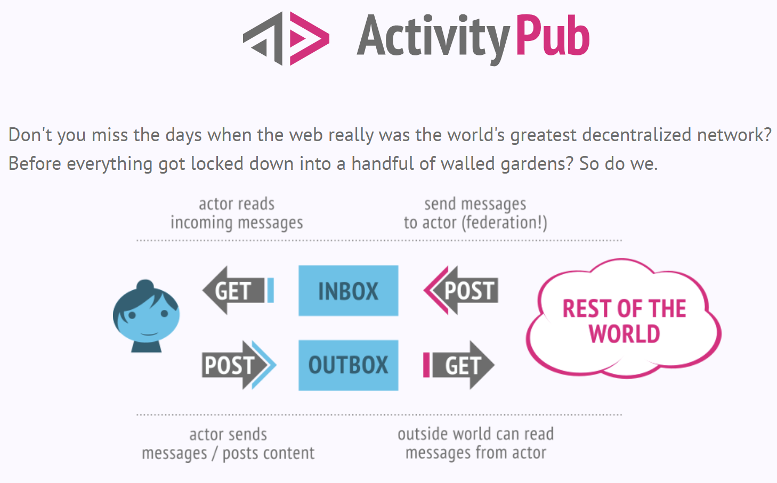
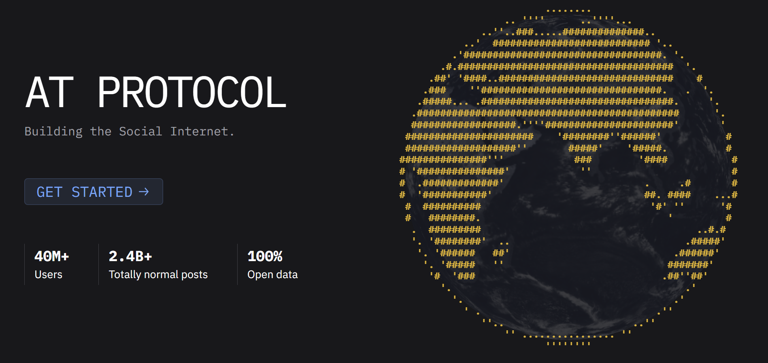
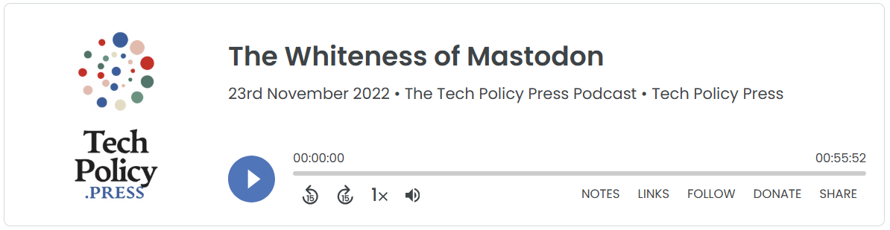
What is the alternative information access infrastructure that we must reimagine and realize in practice as a form of mitigation for authoritarian capture of IA platforms?
In the social media landscape, decentralization has emerged as a dominant strategy to safeguard against capture
But beyond technological decentralization, we need decentralization and democratization of our social infrastructure for governance and moderation

Slide 45

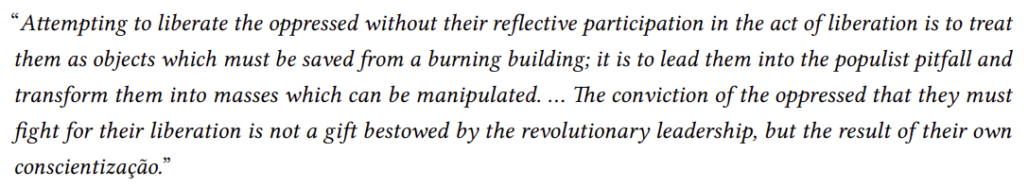
Problem-posing framework for emancipatory IR
Beyond participatory design, challenging the technologists-as-liberator frame by structurally exposing spaces for community members to co-opt and co-construct the technology in aid of their emancipatory struggles
No user involvement
Implicit user feedback
User consultation
Participatory design
Co-option and co-construction
More user agency
Mitra, Neophytou, and Gururaja. Information Access of the Oppressed: A Problem-Posing Framework for Envisioning Emancipatory Information Access Platforms ✊🏽✊🏾✊🏼. Preprint, 2026.

Slide 46


https://jedi.inertial.science/sigir2026
Check out our call-for-presentations and don’t forget to follow us on Bluesky and Mastodon

Slide 47

“The exercise of imagination is dangerous to those who profit from the way things are because it has the power to show that the way things are is not permanent, not universal, not necessary.”
– Ursula K. Le Guin
bhaskar-mitra.github.io
@bmitra.bsky.social
bhaskar.mitra@acm.org
Notes:
Thank you.

