Slide 1
1. mean reversion Mean reversion strategy is based on the concept that the high and low prices of an asset are a temporary phenomenon that revert to their mean value (average value) periodically. Identifying and defining a price range and implementing an algorithm based on it allows trades to be placed automatically when the price of an asset breaks in and out of its defined range
Note:
Moving average is calculated for every 20 ticks(records)
Returns are calculated as (amount received as profit/amount invested)
Algorithm:
if
1.02 * current price < moving average < 1.05 * current price
Then place a buy order
And all the short positions should be covered for profit booking
Because it is the lower position for short bands
or moving average < 0.8 * current price
Then also place a buy order
Because it is the initiation of uptrend and it is going to be a larger band

Slide 2
elif .95 * current price > moving average > .9 * current price then sell all the holdings and short the position as it is the upper position of the short band or moving average > 1.05 * current price then also sell the holdings because it is going to be down trend
FEATURES OF ALGORITHM:
Time complexity:
(number of sell + number of buys)
i:e O(m + n)
Space complexity:
(data of each traded day)
i:e O(d)

Slide 3
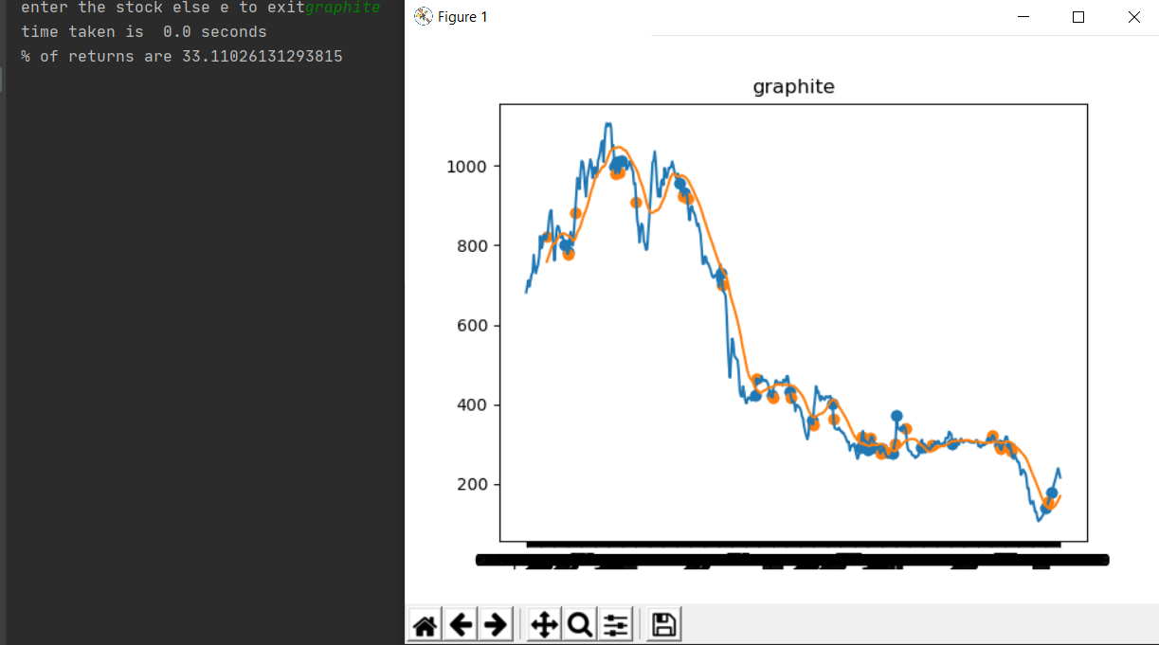
Implementation
This the mean reversion implementation on last two year data of the stock “Graphite India”.(blue dots are buys and orange dots are sell)

Slide 4
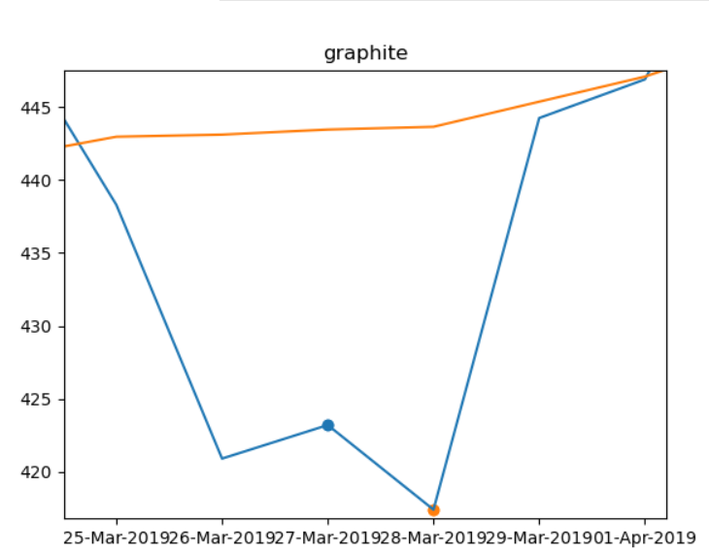
This is a zoomed part of above graph for explaining the algorithm

Slide 5
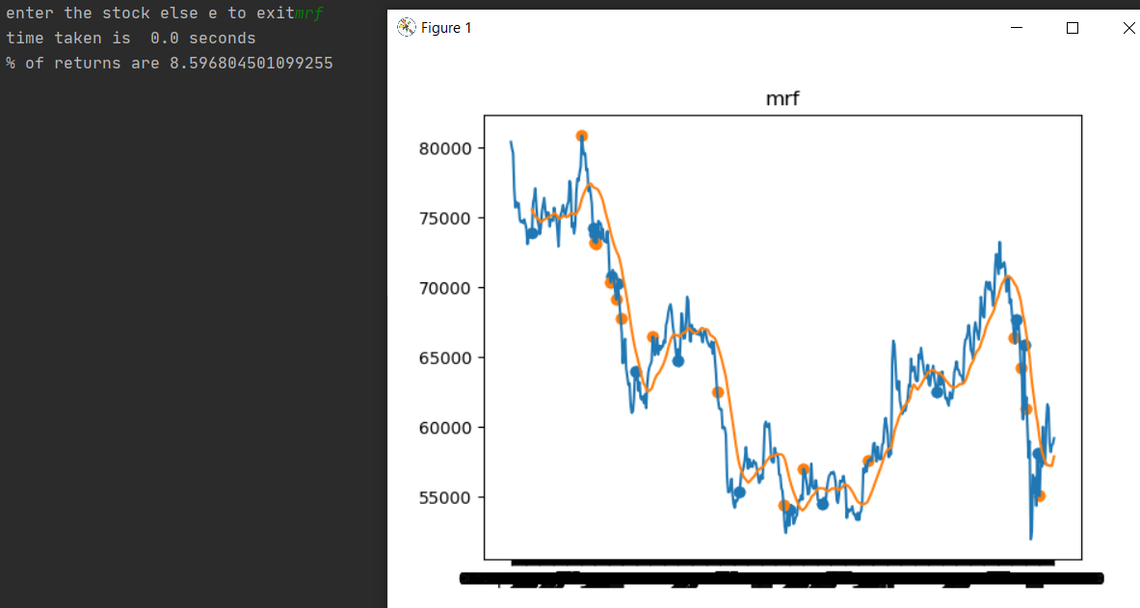
Some Other TEST CASES
1. MRF

Slide 6
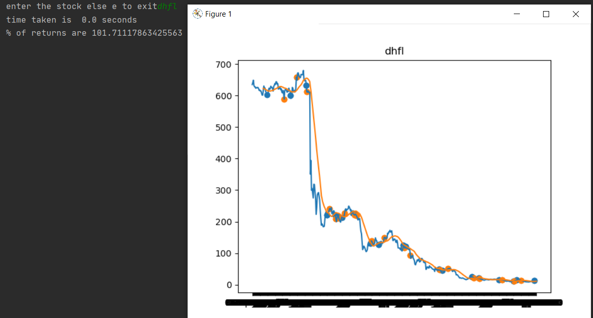
2.DHFL

Slide 7
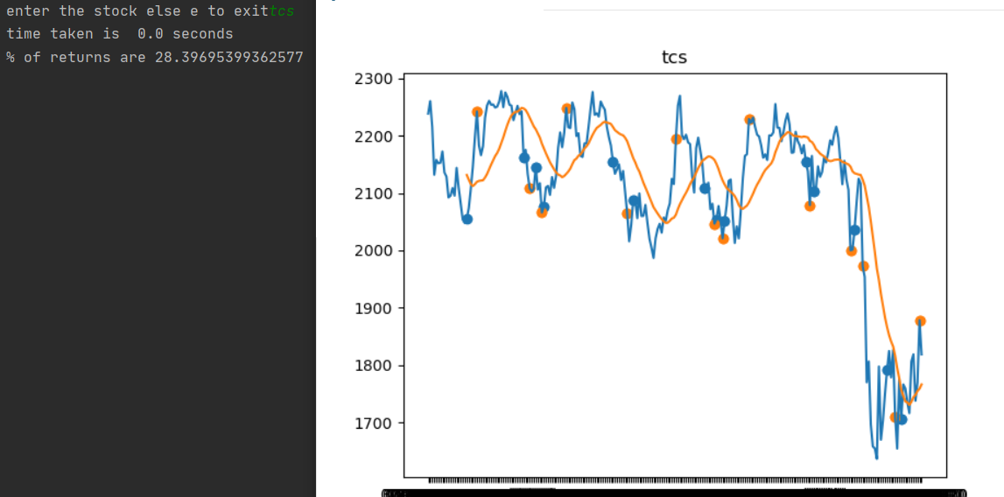
3.TCS

Slide 8
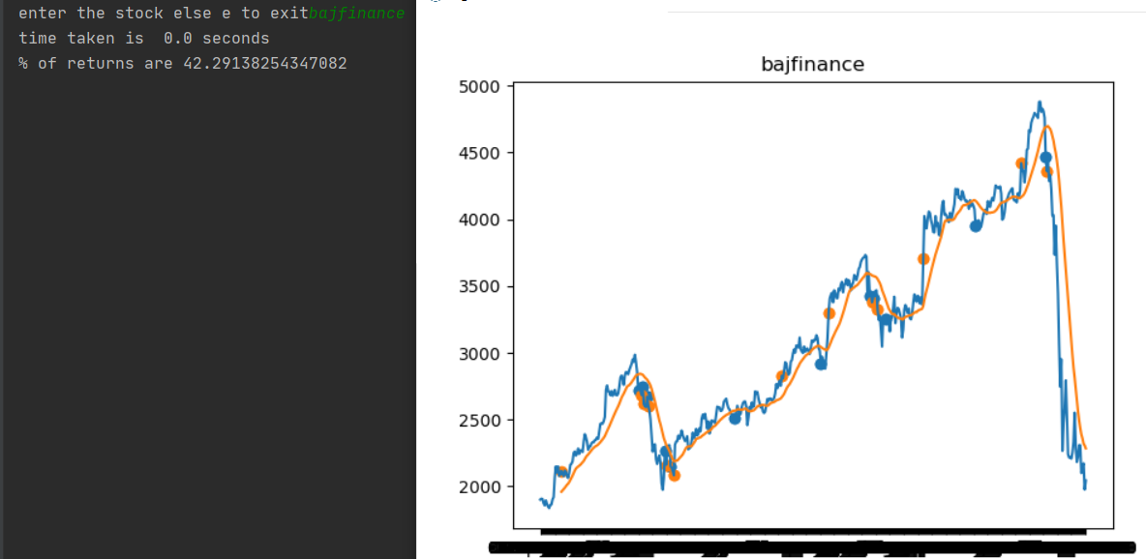
4.BAJFINANCE

Slide 9
2.Volume Weighted Average Price Volume-weighted average price strategy breaks up a large order and releases dynamically determined smaller chunks of the order to the market using stock-specific historical volume profiles. The aim is to execute the order close to the volume-weighted average price (VWAP)
ALGORITHM:
vwap=averageprice= E (price*volume)/ E volume
If vwap of 5d crosses 20d vwap then place the order
if vwap[5d]>vwap[20d]:
Then its a buy
else: it will be a sell
FEATURES OF ALGORITHM:
Time complexity:
(number of sell + number of buys)
i:e O(m + n)
Space complexity:
(data of each traded day)
i:e O(d)

Slide 10
IMPLEMENTATION
NOTE:
RED line denotes “Mark To Mark” price
GREEN line denote 5 days volume weighted average price
YELLOW line denotes 20 days volume weighted average price
ORANGE dots are SELL
BLUE dots are BUY

Slide 11
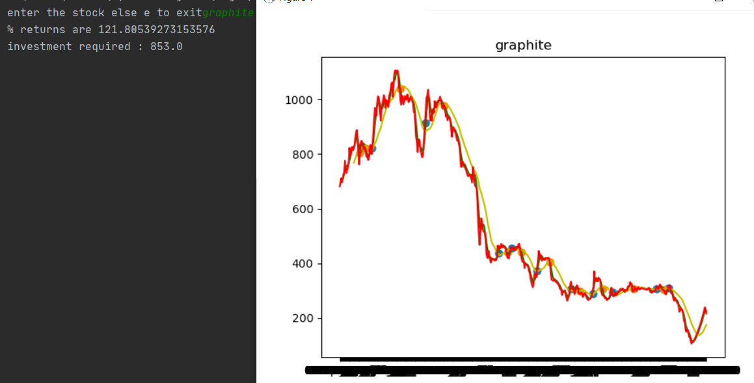
This the vwap implementation on last two year data of the stock “Graphite India”.(blue dots are buys and orange dots are sell)

Slide 12
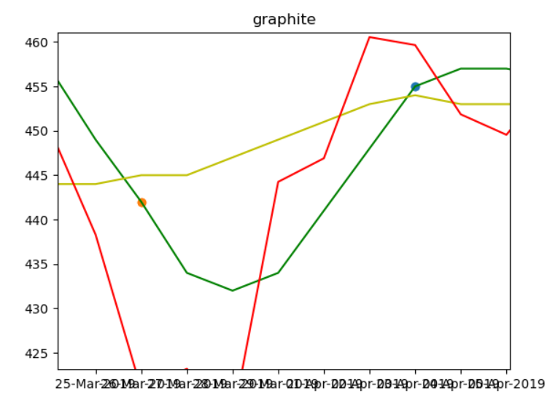
This is a zoomed part of above graph for explaining the algorithm

Slide 13
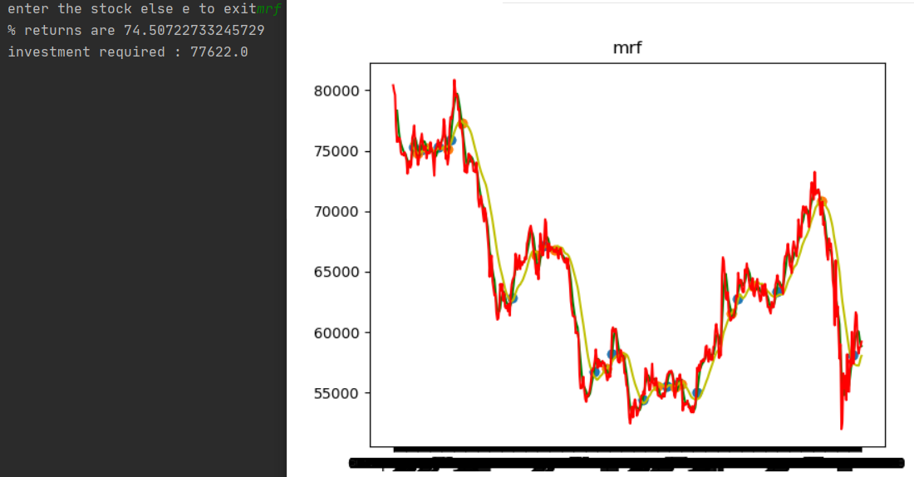
Some Other TEST CASES
1.MRF

Slide 14
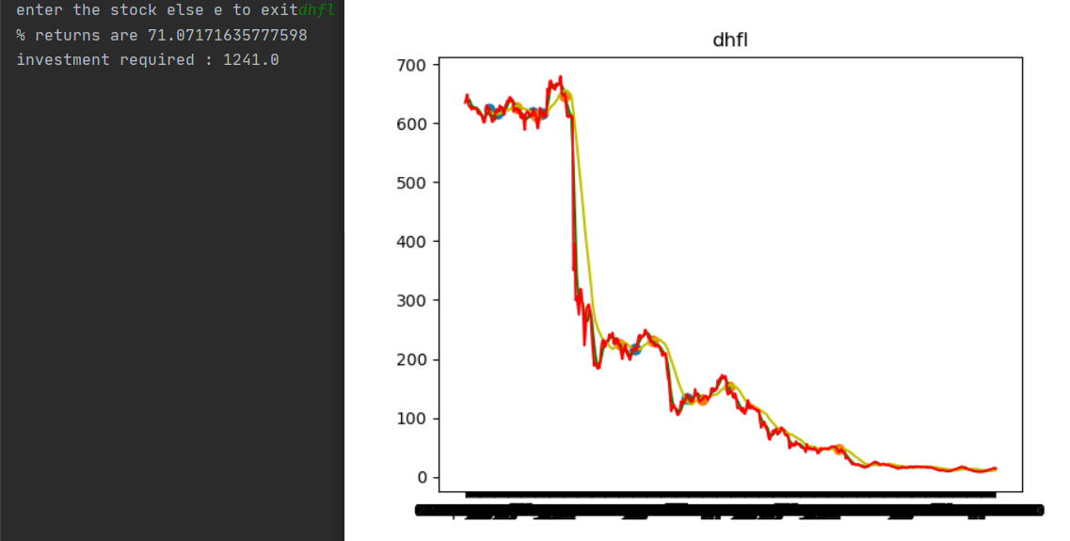
2.DHFL

Slide 15
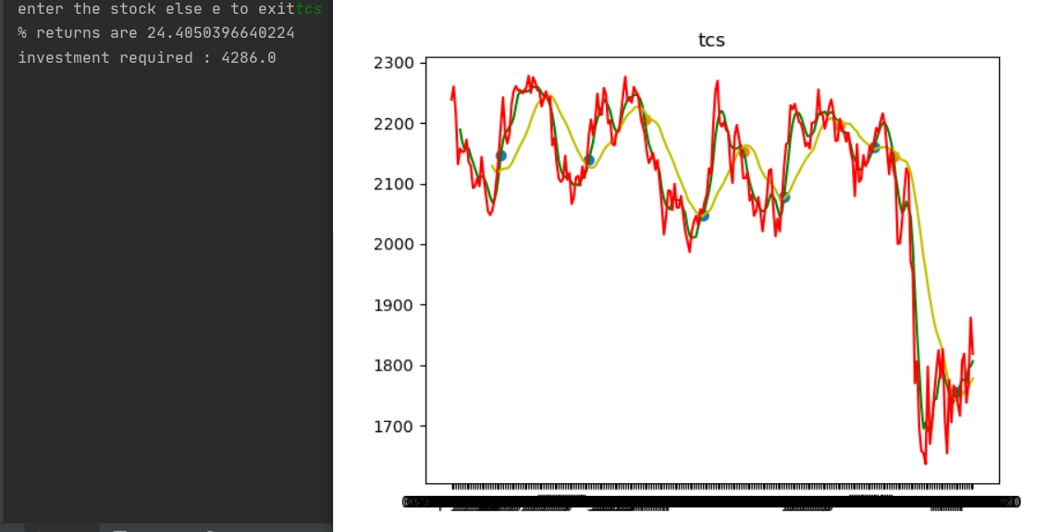
3.TCS

Slide 16
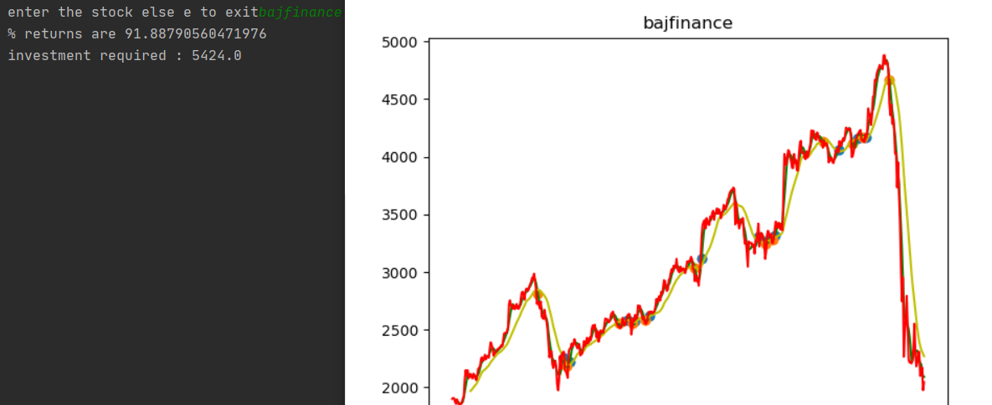
4.BAJFINANCE

Slide 17
3.Bid Ask Spread In option chain put writers are those who ask for a premium to purchase the share at the strike price to them if the price goes down and call writers are those who ask for a premium to buy the share at the strike price if the price goes up. The differences of rates at different strike prices can provide us non-risky profitable trades
NOTE:
We are studying trade only on data of puts of option chain of expiry 14th may 2020
ALGORITHM:
Diff=0
While diff != n + 1:
Rate1=rate at strike price x
Rate2=rate at strike price x + diff
Rate3=rate at strike price x + 2 * diff
Diff++
If Rate1 + Rate3 < 2 * Rate2:
Then
Profit += 2 * Rate2 – Rate1 – Rate3
FEATURES:
Time complexity:
O(n^2) where n is the number of strikes
Space complexity:
O(n)

Slide 18
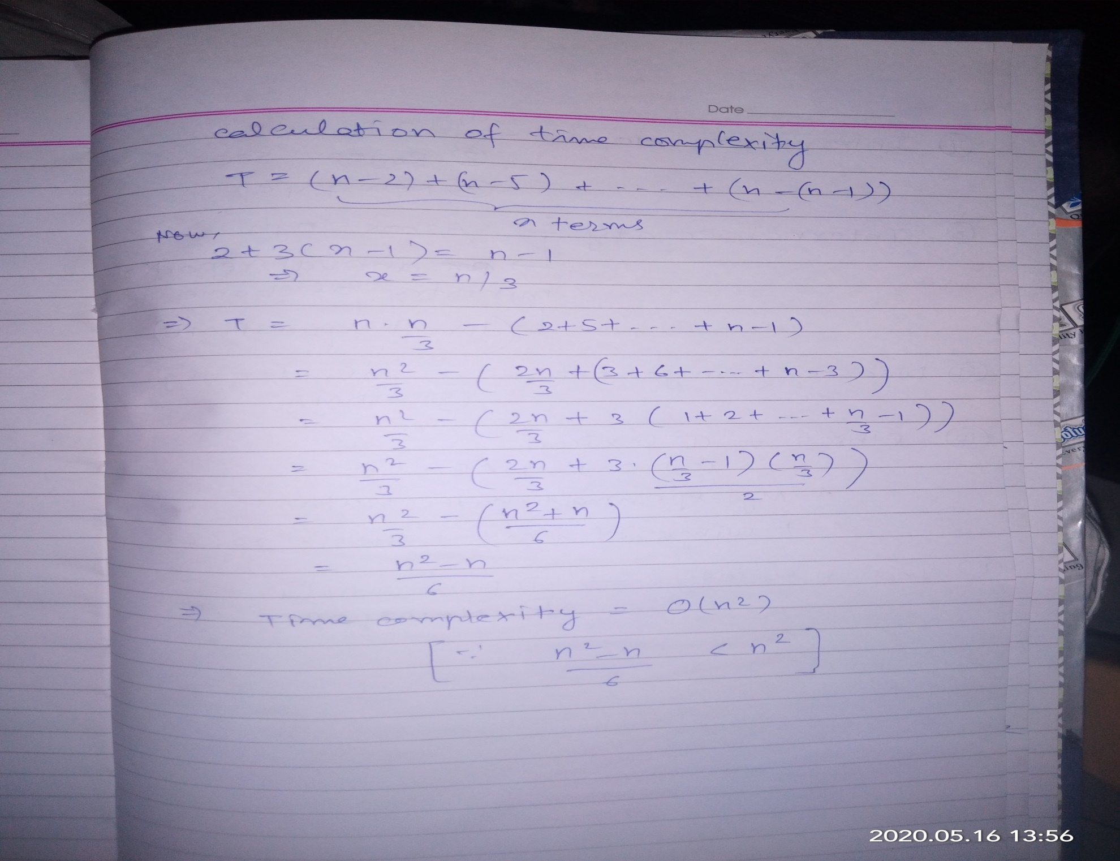

Slide 19
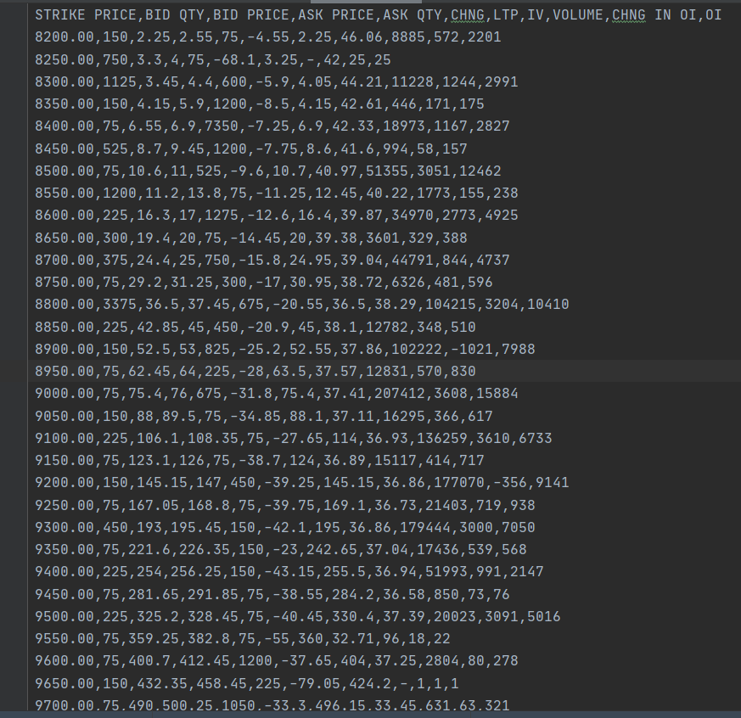
Puts data of nifty for 14th may 2020 expiry on 11th may 2020

Slide 20
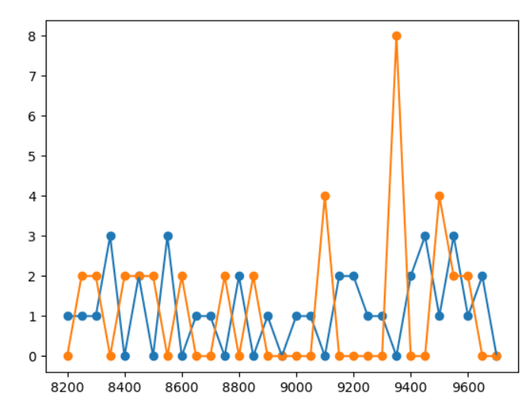
Suggested number of buys(blue) and sells(orange) at different strike rates for profit

Slide 21
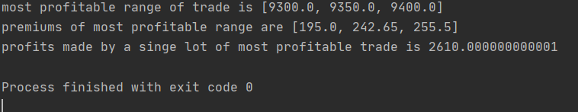
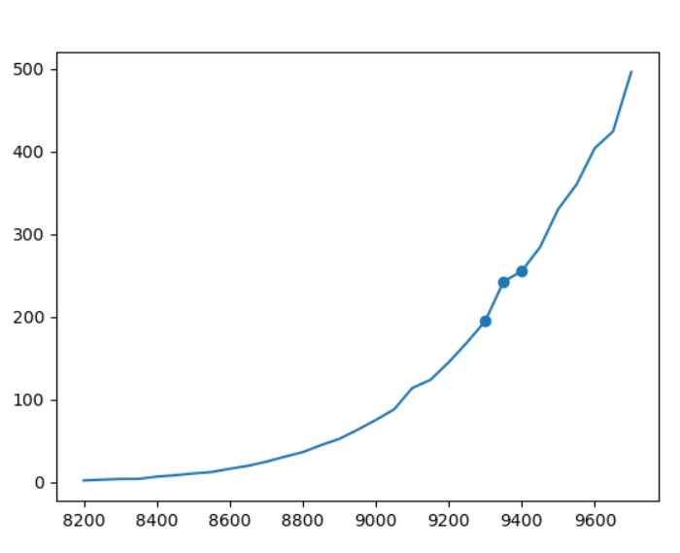
Strike prices with their premium and maximum profit trade

Slide 22
REFERENCES:
https://www1.nseindia.com/
https://financialmodelingprep.com/developer/docs/
https://www.investopedia.com/

