Slide 1
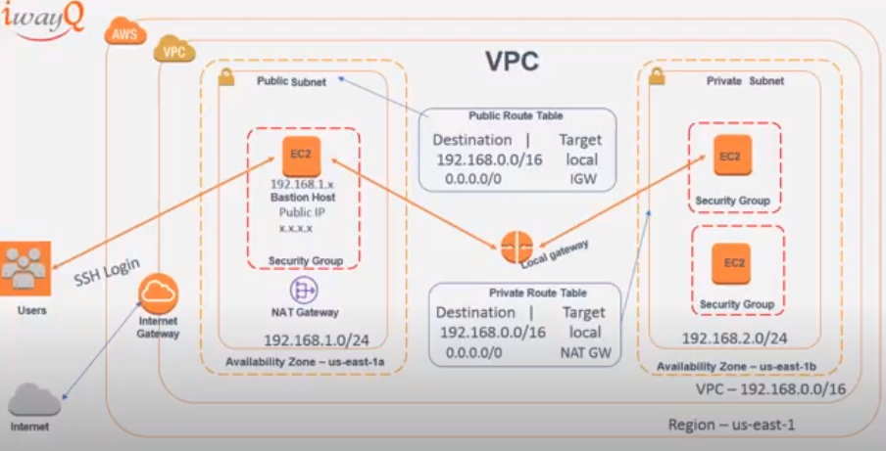

Slide 2




Availability Zone
Security group

