Slide 1
Convolutional Neural Networks

Slide 2
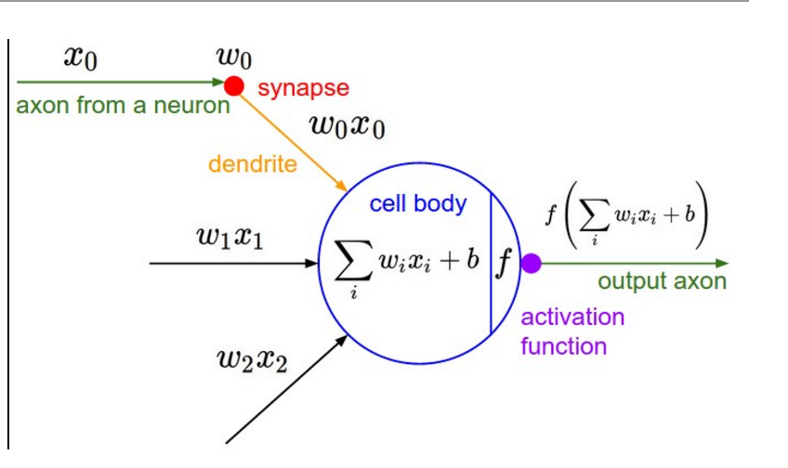
Introduction: Differences With Regular Neural Nets
The fundamental unit of these networks, the neuron/perceptron, remains unchanged. It receives inputs which can be thought of as a vector (x0, x1, x2,...) and computes the dot product with the weight vector (w0, w1, w2, …), and saves this dot product in a number, call it A. We then apply a non-linearity to A (several to choose from), and save it into B. Then, B is returned in the form of the “firing rate” of the neuron/perceptron.

Slide 3
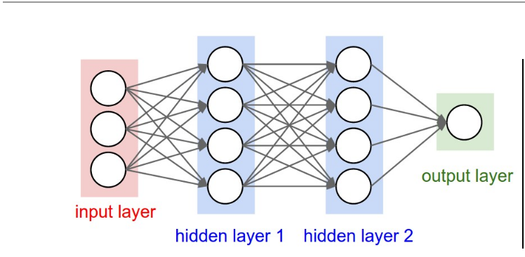
Introduction: Differences With Regular Neural Nets
So how are convolutional Neural Networks different?
The answer is that these convolutional networks are specifically made for image recognition.
An image with dimensions H x W x C would need that number of weights per neuron, causing the traditional model to be slow and bulky, not to mention possibly over fit the data.

Slide 4
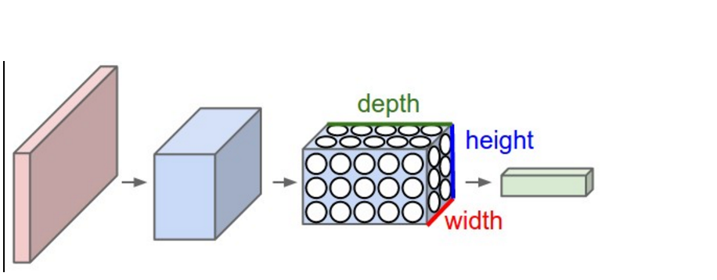
Introduction: Differences With Regular Neural Nets
Convolutional Neural Networks take advantage of the fact that input can be thought of as 3 dimensional inputs. (height, width, color channels).
The extent of the connectivity along the depth axis is always equal to the depth of the input volume. It is important to emphasize again this asymmetry in how we treat the spatial dimensions (width and height) and the depth dimension: The connections are local in space (along width and height), but always full along the entire depth of the input volume.
The use of filters and partial connectivity from one layer to the next allow the same if not better performance while being exponentially more efficient.

Slide 5
Architecture Of Convolutional Neural Nets
INPUT Layer: [H x W x C] with raw pixel values.
CONV Layer: Consists of filters that compute the convolution of the image with a learned weight vector.
RELU Layer: Element - wise activation function, such as the max(0,x) thresholding at zero.
POOL layer: Down sampling operation along the spatial dimensions.
FULLY CONNECTED layer: Compute the class scores and return the probabilities for classification for each potential class. This is where we have our loss function and where we are minimizing it.

Slide 6
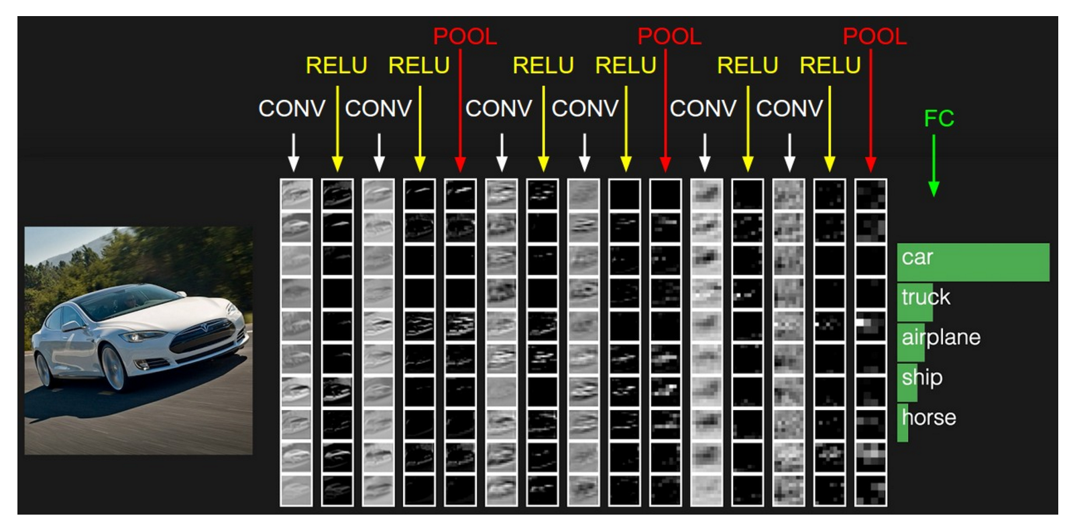

Slide 7
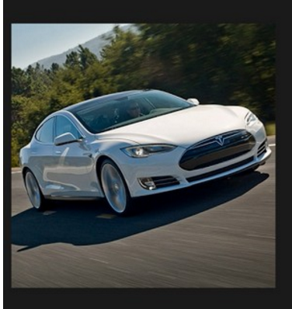
Layers In Detail:
We will follow a 32 x 32 x 3 image of a car through the convolution net and look at its transformations along the way.

Slide 8
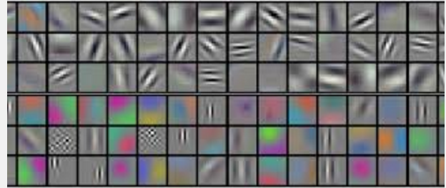
Layers In Detail: Convolution Layer
Some hyper parameters in this step include the number of filters (K), the spatial extent of the filters (F), the stride (S), and the amount of zero padding (P).
While these parameters are best trained by cross validation, for our case, we will choose K = 12, F = 5 x 5 x 3, S = 1, P = 0.
Note that for parameter F, we can only choose the width and height of our filters, but they will always extend through the depth of the image.
Now we will begin the process of training our filters to recognize certain characteristics of an image.

Slide 9
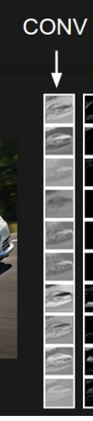
Layers In Detail: Convolution Layer
Each of the 5 x 5 x 3 filters slide across the width and height of the image, and compute the dot product of that section of the image with the filter.
In this sense, this operation is a convolution.
Since our stride size is 1, we can obviously see that each filter will create a 28 x 28 x 1 activation map, and since have 12 of these filters, if we stack all of these activation maps, we have our output volume from this layer to be 28 x 28 x 12.
We had 0 zero-padding, but if we did, then each activation map would be surrounded by 0’s on the sides.

Slide 10

Layers In Detail: RELU Layer
This layer we simply threshold each of the values at 0 (which would be important if our filters in the CONV layer had negative weights).
This is one of several element-wise activation functions possible. This leaves the volume unchanged, and we are still at 28 x 28 x 12.

Slide 11
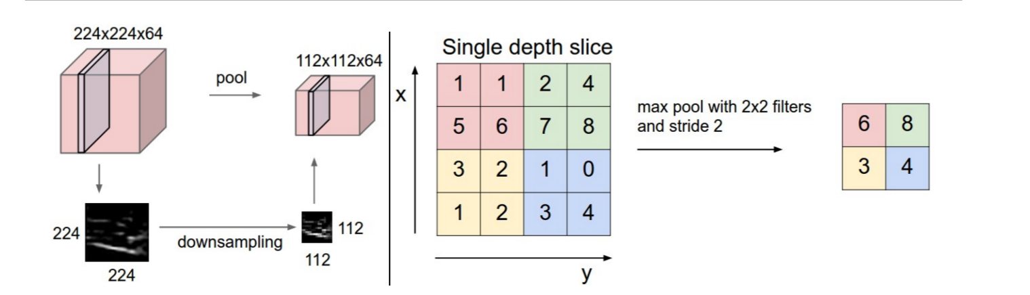
Layers In Detail: POOL Layer
The most common type of pooling is MAX – Pooling over a 2 x 2 block.
We simply look at each 2 x 2 block in each activation map, and choose the largest value in each block. This reduces the size of the activation maps.

Slide 12
Layers In Detail: FC Layer
After a max pool, our volume will now be 14 x 14 x 12. We follow this with another layer of convolution, and another pooling layer. The resulting volume will be 5 x 5 x 12.
Now we have a layer with the weight vector having 5 x 5 x 12 = 300 components and neurons connecting to every portion of the 5 x 5 x 12 volume.
Suppose we have to classify these into one of R classes, then the matrix multiplication will result in a R x 1 matrix holding the “scores” for each possible class. We then normalize these scores and output the most probable classification of the image.

Slide 13
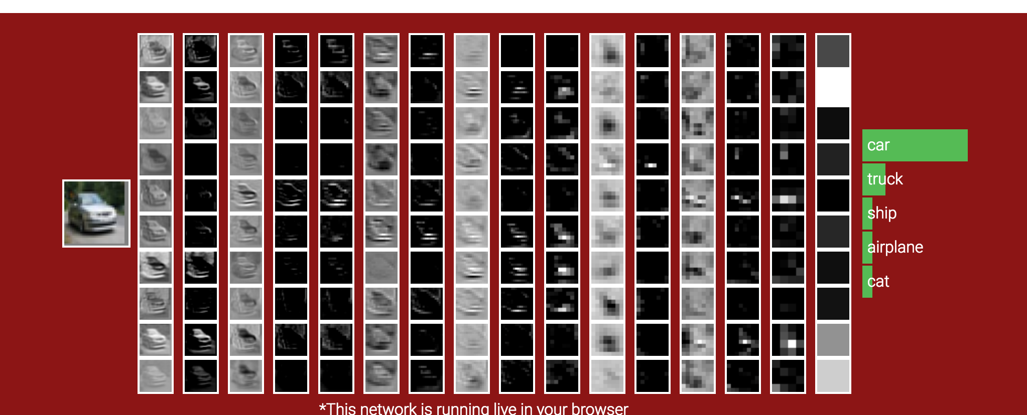

Slide 14
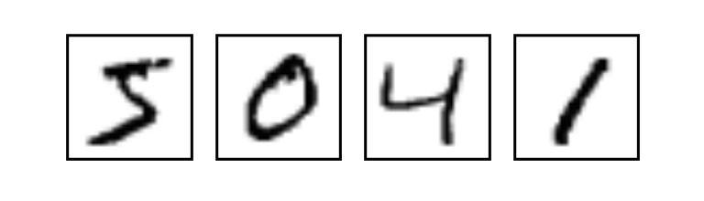
Tensor Flow And CNNs
Now we will use the MNIST data set of hand written digits and see how well our convolutional neural network does in classifying the numbers.
Each image is 28 x 28 x 1.
The accompanying code in TensorFlow will also be shown, but the logic present is universal and not specific to TensorFlow.

Slide 15
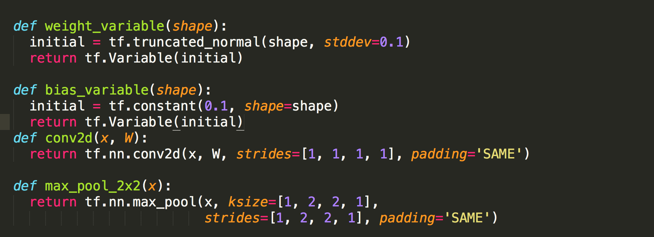
Tensor Flow And CNNs: Functions

Slide 16
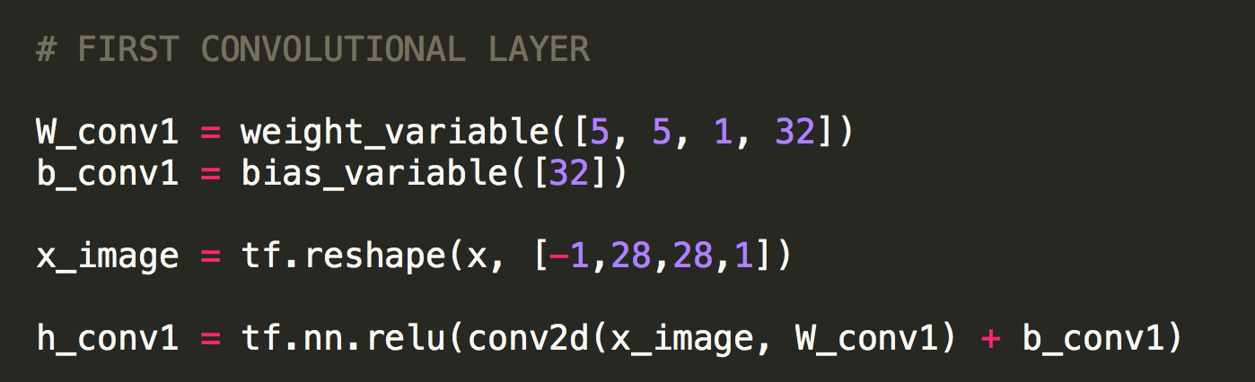
Tensor Flow And CNNs: Layer 1

Slide 17
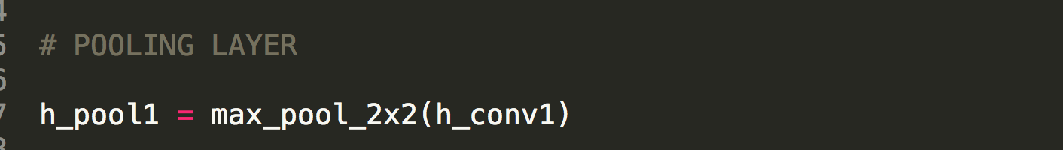
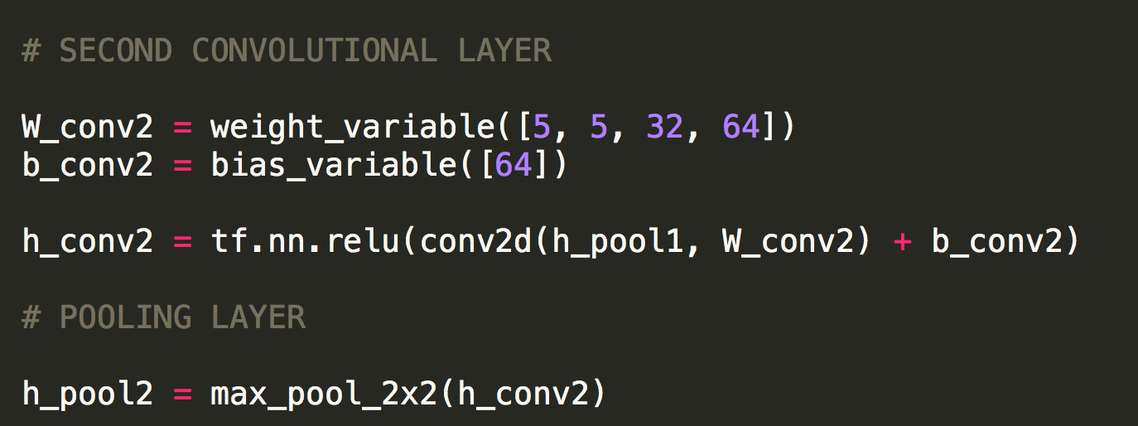
Tensor Flow And CNNs: Layer 2 - 4

Slide 18
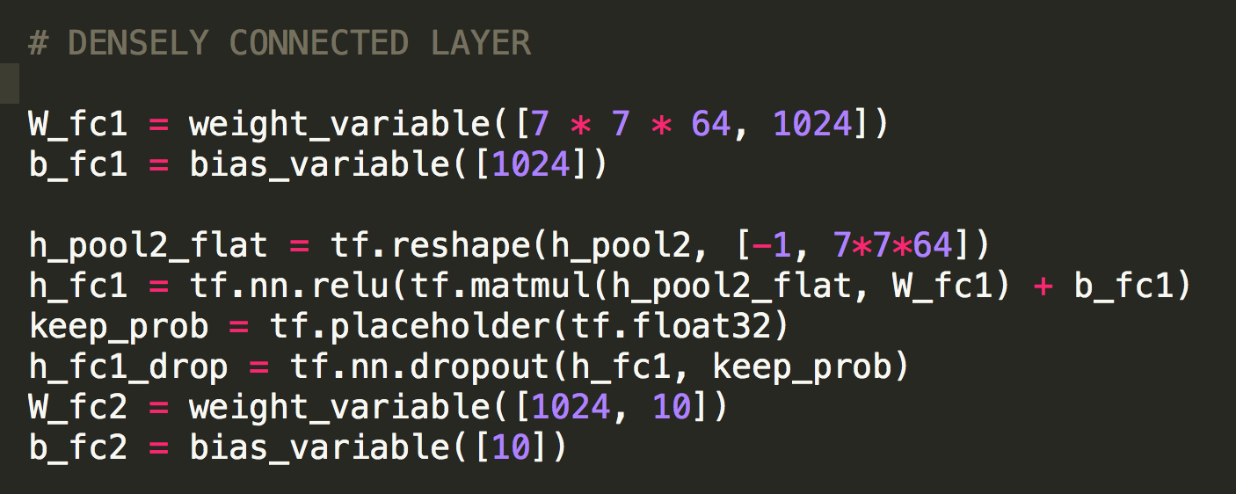
Tensor Flow And CNNs: Layer 2 - 4

Slide 19
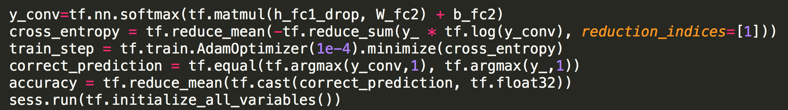
Tensor Flow And CNNs: Layer 5

Slide 20
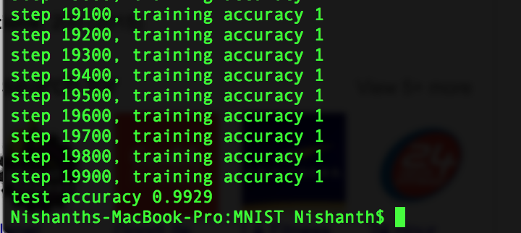
Tensor Flow And CNNs: Results

Slide 21
Summary
Convolutional networks are specifically made for image recognition.
The connections are local in space (along width and height), but always full along the entire depth of the input volume. This allows the network to detect spatial patterns.
Convolutional networks have several important layers, but the fundamental perceptron is the same, and we still have a loss function that we are minimizing.
Highly efficient and accurate results in image recognition can be obtained using these networks.

