Slide 1

BUG TRACKING APPLICATION

Slide 2

Problem Statement
Client
Eureka Server
API Gateway
JWT Security
User
Employee Service
Project Service
Bug Service
Conclusion

Slide 3

Problem Statement
To Create an Application for bug tracking
Employees should be able to view the list of bugs which are open, closed and in progress.
Users should be able to create the bugs.
Admin should be able to perform below operations:
1. Employee Management Module
2. Bug management Module
3. Admin Module
4. Project Module
5. Login Module

Slide 4
Modules
Employee Module
Bug
Management Module
Project Module
Login Module

Slide 5
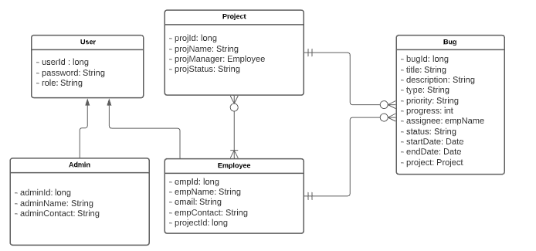
Class Diagram

Slide 6
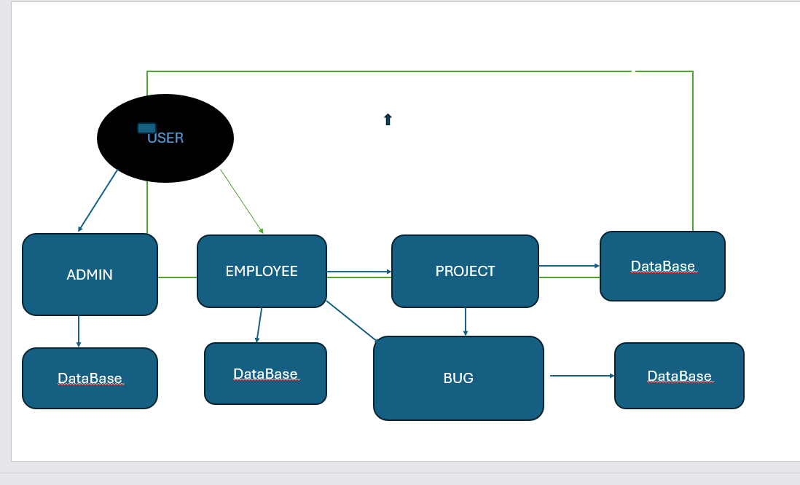
UseCase Diagram

Slide 7
Sequence Diagram
User
Admin
Employee
Project
Bug
Login
Login
Create Employee
Create Project
Create Bug
Fetch Project
Assigned Employee
Bug can Access the Project
Bug can Access the Employees
Log In/Log Out

Slide 8
Database Diagram
Project
Employee
Bug
projectId
projectName
projectManager
status
Employee
employeeId(PK)
employeeName
employeeContact
ProjId
bugId(PK)
title
description
priority
status
EmployeeId(PK)
startDate
endDate
projectId(FK)
User
userId(PK)
username
email
Password
role
Admin
adminId(PK)
adminName
Email
contactInfo

Slide 9
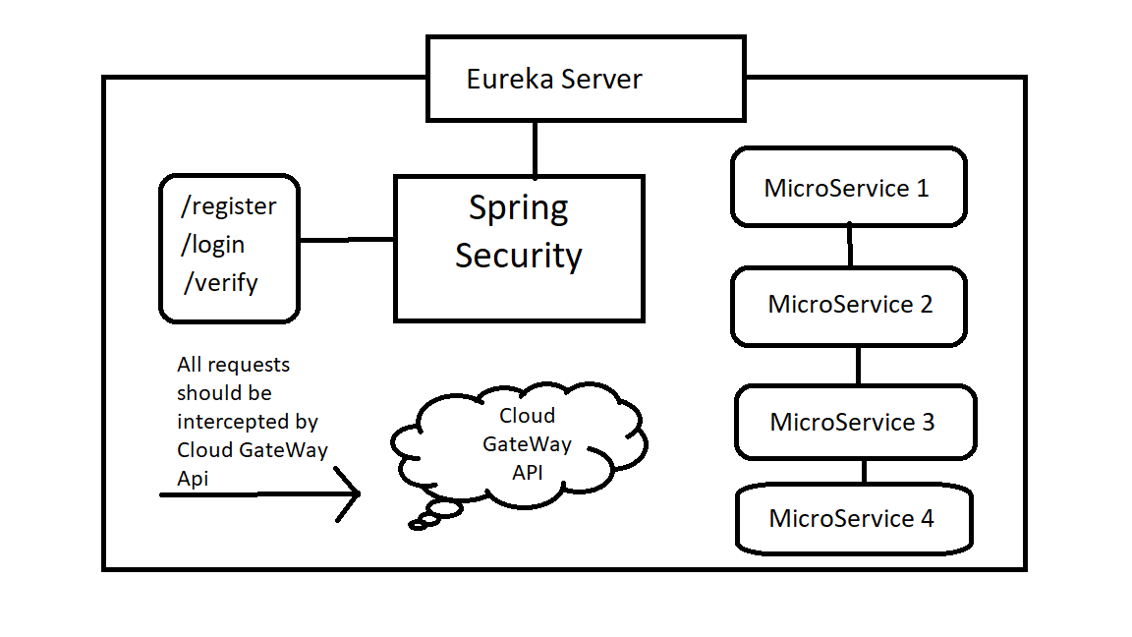

Slide 10
Purpose of the project
•Bug Tracking System is to test the application for the bugs and report it to the project manager and developer.
•The main intention behind the Bug Tracking System is that to track bugs and report them.
•Store the bug information with a unique id in the database.

Slide 11
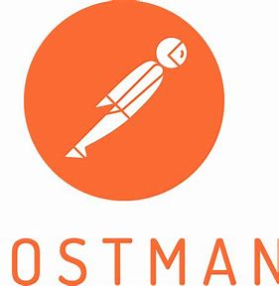
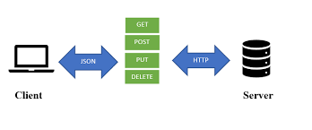
Client
In this tool, nearly any functionality that any developer may need is embedded. This tool has the ability to make various types of HTTP requests like GET, POST, PUT, PATCH, and convert the API to code for languages like JavaScript.

Slide 12

Conclusion
▪Bug Tracking System helps to detect and manage the bugs in software products effectively .
▪
▪This project BTS can be used to track the bugs in the project modules and assist in troubleshooting errors for testing and for development processes .
▪
▪Thisproject highly avoids all sources of delay in bugs reporting level within the project modules in the software industry . As application is deployed in a company server , it is more secure .

