Slide 1
Roller Coaster Project
A Final Project Presentation
By Bhaskar Bhattacharya
ME 557 – Dr. James Oliver

Slide 2
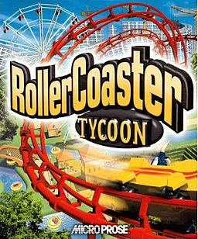
Motivation
Couldn’t get a First Persons View of riding the Rollercoaster

Slide 3
DEMO

Slide 4
OpenGL Features Implemented
Animation
  TimerFunc
  Quaternions + LERP
  2D on the fly check (lighting for effect)
Lighting
  5 lights (4 spot and 1 directed)

Slide 5
Contd..
  Transparency (Transparent base)
Interaction
  QT GUI
  Mouse zoom + movement
Extra
  Billboards

Slide 6
Contd…
Models
  Various models self made in OpenGL (sum of small cylinder pieces)
    Straights, Ups, Downs, Turns

Slide 7
Questions?

Slide 8
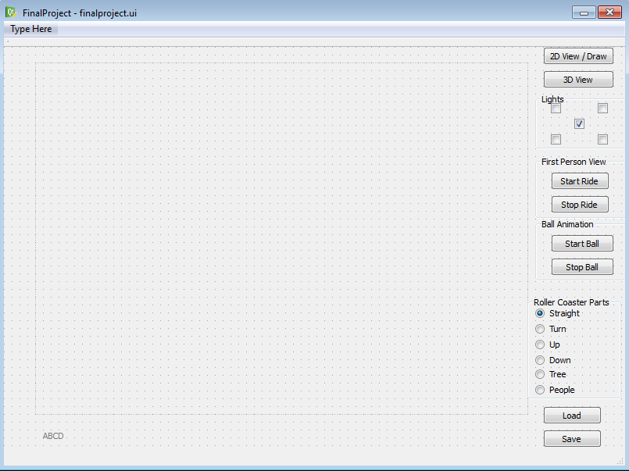
Interface

Slide 9
Features
Different views
Different lighting arrangements at different positions
First person view animation
Third person ball animation

Slide 10
Features
Addition of various parts + billboards
Addition of parts can only be done if valid (red highlight) , invalid (blue highlight)
Use mouse to add parts, scroll for different orientations
Loading and saving of coaster(only 1 file)

Slide 11
Features
Transparent base while riding

