Slide 1

AstroSage Call Center Performance Analysis
Data – Driven Insights & Recommendations

Slide 2
Problem Statement
You are tasked with optimizing the call center operations for AstroSage, which has received a 1 crore investment.
The goal is to determine how to allocate this investment to maximize operational efficiency, customer satisfaction, and profitability.
This project will involve analyzing historical call data, performance metrics, and market trends to make informed decisions.

Slide 3
Data Cleaning Process
Copied raw data to a new sheet and renamed the sheet as 'CLEANED DATA’
Removed unwanted columns and added date / time split
Handled missing values by filing the values using IF(ISBLANK() )
Added computed columns and named them as repeatedUser , repeatedCalls , repeatedChats
Removed duplicates and applied filters
Formatted table and applied filters and later Applied table formatting

Slide 4
Dataset Overview
Total Tables: 1 (AstroSage_analysis)
Total Attributes: 37
Categorical Columns: 15
December has highest call volume, January lowest
Repeat users = 72%
Correlation between duration & rating = -0.0002
Guru with highest satisfaction: Astro Pujaa Rai
Daily call trends, agent performance
Revenue & cost per channel
Customer satisfaction analysis
Repeat behavior and technology investment

Slide 5
Daily Call Volume Analysis
APPROACH USED
The average daily call volume is 246.
On 10/12/2023 there was highest call volume i.e. 430 with DECEMBER month HIGHEST CALL VOLUME MONTH.
On 03/01/2024 there was lowest call volume i.e. 107 with JANUARY month HIGHEST CALL VOLUME MONTH
Call centre receive approx. 226 calls per day but only 40.42% of calls gets complete in total from astrologer side.
RECOMMENDATION
There is a need of hiring new skilled agents and freelancers to manage the workload of existing agents.

Slide 6
Astrologer Performance Ratings
APPROACH USED
Tarot Mystical (Guru id – 305) got the highest rating score of 7.5 out of 8,
Tarot Rittika (Guru id – 80) got the lowest rating score of 0 out of 8
RECOMMENDATION
Professional development and training.
Recognition and reward.
Upgrade technology and tools.

Slide 7
Call Timing and Agent Availability
APPROACH USED Around 8am , the Calls are most made.
Around MID – NIGHT 1am , the Calls are least made.
Approx 660 users calls around 8am.
There are in total 131 Unique Agents based on their UNIQUE GURU ID
RECOMMENDATION
Hire part time or freelancer agents , this reserve agents will balance the workload without increasing permanent cost.
Shift optimization – Optimizing more agents shifts to peak periods accordingly.

Slide 8
Chat Volume Comparison:
DECEMBER AND JANUARY
APPROACH USED
Total chats for December month = 7947
Total chats for January month = 418
Higher Percentage = 95%
Lower Percentage = 5%
RECOMMENDATION
There is a need of hiring new skilled agents and freelancers to manage the workload of existing agents.

Slide 9
Customer Ratings Overview
APPROACH USED
Average ratings for January Month = 2.676413255
Average ratings for December Month = 2.949637572
Both months have a very low rating.
RECOMMENDATION
Professional development and training.
Clear performance metrics.

Slide 10
User Engagement Analysis
APPROACH USED
Total users for December month = 26488 .
Total chats for January month = 1539.
Higher Percentage = 94.50%
Lower Percentage = 5.50%
RECOMMENDATION
Shift optimization – Optimizing more agents shifts to peak periods accordingly.

Slide 11
Call Completion and User Response Breakdown
APPROACH USED
Only 41% users call get completed.
20% of user didn’t get any answer.
Rest 15% users were busy at the time of call.
While 14% users call get failed.
And last 10% of users call remain incomplete.
RECOMMENDATION
Hire part time or freelancer agents , this reserve agents will balance the workload without increasing permanent cost.
Shift optimization – Optimizing more agents shifts to peak periods accordingly.

Slide 12
Platform Usage and Sales Performance
APPROACH USED
72.163% of users used Gurucool website.
27.830% of users used App.
0.007% of users used Dashboard.
Highest sales generated by App = Rs. 1,25,267.382.
RECOMMENDATION
Gurucool is only one platform which provide the service of the Chat to the users with an average rating of 2.72 , which is the clear indicator of unsatisfied users.
So, it is very necessary to improve technology and provide satisfaction to the users.

Slide 13
Different Revenue for Different Products
APPROACH USED
The 78.69% of the TOTAL Net Amount for the company comes from Call service only with Total revenue = Rs. 2,13,987.3153
The 78.47% of the TOTAL Astrologer Earnings comes from Call service with Total revenue = Rs. 99,146.57095
RECOMMENDATION
So, if the call service is a key revenue driver, investing in training programs would be a strategic move to sustain and enhance that success.

Slide 14
User Rating Distribution
APPROACH USED
Least rating. RATING = 0 with a count of 7256.
Most rating. RATING = 7 with a count of 1824.
Percentage of LOW RATING (0 , 1 , 2 , 3 , 4) = 72.51%
Percentage of BETTER RATING (5 , 6 , 7 , 8) = 27.49%
RECOMMENDATION
Professional development and training.
Recognition and reward.
Upgrade technology and tools.

Slide 15
Analysis of the project
Data-backed insights help optimize agent workload and technology focus.
December outperformed January in most KPIs.
Investment in tech and training promises high ROI.
Customer retention is key – repeat users = 68%.
Data analysis enables better decision-making across operations.

Slide 16
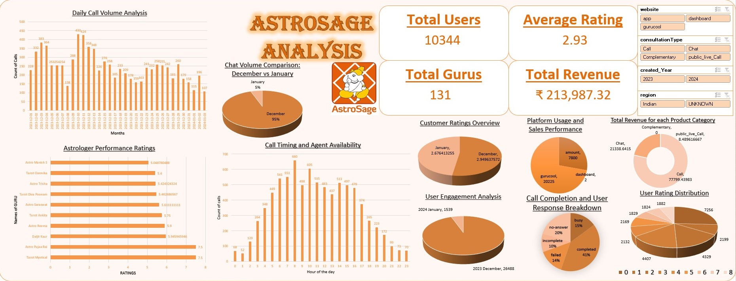

Slide 17
Recommendations
Training vs Hiring
Upgrade Technology & Training preferred
Reasons: Low ratings, failed sessions
Less priority on hiring more agents
Investment Risks & Mitigations
Hiring Risks: Overstaffing, High cost
Training Risks: Cost, Retention
Tech Risks: High upfront cost
Use AVERAGEIFS(), NPV(), FORECAST()
Peak Period Handling Strategy
Identify peaks using COUNTIFS()
Smart staffing at busy times
Introduce Call-Back & Stress Training

Slide 18
Key Metrics for Dashboard
Metrics to track: Calls handled , Avg. Talk Time , Revenue / Call.
Rating used as proxy for customer satisfaction.
Investment guided by data-backed KPIs and ROI analysis.
Total Calls Handled.
Average Talk Time per Session.
Customer Satisfaction Score (Rating).
Revenue per Call, Cost per Call.
Monthly Call Volume Trend.
Technology Utilization and Fail Rate.
Return on Investment (ROI) by Channel.

Slide 19
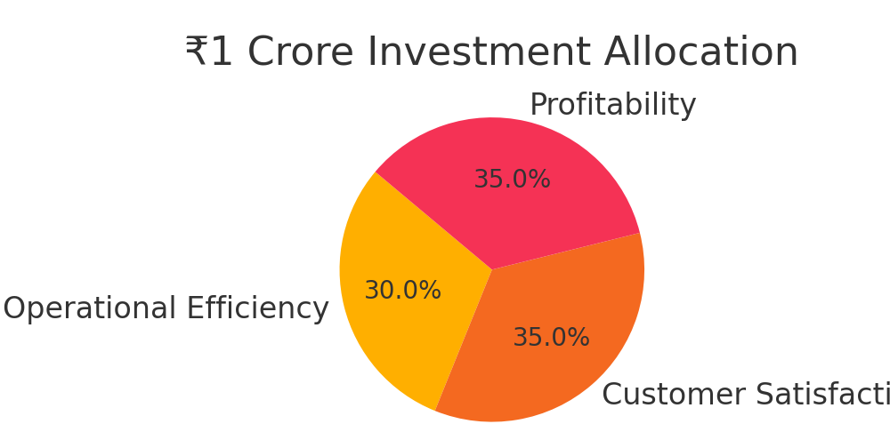
₹1 Crore Investment Allocation Plan
₹30L for Operational Efficiency
(Chatbots, Refund Tracker, Voice APIs)
₹35L for Customer Satisfaction
(Training, Loyalty, 24/7 Support)
₹35L for Profitability
(Ads, Influencers, Dynamic Pricing Tools)
Use: NPV(), ROI formulas to evaluate returns

Slide 20
Key Challenges Identified
High number of incomplete / failed sessions
Low average ratings for some gurus
Lack of region-specific targeting
Operational cost variability across months
Future Recommendations
Adopt AI for smart routing and real-time analytics
Enhance CRM integration for personalization
Implement flexible staffing models for peak hours
Use customer feedback loops for continuous improvement

Slide 21
Strategic Recommendations
Upgrade call center technology to reduce dropped sessions.
Conduct agent training for empathy and stress scenarios.
Use COUNTIFS & AVERAGEIFS to assess incomplete/failed chats.
Introduce call-back system for low-rated sessions.
Reinforce skill development using feedback-based upskilling.
Implement AI-based routing and support tools.
Technology Enhancements
Intelligent Call Routing using AI for better guru-user matching
Conversational AI for Level-1 chat handling (FAQs, refunds)
Real-time Dashboards for live agent monitoring
CRM Integration for personalization & feedback loops
Voice Analytics to detect sentiment and call quality

Slide 22
Conclusion
This project analyzed AstroSage's call center performance using cleaned Excel data. Key findings include high call volumes in December, a large proportion of repeat users (68%), and a weak correlation between call duration and customer satisfaction. Many calls and chats were incomplete, indicating a need for tech upgrades and agent training.
A ₹1 crore investment plan was proposed, focusing on improving operations, customer satisfaction, and profitability through AI tools, CRM systems, and smarter staffing. Overall, data-driven strategies were recommended to enhance service quality, reduce failures, and boost efficiency.

Slide 23
THANK YOU

