Slide 1

COLUMBIA ASIA
HOSPITAL ANALYSIS

Slide 2

PROBLEM STATEMENT
Columbia Asia Hospital aims to leverage data analytics to gain deeper insights into its operations and improve overall performance.
The key focus areas include:
Revenue Analysis: Understanding how different departments contribute to the hospital’s total revenue.
Workforce Planning: Identifying departments that require additional staffing based on patient flow and service demand.
Discount Strategy: Developing effective discount policies to enhance patient satisfaction while maintaining profitability.

Slide 3

OBJECTIVE OF ANALYSIS
The goal of this analysis is to:
Analyze hospital data to uncover key business insights.
Provide data-backed recommendations to help management make informed, strategic decisions.
Build visual dashboards that simplify complex information and support decision-making.

Slide 4
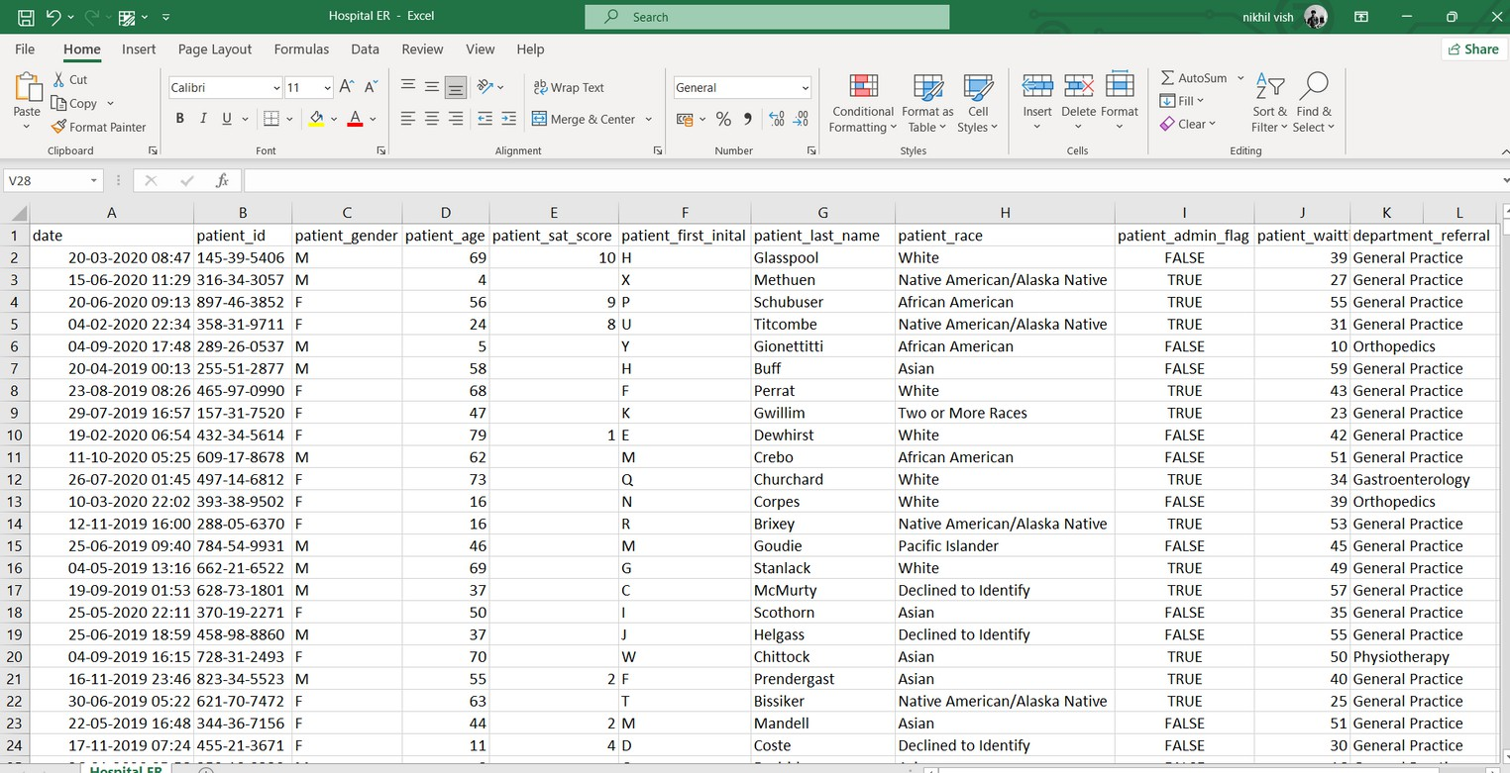
DATA OVERVIEW
The data includes two tables:
doctor_patients_data: Details on doctors, patient visits, fees, and satisfaction scores.
hospital_er: Information on patient demographics,
wait times, and referrals.
Together, they provide a clear view of hospital performance and patient experience.

Slide 5
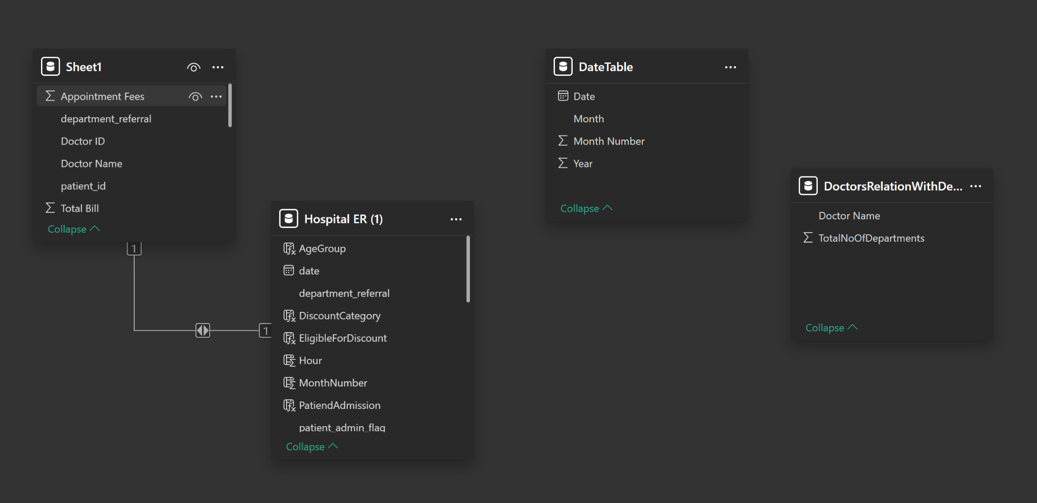
Database Schema

Slide 6
METHODOLOGY
Data Preparation
Patient & Department Analysis
Financial Insights
Recommendations

Slide 7
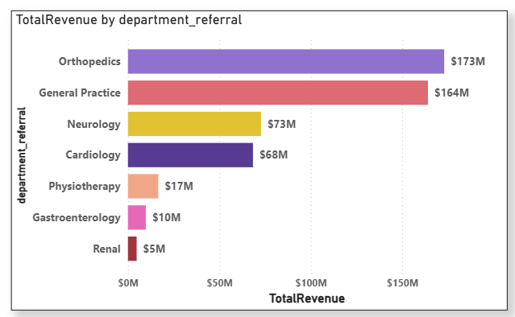
DEPARTMENT WISE REVENUE
Key Insights:
Orthopedics and General Practice are the top revenue-generating departments, contributing the highest share to the hospital’s overall income indicating strong patient demand and service utilization in these areas.
Renal and Gastroenterology generate the least revenue, suggesting either lower patient inflow or limited services offerings, which may require further review or targeted improvement strategies

Slide 8
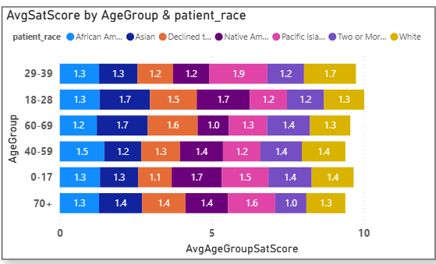
PATIENT SATISFACTION ANALYSIS BY AGE & RACE
Key Insights:
The numbers look a little low, right? That’s because during data cleaning, it was found that around 72% of patient satisfaction scores were missing possibly due to incomplete survey submissions, unrecorded feedback from emergency visits, or manual entry gaps in the hospital system.
Even with limited data, we observed that patients aged 18–39 showed slightly higher satisfaction levels compared to other age groups, while racial differences were minimal, indicating fairly consistent patient experiences across demographics

Slide 9
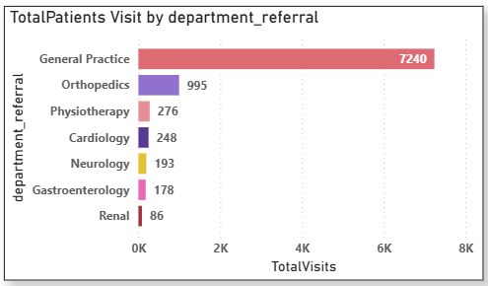
DEPARTMENT WISE PATIENT VOLUME
Key Insights:
General Practice receives the highest number of patient visits (7,240) indicating it is the most frequently consulted and high-demand department in the hospital.
Departments like Renal and Gastroenterology record the lowest patient volumes, suggesting either limited service utilization or potential areas for improved awareness and outreach.

Slide 10
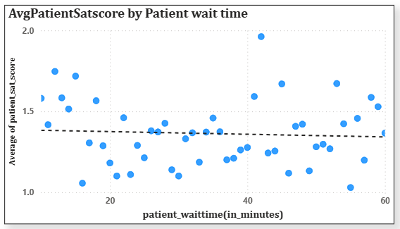
PATIENT WAIT TIME VS SATISFACTION ANALYSIS
Key Insights:
The trendline shows a slight negative correlation between patient wait time and satisfaction score, indicating that longer waiting periods generally lead to lower patient satisfaction.
However, the overall satisfaction scores remain low and scattered, suggesting that factors beyond wait time such as service quality or staff interaction may also influence patient experience.

Slide 11
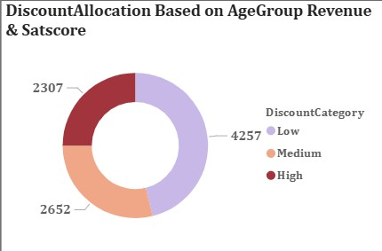
DISCOUNT ALLOCATION ANALYSIS
Key Insights:
The discount allocation was primarily determined based on age group and revenue contribution, while average satisfaction score was considered only at a group level to maintain fairness and simplicity.
The majority of patients fall under the Low discount category, indicating strong- performing age groups in terms of revenue, whereas High discounts were assigned to lower-revenue or less-engaged groups to encourage better participation

Slide 12
RECOMMENDATIONS
1. Optimize Doctor Allocation Across Departments
Increase the number of doctors in high-revenue and high-demand departments to reduce workload and patient wait times.
Redistribute staff from low-patient-volume departments to improve efficiency and service utilization.
Continuously monitor patient flow trends to plan future hiring and ensure balanced department staffing.

Slide 13
RECOMMENDATIONS
2. Strengthen Patient Feedback and Engagement System
A large portion of missing satisfaction scores (~72%) indicates the need for a more effective and engaging feedback mechanism
Develop a simple and engaging feedback mechanism (like digital kiosks or mobile surveys) to reduce missing satisfaction scores.
Ensure feedback is collected consistently after each visit to capture real-time patient experiences.

Slide 14

RECOMMENDATIONS
3. Refine Discount and Retention Strategies
Allocate discounts primarily based on age group and revenue contribution, ensuring fairness across patient segments.
Offer higher discounts to elderly or low-revenue groups to improve accessibility and engagement.
As satisfaction data improves, incorporate sat_scores into discount logic to reward loyal and satisfied patients effectively

Slide 15
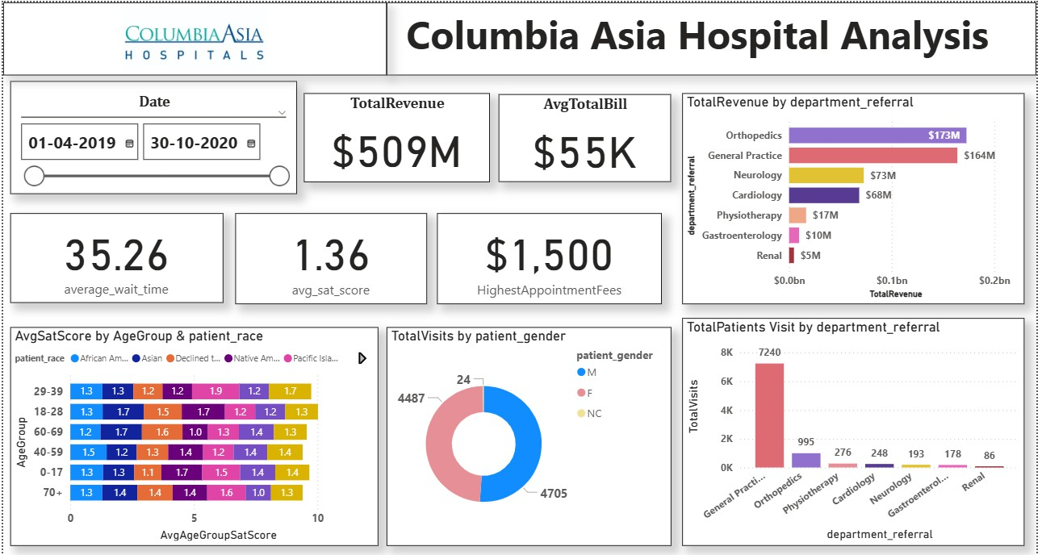
FINAL DASHBOARD(MAIN TAB)
DASHBOARD

Slide 16
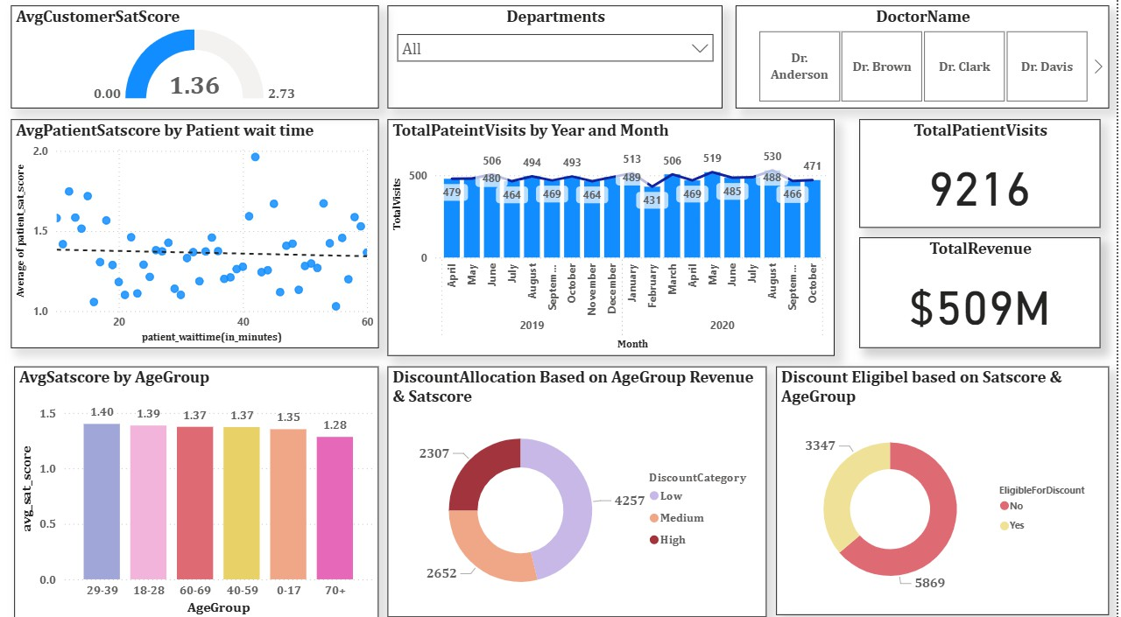
FINAL DASHBOARD(DOCTOR’S TAB)
DASHBOARD

Slide 17
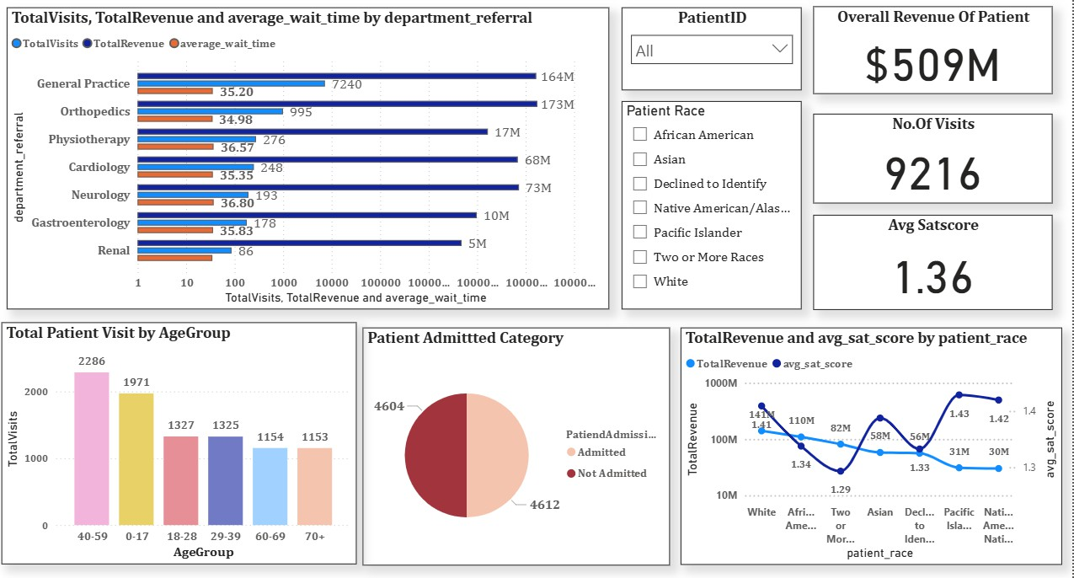
FINAL DASHBOARD(PATIENT’S TAB)
DASHBOARD

Slide 18
CONCLUSION
Overall, I want to say that Columbia Asia Hospital is performing strongly in terms of revenue generation, with departments like Orthopedics and General Practice leading in both patient volume and financial contribution.
However, there is scope to optimize staffing by increasing the number of doctors in high- demand departments and redistributing resources where patient inflow is low.
The hospital should also focus on improving patient feedback collection, ensuring a more engaging and consistent satisfaction tracking system to enhance service quality.
Lastly, the discount strategy designed around age group and revenue serves as a fair approach, but it can be further improved by integrating reliable satisfaction data in the future for more personalized and data-driven discount allocation

Slide 19
THANKS!

