Slide 1

VidyaSetu – Bridge of Knowledge
Scalable. Inclusive. Joyful.
Team Alpha | Tech Innovations College | Problem ID: #SIH2024-EDU-007

Slide 2





The Challenge We’re Solving
Fragmented Learning
Disjointed tools, inconsistent access to information.
No Multilingual Support
Exclusion for non-English speakers, limited reach.
Low Engagement
Monotonous interfaces, lack of interactive elements.
Inaccessible Dashboards
Complex UIs, not adaptive to diverse user needs.

Slide 3










Our Solution – VidyaSetu
VidyaSetu is a unified, multilingual dashboard designed to transform the educational experience. It brings together essential features in one intuitive platform.
Multilingual Modal
Seamless switching between English & Punjabi.
Unified Dashboard
Attendance, Marks, Assignments in one view.
AI Assistant (VidyaBot)
Personalized help and interactive learning.
Modern UI/UX
Clean, intuitive, and office-ready interface.
Interactive Quizzes
Engaging assessments for better retention.

Slide 4

Architecture & Tech Stack: How It Works
User
Frontend
Backend
Database
Frontend
  HTML
Backend
Database
AI Integration
  Tailwind CSS
  Node.js
  Firestore (NoSQL)
  Copilot
  JavaScript
  Python

Slide 5
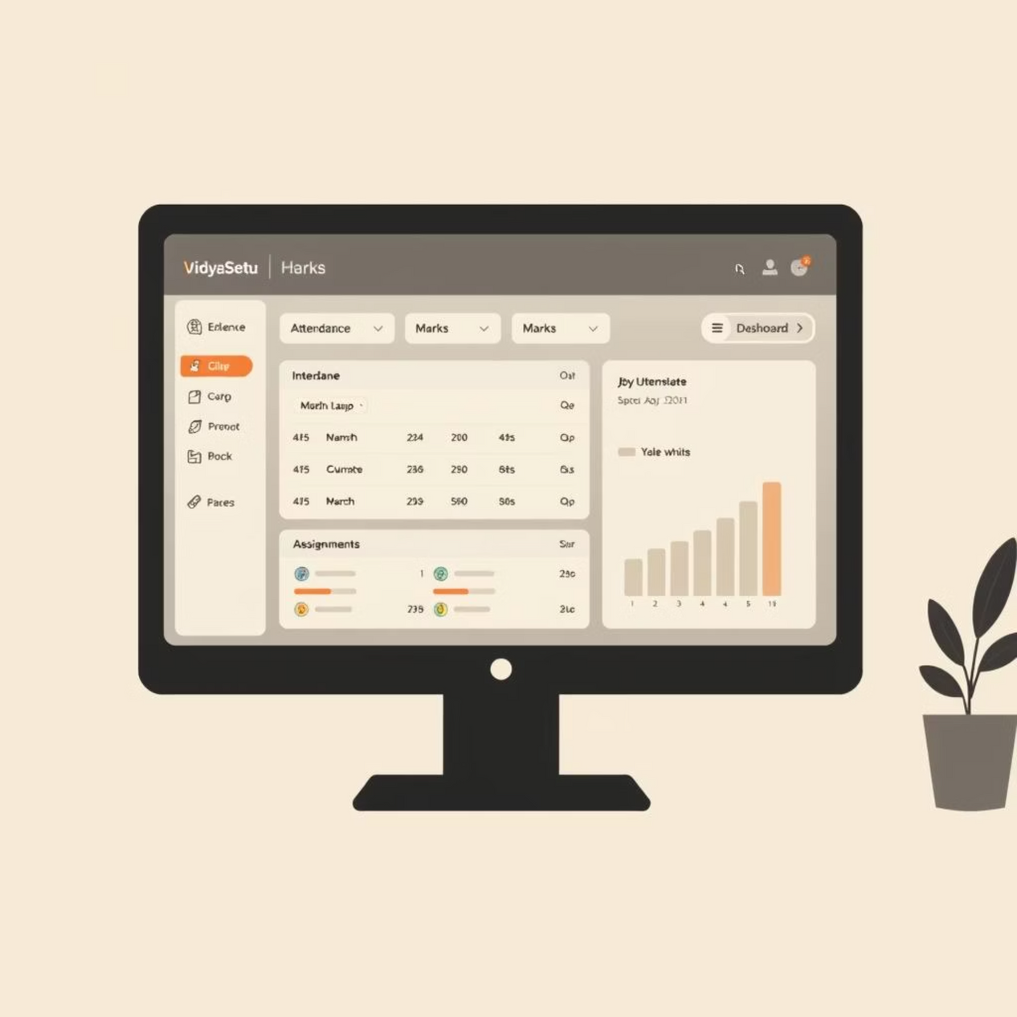
UI/UX Design: Designed for Clarity & Trust
  Consistent Look & Feel: Unified design across all modules.
  Responsive Layout: Seamless experience on desktop and mobile.
  Intuitive Language Switch: Easy access to multilingual support.
  Clean Aesthetics: Modern, professional, and clutter-free.
VidyaSetu ensures an optimal viewing and interaction experience, adapting to any device for maximum accessibility.

Slide 6
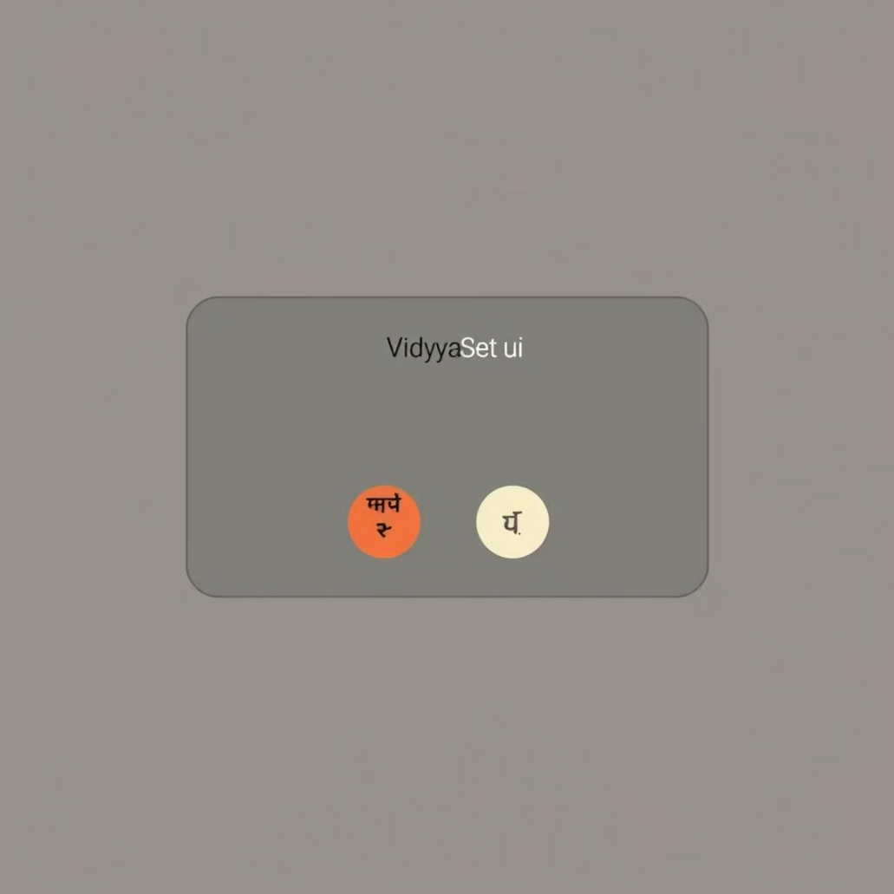
Inclusive by Design: Multilingual & Accessibility
  Multilingual Support: Currently supports English and Punjabi, bridging communication gaps.
  Future-Ready: Planned expansion to include Hindi, Marathi, and other regional languages.
  Accessible Fonts & Contrast: Designed with readability in mind for all users.
  Inclusive Learning: Ensures no student is left behind due to language or accessibility barriers.
Our commitment to inclusivity ensures that VidyaSetu caters to a diverse user base, fostering a truly accessible learning environment.

Slide 7

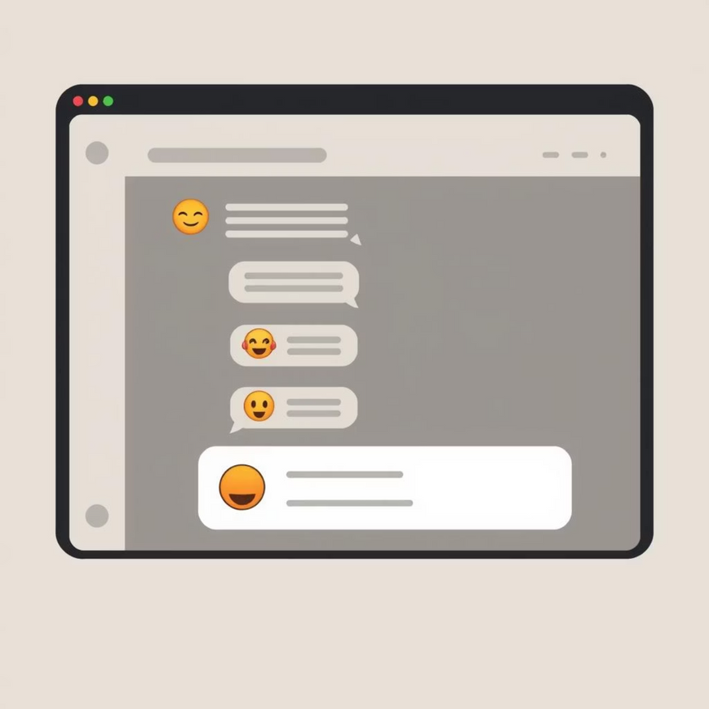
Engagement Features: Making Learning Joyful
VidyaBot Assistant
Interactive Quizzes
Personalized guidance and instant answers.
Fun and engaging ways to test knowledge.
VidyaSetu integrates features that actively involve students, making education a dynamic and enjoyable experience, promoting better retention and understanding.

Slide 8
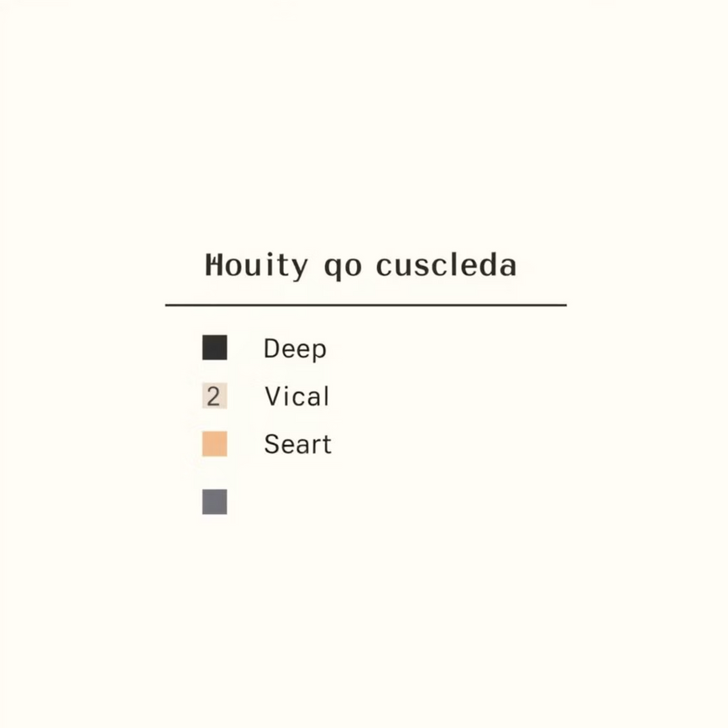
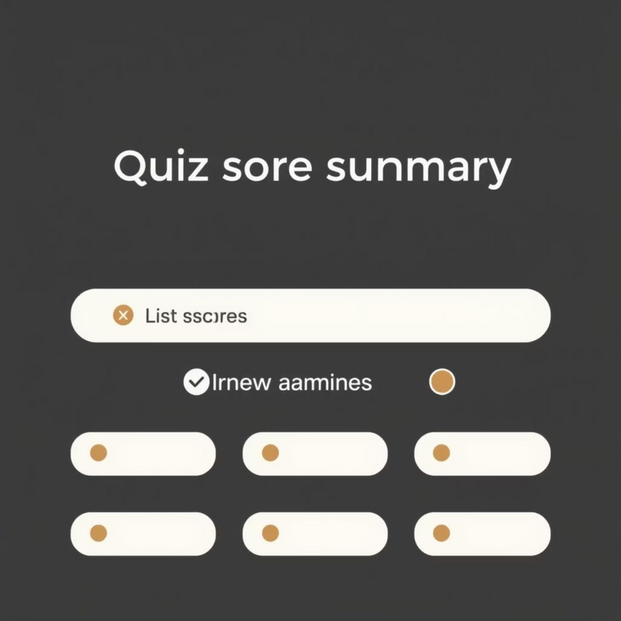
Quiz Module: Interactive Learning
Card-based Design
Instant Feedback & Review
Clean and intuitive interface for questions.

Slide 9




Innovation & Impact: Why We Stand Out
Blends Design & Structure
Scalable & Accessible
Aesthetic appeal meets robust functionality.
Designed for growth and diverse user needs.
AI-Powered Assistant
Designed for All Learners
Personalized support with VidyaBot.
Empowering both rural and urban students.
VidyaSetu is more than just a platform; it's a commitment to revolutionizing education through thoughtful design, cutting-edge technology, and inclusive principles.

Slide 10
Roadmap & Scalability: What's Next
Language Expansion
1
Integrate Hindi, Marathi, and other regional languages.
2
Advanced AI
Enhanced VidyaBot features and predictive analytics.
Role-Based Dashboards
3
Customized views for teachers, parents, and administrators.
4
Gamification
Introduce badges, leaderboards, and interactive challenges.
Comprehensive Analytics
5
In-depth insights into student performance and platform usage.
Our vision for VidyaSetu is continuously evolving, with a clear roadmap to enhance features and expand its reach, ensuring it remains at the forefront of educational innovation.

