Slide 1
Demo

Slide 2
Problem statement
In the Intuit Small Business Ecosystem, a User uses one or more Intuit products to run their business. A user sells items or performs services for a Customer. A Customer may or may not be a user of Intuit products. It is not explicitly captured in the system if a customer is also a user of Intuit products but can be probabilistically inferred by matching attributes such as email, name, etc
List of Users
List of Customer and user association
List of Products and user association

Slide 3
Craft demo component
Online ( API,Caching layer)
Oflline ( dropbox,sqoop,Hadoop,workflow)

Slide 4


Online Mode
Load Balancer
Web
Server
---
---
o
Cache
User
Application Server
Database
Offline Mode
Drop
Box
HDFS
Work-Flow
(Oozie)
Push
Input
Pull
Database

Slide 5
Node Creation
User
{Fullname}
Product
Customer
{ProductID}
{CustomerID}

Slide 6
Edge Creation
User
HAS_CUSTOMER
HAS_PRODUCT
Customer
Product

Slide 7
Start
Node
Fork
User
Product
Customer
Fail
Join Node
Fail
Edge Fork
Fail
Fail
User
Product
User
Customer
Fail
email
Fail
Join Edge
Success
End

Slide 8
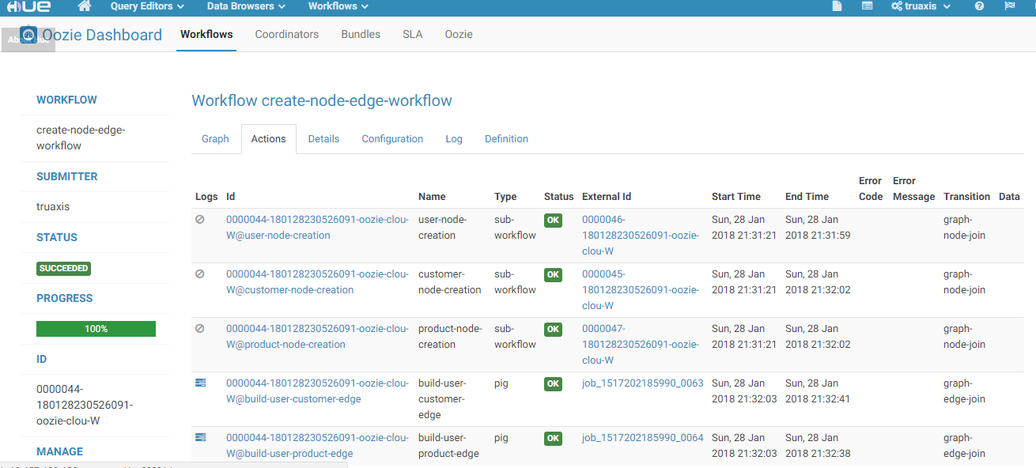
Workflow

Slide 9
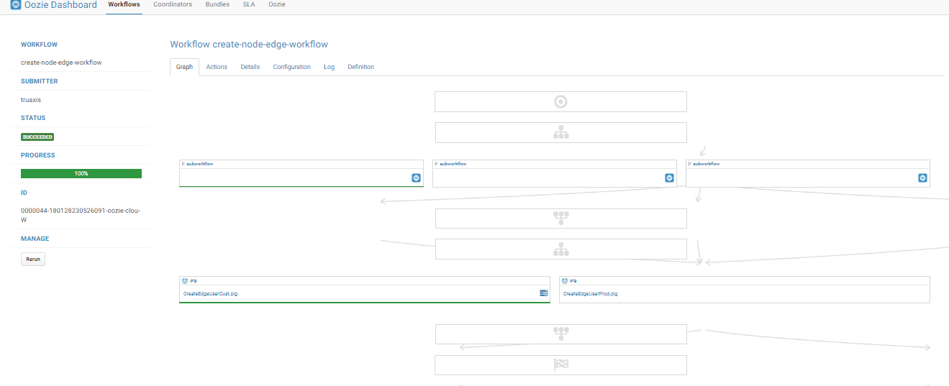
Graph

Slide 10
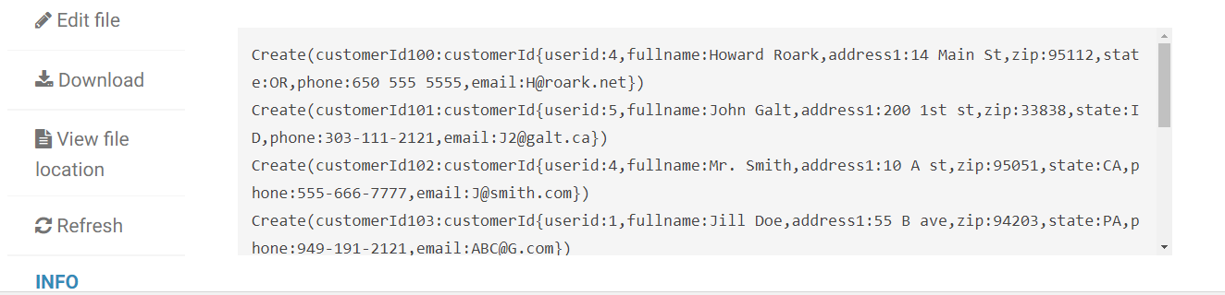
Node Creation

Slide 11
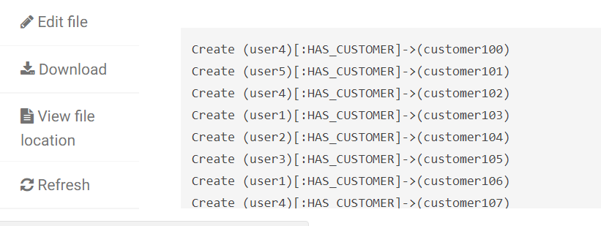
Edge Creation

Slide 12
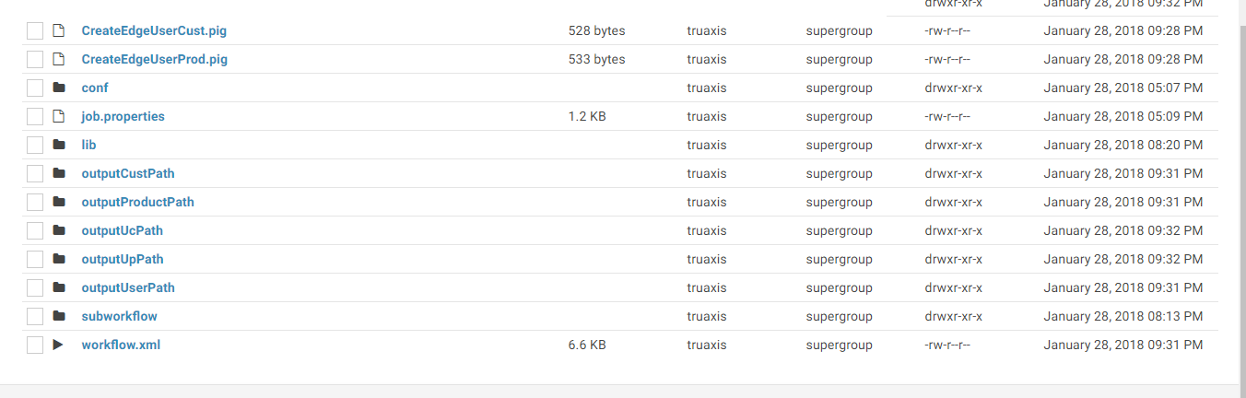
HDFS structure

Slide 13
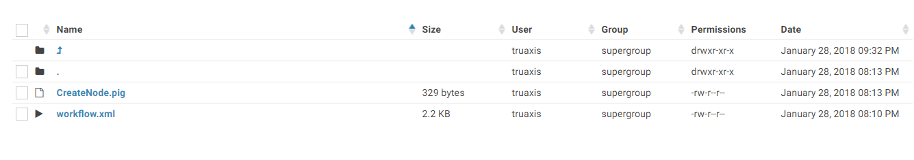
Hdfs structure for subworkflow

Slide 14
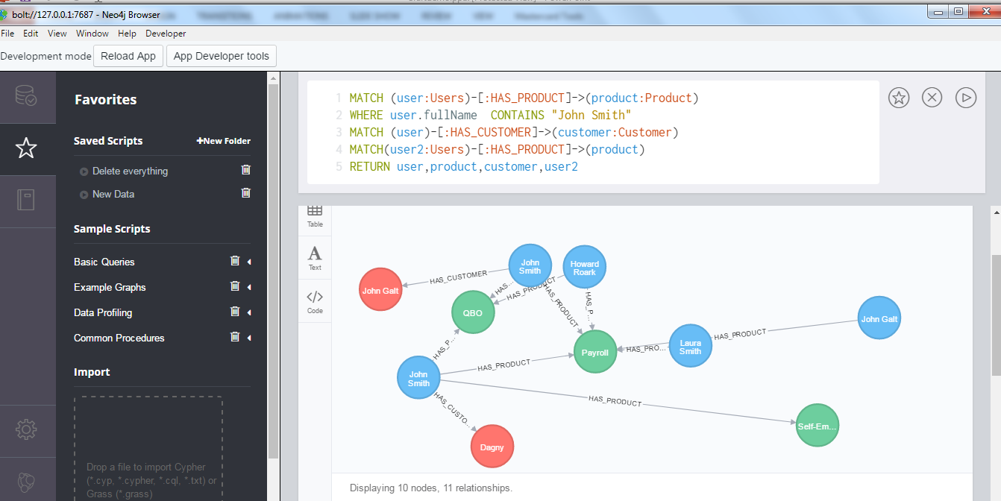
Graph visualization

Slide 15
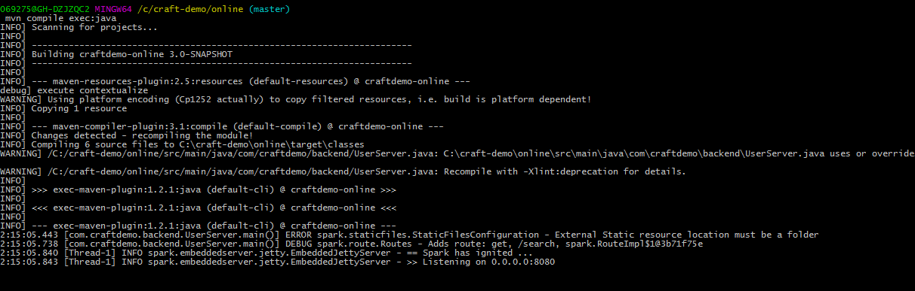
API Server

Slide 16
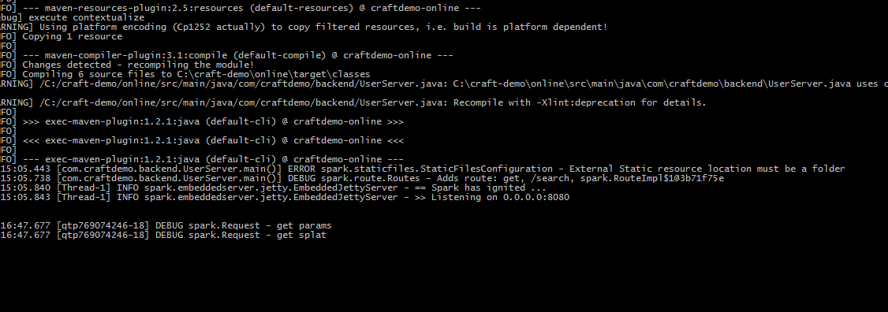
API request

Slide 17
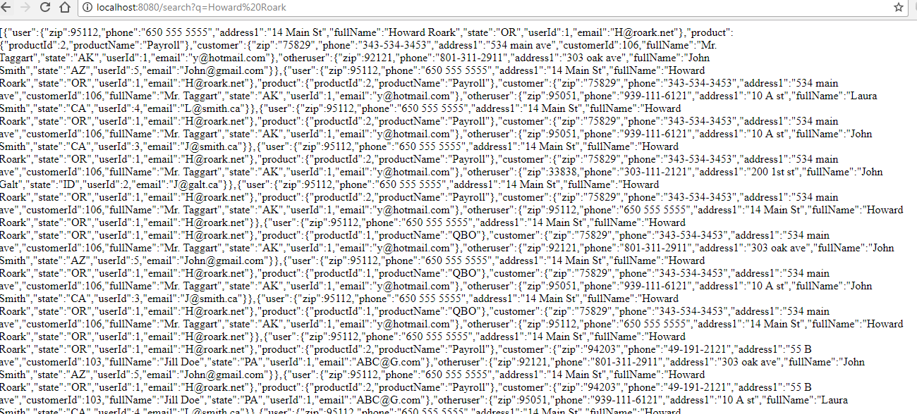
API response

Slide 18
Environment and Version used
pig 0.12.0
java 1.8
window
oozie 4.1
hadoop 2.6
hive 1.1
Centos
Neo4j 3.3.2 database

Slide 19
Algorithm
forech product :Products
Create Node for Products (1)
foreach user : Users
Create Node for Users (2)
foreach customer :Customers
Create customer Node (3)
foreach Node :UserProductRelation :
Create edge from User Node to Product Node ( relation HAS_PRODUCT} (4)
foreach item : CustomerUserIntuitInfo
Create edge from the user to customer Node ( relation HAS_CUSTOMER )(5)

Slide 20
Capacity Planning
Memory estimate
Qps

Slide 21
TODO
Feeder ( Partial/Full update)
Caching
Load balancer
UI

Slide 22
Git location
Offline
https://github.com/bhaskarrana/craftdemo-offline
Online
https://github.com/bhaskarrana/craftdemo-online

Slide 23
References
https://neo4j.com/download
https://en.wikipedia.org/wiki/Graph_database
https://pig.apache.org/
http://oozie.apache.org/
https://neo4j.com/graph-databases-book/
https://github.com/neo4j-examples
https://google.com
https://udemy.com
https://youtube.com

Slide 24
QnA

