Slide 1
Cartooning Of An Image
Under Image Processing
Team ID: 15
Team Members: P. Srikar Reddy(16H61A0523)
M. Sneha Sri (16H61A0530)
P. Sainath (17H65A0511)
Project Guide: G. Lavanya

Slide 2
CONTENTS
Abstract
Introduction
Existing approaches and drawbacks
Motivation
Objectives
Methodology used
Tools and techniques used
Conclusion
References

Slide 3
ABSTRACT
To cartoonize images and different objects and blend them accordingly as we require. Our aim is to create a cartoon which doesn’t look like a filter applied on an image but, is actually a cartoonic view of an input image. In order to get the basic cartoon effect, we just need the bilateral filter and some edge detection mechanism. We can access this cartoon images through an application where you can also save them and make changes.

Slide 4
INTRODUCTION
The method of image processing is used to do some processes on a picture like an image enhancement or to remove some functional data from the image.
Cartooning of an image is an interesting project under image processing where it takes an input image, processes it and produces an output as a cartoon.

Slide 5
EXISTING APPROACHES AND DRAWBACKS
There are many photo cartooning applications but most of them are producing images just by applying the filter to the input image.
The few applications which produce the cartoonic look are not freeware.

Slide 6
MOTIVATION
Cartoons are humorous, satirical, and at times opinionated. Drawing cartoons is however, not easy. Only those well-trained artists who possess this great skill can do it well. Recently, many technologies have been developed to make it possible to create cartoons entirely on the computer. This can be recreating and helps one to have a cartoonic view of everything.

Slide 7
OBJECTIVES
To develop an application to cartoonize humans, other objects and images
Make it possible to blend as many cartoons as possible
Save the cartoons in the application if needed.

Slide 8
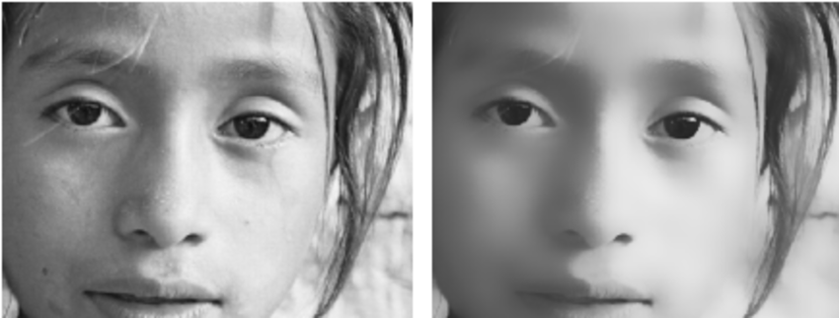
METHODOLOGY
Downscale the image and then apply bilateral filter to get a cartoon flavour. Then again we upscale the image.
Bilateral Filter: This filter is the key element in the colour image processing chain, as it homogenizes colour regions while preserving edges, even over multiple iterations.

Slide 9
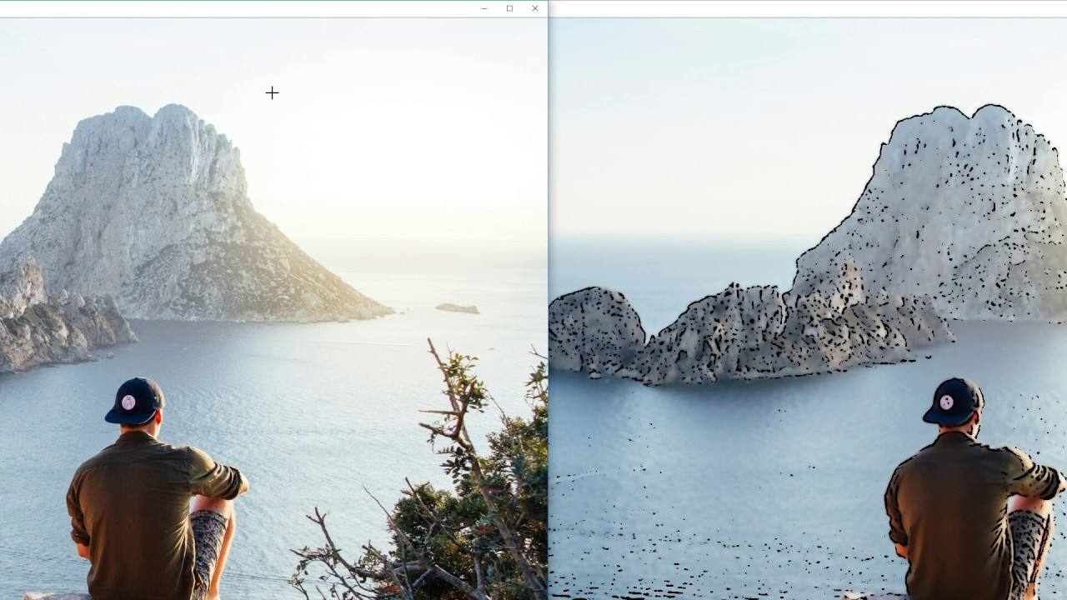
Getting a blurred version of the original image. For this, we first convert the image to gray – scale and then we apply the media blur filter.
Next step is to identify the edges in the image using Edge Detection.
Edge Detection- Process of identifying edges in an image to be used as a fundamental asset in image analysis and locating areas with strong intensity contrasts.
The Open Computer Vision Library (OpenCV) provides a standard toolkit for performing basic and complex image processing algorithms like these.

Slide 10
TOOLS AND TECHNOLOGIES USED
Android Studio 3.0 and above
Open CV
Python
Camera to capture an image

Slide 11
CONCLUSION
This application is used to create personalised cartoons for an input image and blend them with other images as we require. We can also save the images and use them again later. Using the bilateral filter and edge detection we can create the
cartoonized image with following characteristics: Really clear edges and Homogeneous colours. Starting from an original image taken with
a camera we’re going to give it a cartoon effect keeping in mind these characteristics.

Slide 12
REFERENCE
https://www.geeksforgeeks.org/cartooning-an-image- using-opencv-python/
http://citeseerx.ist.psu.edu/viewdoc/download?doi=10.1.1.90.6465&rep=rep1&type=pdf
Various other documents and sites on the internet

Slide 13
THANKYOU

