Slide 1

IILM UNIVERSITY, GREATER NOIDA
School of Computer Science and Engineering
E-Commerce Website with Modern UI
MERN Full Stack Development With Project — Virtual Internship
STUDENT NAME
ENROLLMENT / ROLL NO.
PROGRAM & SEMESTER
Bhaskar Singh
CS-23411470
B.Tech CSE — 7th Semester
BATCH
ORGANIZATION
2026-27
EduSkills Academy (AICTE — National Internship Portal)
June – August 2026 | 8-Week Virtual Internship

Slide 2
WHAT WE'LL COVER
Agenda
01
Internship & Organization
About the program and EduSkills Academy
02
The Problem & Objectives
Why an e-commerce platform, and project goals
03
Technology & Architecture
MERN stack, tools, and system design
04
Methodology & Features
8-week roadmap and platform capabilities
05
Outcomes & Learnings
Results, skills gained, and certification
02

Slide 3
SECTION 01
About the Internship Program
An 8-week AICTE-approved virtual internship, delivered through the National Internship Portal, giving students structured, hands-on exposure to full stack web development using the MERN stack.
MERN
MongoDB
Duration: 8 Weeks
Period: June – August 2026
Express.js
Grade Awarded: O — Outstanding
React.js
Certifying Body: AICTE, Ministry of Education
Node.js
03

Slide 4
SECTION 01
Organization Profile — EduSkills Academy
Who they are
What they deliver
Program recognition
An ed-tech organization partnering with AICTE to run industry-aligned virtual internships in emerging technologies.
Structured weekly modules, live & recorded sessions, hands-on assignments, and a capstone project.
Internships are certified by AICTE, Ministry of Education, via the National Internship Portal.
04

Slide 5
SECTION 02
The Problem
Small and medium businesses are often priced out of good e-commerce platforms — while customers expect fast, modern, mobile-friendly shopping experiences.
Expensive or rigid licensing on existing platforms
Our Goal
Design and build a full-featured, cost-effective e-commerce web application with a modern, clean, responsive UI — covering product discovery, cart, wishlist, checkout, and an admin panel — on a scalable full stack JavaScript architecture.
Outdated, non-responsive user interfaces
Difficult to customize for a specific brand
Poor cart, checkout, and order-tracking experience
05

Slide 6
SECTION 02
Project Objectives
1
Design a responsive, modern e-commerce interface using React.js
2
Build a secure, scalable back end with Node.js & Express.js
3
Design a flexible NoSQL data model in MongoDB
4
Implement authentication & authorization using JWT
5
Build core shopping features: catalogue, cart, wishlist, checkout
6
Provide an admin dashboard for products, orders & users
06

Slide 7
SECTION 02
Scope of the Project
IN SCOPE
OUT OF SCOPE (Future Work)
✓ Customer browsing, search & category filters
• Multi-vendor marketplace functionality
✓ Cart, wishlist & multi-step checkout
• Live, certified third-party payment gateway
✓ Secure registration, login & role-based access
• Production-scale deployment with load balancing
✓ Admin: product, category, order & user management
✓ Payment gateway integration (test mode)
07

Slide 8
SECTION 03
Technology Stack & Tools
Front End
Back End
Data & Media
Dev Tools
React.js
Node.js
MongoDB
Git & GitHub
Tailwind CSS
Express.js
Mongoose ODM
Postman
Redux Toolkit
JWT + bcrypt
Cloudinary
VS Code
React Router
REST APIs
08

Slide 9
SECTION 03
System Architecture — Three-Tier Design
Presentation Layer
Renders UI, handles user interaction & client-side routing
React.js · Tailwind CSS · Redux Toolkit
Application Layer
Exposes REST APIs, business logic, authentication & validation
Node.js · Express.js · JWT
Data Layer
Stores & retrieves users, products, carts, and orders
MongoDB · Mongoose
09

Slide 10
SECTION 04
Development Methodology — 8-Week Roadmap
W1–2
W3–4
W5–6
W7
W8
Orientation, MERN fundamentals, planning & schema design
Back-end: REST APIs, MongoDB models, JWT auth
Front-end: React components, routing, state, UI integration
Cart, checkout, payment integration & admin dashboard
Testing, polishing, deployment prep & final presentation
10

Slide 11
SECTION 04
Key Platform Features
Product Catalogue
Cart & Wishlist
Secure Accounts
Search, category filters & detailed product pages
Persistent cart with a smooth multi-step checkout
JWT-based registration, login & role-based access
Order Management
Admin Dashboard
Payment Integration
Order placement, summary & status tracking
Add, update & remove products; manage orders
Razorpay / Stripe test-mode checkout flow
11

Slide 12
SECTION 04
A Modern, Responsive Shopping Experience
Clean Product Grid
Card-based layout with clear visual hierarchy
Instant Search & Filters
Find products in seconds
One-Click Add to Cart
Frictionless path from browse to buy
Fully Responsive
Optimized for mobile, tablet & desktop
12

Slide 13
SECTION 05
Outcomes Achieved
Fully functional, responsive e-commerce website with a modern UI
Secure authentication with JWT-based session handling
Complete shopping flow: catalogue → cart → checkout → order
Admin dashboard for product & order management
RESTful API layer tested end-to-end with Postman
Hands-on experience with the full MERN development workflow
13

Slide 14
SECTION 05
Skills & Learnings Gained
Technical Skills
Professional Skills
Full stack JavaScript development (MERN)
Agile, sprint-based project execution
REST API design & database modelling
Version control & collaborative workflows
Authentication & security practices
Debugging, testing & deployment readiness
14

Slide 15
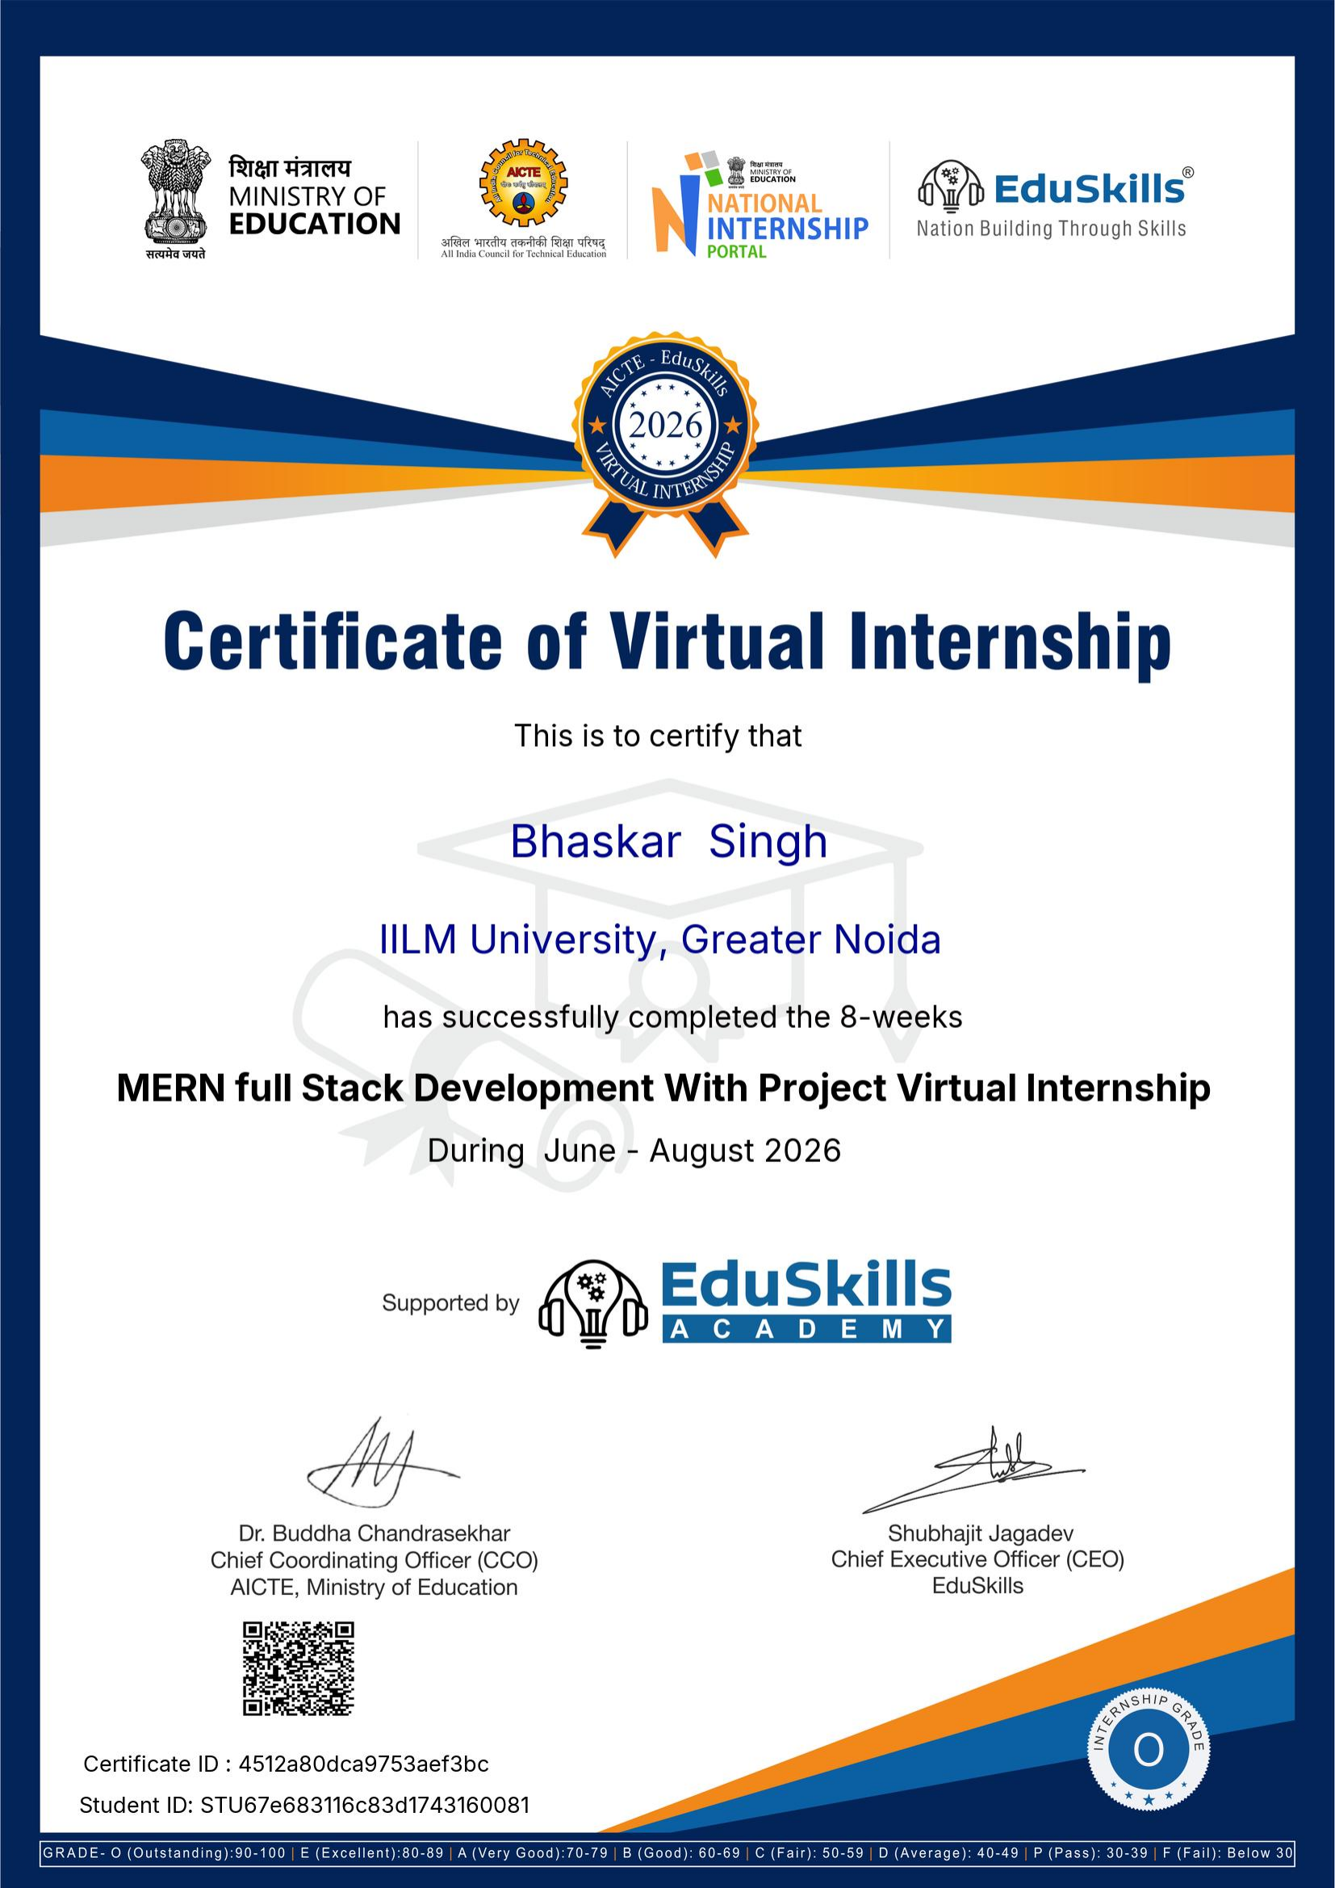
RECOGNITION
Certificate of Completion
15

Slide 16
WRAPPING UP
Conclusion
This internship provided practical, project-based mastery of the MERN stack — from database design through to a deployable, modern e-commerce application. Beyond the technical stack, it strengthened problem-solving, planning, and independent execution skills that translate directly into industry-ready software development practice.
MongoDB · Express.js · React.js · Node.js
16

Slide 17
Thank You
Bhaskar Singh | CS-23411470 | B.Tech CSE, 7th Semester
IILM University, Greater Noida · MERN Full Stack Development With Project Virtual Internship

