Slide 1
Motion Study and Work Design
Basic Motion Elements and Work Analysis
Principles of Motion Economy and Work Design

Slide 2
Definitions
Motion study involves the analysis of the basic hand, arm, and body movements of workers as they perform work.
Work design involves the methods and motions used to perform a task.
This design includes
  the workplace layout and environment
  the tooling and equipment (e.g., work holders, fixtures, hand tools, portable power tools, and machine tools).
work design is the design of the work system.

Slide 3
Basic Motion Elements
Any manual task is composed of work elements, and the work elements can be further subdivided into basic motion elements. We will define basic motion elements and how they can be used to analyze work
Frank Gilbreth was the first to catalog (list) the basic motion elements.
Therbligs are the basic building blocks of virtually all manual work performed at a single workplace and consisting primarily of hand motions. – A list of Gilbreth’s 17 therbligs is presented along with the letter symbol used for each as well as a brief description.
With some modification, these basic motion elements are used today in a number of work measurement systems, such as Methods - Time Measurement (MTM) and the Maynard Operation Sequence Technique (MOST).
Methods analysis at the therblig level seeks to eliminate or reduce ineffective therbligs.
    Some of the motion element names and definitions have been revised

Slide 4
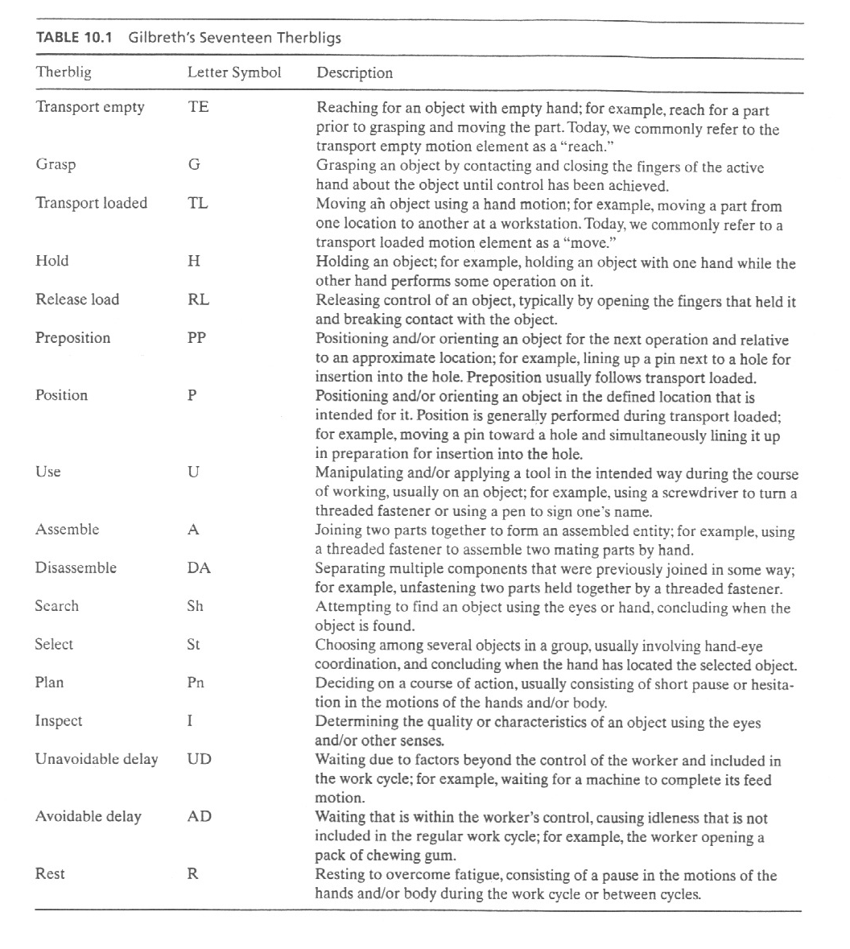

Slide 5
17 Therbligs
Transport empty (TE) – reach for an object
Grasp (G) – grasp an object
Transport loaded (TL) – move an object with hand and arm
Hold (H) – hold an object
Release load (RL) – release control of an object
Use (U) – manipulate a tool

Slide 6
17 Therbligs (continued)
Pre-position (PP) – position object for next operation
Position (P) – position object in defined location
Assemble (A) – join two parts
Disassemble (DA) – separate multiple parts that were previously joined
Search (Sh) – attempt to find an object using eyes or hand

Slide 7
17 Therbligs (continued)
Select (St) – choose among several objects in a group
Plan (Pn) – decide on an action
Inspect (I) – determine quality of object
Unavoidable delay (UD) – waiting due to factors beyond worker control
Avoidable delay (AD) – worker waiting
Rest (R) – resting to overcome fatigue

Slide 8
Classification of Therbligs
Effective therbligs:
Transport empty
Grasp
Transport loaded
Release load
Use
Assemble
Disassemble
Inspect
Rest
Ineffective therbligs:
Hold
Pre-position
Position
Search
Select
Plan
Unavoidable delay
Avoidable delay

Slide 9
Micromotion Analysis
Each therblig represents time and energy spent by a worker to perform a task. If the task is repetitive, of relatively short duration, and will be performed many times, it may be appropriate to analyze the therbligs that make up the work cycle as part of the work design process.
The term micromotion analysis is sometimes used for this type of analysis.
Objectives:
  Eliminate ineffective therbligs if possible
  Avoid holding objects with hand – Use workholder
  Combine therbligs – Perform right-hand and left-hand motions simultaneously
  Simplify overall method
  Reduce time for a motion, e.g., shorten distance

Slide 10
Principles of Motion Economy
Developed over many years of practical experience in work design
They are guidelines that can be used to help determine
    Work method
    Workplace layout
    Tools, and equipment
Objective is to maximize efficiency and minimize worker fatigue

Slide 11
Three Categories of Principles
The principles of motion economy can be organized into three categories:
Principles that apply to the use of the human body
Principles that apply to the workplace arrangement
Principles that apply to the design of tooling and equipment

Slide 12
Use of Human Body
1. Both hands should be fully utilized.
The natural tendency of most people is to use their preferred hand (right hand for right-handed people and left hand for left-handed people) to accomplish most of the work.
The other hand is relegated to a minor role, such as holding the object, while the preferred hand works on it. This first principle states that both hands should be used as equally as possible.
2. The two hands should begin and end their motions at the same time.
This principle follows from the first. To implement, it is sometimes necessary to design the method so that the work is evenly divided between the right-hand side and the left-hand side of the workplace. In this case, the division of work should be organized according to the following principle.

Slide 13
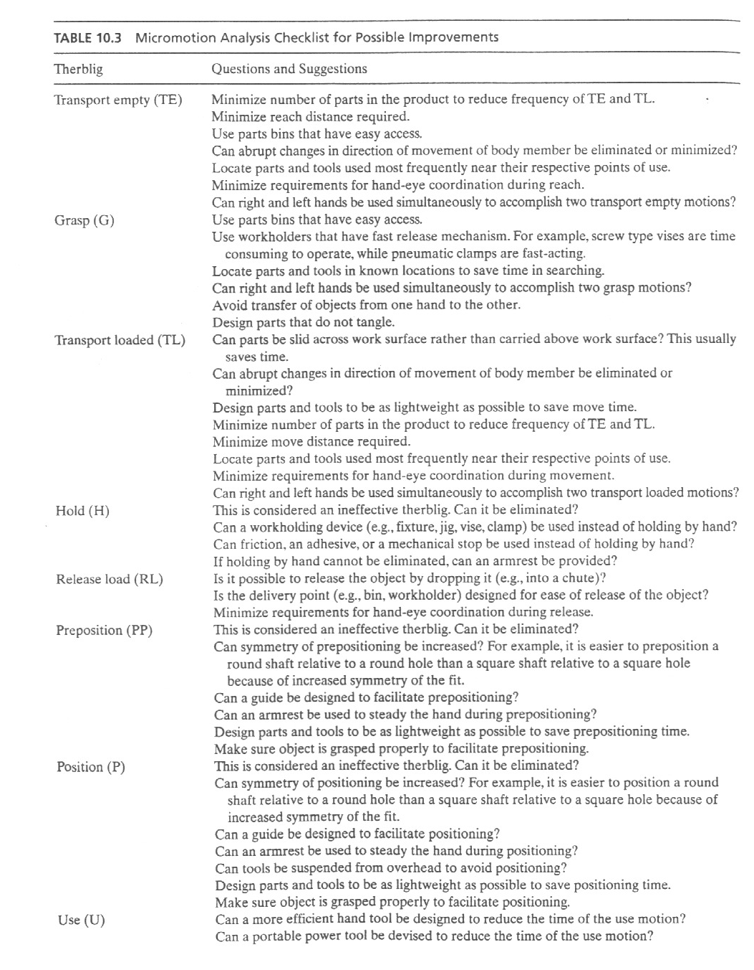

Slide 14
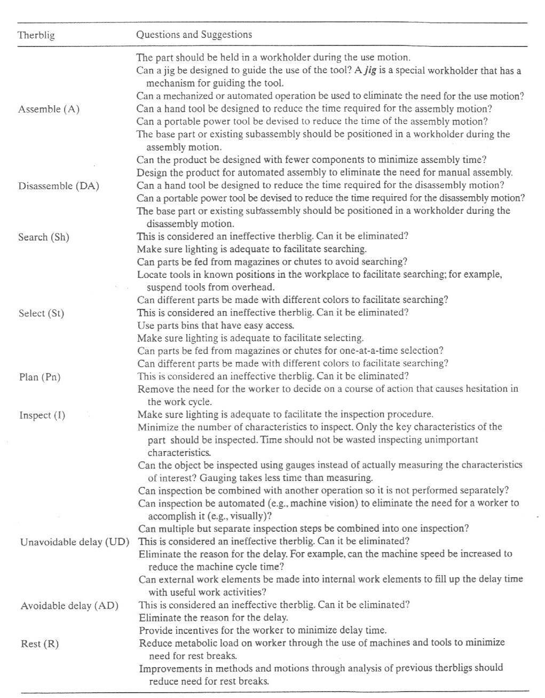

Slide 15
Use of Human Body
3. The motions of the hands and arms should be symmetrical and simultaneous.
This will minimize the amount of hand-eye coordination required by the worker. And since both hands are doing the same movements at the same time, less concentration will be required than if the two hands had to perform different and independent motions.
4. The work should be designed to emphasize the worker’s preferred hand.
The preferred hand is faster, stronger, and more practical. If the work to be done cannot be allocated evenly between the two hands, then the method should take advantage of the worker’s best hand.
For example, work units should enter the workplace on the side of the worker’s preferred hand and exit the workplace on the opposite side. The reason is that greater hand-eye coordination is required to initially acquire the work unit, so the worker should use the preferred hand for this element. Releasing the work unit at the end of the cycle requires less coordination.

Slide 16
Use of Human Body
5. The worker’s two hands should never be idle at the same time.
The work method should be designed to avoid periods when neither hand is working. It may not be possible to completely balance the workload between the right and left hands, but it should be possible to avoid having both hands idle at the same time.
The exception to this principle is during rest breaks. The work cycle of a worker-machine system may also be an exception, if the worker is responsible for monitoring the machine during its automatic cycle, and monitoring involves using the worker’s cognitive senses rather than the hands. If machine monitoring is not required, then internal work elements should be assigned to the worker during the automatic cycle.
The next five principles of motion economy attempt to utilize the laws of physics to assist in the use of the hands and arms while working.

Slide 17
Use of Human Body
6. Method should consist of smooth continuous
  curved motions rather than straight motions with
  sudden changes in direction
It takes less time to move through a sequence of smooth continuous curved paths than through a sequence of straight paths that are opposite in direction, even though the actual total distance of the curved paths may be longer (since the shortest distance between two points is a straight line).
The reason behind this principle is that the straight-line path sequence includes start and stop actions (accelerations and decelerations) that consume the worker’s time and energy.
Motions consisting of smooth continuous curves minimize the lost time in starts and stops.

Slide 18
Use of Human Body
7. Use momentum to facilitate task
When carpenters strike a nail with a hammer, they are using momentum, which can be defined as mass times velocity. Imagine trying to apply a static force to press the nail into the wood.
Not all work situations provide an opportunity to use momentum as a carpenter uses a hammer, but if the opportunity is present, use it. The previous principle dealing with smooth continuous curved motions illustrates a beneficial use of momentum to make a task easier.
8. Take advantage of gravity – Don’t oppose it
Less time and energy are required to move a heavy object from a higher elevation to a lower elevation than to move the object upward. The principle is usually implemented by proper layout and arrangement of the workplace, and so it is often associated with the workplace arrangement principles of motion economy.

Slide 19
Use of Human Body
9. Method should achieve a natural cadence of the motions involved
Rhythm refers to motions that have a regular recurrence and flow from one to the next. Basically, the worker learns the rhythm and performs the motions without thinking, much like the natural and instinctive motion pattern that occurs in walking.
10. Use lowest classification of hand and arm motion (five classifications)
The five classifications of hand and arm motions are presented in Table 10.5.
With each lower classification, the worker can perform the hand and arm motion more quickly and with less effort. Therefore, the work method should be composed of motions at the lowest classification level possible.
This can often be accomplished by locating parts and tools as close together as possible in the workplace.

Slide 20
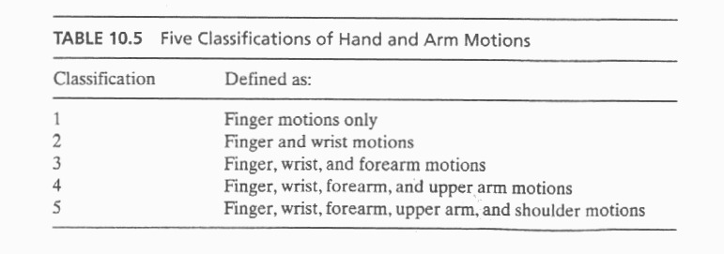
The two remaining human body principles of motion
economy are recommendations for using body members other than the hands and arms.

Slide 21
Use of Human Body
11. Minimize eye focus and travel
In work situations where hand-eye coordination is required, the eyes are used to direct the actions of the hands. Eye focus occurs when the eye must adjust to a change in viewing distance—for example, from 25 in. to 10 in. with little or no change in line of sight.
Eye travel occurs when the eye must adjust to a line-of-sight change—for example, from one location in the workplace to another, but the distances from the eyes are the same. Since eye focus and eye travel each take time, it is desirable to minimize the need for the worker to make these adjustments as much as possible. This can be accomplished by minimizing the distances between objects (e.g., parts and tools) that are used in the workplace.
12. The method should be designed to utilize the worker’s feet and legs when appropriate.
The legs are stronger than the arms, although the feet are not as practical as the hands. The work method can sometimes be designed to take advantage of the greater strength of the legs, for example, in lifting tasks.

Slide 22
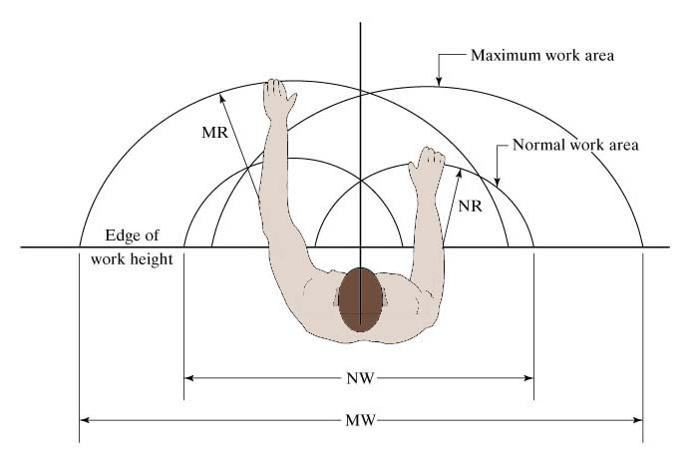
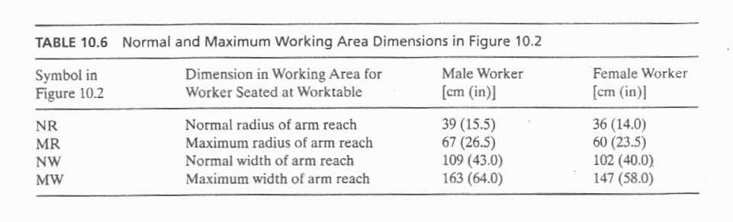
Workplace Arrangement
Figure 10.2 Normal and maximum working areas in the workplace.

Slide 23
Workplace Arrangement
1. Locate tools and materials in fixed positions within the work area
As the saying goes, “a place for everything, and everything in its place.” The worker eventually learns the fixed locations, allowing him to reach for the object without wasting time looking and searching.
2. Locate tools and materials close to where they are used
This helps to minimize the distances the worker must move (travel empty and travel loaded) in the workplace. In addition, any equipment controls should also be located in close proximity. This guideline usually refers to a normal and maximum working area, as shown in Figure 10.2 and clarified further in Table 10.6. It is generally desirable to keep the parts and tools used in the work method within the normal working area, as defined for each hand and both hands working together.
If the method requires the worker to move beyond the maximum working area, then the worker must move more than just the arms and hands. This expends additional energy, takes more time, and ultimately contributes to greater worker fatigue.

Slide 24
Workplace Arrangement
3. Locate tools and materials to be consistent with sequence of work elements
Items should be arranged in a logical pattern that matches the sequence of work elements. Those items that are used first in the cycle should be on one side of the work area, the items used next should be next to the first, and so on,.
The alternative to this sequential arrangement is to locate items randomly in the work area. This increases the amount of searching required and detracts from the rhythm of the work cycle.
Figure 10.3 shows the top view of a workplace layout that illustrates these first three principles. Note that the layout in (b) locates bins in a more accessible pattern that is consistent with the sequence of work elements.

Slide 25
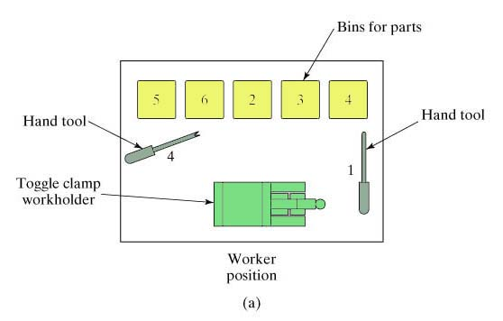
Illustration of First Three Principles
Figure 10.3 Two workplace layouts.
(a) Poor arrangement of parts and tools in workplace

Slide 26
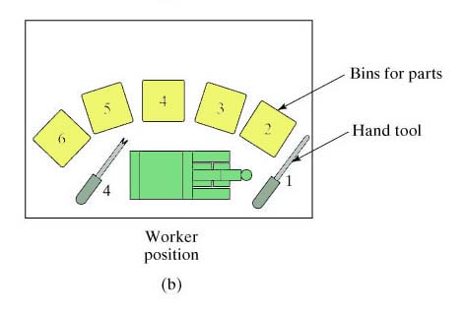
Illustration of First Three Principles
(b) Good arrangement of parts and tools in workplace
Numbers indicate sequence of work elements in relation to locations of hand tools and parts bins.

Slide 27
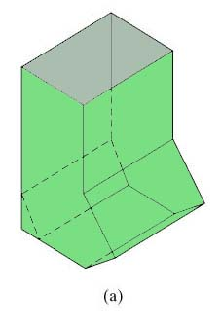
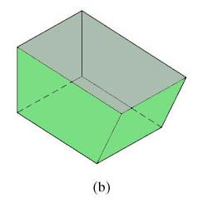
Workplace Arrangement
4. Use gravity feed bins to deliver small parts and fasteners
A gravity feed bin is a container that uses gravity to move the items in it to a convenient access point for the worker. One possible design is shown in Figure (a). It generally allows for quicker acquisition of an item than a conventional rectangular tray shown in Figure (b).

Slide 28
Workplace Arrangement
5. Use gravity drop chutes (channels, tubes) for completed work units where appropriate
The drop chutes should lead to a container adjacent to the worktable. The entrance to the gravity chute should be located near the normal work area, permitting the worker to dispose of the finished work unit quickly and conveniently. They are most appropriate for lightweight work units that are not fragile.
6. Provide adequate illumination
The issue of illumination is normally associated with ergonomics.
However, illumination has long been known to be an important factor in work design.
Illumination is especially important in visual inspection tasks.

Slide 29
Workplace Arrangement
7. A proper chair should be provided for the worker
This usually means an adjustable chair that can be fitted to the size of the worker. The adjustments usually include seat height and back height. Both the seat and back are padded.
Many adjustable chairs also provide a means of increasing and decreasing the amount of back support.
The chair height should be in proper relationship with the work height. An adjustable chair for the workplace is shown in Figure .

Slide 30
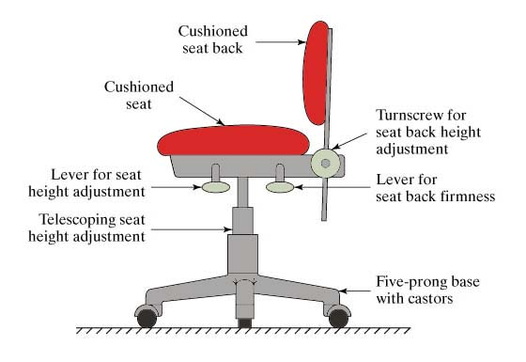
Adjustable Chair for Workplace

Slide 31
Design of Tooling and Equipment
1. Work-holding devices should be designed for the task
A mechanical workholder with a fast-acting clamp permits the work unit to be loaded quickly and frees both hands to work on the task productively.
Typically, the workholder must be custom-designed for the work part processed in the task.
2. Hands should be relieved of work elements that can be performed by the feet using foot pedals
Foot pedal controls can be provided instead of hand controls to operate certain types of equipment. Sewing machines are examples in which foot pedals are used as integral components in the operation of the equipment.
As our examples suggest, training is often required for the operator to become proficient in the use of the foot pedals.

Slide 32
Design of Tooling and Equipment
3. Combine multiple functions into one tool where possible
Many of the common hand tools implements this principle, such as head of a claw hammer is designed for both striking and pulling nails. Nearly all pencils are designed for both writing and erasing. Less time is usually required to reposition such a double-function tool than to put one tool down and pick another one up.
4. Perform multiple operations simultaneously rather than sequentially
A work cycle is usually conceptualized as a sequence of work elements or steps.
The steps are performed one after the other by the worker and machine.
In some cases, the work method can be designed so that the steps are accomplished at the same time rather than sequentially.
Special tooling and processes can often be designed to simultaneously accomplish the multiple operations.

Slide 33
Design of Tooling and Equipment
5. Where feasible, perform operation on multiple parts simultaneously
This usually applies to cases involving the use of a powered tool such as a machine tool. A good example is the drilling of holes in a printed circuit board (PCB). The PCBs are stacked three or four thick, and a numerically controlled drill press drills each hole through the entire stack in one feed motion.
6. Design equipment controls for operator convenience and error avoidance
Equipment controls include dials, cranks, levers, switches, push buttons, and other devices that regulate the operation of the equipment. All of the controls needed by the operator should be located within easy reach, so as to minimize the body motions required to access and activate them.

Slide 34
Design of Tooling and Equipment
7. Hand tools and portable power tools should be designed for operator comfort & convenience
For example, the tools should have handles or grips that are slightly compressible so that they can be held and used comfortably for the duration of the shift.
The location of the handle or grip relative to the working end of the tool should be designed for maximum operator safety, convenience, and effectiveness of the tool. If possible, the tool should accommodate both right-handed and left handed workers.
8. Mechanize or automate manual operations if economically and technically feasible
Mechanized or automated equipment and tooling that are designed for the specific operation will almost always outperform a worker in terms of speed, repeatability, and accuracy. This results in higher production rates and better quality products.
The economic feasibility depends on the quantities to be produced. In general, higher quantities are more likely to justify the investment in mechanization and automation.

