Slide 1
Total Quality Management

Slide 2
Introduction
What is quality?
Dictionary has many definitions: “Essential characteristic,” “Superior,” etc.
Some definitions that have gained wide acceptance in various organizations: “Quality is customer satisfaction,” “Quality is Fitness for Use.”
The American National Standards Institute (ANSI) and the American Society for Quality (ASQ) define quality as:
“The totality of features and characteristics of a product or service that bears on its ability to satisfy given needs.”

Slide 3
Introduction
What is TQM?
A comprehensive, organization-wide effort to improve the quality of products and services, applicable to all organizations.

Slide 4
Introduction
What is a customer?
Anyone who is impacted by the product or process delivered by an organization.
External customer: The end user as well as intermediate processors. Other external customers may not be purchasers but may have some connection with the product.
Internal customer: Other divisions of the company that receive the processed product.
What is a product?
The output of the process carried out by the organization. It may be goods (e.g. automobiles, missile), software (e.g. a computer code, a report) or service (e.g. banking, insurance)

Slide 5
Introduction
How is customer satisfaction achieved?
Two dimensions: Product features and Freedom from deficiencies.
Product features – Refers to quality of design.
Examples in manufacturing industry: Performance, Reliability, Durability, Ease of use, Esthetics etc.
Examples in service industry: Accuracy, Timeliness, Friendliness and courtesy, Knowledge of server etc.
Freedom from deficiencies – Refers to quality of conformance.
Higher conformance means fewer complaints and increased customer satisfaction.

Slide 6
Why Quality?
Reasons for quality becoming a cardinal priority for most organizations:
Competition – Today’s market demand high quality products at low cost. Having `high quality’ reputation is not enough! Internal cost of maintaining the reputation should be less.
Changing customer – The new customer is not only commanding priority based on volume but is more demanding about the “quality system.”
Changing product mix – The shift from low volume, high price to high volume, low price have resulted in a need to reduce the internal cost of poor quality.

Slide 7
Why Quality?
Product complexity – As systems have become more complex, the reliability requirements for suppliers of components have become more stringent.
Higher levels of customer satisfaction – Higher customers expectations are getting spawned by increasing competition.
Relatively simpler approaches to quality viz. product inspection for quality control and incorporation of internal cost of poor quality into the selling price, might not work for today’s complex market environment.

Slide 8
Quality perspectives
Everyone defines Quality based on their own perspective of it. Typical responses about the definition of quality would include:
Perfection
Consistency
Eliminating waste
Speed of delivery
Compliance with policies and procedures
Doing it right the first time
Delighting or pleasing customers
Total customer satisfaction and service

Slide 9
Quality perspectives
Judgmental perspective
“goodness of a product.”
Shewhart’s transcendental definition of quality – “absolute and universally recognizable, a mark of uncompromising standards and high achievement.”
Examples of products attributing to this image: Rolex watches, Lexus cars.
Product-based perspective
“function of a specific, measurable variable and that differences in quality reflect differences in quantity of some product attributes.”
Example: Quality and price perceived relationship.

Slide 10
Quality perspectives
User-based perspective
“fitness for intended use.”
Individuals have different needs and wants, and hence different quality standards.
Example – Nissan offering ‘dud’ models in US markets under the brand name Datson which the US customer didn’t prefer.
Value-based perspective
“quality product is the one that is as useful as competing products and is sold at a lesser price.”
US auto market – Incentives offered by the Big Three are perceived to be compensation for lower quality.

Slide 11
Quality perspectives
Manufacturing-based perspective
“the desirable outcome of a engineering and manufacturing practice, or conformance to specification.”
Engineering specifications are the key!
Example: Coca-cola – “quality is about manufacturing a product that people can depend on every time they reach for it.”

Slide 12
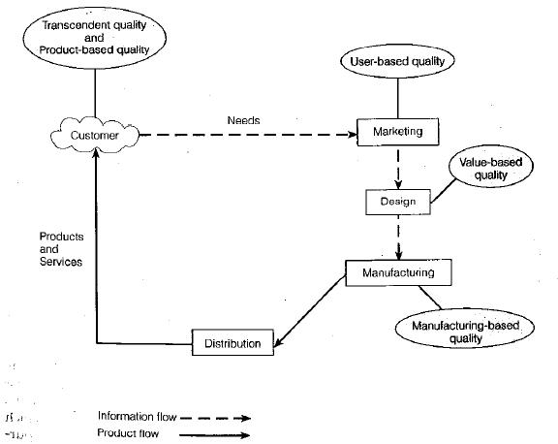
Quality perspectives

Slide 13
Quality levels
At organizational level, we need to ask following questions:
Which products and services meet your expectations?
Which products and services you need that you are not currently receiving?
At process level, we need to ask:
What products and services are most important to the external customer?
What processes produce those products and services?
What are the key inputs to those processes?
Which processes have most significant effects on the organization’s performance standards?

Slide 14
Quality levels
At the individual job level, we should ask:
What is required by the customer?
How can the requirements be measured?
What is the specific standard for each measure?

Slide 15
History of quality management
…To know the future, know the past!
Before Industrial Revolution, skilled craftsmen served both as manufacturers and inspectors, building quality into their products through their considerable pride in their workmanship.
Industrial Revolution changed this basic concept to interchangeable parts. Likes of Thomas Jefferson and F. W. Taylor (“scientific management” fame) emphasized on production efficiency and decomposed jobs into smaller work tasks. Holistic nature of manufacturing rejected!

Slide 16
History of quality management
Statistical approaches to quality control started at Western Electric with the separation of inspection division. Pioneers like Walter Shewhart, George Edwards, W. Edwards Deming and Joseph M. Juran were all employees of Western Electric.
After World War II, under General MacArthur's Japan rebuilding plan, Deming and Juran went to Japan.
Deming and Juran introduced statistical quality control theory to Japanese industry.
The difference between approaches to quality in USA and Japan: Deming and Juran were able to convince the top managers the importance of quality.

Slide 17
History of quality management
Next 20 odd years, when top managers in USA focused on marketing, production quantity and financial performance, Japanese managers improved quality at an unprecedented rate.
Market started preferring Japanese products and American companies suffered immensely.
America woke up to the quality revolution in early 1980s. Ford Motor Company consulted Dr. Deming to help transform its operations.
(By then, 80-year-old Deming was virtually unknown in USA. Whereas Japanese government had instituted The Deming Prize for Quality in 1950.)

Slide 18
History of quality management
Managers started to realize that “quality of management” is more important than “management of quality.” Birth of the term Total Quality Management (TQM).
TQM – Integration of quality principles into organization’s management systems.
Early 1990s: Quality management principles started finding their way in service industry. FedEx, The Ritz-Carton Hotel Company were the quality leaders.
TQM recognized worldwide: Countries like Korea, India, Spain and Brazil are mounting efforts to increase quality awareness.

Slide 19
Evolution of TQM philosophies
The Deming Philosophy
Definition of quality, “A product or a service possesses quality if it helps somebody and enjoys a good and sustainable market.”
Improve quality
Decrease cost because of less rework, fewer mistakes.
Productivity improves
Long-term competitive strength
Stay in business
Capture the market with better quality and reduced cost.

Slide 20
The Deming philosophy
14 points for management:
Create and publish to all employees a statement of the aims and purposes of the company. The management must demonstrate their commitment to this statement.
Learn the new philosophy.
Understand the purpose of inspection – to reduce the cost and improve the processes.
End the practice of awarding business on the basis of price tag alone.
Improve constantly and forever the system of production and service.

Slide 21
The Deming philosophy
Institute training
Teach and institute leadership.
Drive out fear. Create an environment of innovation.
Optimize the team efforts towards the aims and purposes of the company.
Eliminate exhortations for the workforce.
Eliminate numerical quotas for production.
Remove the barriers that rob pride of workmanship.
Encourage learning and self-improvement.
Take action to accomplish the transformation.

Slide 22
The Deming philosophy
“A System of Profound Knowledge”
Appreciation for a system - A system is a set of functions or activities within an organization that work together to achieve organizational goals. Management’s job is to optimize the system. (not parts of system, but the whole!). System requires co-operation.
Psychology – The designers and implementers of decisions are people. Hence understanding their psychology is important.

Slide 23
The Deming philosophy
Understanding process variation – A production process contains many sources of variation. Reduction in variation improves quality. Two types of variations- common causes and special causes. Focus on the special causes. Common causes can be reduced only by change of technology.
Theory of knowledge – Management decisions should be driven by facts, data and justifiable theories. Don’t follow the managements fads!

Slide 24
The Juran philosophy
Pursue quality on two levels:
The mission of the firm as a whole is to achieve high product quality.
The mission of each individual department is to achieve high production quality.
Quality should be talked about in a language senior management understands: money (cost of poor quality).
At operational level, focus should be on conformance to specifications through elimination of defects- use of statistical methods.

Slide 25
The Juran philosophy
Quality Trilogy –
Quality planning: Process of preparing to meet quality goals. Involves understanding customer needs and developing product features.
Quality control: Process of meeting quality goals during operations. Control parameters. Measuring the deviation and taking action.
Quality improvement: Process for breaking through to unprecedented levels of performance. Identify areas of improvement and get the right people to bring about the change.

Slide 26
The Crosby philosophy
Absolute’s of Management
Quality means conformance to requirements not elegance.
There is no such thing as quality problem.
There is no such thing as economics of quality: it is always cheaper to do the job right the first time.
The only performance measurement is the cost of quality: the cost of non-conformance.
Basic Elements of Improvement
Determination (commitment by the top management)
Education (of the employees towards Zero Defects (ZD))
Implementation (of the organizational processes towards ZD)

Slide 27
TQM for Middle Management
Process Management
Statistical Process Control (SPC)

Slide 28
Process management
Planning and administrating the activities necessary to achieve high quality in business processes; and also identifying opportunities for improving quality and operational performance – ultimately, customer satisfaction.
Process simplification reduces opportunities for errors and rework.
Processes are of two types – value-added processes and support processes.
Value-added processes – those essential for running the business and achieving and maintaining competitive advantage. (Design process, Production/Delivery process)

Slide 29
Process management
Support processes – Those that are important to an organization’s value-creation processes, employees and daily operations.
Value creation processes are driven by external customer needs while support processes are driven by internal needs.
To apply the techniques of process management, a process must be repeatable and measurable.
Process owners are responsible for process performance and should have authority to manage the process. Owners could range from high-level executive to workers who run a cell.
Assigning owners ensures accountability.

Slide 30
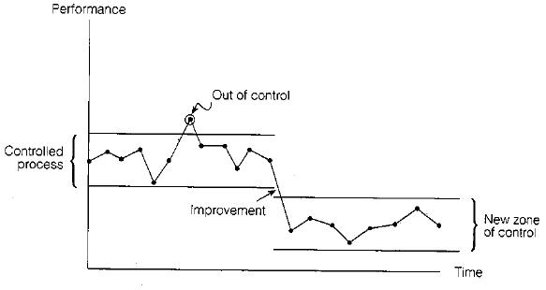
Process management

Slide 31
Process control
Control is the activity of ensuring the conformance to the requirements and taking corrective action when necessary.
Two reasons for controlling the process
Process control methods are the basis of effective daily management of processes.
Long-term improvements can not be made to a process unless the process is first brought under control.
Short-term corrective action should be taken by the process owners. Long-term remedial action should be the responsibility of the management.

Slide 32
Process control
Effective quality control systems include
Documented procedures for all key processes
A clear understanding of the appropriate equipment and working environment
Methods of monitoring and controlling critical quality characteristics
Approval processes for equipment
Criteria for workmanship: written standards, samples etc.
Maintenance activities

Slide 33
Process improvement
Customer loyalty is driven by delivered value.
Delivered value is created by business processes.
Sustained success in competitive markets require a business to continuously improve delivered value.
To continuously improve value creation ability, a business must continuously improve its value creation processes.
Continuous process improvement is an old management concept dating back to 1895. However, those approaches were mainly productivity related.
More recently (1951) Toyota implemented Just-In-Time which relies on zero defects and hence continuous improvement!

Slide 34
Process improvement: Kaizen
Japanese for gradual and orderly continuous improvement over a long period of time with minimum financial investment, and with participation by everyone in the organization.
Improvement in all areas of business serves to enhance quality of the firm.
Three things required for successful kaizen program: operating practices, total involvement, and training.
Operating practices expose opportunities for improvement. JIT reveals waste and inefficiency as well as poor quality.

Slide 35
Process improvement: Kaizen
Every employee strives for improvement. Top management views improvement as part of strategy and supports it. Middle management can implement top management’s improvement goals by establishing, maintaining, and upgrading operating standards. Workers can engage through suggestions, small group activity.
Middle management can help create conducive environment for improvement by improving cooperation amongst departments, and by making employees conscious of their responsibilities for improvement.
Supervisors can direct their attention more on improvement than supervision, which will facilitate communication.

Slide 36
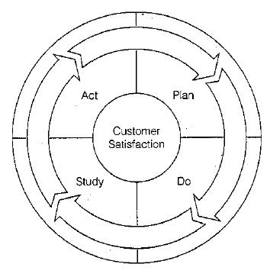
Kaizen: Implementation
The Deming cycle: Originally developed by Walter Shewart, but renamed in 1950s because Deming promoted it extensively.

Slide 37
Kaizen: Implementation
Plan – Study the current system; identifying problems; testing theories of causes; and developing solutions.
Do – Plan is implemented on a trial basis. Data collected and documented.
Study – Determine whether the trial plan is working correctly by evaluating the results.
Act – Improvements are standardized and final plan is implemented.
Variation of PDSA cycle: FADE – Focus, Analyze, Develop, Execute cycle!

Slide 38
Kaizen: Implementation
Juran’s breakthrough sequence:
Proof of the need
Project identification
Organization for breakthrough – two paths identified: symptom to cause (diagnostic) and cause to remedy (remedial) paths.
Diagnostic journey
Remedial journey
Holding the gains.

Slide 39
Process improvement tools
Seven QC Tools
Flow charts
Check sheets
Histograms
Pareto diagrams
Cause-and-effect diagrams
Scatter diagrams
Control charts

Slide 40
Flow charts
Process map identifies the sequence of activities or the flow in a process.
Objectively provides a picture of the steps needed to accomplish a task.
Helps all employees understand how they fit into the process and who are their suppliers and customers.
Can also pinpoint places where quality-related measurements should be taken.
Also called process mapping and analysis.
Very successfully implemented in various organizations. e.g. Motorola reduced manufacturing time for pagers using flow charts.

Slide 41
Check sheets
Special types of data collection forms in which the results may be interpreted on the form directly without additional processing.
Data sheets use simple columnar or tabular forms to record data. However, to generate useful information from raw data, further processing generally is necessary.
Additionally, including information such as specification limits makes the number of nonconforming items easily observable and provides an immediate indication of the quality of the process.

Slide 42
Check sheets

Slide 43
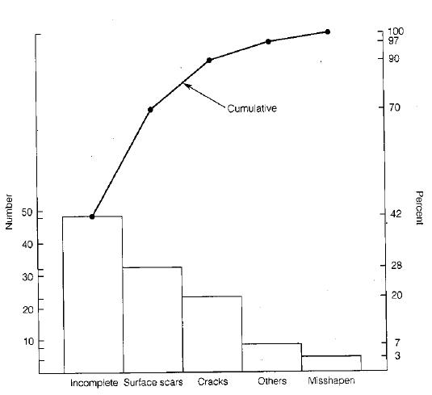
Pareto diagrams
Based on the 85-15 Pareto distribution.
Helpful in identifying the quality focus areas.
Popularized by Juran.
It is a histogram of the data from the largest frequency to the smallest.

Slide 44
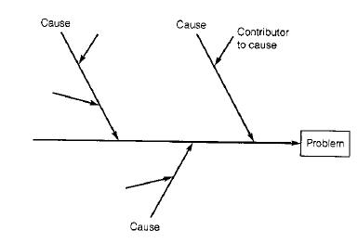
Cause-effect diagrams
Also called fishbone diagrams (because of their shape) or Ishikawa diagrams.
Helps in identifying root causes of the quality failure. (Helps in the diagnostic journey.)

Slide 45
Scatter diagrams
Graphical components of the regression analysis.
Often used to point out relationship between variables. Statistical correlation analysis used to interpret scatter diagrams.

Slide 46
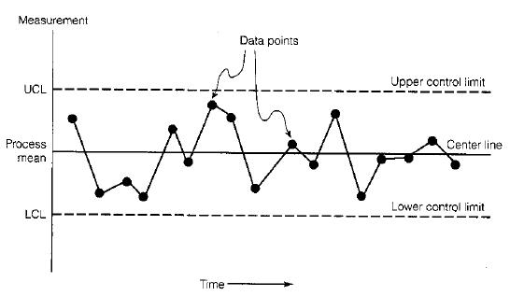
Run charts and Control charts
Run chart: Measurement against progression of time.
Control chart: Add Upper Control Limit and Lower Control Limit to the run chart.

Slide 47
TQM for the Workforce
Kaizen teams
Quality Circles

Slide 48
Quality circles
Teams of workers and supervisors that meet regularly to address work-related problems involving quality and productivity.
Developed by Kaoru Ishikawa at University of Tokyo.
Became immediately popular in Japan as well as USA.
Lockheed Missiles and Space Division was the leader in implementing Quality circles in USA in 1973 (after their visit to Japan to study the same).
Typically small day-to-day problems are given to quality circles. Since workers are most familiar with the routine tasks, they are asked to identify, analyze and solve quality problems in the routine processes.

Slide 49
Additional process improvement tools
Kaizen blitz
An intense and rapid improvement process in which a team or a department throws all its resources into an improvement project over a short period of time.
Short time “burst” rather than long range simmer- hence the name.
Blitz teams usually comprise of employees from all areas involved in the process who understand it and can implement the changes on the spot.

Slide 50
Additional process improvement tools
Poka-Yoke (Mistake proofing)
Approach for mistake-proofing processes using automatic devises or methods to avoid simple human error.
Developed and refined in the 1960s by the late Shigeo Shingo, a Japanese manufacturing engineer who developed the Toyota production system.
Focused on two aspects:
Prediction – Recognizing that a defect is about to occur and provide a warning.
Detection – Recognizing that a defect has occurred and stop the process.

Slide 51
Quality Management Awards and Framework
ISO 9000: 2000
Malcolm Baldrige National Quality Award
Deming Prize
Six Sigma

Slide 52
ISO 9000: 2000
Created by International Organization for Standardization (IOS) which was created in 1946 to standardize quality requirement within the European market.
IOS initially composed of representatives from 91 countries: probably most wide base for quality standards.
Adopted a series of written quality standards in 1987 (first revised in 1994, and more recently (and significantly) in 2000).
Prefix “ISO” in the name refers to the scientific term “iso” for equal. Thus, certified organizations are assured to have quality equal to their peers.

Slide 53
ISO 9000: 2000
Defines quality systems standards based on the premise that certain generic characteristics of management principles can be standardized.
And that a well-designed, well-implemented and well managed quality system provides confidence that outputs will meet customer expectations and requirements.
Standards are recognized by 100 countries including Japan and USA.
Intended to apply to all types of businesses. (Recently, B2B firm bestroute.com became the first e-commerce company to get ISO certification.)

Slide 54
ISO 9000: 2000
Created to meet five objectives:
Achieve, maintain, and seek to continuously improve product quality in relation to the requirements.
Improve the quality of operations to continually meet customers’ and stakeholders’ needs.
Provide confidence to internal management that quality requirements are being met.
Provide confidence to the customers that quality requirements are being met.
Provide confidence that quality system requirements are fulfilled.

Slide 55
ISO 9000: 2000 structure
Consists of three documents
ISO 9000 – Fundamentals and vocabulary.
ISO 9001 – Requirements.
Organized in four sections: Management Responsibility; Resource Management; Product Realization; and Measurement, Analysis and Improvement.
ISO 9004 – Guidelines for performance improvements.

Slide 56
ISO 9000: 2000 Quality Management Principles
Principle 1: Customer Focus
Principle 2: Leadership
Principle 3: Involvement of people
Principle 4: Process approach
Principle 5: Systems approach for management
Principle 6: Continual improvement
Principle 7: Factual approach to decision making
Principle 8: Mutually beneficial supplier relationships.

Slide 57
ISO 9000: 2000 registration
Originally intended to be a two-party process where the supplier is audited by its customers, the ISO 9000 process became a third-party accreditation process.
Independent laboratory or a certification agency conducts the audit.
Recertification is required every three years.
Individual sites – not entire company – must achieve registration individually.
All costs are to be borne by the applicant.
A registration audit may cost anywhere from $10,000 to $40,000.
(more information at http://www.iso.ch)

Slide 58
Six Sigma
Business improvement approach that seeks to find and eliminate causes of defects and errors in processes by focusing on outputs that are critical to customers.
The term Six Sigma is based on a statistical measure that equates 3.4 or fewer errors or defects per million opportunities.
Motorola pioneered the concept of Six Sigma.
The late Bill Smith, a reliability engineer is credited with conceiving the idea of Six Sigma.
GE (specifically CEO Jack Welch) extensively promoted it.

Slide 59
Six Sigma
Core philosophy based on key concepts:
Think in terms of key business processes and customer requirements with focus on strategic objectives.
Focus on corporate sponsors responsible for championing projects.
Emphasize quantifiable measures such as defects per million opportunities (dpmo).
Ensure appropriate metrics is identified to maintain accountability.
Provide extensive training.
Create highly qualified process improvement experts -“belts”.
Set stretch objectives for improvement.

Slide 60
Six Sigma
Contrasts between traditional TQM and Six Sigma (SS) -
TQM is based largely on worker empowerment and teams; SS is owned by business leader champions.
TQM is process based; SS projects are truly cross-functional.
TQM training is generally limited to simple improvements tools and concepts; SS is more rigorous with advanced statistical methods.
TQM has little emphasis on financial accountability; SS requires verifiable return on investment and focus on bottom line.

Slide 61
TQM for Top Management
Strategic Quality Management (SQM)
Competitive Advantage

Slide 62
SQM: Hoshin planning
Hoshin kanri: Japanese for management cycle build around Plan, Do, Check, Act. Elements of this cycle include –
Quality policies
Quality goals
Deployment of goals
Plans to meet goals
Organizational structure
Resources
Measurement feedback
Review of progress
Training

Slide 63
SQM: Vision/Mission statement
Developed by taking everyone in confidence. Guide for the Quality journey. Ties quality to overall business goals.
Vision Statement: Collection of quality policies. A vision statement outlines what a company wants to be. It focuses on tomorrow; it is inspirational; it provides clear decision-making criteria; and it is timeless. A vision needs to address three areas: people, culture (or values) and product or service.
Mission statement: A mission statement outlines what the company is now. It focuses on today; it identifies the customers; it identifies the critical processes; and it states the level of performance.

Slide 64
SQM: Vision/Mission statement
It has been said that a vision is something to be pursued, while a mission is something to be accomplished.
Mission is what you do best every day, and vision is what the future looks like because you do that mission so exceedingly well.
For vision – Think leading with inspiration and courage, obsessed with future possibility.
For mission – Think managing with greatness and untamed strength, improving everything daily.
Famous vision statement – “By the end of the decade, we will put a man on the moon.” JFK.
Famous mission statement – “CRUSH REEBOK.” Nike

Slide 65
SQM: Quality policies
Prepared to provide guidelines for planning the overall quality program; and defining the action to be taken in situation for which personnel had requested guidelines.
Policies state: a) a principle to be followed; b) what is to be done.
Examples of quality policy – For a computer manufacturer: “In selecting suppliers, decision makers are responsible for choosing the best source even if this means internal sources are not selected.”

Slide 66
SQM: Quality goals
A goal (or objective) is a statement of the desired result to be achieved within a specified period – an aimed-at target.
These goals then become basis for detailed planning of activities.
Tactical goals are short range (up to 1 year), whereas strategic goals are long range (say, 5 years).
Examples of corporate quality goals – For a health product company, the quality goals over the next year could be: “The average leakage rate for …. product shall be reduced to …”
Note that quality goal statements include quantified data.
Typically Pareto analysis is used to develop the quality goals.

Slide 67
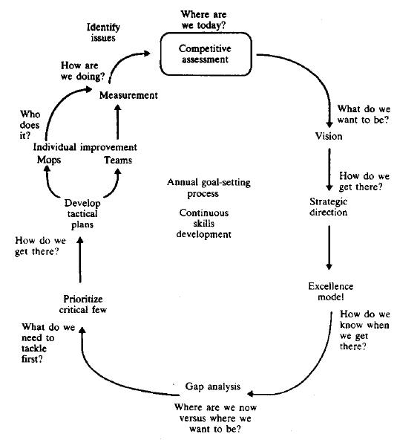

Slide 68
SQM: Deploying quality goals
Broad goals don’t lead to results. First they have to be deployed as follows:
Division and subdivision of the goal until specific deeds to be done are identified.
Allocation of responsibility of doing these deeds.
Provision for the needed resource.

Slide 69
SQM: Caveats
Reasons of failure of SQM could be
Lack of leadership by upper management.
Lack of infrastructure for quality.
Failure to understand the skepticism about the “new quality program.”
Management assumption that the exhortation approach will work.
Failure to start small and learn from pilot programs.
Reliance on specific techniques as the primary means.
Underestimating the time and resource required.

