Slide 1

WEL COME TO FORCE MOTORS LIMITED

Slide 2
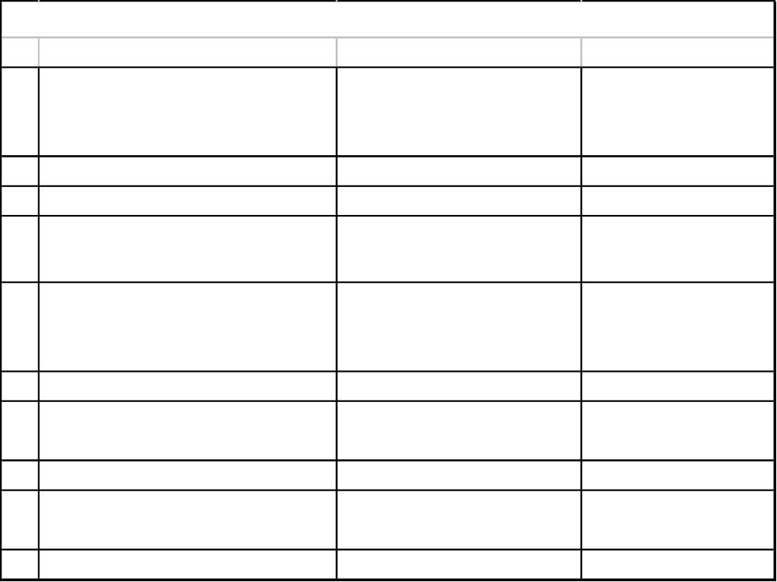

Slide 3
To understand our quality requirement
& upgrade to achieve this through
Suppliers Quality Improvement Program.
Objective of Meeting
Next

Slide 4
.
A)ISO 9001/TS16949 requirement.
B)To assess supplier quality system
& ensure defect free parts.
C)TO Avoid inspection at Force motors
D)QMS Up gradation at your end.
Why SQIP ?
Next

Slide 5
Before starting about SQIP we would
like to inform our Business partners that:-
-We had a similar program in year
2001-2002 to introduce this concept.
-We are very happy to announce that with
active support from our Business Partners
we brought 75 vendors under STU status
through SQIP out of 148 vendors.
(in Transmission Division)
Next

Slide 6
-Considering the response we have a thought
of meeting once again with our Business
Partners,those who are not covered under
SQIP.
-We expect your active participation to
implement this concept which will
result in consistent product quality.
Next

Slide 7
What is
Suppliers Quality Improvement Program
(i.e SQIP) ?
-This is a 10 steps program.
Next

Slide 8
10 STEPS OF SQIP.
STEP 1 & 2 :-
1) SUPPLIER ASSESMENT & ORIENTATION.
2) SUPPLIER SELF EVALUATION.
PREPARE A TEAM OF APPROPRIATE PERSONS,
AS AUDITORS WITHIN YOURORGANISATION &
EVALUATE YOUR QUALITY SYSTEMS-WITH A
CRITICISM IN ORDER TO IMPROVE.
“SELF EVALUATION CHECK LIST ATTACHED IN
FOLDER”
Next

Slide 9
STEP 3 :-
EVALUATION OF SUPPLIER QUALITY SYSTEM
ONCE YOU YOURSELF ARE SATISFIED WITH
YOUR SYSTEM, A TEAM FROM FML WILL AUDIT
YOUR SYSTEM FOR COMPLIANCE & WILL
SUGGEST IMPROVEMENTS IF FOUND NECESSARY.
A SUCCESSFUL AUDIT OF QMS IS MAJOR STEP IN
PROGRAMME (SYSTEM AUDIT).
STEP 4 :-PART LEVEL CONTROL PLANS
EACH ITEM MANUFACTURED FOR FML SHOULD
HAVE CONTROL PLAN.
Next

Slide 10
CONTROL PLAN CONSIST OF FOLLOWINGS :
A) PART DRAWING & RELATED STANDARD
B) OPERATION SEQUENCE & PROCESS FLOW DIAGRAM -
ACTIVITIES FROM RECEIPT OF RAW MATERIAL TO FINAL INSPECTION,
PRESERVATION,PACKING, SHIPMENT OF PRODUCT
C) PROCESS DETAILS LIKE
1) OPERATION
2) MACHINE/EQUIPMENT USED
3) DETAILS OF OPERATION/STEPS/OPERATION DRAWING
4) TOOLS,JIGS,FIXTURES USED.
5) CONTROL CHARACTERISTICS /PARAMETERS& THEIR SPECIFICATIONS
FOR PROCESS & FOR PRODUCT
6) METHOD OF INSPECTION GAUGES/EQUIPMENTS
7) FREQUENCY OF INSPECTION
8) INSPECTION RESPONSIBILITY
9) DATA RECORDING PROCESS
D) QUALITY CONTROL PROCEDURES
E) WORK INSTRUCTION/SOP FOR MANUFACTURING & INSPECTION
ACTIVITIES.
Next

Slide 11
F) INSPECTION STATUS & TRACEABILITY PROCEDURE
G) PRESERVATION PACKING,SHIPPING SPECIFICATIONS/DATA
RECORDING.
H) CORRECTIVE ACTION LOOP
1) PROCESS OF COLLECTING DATA OF INTERNAL REWORK & REJECTION
- PROCESS OF ANALYSIS
- PROCESS OF CAPA
- DATA RECORDING PROCESS & FORMATS
2) PROCESS OF RECEIVING DATA OF EXTERNAL REJECTION
- PROCESS OF ANALYSIS
- PROCESS OF CAPA
- DATA RECORDING PROCESS & FORMATS.
- FEEDBACK TO FML ON CORRECTIVE ACTIONS/PREVENTIVE
- ACTIONSFOLLOW UPS
X) SETTING APPROVALS:- PROCESS,FORMATS
RESPOSIBILTIES
SETTING REJECTION CONTROL
PROCEDURE
XX)PATROL INSPECTION AS PER PROCESS SHEET:-
PROCESS FORMATS RESPONSIBILITY REJECTION CONTROL PROCEDURE

Slide 12
iii)FINAL INSPECTION:- CHECK LIST
DATA RECORDING
STATUS IDENTIFICATION
NC CONTROL PROCEDURE(REWORK
SCRAP USE UNDER DEVIATION)
iv)INSPECTION REPORT(PDIR) TO BE SENT TO FML ALONG WITH EACH
CONSIGNMENT IN LINE WITH FML INSPECTION PLAN
STEP 5:-PRODUCT QUALIFICATIONS:-
-IMPLEMENTATION OF ABOVE PLANS IN EVERY DAY PRACTICE
-EVIDANCES OF COMPLIANCE
-RESULTS AT FML
-QUALITY RECORDS
THIS WILL BE AUDITED BY FML AUDITOR
DURING PRODUCT AUDIT
Next

Slide 13
STEP 6 :-DEMONSTRATION OF TOTAL QUALITY
CAPABILITY
- QUALITY PERFORMANCE FOR LAST SIX MONTHS
- PERIODIC AUDITS OF QUALITY SYSTEMS(PLANNED
& SURPRISE AUDITS)
- RESPONSE TO FML
- CONTINUOUS IMPROVEMENT TREND WILL BE
MONITORED BY FML
STEP 7:-ACHEIVEMENT OF SHIP TO USE(STU)
-CONSISTENTLY GOOD PERFORMANCE & AUDIT RESULTS
WILL MAKE YOU TO ACHIEVE “SHIP TO USE” STATUS
WHERE PARTS ARE NOT CHECKED AT FML RECEIPT
INSPECTION & WILL BE SENT DIRECTLY FOR USE.
-RESPONSIBILITY OF QUALITY LIES WITH YOU
-IN CASE OF REJECTION YOU HAVE TO RESPOND ON
PRIORITY.REJECTION WILL HAMPER THIS STATUS
-REVIEW OF SYSTEM FAILURE & YOUR RESPONSE
WILL DECIDE COURSE OF ACTION
Next

Slide 14
STEP 8:- IMPLEMENT QUALITY
MAINTANENCE ACTIVITY
STEP 9:- PRE-CERTIFICATION
REVIEW.
STEP10. CERTIFICATION
Next

Slide 15
1) SYSTEM AUDIT.
IT IS BASED ON FOLLOWING PROCESSES
a) QUALITY MANAGEMENT
QUALITY POLICY DOCUMENTED
QUALITY MANUAL DOCUMENTED
QUALITY PROGRAMS CONDUCTED
(Quality Circles;7Tools;Task forces & etc.)
Next

Slide 16
INVOLVEMENT OF UPPER
MANAGEMENT IN QUALITY &
CONTINUOUS IMPROVEMENT
TRAINING PROGRAMS
STATISTICAL TECHINUQUES USED
b)QUALITY PLANNING
CONTROL PLANS AVAILABLE(PART
DRAWING;OPERATIONAL SEQUENCE/
PROCESS FLOW DIAGRAM;MACHINES;
TOOLS; FIXTURES; GAUGES & FREQUENCY
OF INSPECTION
Next

Slide 17
PRODUCT & PROCESS AUDIT ARE
CONDUCTED
PREVENTIVE MAINTANENCE CARRIED
OUT FOR MACHINES;JIGS & FIXTURES
DRAWINGS WITH LATEST REVISIONS
AVAILABLE & UPDATED
Next

Slide 18
C) PURCHASED MATERIAL
PROCEDURE AVAILABLE
FACILITIES/RESOURCES FOR INSPECTION
& TESTING
NON CONFORMING MATERIAL
CONTROLLED(Traceability;Identification)
5 S (HOUSE KEEPING)
Next

Slide 19
D) PROCESS
AREAS DEFINED FOR MATERIAL
(In-process; Finished; Rework; Rejection/Scrap)
WORK INSTRUCTION AVAILABLE
FIRST PIECE & INPROCESS INSPECTION
CARRIED OUT
ANALYSIS OF NON CONFIRMING
MATERIAL
Next

Slide 20
CORRECTIVE & PREVENTIVE ACTIONS
TAKEN.
RECORD OF CUSTOMER COMPLAINTS
TO BE MAINTAINED & FEED BACK.
OBJECTIVES TO BE DEFINED TARGET
BASED(Rejection;Rework;Breakdown hours)
5 S (HOUSE KEEPING)
Next

Slide 21
E) FINISHED PRODUCTS
INSPECTION PLANS FOR FINAL
INSPECTION AVAILABLE.
IDENTIFICATION & TRACEABILITY OF
FINISHED PRODUCT.
NON COFIRMING PRODUCTS ANALYSED
DISPOSED & RECORDS CREATED
PROCESS OF CORRECTIVE &
PREVENTIVE ACTION
Next

Slide 22
AWARENESS OF CUSTOMER
REQUIREMENT & COMPLAINTS
PREDESPATCH INSPECTION REPORTS
TO BE SENT
CUSTOMER SATISFACTION SURVEY
5S
F) PROCEDURE FOR NON CONFORMING
PRODUCT.
Next

Slide 23
G) MEASURING & TESTING EQUIPMENT
SYSTEM OF NEW GAUGE/
INSTRUMENT INSPECTION.
SYSTEM OF PERIODIC CALIBRATION.
HANDLING & STORAGE OF GAUGES
INSTRUMENTS
H) GENERAL OBSERVATIONS
IS QUALITY 1st PRIORITY OF MGMT.
(Mgmt review meeting conducted)
CONTINUOUS IMPROVEMENT.
Next

Slide 24
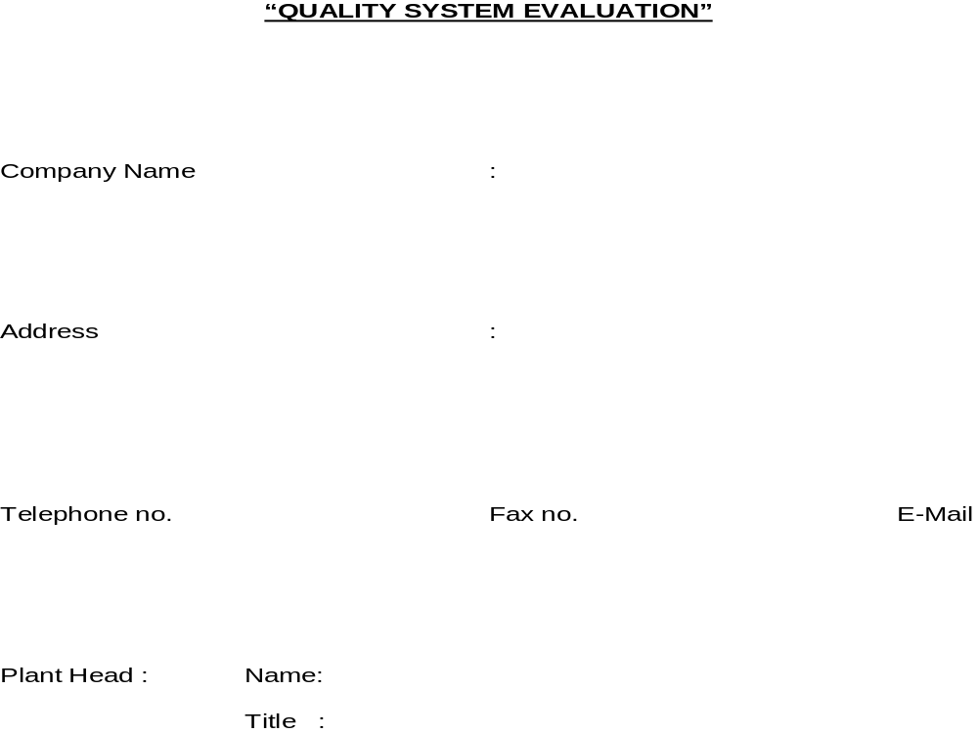
Next

Slide 25
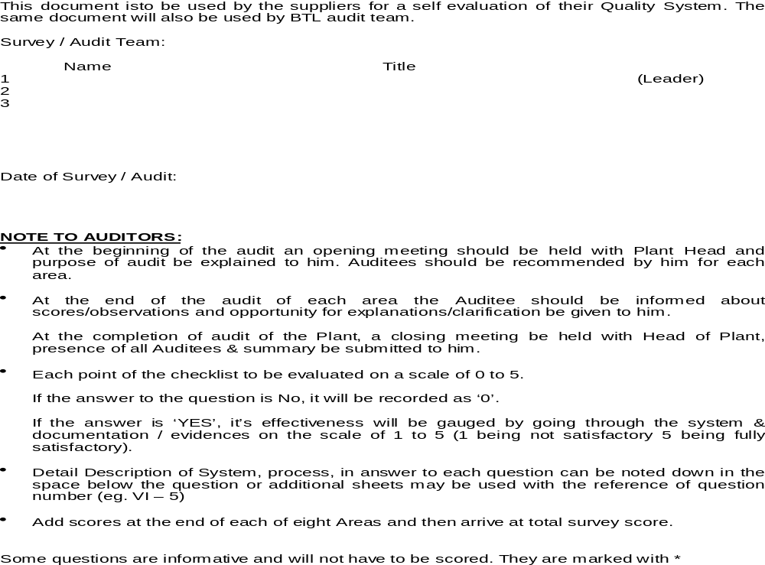
Next

Slide 26
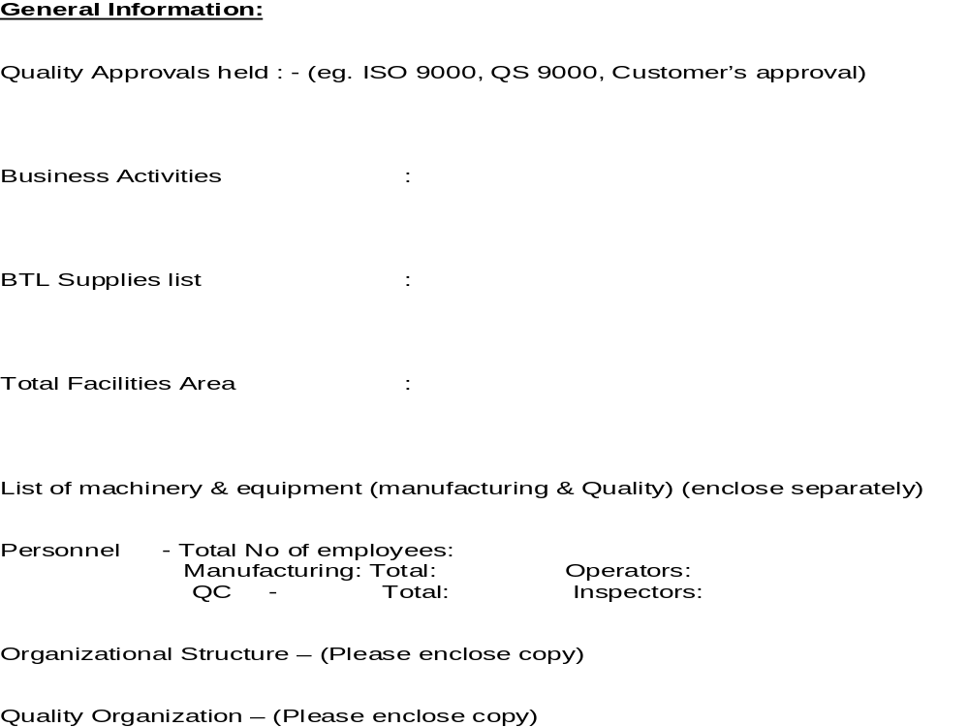
Next

Slide 27
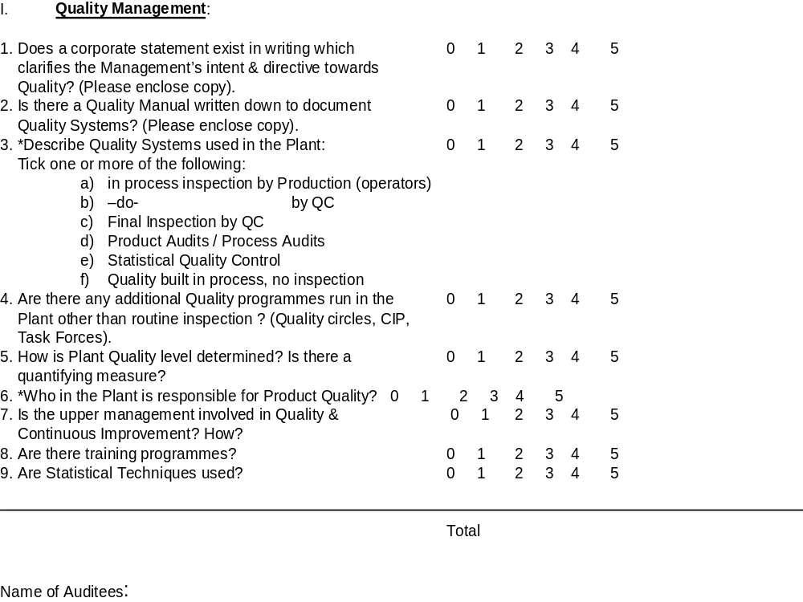
Next

Slide 28
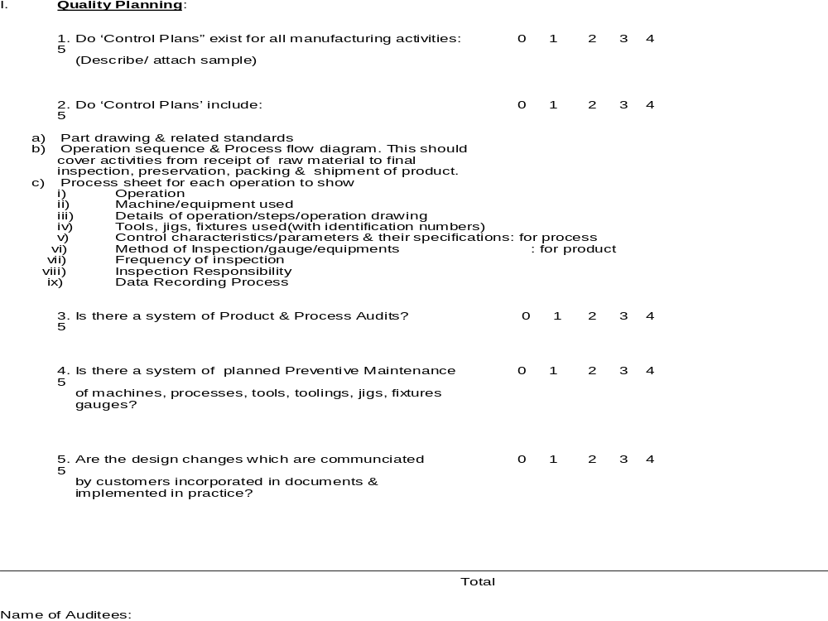
Next

Slide 29
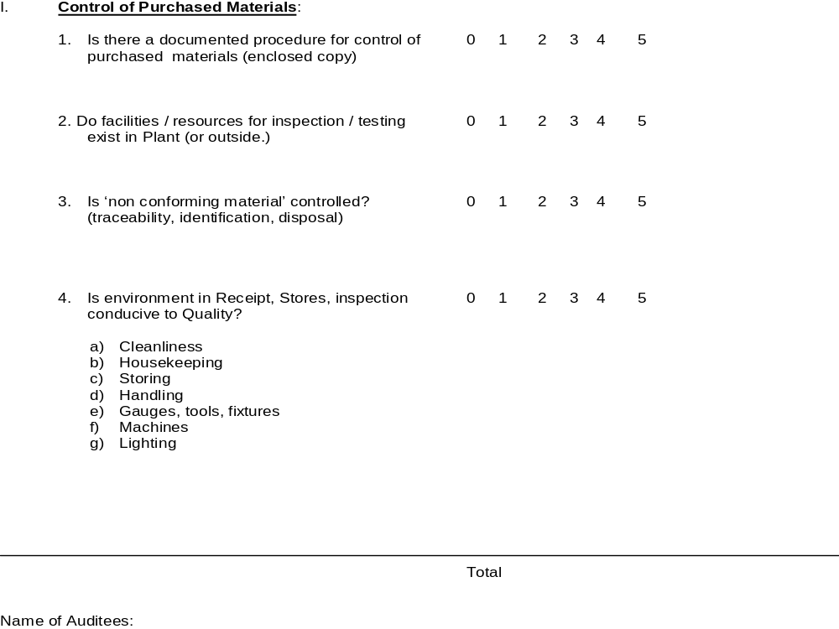
Next

Slide 30
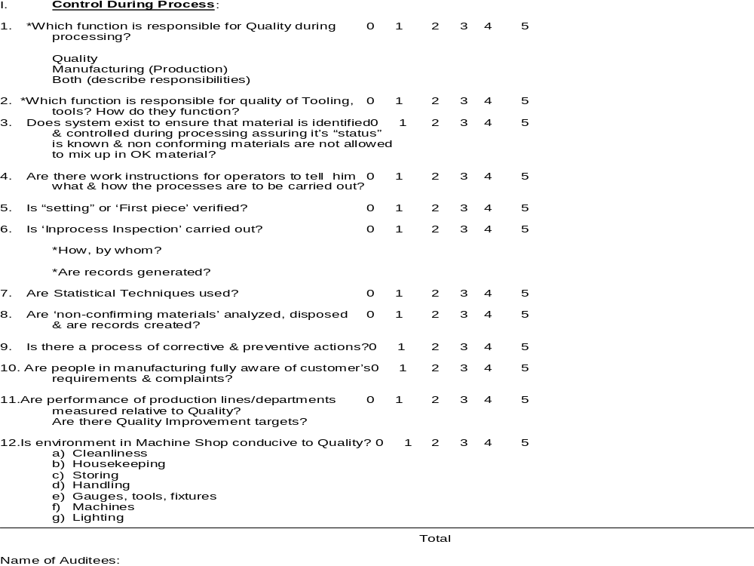
Next

Slide 31
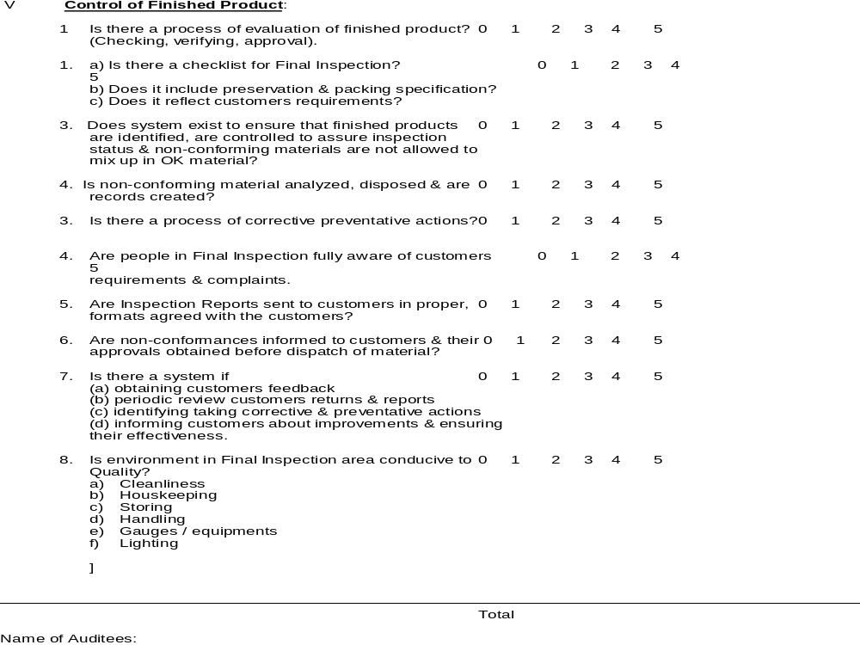
Next

Slide 32
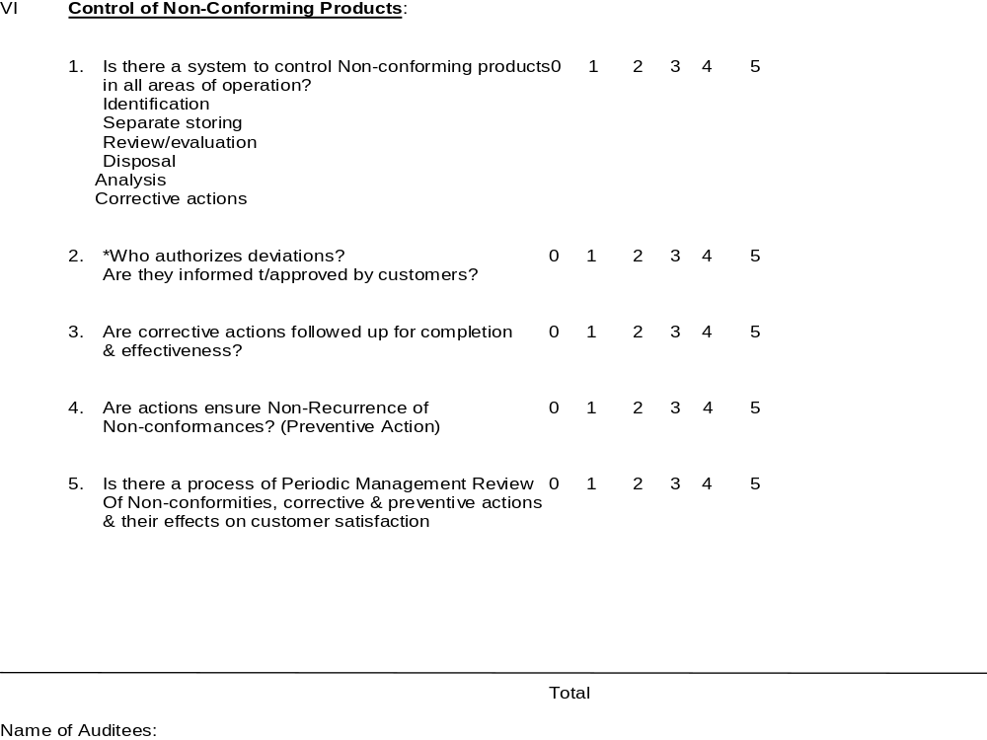
Next

Slide 33
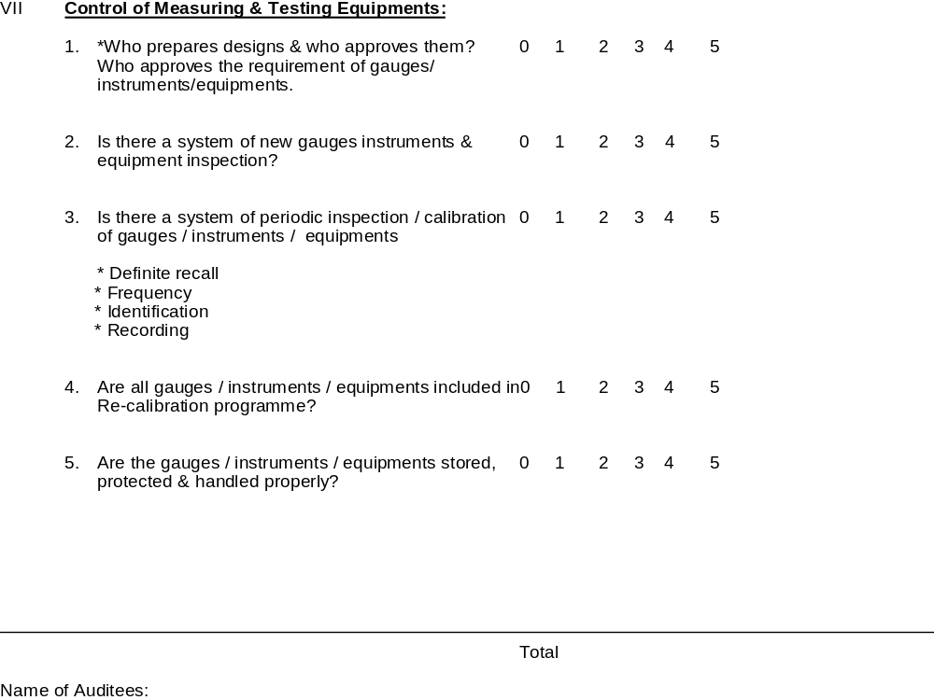
Next

Slide 34
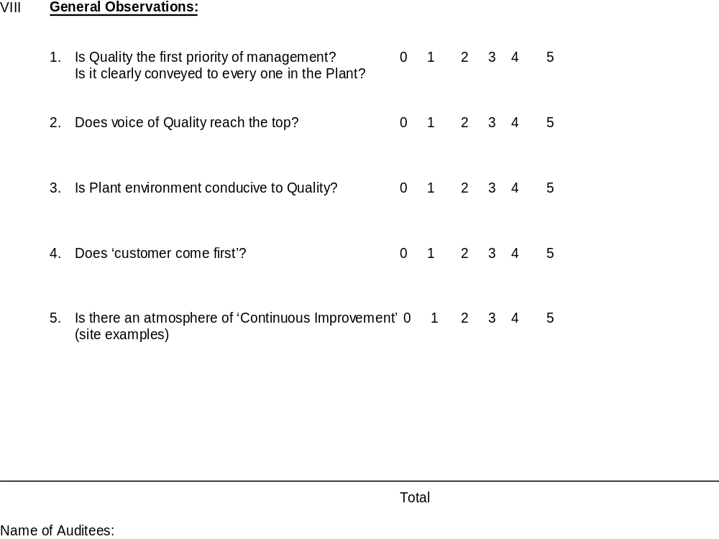
Next

Slide 35
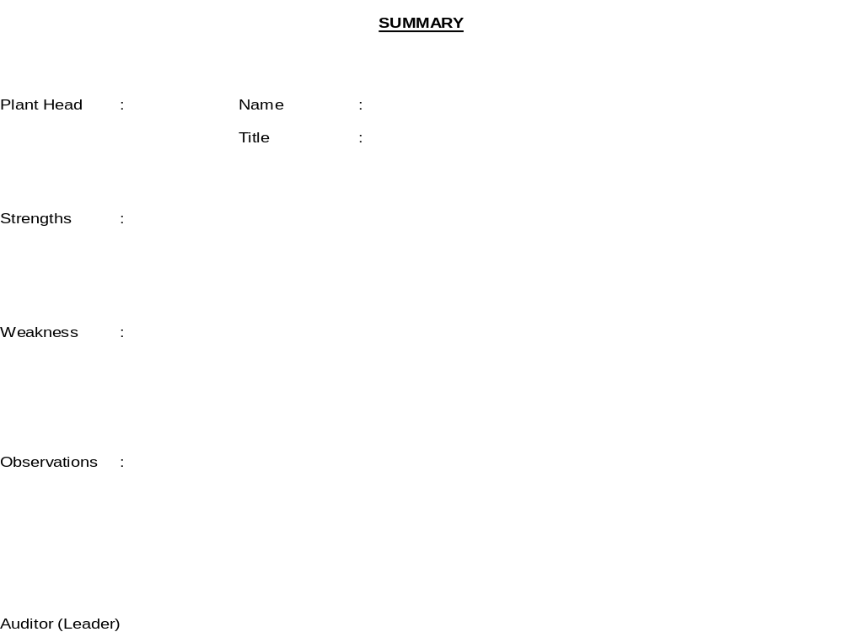
Next

Slide 36
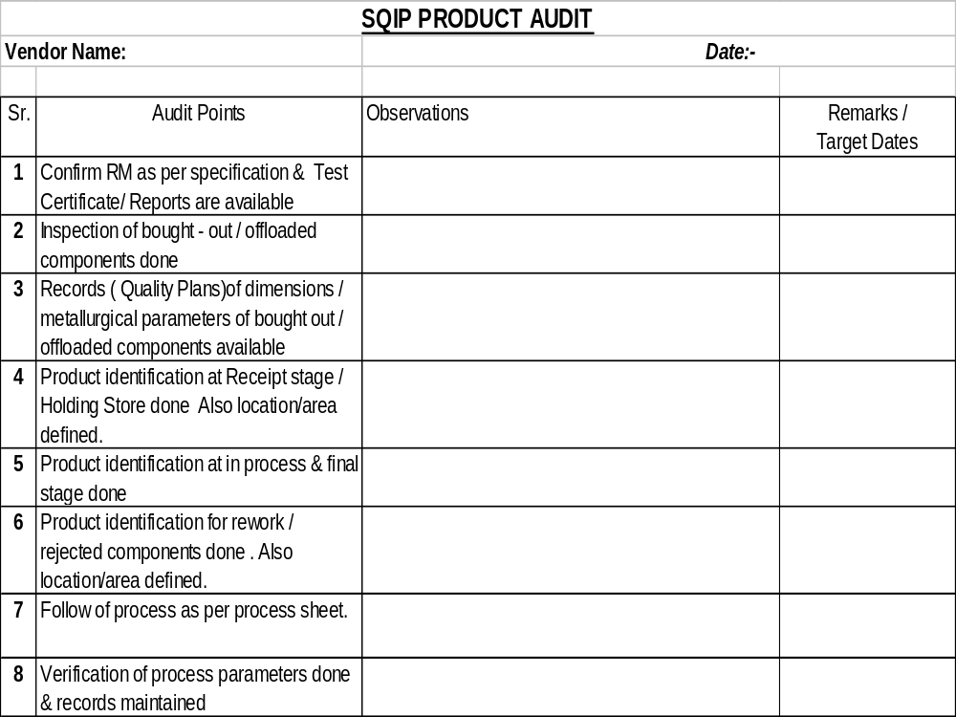
Next

Slide 37
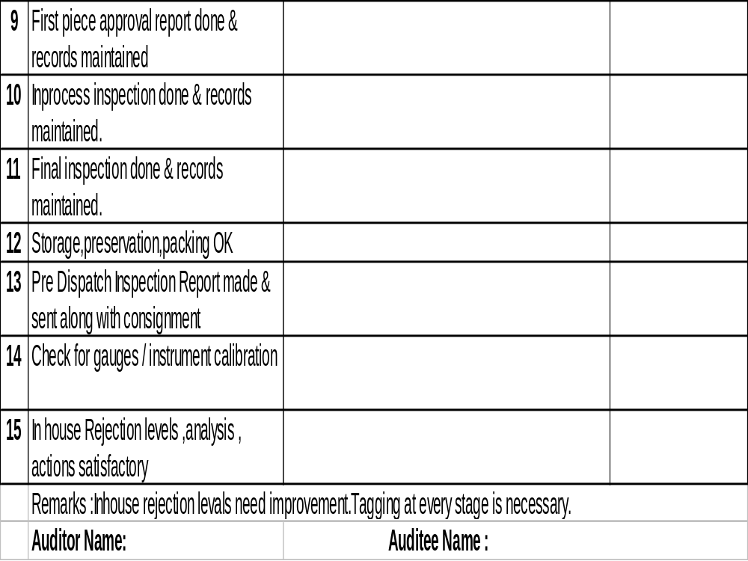
Next

Slide 38
Next

Slide 39
Next

Slide 40

THANK YOU

