Slide 1
WELCOME
TO THE WORK SHOP ON
INTRODUCTION
7 QC TOOLS

Slide 2
LIST OF 7 QC TOOLS
Check sheet
Histogram
Pareto diagram
Cause and effect diagram
Scatter diagram
Stratification
Graphs and control charts
7 QC TOOLS

Slide 3
WHEN TO USE IT
Use it when data is to be recorded manually, to ensure the
data is accurately recorded and is easy to use later, either
for direct interpretation or for transcription, for example
into a computer.
Use it when the recording involves counting, classifying,
checking or locating.
Use it when it is useful to check each measurement as it is
recorded, for example that it is within normal bounds.
Use it when it is useful to see the distribution of measures
as they are built up.
CHECK SHEET

Slide 4
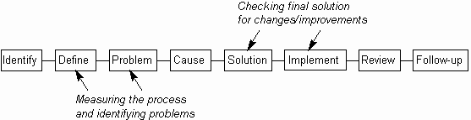
WHEN TO USE IT
CHECK SHEET

Slide 5
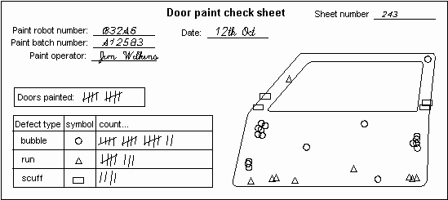
CHECK SHEET

Slide 6
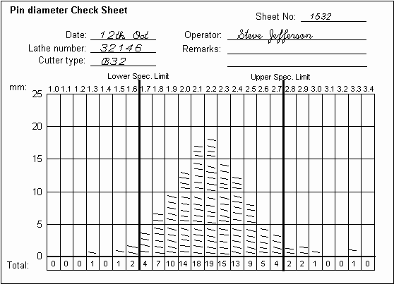
PROCESS DISTRIBUTION SHEET
CHECK SHEET

Slide 7
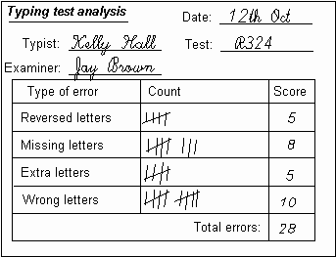
DEFECTIVE ITEM CHECHSHEET
CHECK SHEET

Slide 8
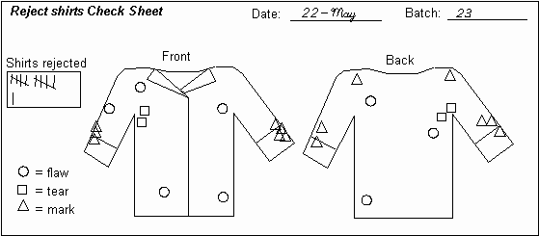
LOCATION PLOT
CHECK SHEET

Slide 9
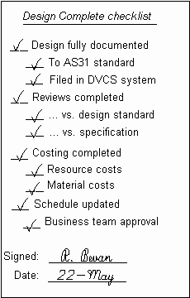
DESIGN CHECK LIST
CHECK SHEET

Slide 10
HISTOGRAM:WHEN TO USE IT
Use it to investigate the distribution of a set of
measurements.
Use it when it is suspected that there are multiple factors
affecting a process, to see if this shows up in the
distribution.
Use it to help define reasonable specification limits for a
process by investigating the actual distribution.
Use it when you want to see the actual shape of the
distribution, as opposed to calculating single figures like the
mean or standard deviation.
HISTOGRAM

Slide 11
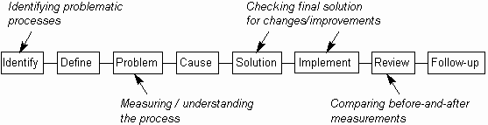
HISTOGRAM:WHEN TO USE IT
HISTOGRAM

Slide 12
HOW TO UNDERSTAND IT
The Histogram shows the frequency distribution across a set of measurements as a set of physical bars. The width of each bar is constant and represents a fixed range of measurements (called a cell, bin or class). The height of each bar is proportional to the number of measurements within that cell. Each bar gives a solid visual impression of the number of measurements in it and together the bars show the distribution across the measurement range.
HISTOGRAM

Slide 13
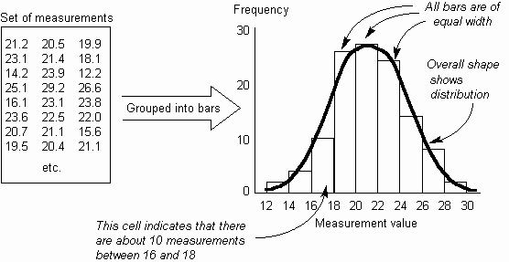
HOW TO UNDERSTAND IT
HISTOGRAM

Slide 14


HISTOGRAM PATTERN
HISTOGRAM PATTERN | SYMPTOM | POSSIBLE PROBLEM
 | Low with gaps | Bar range too narrow There is no continuous flow of data. This is an another version of plateau distribution
 | High with few bars | Could be extreme version of truncated distribution.
HISTOGRAM

Slide 15
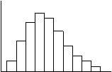

HISTOGRAM PATTERN
HISTOGRAM PATTERN | SYMPTOM | POSSIBLE PROBLEM
 | Skewed (this is positive; negative skew has tail to right) | Natural distribution (more variation in one direction) or incomplete data being used.
 | Exponential | Distribution is not bell-shaped (extreme version of skewed)
HISTOGRAM

Slide 16


HISTOGRAM PATTERN
HISTOGRAM PATTERN | SYMPTOM | POSSIBLE PROBLEM
 | Dual-peaked (bimodal) | Measurement is of two processes. This is very common, e.g. data from two periods, process changed mid-stream.
 | Isolated-peaked | Two processes being measured (well-separated bimodal distribution).
HISTOGRAM

Slide 17

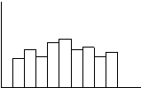
HISTOGRAM PATTERN
HISTOGRAM PATTERN | SYMPTOM | POSSIBLE PROBLEM
 | Cog-toothed (or Combed) | Faulty measurement, rounding error or version of plateau distribution
 | Plateau | Combination of multiple bell-shaped curves, extreme version of bimodal distribution (multiple processes) or faulty measurement
HISTOGRAM

Slide 18
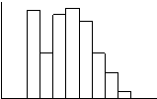
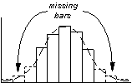
HISTOGRAM PATTERN
HISTOGRAM PATTERN | SYMPTOM | POSSIBLE PROBLEM
 | Edge-peaked | Modified data - often caused by shifting data that was out of specification back inside specification limits.
 | Truncated | Incompletely reported data or measured after inspection has rejected items outside specification limits.
HISTOGRAM

Slide 19
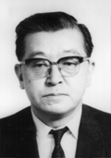
INTRODUCTION
“One of the greatest principles behind QC is consumer satisfaction. Within a company, the next process is the customer. If this way of thinking is driven home, the walls of sectionalism will crumble and fresh air will breeze through the company.”
- Dr. K. Ishikawa.
CAUSE-EFFECT DIAGRAM

Slide 20
WHEN TO USE IT
Use it when investigating a problem, to identify and select
key problem causes to investigate or address.
Use it when the primary symptom (or effect) of a problem is
known, but possible causes are not all clear.
Use it when working in a group, to gain a common
understanding of problem causes and their relationship.
Use it to find other causal relationships, such as potential
risks or causes of desired effects.
CAUSE-EFFECT DIAGRAM

Slide 21
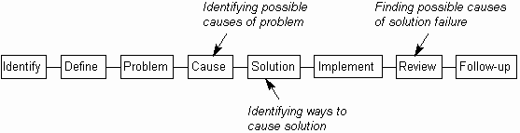
WHEN TO USE IT
CAUSE-EFFECT DIAGRAM

Slide 22
CAUSE-EFFECT DIAGRAM
Also known as an Ishikawa Diagram (after its originator, Kaoru Ishikawa, who first used in 1940s). It is also more popularly known as the Fishbone Diagram.
In essence, it is simply a tree or hierarchy, showing how causes have causes have causes. Its main use is to discover potential causes of unwanted problems. It also can be used more flexibly for such as discovering how to cause solutions
CAUSE-EFFECT DIAGRAM

Slide 23
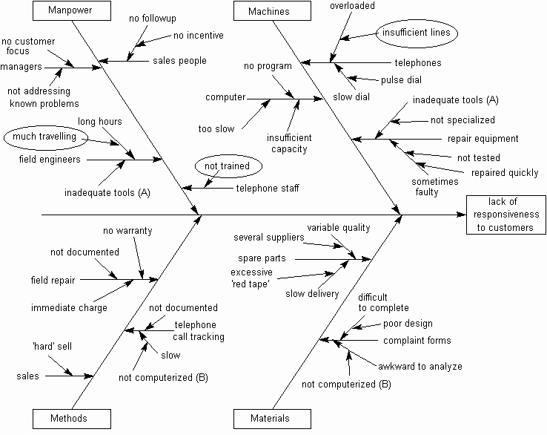
CAUSE-EFFECT DIAGRAM
CAUSE-EFFECT DIAGRAM

Slide 24
CAUSE STUDY
MACHINE
CAUSE
MAN
CAUSE & EFFECT DIAGRAM
METHOD
MATERIAL

Slide 25
INTRODUCTION
The Pareto principle is to concentrate on “vital few” rather than “trivial many” in tackling quality problems. The Pareto diagram is a tool for identifying few actually important causes for defectives which result in large proportion of defectives, instead of concentrating on large number of causes which contributes to a small proportion of the total defectives.
PARETO ANALYSIS

Slide 26
WHEN TO USE IT
Use it when selecting the most important things on which
to focus, thus differentiating between the 'vital few' and the
'trivial many'.
Use it after improving a process, to show the relative
change in a measured item.
Use it when sorting a set of measurements, to visually
emphasize their relative sizes.
Use it, rather than a Bar Chart or Pie Chart to show the
relative priority of a set of numeric measurements
PARETO ANALYSIS

Slide 27
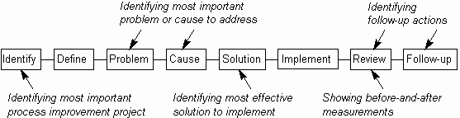
WHEN TO USE IT
PARETO ANALYSIS

Slide 28
CONSTRUCTING PARETO
A Pareto diagram is a bar chart of number of defectives with bars representing the number of defectives due to different sources arranged in descending order of their importance. A line graph of cumulative number of defectives (Ogive) is also drawn in the same chart. The defects are given along the x axis, the number of defects are given on the left y axis and the cumulative %defects is given along the right y axis.
PARETO ANALYSIS

Slide 29
EXAMPLE
The same details are shown in the form of a table and
Pareto diagram indicating the cumulative effect of the problem.
SL. NO
PROBLEMS
No.Of tallies
%
Cumulative %
1
Non availability of sparking machine at the right time.
23
23
23
2
High cost of the process.
22
22
45
3
Transport difficulties and job handling.
20
20
65
PARETO ANALYSIS
4
Not flexible for heavy jobs.
16
16
81
5
Frequent dismantling of the tool.
07
07
88
6
Long processing time.
06
06
94
7
Lack of skill.
04
04
98
8
02
02
100
Material composition

Slide 30
EXAMPLE
A- Non availability of sparking machine at the right time.
B- High cost of the process.
C- Transport difficulties and job handling.
D- Not flexible for heavy jobs.
E- Frequent dismantling of the tool.
F-Long processing time.
G- Lack of skill.
H- Material composition.
Pareto Analysis
98%
100%
100
94%
100
90
88%
81%
80
80
70
65%
60
Cumulative %age
50
45%
50
PARETO DIAGRAM
Tallies
40
30
23%
23
22
20
20
16
10
07
06
04
02
0
0
A
B
C
D
E
F
G
H
PROBLEMS

Slide 31
WHEN TO USE IT
Use it when it is suspected that the variation of two
items is connected in some way, to show any actual
correlation between the two.
Use it when it is suspected that one item may be causing
another, to build evidence for the connection between
the two.
Use it only when both items being measured can be
measured together, in pairs
SCATTER DIAGRAM

Slide 32
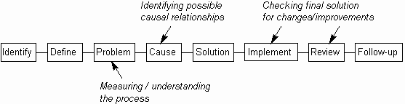
WHEN TO USE IT
SCATTER DIAGRAM

Slide 33
REASONS FOR USING SCATTER DIAGRAM
A Scatter Diagram shows correlation between two items for three reasons:
There is a cause and effect relationship between the two
measured items, where one is causing the other (at least in part).
2. The two measured items are both caused by a third item. For example, a Scatter Diagram which shows a correlation between cracks and transparency of glass utensils because changes in both are caused by changes in furnace temperature.
3. Complete coincidence. It is possible to find high correlation of unrelated items, such as the number of ants crossing a path and newspaper sales.
SCATTER DIAGRAM

Slide 34
REASONS FOR USING SCATTER DIAGRAM
Scatter Diagrams may thus be used to give evidence for a cause and effect relationship, but they alone do not prove it. Usually, it also requires a good understanding of the system being measured, and may required additional experiments.
SCATTER DIAGRAM

Slide 35
1.Determine the two items that you wish to compare. One
may be identified as the suspected cause and the other as
the suspected effect. This may come from the use of
other tools, such as a Cause-Effect Diagram or Relations
Diagram
2. Identify the measurements to be taken. Both must be
variables (i.e. measurable on a continuous scale) and it
must be possible to measure both at the same time.
SCATTER DIAGRAM

Slide 36
3. Make 50 to 100 pairs of measurements. When doing
this, aim to keep all other variables as steady as possible,
as they could interfere with the final figures
4. Plot the measured pairs on the Scatter Diagram. Design
the axes and scales on the diagram to give the maximum
visual spread of points. This may involve using different
scales and making the axes cross at non-zero values
SCATTER DIAGRAM

Slide 37
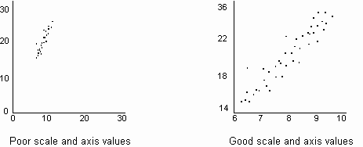
SCATTER DIAGRAM

Slide 38
5. If the correlation is high, a regression ('average') line
may be drawn through the plotted points, to emphasize
the trend.
6. If the correlation is reasonably linear, then a
correlation coefficient may be calculated.
7. Interpret the diagram and act accordingly
SCATTER DIAGRAM

Slide 39
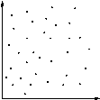
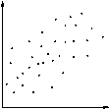
DEGREE OF CORRELATION
SCATTER DIAGRAM | DEGREE OF CORRELATION | INTERPRETATION
 | None | No relationship can be seen. The 'effect' is not related to the 'cause' in any way.
 | Low | A vague relationship is seen. The 'cause' may affect the 'effect', but only distantly. There are either more immediate causes to be found or there is significant variation in the 'effect'.
SCATTER DIAGRAM

Slide 40
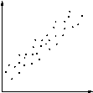
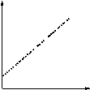
DEGREE OF CORRELATION
SCATTER DIAGRAM | DEGREE OF CORRELATION | INTERPRETATION
 | High | The points are grouped into a clear linear shape. It is probable that the 'cause' is directly related to the 'effect'. Hence, any change in 'cause' will result in a reasonably predictable change in 'effect'.
 | Perfect | All points lie on a line (which is usually straight). Given any 'cause' value, the corresponding 'effect' value can be predicted with complete certainty.
SCATTER DIAGRAM

Slide 41
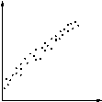
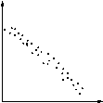
TYPE OF CORRELATION
SCATTER DIAGRAM | TYPE OF CORRELATION | INTERPRETATION
 | Positive | Straight line, sloping up from left to right. Increasing the value of the 'cause' results in a proportionate increase in the value of the 'effect'.
 | Negative | Straight line, sloping down from left to right. Increasing the value of the 'cause' results in a proportionate decrease in the value of the 'effect'.
SCATTER DIAGRAM

Slide 42
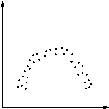
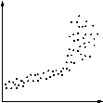
TYPE OF CORRELATION
SCATTER DIAGRAM | TYPE OF CORRELATION | INTERPRETATION
 | Curved | Various curves, typically U- or S-shaped. Changing the value of the 'cause' results in the 'effect' changing differently, depending on the position on the curve.
 | Part linear | Part of the diagram is a straight line (sloping up or down). May be due to breakdown or overload of 'effect', or is a curve with a part that approximates to a straight line (which may be treated as such).
SCATTER DIAGRAM

Slide 43
SCATTER DIAGRAM
Variable 2
SCATTER DIAGRAM
Variable 1

Slide 44
DEGREE OF CORRELATION
The correlation coefficient gives a numerical value to the degree of correlation. This will vary from -1, which indicates perfect negative correlation, through 0, which indicates no correlation at all, to +1, which indicates perfect positive correlation. Thus the closer the value is to plus or minus 1, the better the correlation. In a perfect correlation, all points lie on a straight line.
A regression line forms the 'best fit' or 'average' of the plotted points. It is equivalent to the mean of a distribution
SCATTER DIAGRAM

Slide 45
WHEN TO USE IT
Use when investigating a process, to determine whether it
is in a state of statistical control and thus whether actions
are required to bring the process under control.
Use it to differentiate between special and common causes
of variation, identifying the special causes which need to
be addressed first.
Use it to detect statistically significant trends in
measurements; for example, to identify when and by how
much a change to the process has improved it
CONTROL CHART

Slide 46
WHEN TO USE IT
Use it as an ongoing 'health' measure of a process, to
help spot problems before they become significant.
It is only practical to use it when regular measurements
of a process can be made. Typically this is in processes
that repeat within a reasonably short space of time.
CONTROL CHART

Slide 47
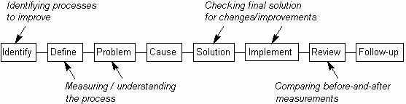
WHEN TO USE IT
CONTROL CHART

Slide 48
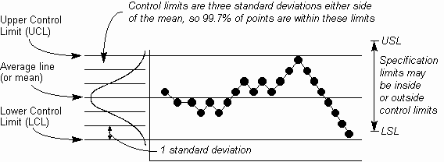
HOW TO UNDESTAND IT
CONTROL CHART

Slide 49
HOW TO UNDESTAND IT
In many cases, quality is influenced by multiple elements. Compounding of the effects of these elements makes it difficult to find our the clear relationship between each element and quality, namely causes and results. In such a case, the technique of stratification is often found to be effective.
For instance, to find out the cause of product defects, data is collected separately in accordance with raw materials, specifications of finished products, workers, or time. The technique of data taking based on segregated elements is called “Stratification”.
STRATIFICATION

Slide 50
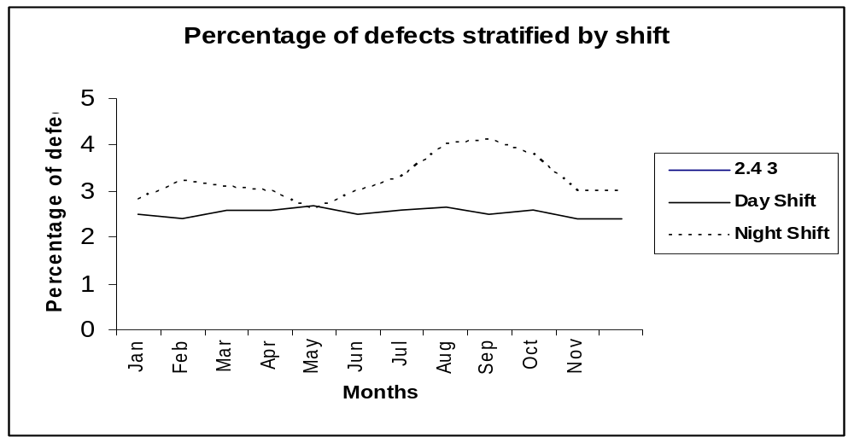
HOW TO UNDESTAND IT
Percent of defects stratified by types of problems
STRATIFICATION

