Slide 1
Hosting a Personal Academic Web Site
Bill Hasling
Maxwell Lab Group Meeting
March 27, 2025

Slide 2
Why Might I want a Personal Web Site?
Establish a Scientific/Professional presence in the cloud
Help people learn who you are
Help facilitate collaboration with colleagues (build a network)
Help with job or post doc applications
Record your accomplishments

Slide 3
Hosting Options
Hosting Options
GitHub Pages
Google Cloud
AWS S3
WIX
Squarespace
Hostinger
Webpage Development Options
Markdown
Html/Javascript/CSS
WordPress
In this presentation we are going to build it with GitHub Pages with an Open-Source Template
This allows free hosting and development with simple markdown files.
You could also host with GitHub pages using any development option (markdown is easier)

Slide 4
Steps for a Trivial Hosted GitHub Page
1. Create a github personal account that will live after Princeton.
2. Create a repo using https://github.com/<account>
3. Edit your README.md file with information about you.
3. Use Setting/Pages to select the main or master branch and root folder and press SAVE.
4. Wait a minute and browse to your free personal web site
https://<account>/<account.github.io
(Let’s try this…)

Slide 5
Create a Site using a GitHub template
There are several github templates you can find in the cloud.
Some examples:
https://github.com/academicpages/academicpages.github.io
https://al-folio.github.io
We are going to use academic pages in our example.

Slide 6
YouTube Video Example
There is a YouTube video describing how to create a site with academic pages:
https://www.youtube.com/watch?v=8lJhXJCUYCc
In this presentation we will walk through those same things,
plus some other tips.

Slide 7
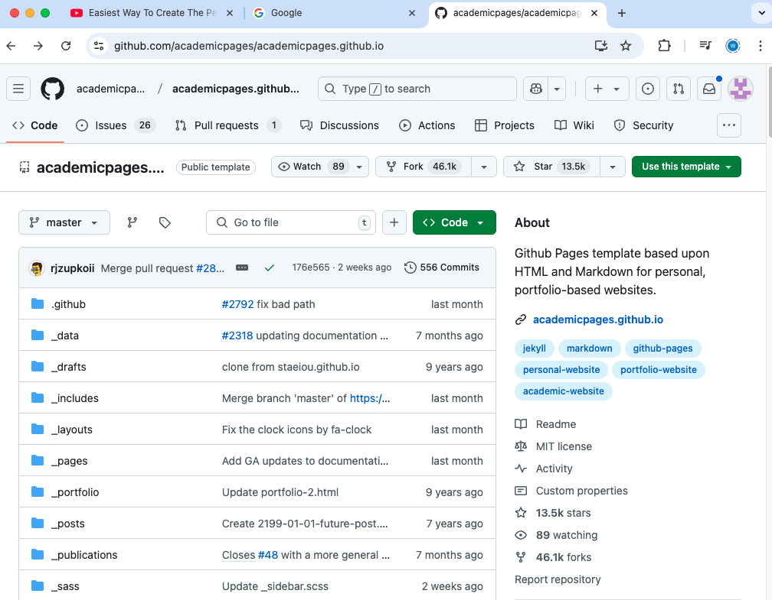
Browse to Academic Pages and Create a Fork
Browse to the academic pages GitHub site
and login with your personal GitHub account.
You want to use a GitHub account that you will keep after your stay at Princeton.
Click Fork and Create a new Fork of this Repo.

Slide 8
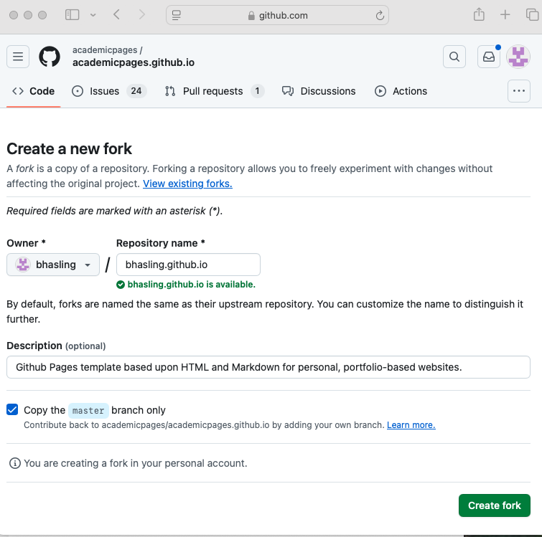
Use Fork Dialog To Create a new GitHub Repo
Create a new repository with your name:
You should use your GIT account name (eg): bhasling.github.io
This repository name will be the URL of your website.
You should add the .github.io to your repo name so the repo name is a public URL in .io domain.
Click “Create fork” to create the repo.

Slide 9
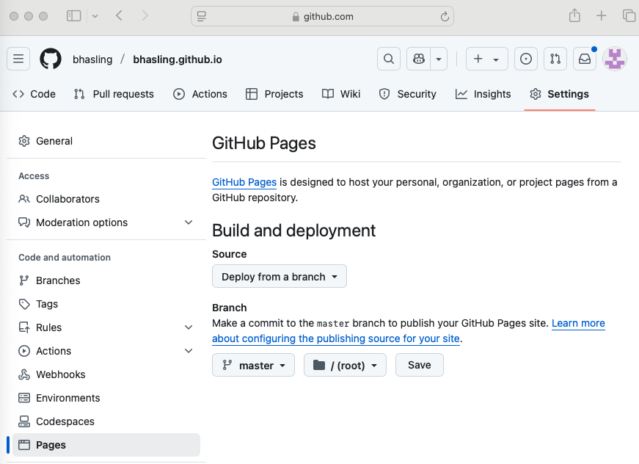
Publish to GitHub Pages
After creating the repo, your browser will
show your new repo.
Click Settings Menu
Click Pages to show Git Hub Pages Options
Select Master Branch for the content
Click Save

Slide 10
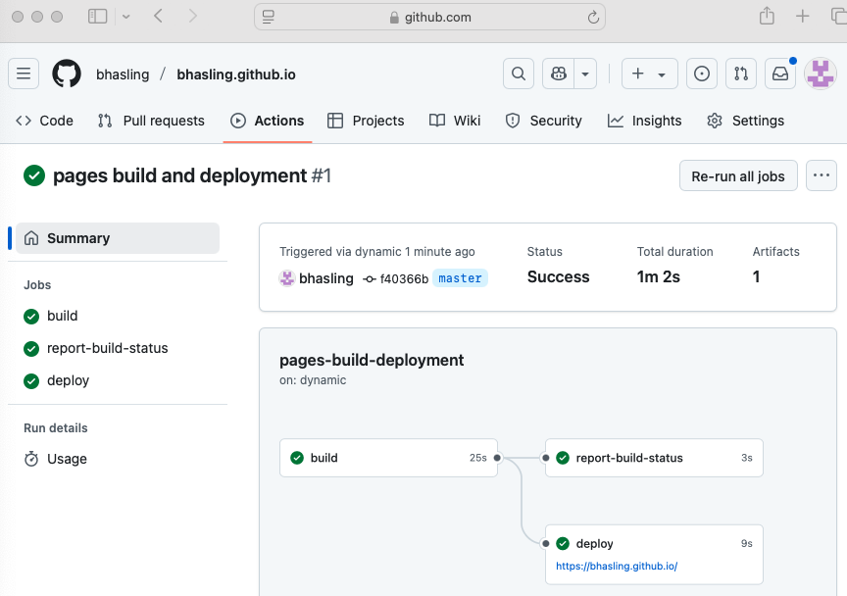
View The Website After it Builds
After a few minutes it will be visible here.
You can also click on the Actions menu to see the progress of the GitHub action that is building the website.

Slide 11
Browse Generate Personal Web page
Browse to the URL. The one I created previously would be:
https://bhasling.github.io It can take a minute to publish the repo.
These web pages have caching enabled so it can take 10 minutes for the cache to reset after you make a change.
You can clear your browser file cache to make this refresh faster.

Slide 12
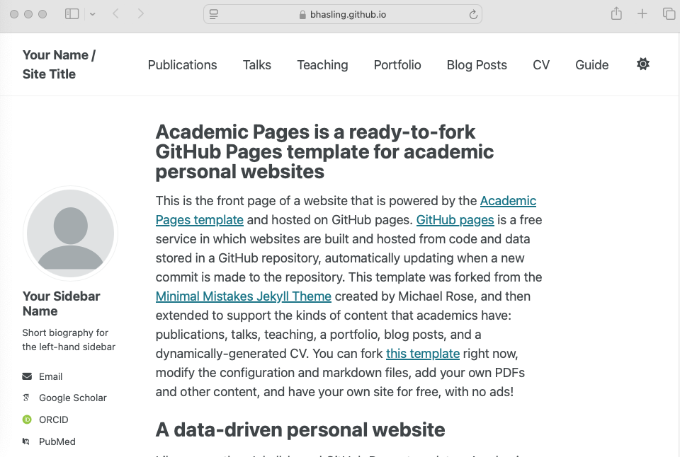
Example WebSite from Template (no changes)
Note: Web site rescales when
the window size changes and
displays fine on a phone with a
Hamberger menu for navigation.
For the next step we will tailor
the web site with personal
Information.

Slide 13
Edit the _config.yml in your Repo
1. Clone your repo in a local file folder like you would for code. 2. Edit the following attributes in the _config.yml YAML file:
Attribute | Value/Description
-title | Bill Hasling / Research Software Engineer
-url | https://<account>.github.io
-repository | <account>/<account>.github.io
-name | “Bill Hasling”
author: avatar: name: location: employer: email: bio: | “<photo.jpg>” “Bill Hasling” “Princeton, NJ” ”Princeton University” “<emailaddress>” “bhasling@gmail.com”
Add photo file
to
“files” folder

Slide 14
Replace template main page body
Edit the “about.md” file in the “_pages” folder. This is a markdown file that contains the initial page of your personal web site. For example,
Interests
=====
These are my interests.
Recent Experience
=====
This is what I have doing lately…

Slide 15
Edit _config.yml for Social Media Links
Remove lines for social media entries you do NOT have: E.g arxiv : # URL - Update with the correct link to you orcid : http://orcid.org/yourorcidurl bluesky : "bsky.app" # Replace this with you Bluesky username
Update ones you do have:
email : "bhasling@gmail.com”
github : "bhasling"
linkedin : "bill-hasling-970954b"

Slide 16
Edit the _data/navigation.yml file (toolbar)
Edit the navigation.yml file to:
Remove unnecessary menu items from tool bar
Re-order items in tool bar
Add your “CV.pdf” to files folder of repo and change navigation.yml
- title: "CV"
url: /files/CV.pdf
Add your CV into /files/CV.pdf in your repo.
or remove the CV entry in navigation.yaml.

Slide 17
Edit Folders Associated with Toolbar Links
Edit folder “_publications”, “_talks”, “_teaching” that are relevant to you,
Remove template .md files from the folder.
Add .md files with your own publications.
(See _config.yml “publication_categories:” for publication categories)

Slide 18
(Optional) Add Background Color to Heading
Change the file /_sass/layout/_masthead.scss
.masthead {
background: var(--global-link-color);
.masthead__menu-item {
background: var(--global-link-color);
color:var(--global-masthead-link-color);
Change the file /_sass/layout/_navigation.scss
.greedy-nav {
background: var(--global-link-color);
color: var(--global-masthead-link-color);

Slide 19
Use White text for New Colored Headings
Change the file /_sass/theme/_default.scss
-global-masthead-link-color : white;
Change the file /_sass/theme/_dark.scss
-global-masthead-link-color : white;

Slide 20
(Optional) Change Heading Color
If you want you can change the color of the page heading.
Change files /_sass/theme/_default.scss
--global-link-color : orange;
Change file /_sass/theme/_dark.scss
--global-link-color : orange;

Slide 21
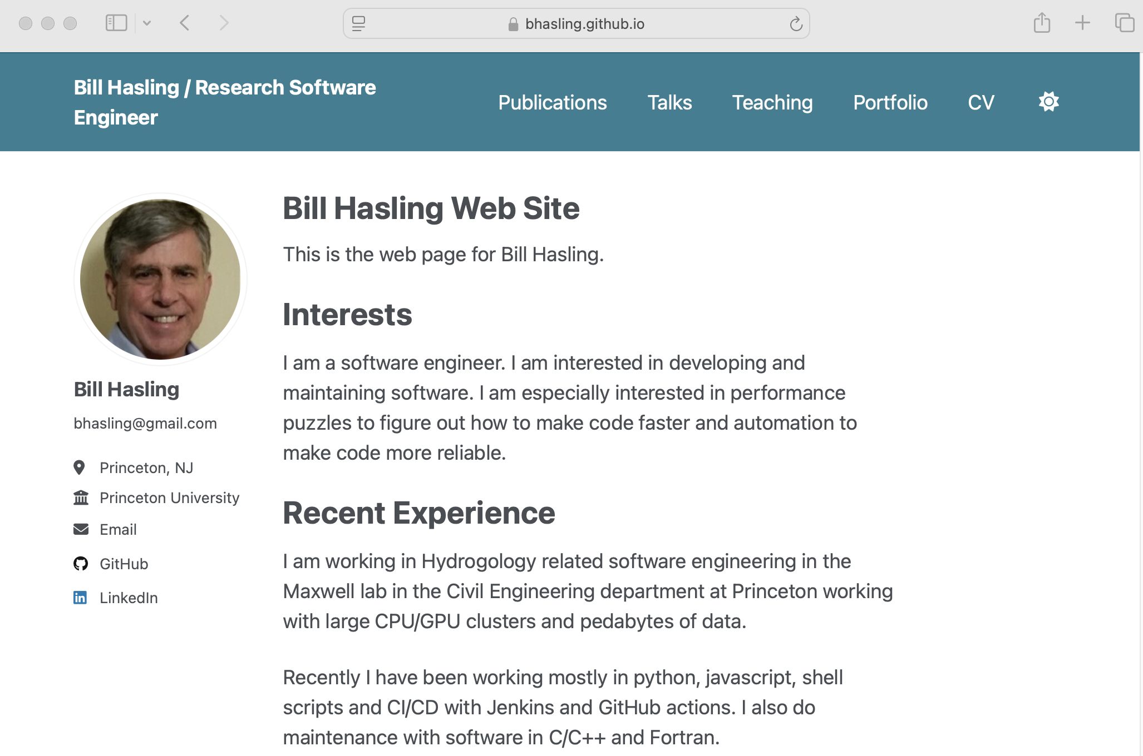
After Committing Site Changes
Click for dark mode
Click to open CV.pdf

Slide 22
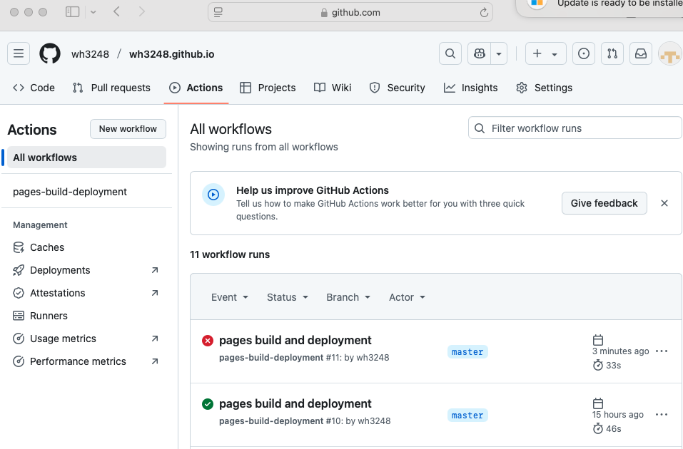
Debug Syntax Error in Config Files
If you commit a syntax error
the GitHub action will fail. This will look like nothing changed after your commit.
Look at the GitHub Action status to see the syntax error.

Slide 23
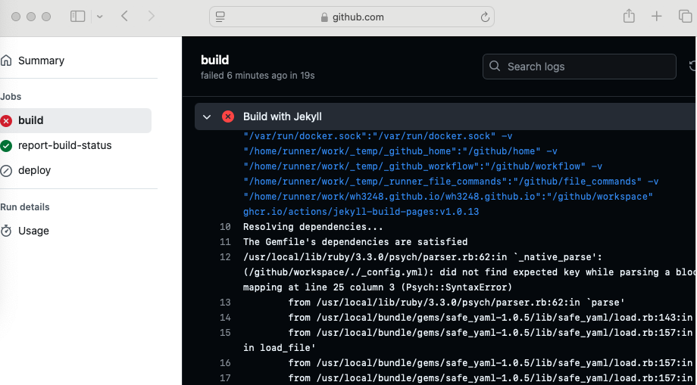
View Syntax Error
Click error links in Git Hub Actions to get to build error log.
See error message shows parse error in _config.yml on line 25.
In this case it was a missing closing quote in a string.

Slide 24
Questions?
Any questions?

