Slide 1
REAL TIME FACE TRACKING ROBOT
Group members: 201511014 I.s.s Bhaswanth
201511016 K.Suneel kumar
201511048 Y.Sankeerth
201511045 V.M.S Rayudu

Slide 2
REQUIRED COMPONENTS
Arduino Uno Microcontroller.
Matlab software(R2012b , installed with arduino I/O support package).
Servo Motors x 2.
Usb Webcam (Logitech 720p).
Jumper cables.

Slide 3
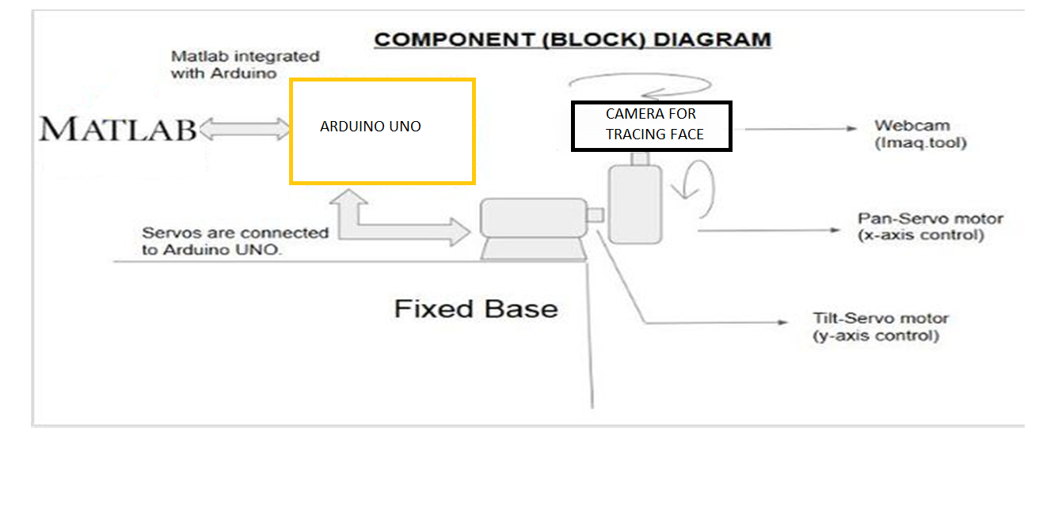
BLOCK DIAGRAM

Slide 4
WORKING
Firstly , code in Matlab detects a face from every frame of the live video stream
Inserts a bounding box around the Region of Interest., which is a face in this case(by detecting some haar features present in the human faces).
The project code follows the Viola Jones algorithm for face detection.
The set of frames with bounding boxes make up the addition of a bounding box around the face in live video.
While adding a bounding box , we also calculate the coordinates of centroid of the bounding box.
These coordinates are sent as a string to the arduino UNO microcontroller., from Matlab and these are processed according to the code written on arduino IDE for the movement of motors.

Slide 5
WORKING
During processing , the arduino gets the positions of PAN and TILT servo motors (that are attached as shown in the block diagram).
Then , arduino checks if the centroid coordinates lie in the centre region of the screen.
We are trying to move the camera in such a way that the centroid lies at the centre of the frame.(The pan and tilt servos are given to the digital pins 9 and 10 respectively...).
For this reason the frame is divided into left and right halves and also top and bottom halves.
If the centroid falls in the left half , the camera is panned right and if it falls in the right half , camera is panned left and the same with the top and bottom halves and tilting.

Slide 6
Possible Extention
Currently only camera moves as per the movement of face. It can’t move if the face moves beyond its limits.
So, we are planning for a robot possesses camera on it and moves if the face started moving beyond its limits.

