Slide 1

Physical Design (MVE322IA)
Project Based Learning
RTL to GDS-II Implementation of MIPI DSI Host Controller for Foveated Rendering Systems
Dilip C | 1RV25LVS10
Karthik Bhat Y | 1RV25LVS13
M. Tech VLSI Design & Embedded Systems Department of ECE, RVCE, Bengaluru-59
*
1

Slide 2
Outline
Outline
About the organization (for internship students)
Introduction
Motivation
Problem Statement
Objectives of the project
Literature Survey
Methodology
Work done so far (Use this from phase 2 presentation onwards)
Work plan for next phase (Use this from phase 2 presentation onwards)
Project timeline
References
Introduction
Literature Survey
Problem Statement
Objectives
Methodology
References

Slide 3
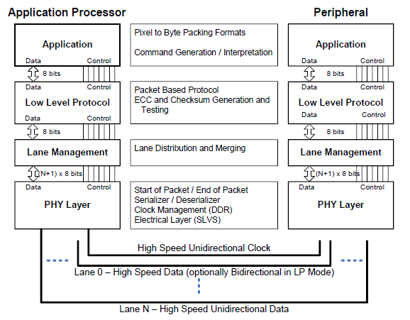
Introduction: MIPI Display Serial Interface (DSI)
MIPI DSI is the dominant high-speed serial interface as 80% of new mobile SoCs integrate DSI as their primary display interface for connecting application processors to display panels in mobile, automotive, and extended-reality (XR) devices
Defined by the MIPI Alliance, DSI operates over a D-PHY physical layer using differential signaling with High-Speed mode and Low-Power mode
DSI defines a three-layer protocol stack: Application Layer, Low-Level Protocol Layer and Lane Management Layer
Two operating modes exist: Video Mode for real-time pixel streaming to panels without frame buffers, and Command Mode for register-based access to panels with internal frame buffers
Packets are protected by Hamming (8,6), ECC for headers and CRC-16 for payloads, providing single-bit error correction and double-bit error detection
DSI Layers
*
Department of ECE
3

Slide 4
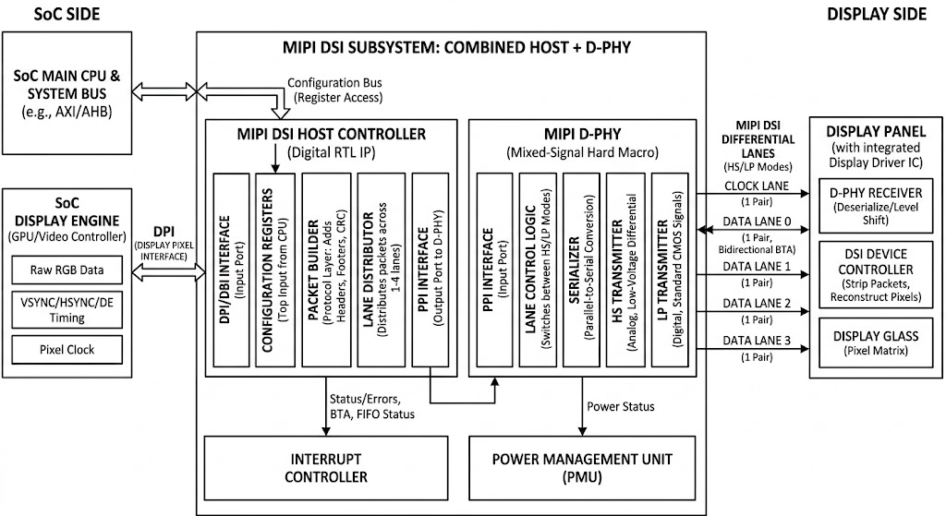
Introduction: MIPI DSI Host Controller
A MIPI DSI Host Controller is a digital core, that manages communication between an application processor and a display panel
Host Controller receives continuous, uncompressed raw RGB pixels and standard timing signals directly from the SoC Display Engine via the DPI
Inside the Host Controller, the Packet Builder converts the raw video stream into standard MIPI protocol packets by appending necessary Headers, ECC, and CRC footers.
SoC – MIPI DSI Subsystem – Display Interface
The packetized data is distributed in a round-robin fashion across 1 to 4 logical data lanes and handed off to the physical layer as parallel bytes through the PHY-Protocol Interface (PPI).
The D-PHY acts as the system's SERDES, serializing the parallel bytes and driving them off-chip as high-speed differential signals (HS mode) or low-power CMOS signals (LP mode).
*
Department of ECE
4

Slide 5

Introduction: Foveated Rendering for XR Displays
Foveated rendering is a performance-optimizing graphics technique that uses eye-tracking to render high-resolution detail only where the user is looking (the fovea) while reducing quality in peripheral areas
Foveated rendering exploits the human visual system's non-uniform acuity, the fovea covers only ~2° of visual angle, at 20°, visual acuity drops to ~1/3 of foveal; at 60° it falls below 1/10, meaning peripheral detail is largely imperceptible to the viewer
Modern VR headsets require 4K+ per eye at 90-120 Hz, generating around 80 Gbps of raw pixel data per eye far exceeding D-PHY bandwidth, by rendering the foveal region at full quality and reducing peripheral quality, foveated rendering achieves bandwidth reduction without perceptible quality loss
Foveated rendering directly impacts the display interface: variable pixel quality across the frame creates opportunities for bandwidth-adaptive DSI packet scheduling
Example of Foveated Rendering Frame
*
Department of ECE
5

Slide 6
Literature Survey
Sl No | Paper Title, Journal Name, Year | Major findings / Observations
1 | A UVM-based Verification Approach for MIPI DSI Low-Level Protocol Layer Authors: V. Melikyan, M.W. El-Kharashi et al. Journal: IEEE Conference Year: 2022 | Proposes constrained-random for DSI low-level protocol using UVM Uses SystemVerilog Assertions (SVA) for protocol compliance Provides reusable and scalable verification environment Directly informs verification strategy for packetizer and D-PHY Implements error injection mechanism for protocol stress testing
2 | Design of D-PHY Chip for Mobile Display Interface Supporting MIPI Standard Authors: B.D. Kim, S.J. Lee, D.H. Kim, K.R. Cho Journal: Microelectronics Journal / IEEE ICCE Year: 2012 | D-PHY chip in 0.13 µm CMOS achieving 1 Gbps/lane with <5% jitter Covers HS-TX, HS-RX, LP-TX, LP-RX, LP-CD analog blocks Power consumption of 0.74 mW — provides power benchmark reference Includes silicon measurement data for D-PHY timing parameters Foundation reference for D-PHY TX digital interface design
3 | Low-Cost Unified Pixel Converter from MIPI DSI Packets into Arbitrary Pixel Sizes Authors: K. Kwon, D. Kang, G. Ko, S. Kim, S. Kim Journal: MDPI Electronics (Open Access) Year: 2022 | Proposes pixel converter classifying DSI packets by base-and-remainder Verified on FPGA, synthesized with Samsung 65 nm library Achieved 25.7% area reduction and 38.6% power reduction Directly relevant to Pixel-to-Byte Packer module design Most relevant MIPI DSI implementation paper with synthesis results
*
Department of ECE
6

Slide 7
Literature Survey
Sl No | Paper Title, Journal Name, Year | Major findings / Observations
4 | Foveated Rendering: A State-of-the-Art Survey Authors: L. Wang, X. Shi, Y. Liu Journal: Computational Visual Media (Springer) Year: 2023 | Most comprehensive survey of foveated rendering (1990-2021) Proposes taxonomy: adaptive resolution, geometric/shading simplification Reviews perceptual models of human visual system for foveation Covers gaze-contingent displays and variable-rate rendering Provides theoretical foundation for foveation tier model
5 | Towards Foveated Rendering for Gaze-Tracked Virtual Reality Authors: A. Patney, M. Salvi et al. (NVIDIA) Journal: ACM TOG / SIGGRAPH Asia Year: 2016 | Seminal NVIDIA paper on gaze-tracked foveated rendering for VR Fovea covers ~4% of pixels, achieves up to 70% shading reduction Basis for NVIDIA Variable Rate Shading (VRS) hardware feature Demonstrates perceptually lossless quality at massive compute savings Key reference for bandwidth reduction rationale in design
6 | Process Only Where You Look (POLO): HW-Algorithm Co-optimization for Foveated Rendering Authors: H. Wang, W. Liu, K. Chen, Q. Sun, S.Q. Zhang Journal: ISCA ‘25 Year: 2025 | Proposes dedicated foveated rendering HW accelerator for VR SoCs Explicitly models MIPI communication time in pipeline equation Achieves 3.9× reduction in end-to-end latency over GPU-only Integrated via NoC with CPU, GPU, and DMA in SoC architecture Relevant paper: justifies MIPI DSI + foveation combination
*
Department of ECE
7

Slide 8
Literature Survey
Sl No | Paper Title, Journal Name, Year | Major findings / Observations
7 | Power, Performance, and Image Quality Tradeoffs in Foveated Rendering Authors: R. Singh, M. Huzaifa et al. Journal: IEEE VR Conference Year: 2023 | Comprehensive study of foveated rendering tradeoffs on mobile SoCs Tracked foveated rendering achieves >40% total energy reduction Evaluated on NVIDIA Jetson showing 20× energy efficiency improvement Quantifies power budgets relevant to DSI controller design Validates bandwidth savings translate to measurable power reduction
8 | ASIC Flow Implementation on a 32-Bit RISC-V Processor using Cadence Authors: IEEE Conference Authors Journal: IEEE Conference Year: 2025 | RV32I synthesized using Genus (TSMC 45nm) — our target technology LEC verification using Conformal, PnR using Innovus, STA using Tempus Demonstrates the exact Cadence tool chain used in project Reports gate count, timing closure, and power for 45nm implementation Closest comparable reference for tool flow and technology node
9 | MIPI Alliance, “MIPI DSI Specification v1.01.00” MIPI Alliance, “MIPI D-PHY Specification v1,1” | Details the Display Serial Interface protocol specifications Describes video mode interface timing for displays Standardizes serial interfaces for mobile display panels Defines D-PHY physical layer for mobile devices Supports high speed bitrates above one gigabit
*
Department of ECE
8

Slide 9
Problem Statement
In modern VR/AR head-mounted displays, where 4K+ resolution at 90-120 Hz per eye generates large raw pixel data which needs excessive display interface bandwidth demand. Conventional MIPI DSI host controllers transmit all pixels at uniform quality, wasting bandwidth on peripheral regions that the human visual system cannot resolve.
Existing foveated rendering implementations operate entirely in the GPU software domain, with no optimization at the display interface level. No published academic work combines MIPI DSI host controller design with foveated-rendering-aware bandwidth optimization. Hence, bandwidth-efficient MIPI DSI host controller architecture with a novel foveated region mapper implementing gaze-contingent pixel format adaptation (RGB888/RGB666/RGB565) across three quality tiers to achieve DSI link bandwidth reduction while maintaining full visual quality in the foveal region.
*
Department of ECE
9

Slide 10
Objectives of the Project
To design and implement a MIPI DSI v1.3-compliant Host Controller, supporting 1-4 data lane D-PHY interface with Video Mode operation, ECC-protected packet headers, CRC-protected payloads, and configurable timing parameters, targeting 200 MHz operation
To integrate a Foveated Region Mapper module that computes and assigns each pixel to one of three quality tiers (Foveal-RGB888, Mid-RGB666, Outer-RGB565), achieving DSI link bandwidth reduction through gaze-contingent pixel format adaptation.
To perform Functional Verification on the design and to define UPF power intent with 3 power domains (Always-On, DSI Core, Foveation), isolation cells, and retention registers.
To execute the complete RTL-to-GDS-II physical design flow using Cadence Genus (synthesis with UPF), Conformal (LEC), Innovus and Tempus, achieving timing closure with DRC & LVS clean GDS-II output.
*
Department of ECE
10

Slide 11
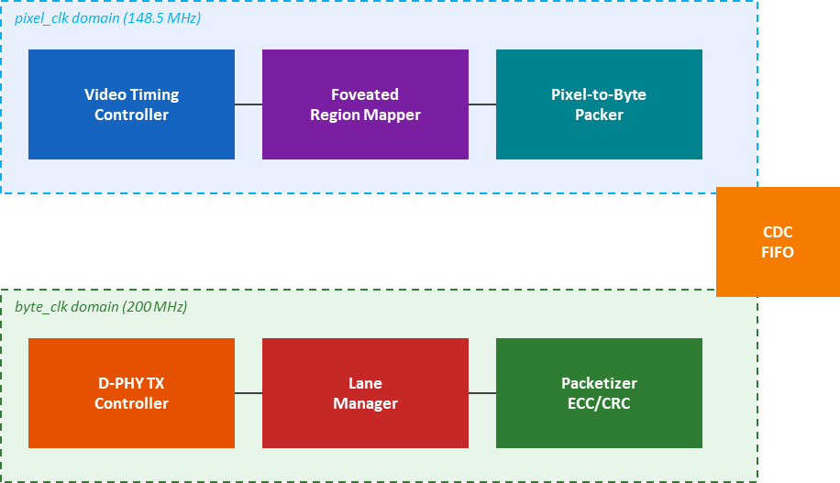
Design Methodology – MIPI DSI Host Controller
System Architecture – 7 Module Pipeline for Foveated Rendering System
*
Department of ECE
11

Slide 12
References
Sl No | Author, Title of paper, Journal | Year
1 | V. Melikyan et al., "A UVM-based Verification Approach for MIPI DSI Low-Level Protocol Layer," IEEE Conf. | 2022
2 | B.D. Kim et al., "Design of D-PHY Chip for Mobile Display Interface Supporting MIPI Standard," Microelectronics J. | 2012
3 | K. Kwon et al., "Low-Cost Unified Pixel Converter from MIPI DSI Packets," MDPI Electronics | 2022
4 | L. Wang et al., "Foveated Rendering: A State-of-the-Art Survey," Computational Visual Media (Springer) | 2023
5 | A. Patney et al. (NVIDIA), "Towards Foveated Rendering for Gaze-Tracked VR," ACM TOG / SIGGRAPH Asia | 2016
6 | H. Wang et al., "POLO: Process Only Where You Look," ISCA '25 | 2025
7 | R. Singh et al., "Power, Performance, and Image Quality Tradeoffs in Foveated Rendering," IEEE VR | 2023
8 | ASIC Flow Implementation on 32-bit RISC-V Processor using Cadence, IEEE Conf. | 2025
*
Department of ECE
12

Slide 13
Thank You
*
Department of ECE
13

