Slide 1
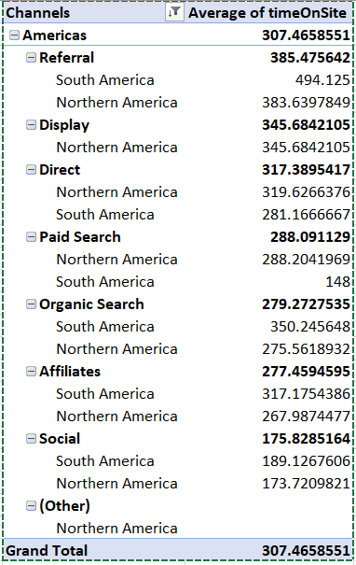
Channel Analysis
Question 1
1. As can be seen from the pivot table, Channel “Direct” has the 3rd largest engagement level.

Slide 2
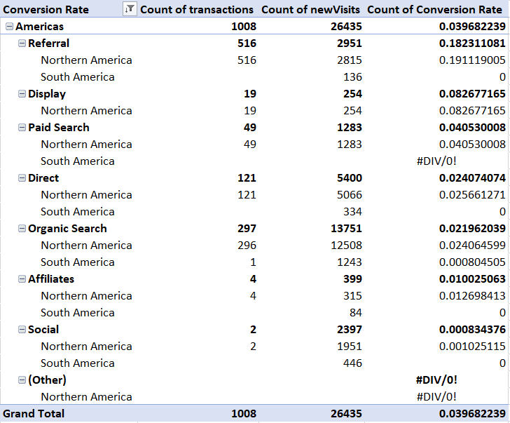
Channel Analysis
Question 2
2. As can be seen from the pivot table, Channel “Referrals” has the largest Conversion Rate.

Slide 3
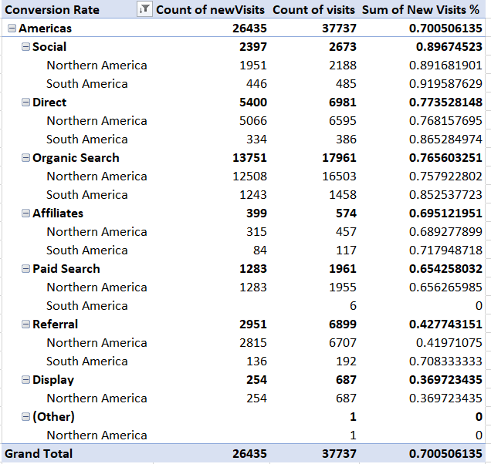
Channel Analysis
Question 3
3. As can be seen from the pivot table, Channel “Social” brings the largest percentage of New Visitors.

