Slide 1

DFG_Hackathon
Aparna Bhat
Mahotsavy Dama

Slide 2
Challenge statement
Partner with United Nations and understand the goal 4:
Equitable Quality Education
Lifelong learning for all
Visualize the pace of growth towards 2030

Slide 3
Exploratory data analysis
The indicators we deemed important
Proportion of teachers who have received at least the minimum organized teacher training (e.g. pedagogical training) pre-service or in-service required for teaching at the relevant level in a given country, by sex and education level (%)
Proportion of youth and adults with information and communications technology (ICT) skills, by sex and type of skill (%)
Proportion of children aged 36−59 months who are developmentally on track in at least three of the following domains: literacy-numeracy, physical development, social-emotional development, and learning (% of children aged 36-59 months) 244

Slide 4
Dealing with missing data
Mean of data: Keeps the mean same
Same as previous value: More practical
Dropping the rows: Not so great as data is precious
Filling with zeroes: This doesn’t affect the rest of the data

Slide 5
Data analysis
Analyzing the teacher’s education:
Step1: Finding the world’s mean by year and by sex
Step2: Analyzing the trends of female teacher’s education
Step3: Prediction for 2019 and 2030
Step4: Analyzing the trends of male teacher’s education
Step5: Prediction for 2019 and 2030

Slide 6
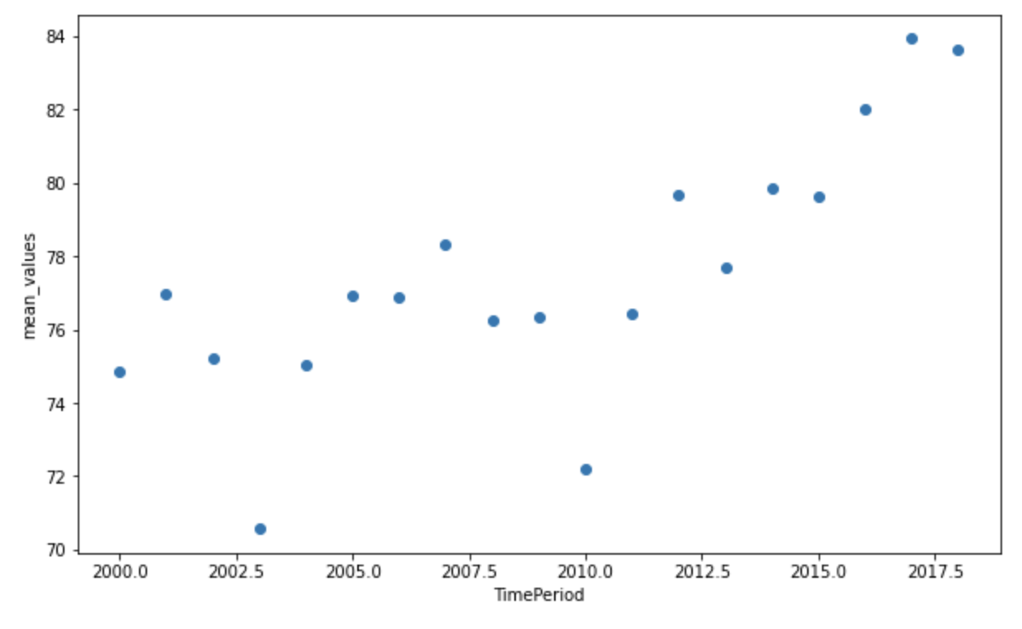
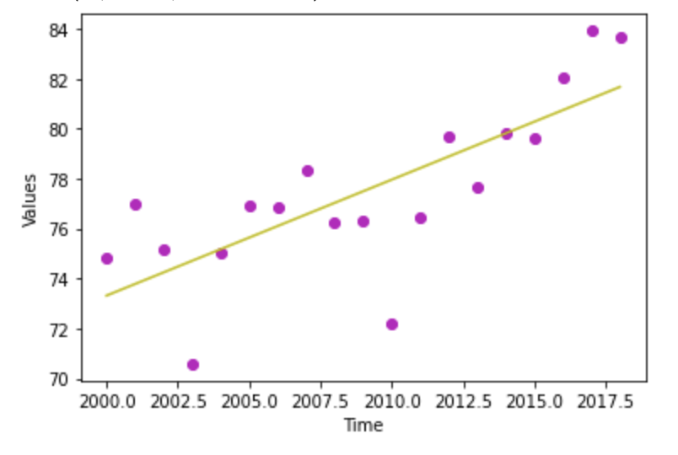
Steps 2&3
First is the scatter plot that shows the trends in female teacher’s education
The second is the Linear Regression plot showing the best fit line

Slide 7
Forecasting model Predictions for female teacher’s education
Slope from the regression: 0.46
Intercept: -855.32
Prediction for 2030: 86.6%

Slide 8
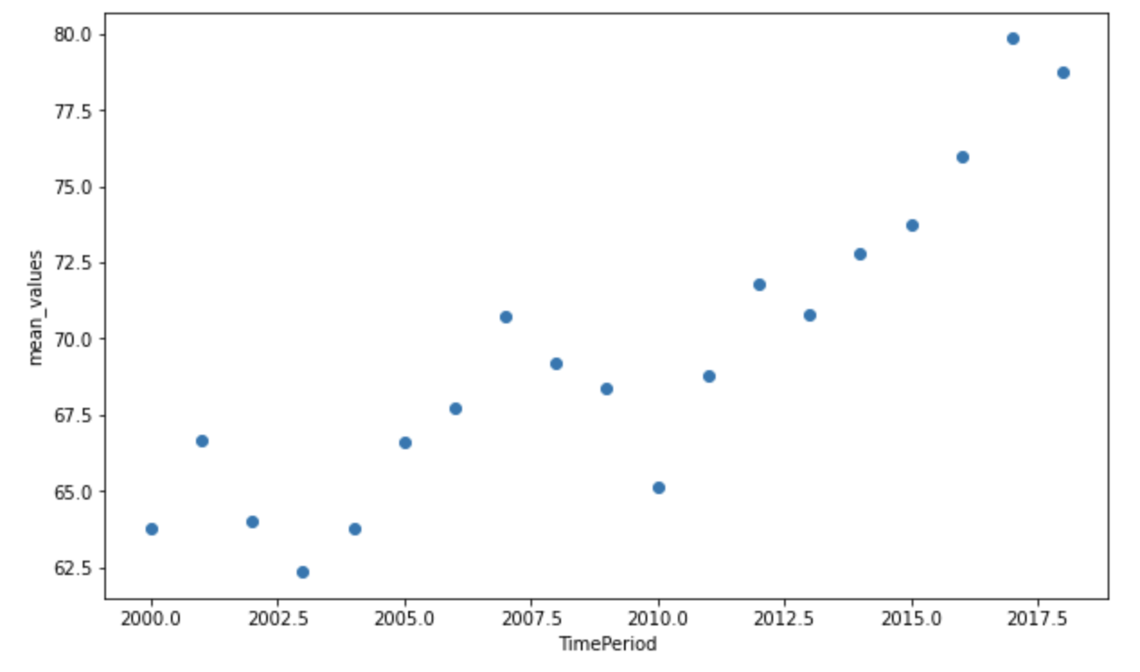
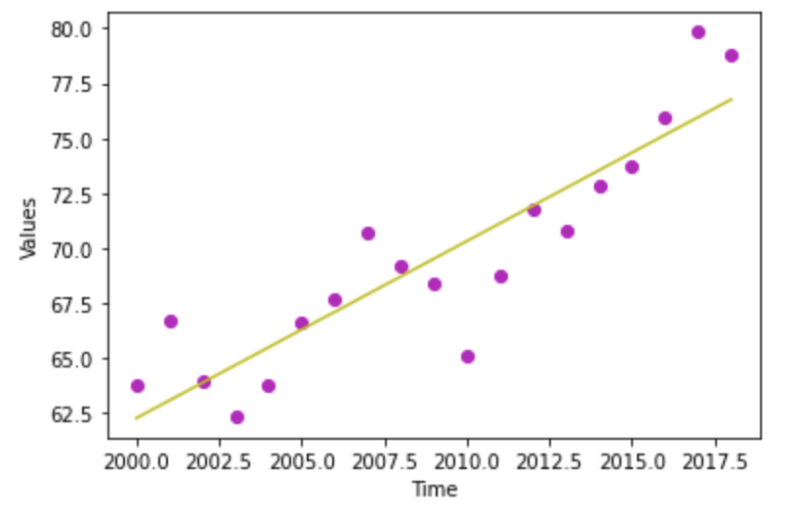
Steps 4&5
First is the scatter plot that shows the trends in female teacher’s education
The second is the Linear Regression plot showing the best fit line

Slide 9
Forecasting model Predictions for male teacher’s education
Slope from the regression: 0.80
Intercept: -1546.31
Prediction for 2030: 77.69%

Slide 10
Data analysis_2
Analyzing the Proportion of youth and adults with information and communications technology (ICT) skills:
Countries considered for analysis:- 10 ('China', ‘Columbia', 'Congo', 'Egypt', 'Pakistan', 'Poland', 'Iraq', 'Mexico', 'Nigeria’, ‘Turkey’)
Analyzing the ICT skills:
Step 1: Finding the world’s mean by year and by sex
Step 2: Finding the mean by year and by sex for the above selected countries
Step 3: Analyzing the trends of female with ICT skills
Step 4: Prediction for 2019 and 2030
Step 5: Analyzing the trends of male with ICT skills

Slide 11
Data analysis_2 continue
Step 6: Prediction for 2019 and 2030
Step 7: Analyzing the trends of female with ICT skills for the selected 10 countries
Step 8: Prediction for 2019 and 2030
Step 9: Analyzing the rends of male with ICT skills for the selected 10 countries
Step 10: Prediction for 2019 and 2030

Slide 12
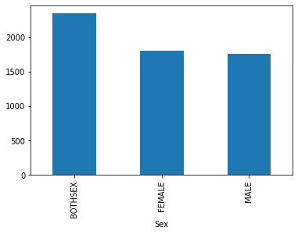
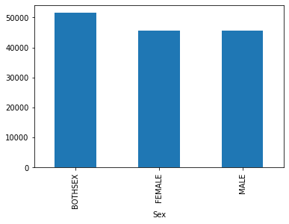
Number of people with ICT skills vs World
10 countries
World

Slide 13
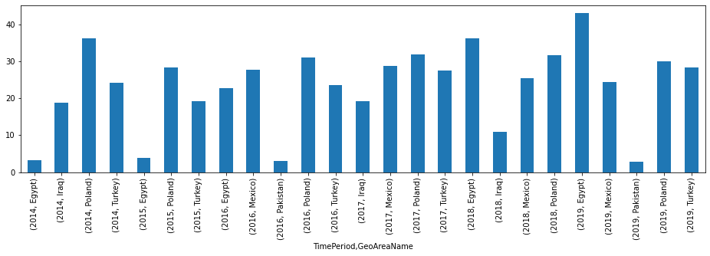
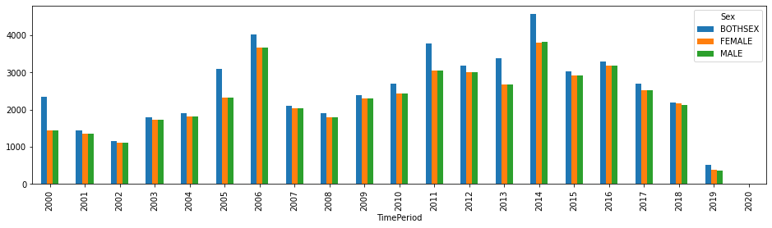
Considering the mean values

Slide 14
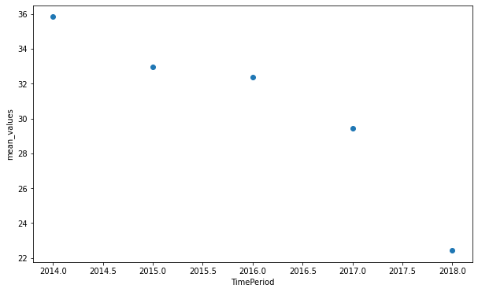
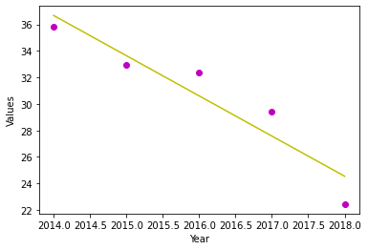
Steps 3&4
First is the scatter plot that shows the trends in female with ICT skills
The second is the Linear Regression plot showing the best fit line

Slide 15
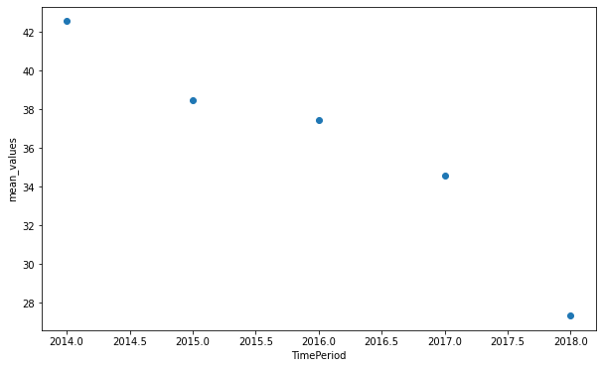
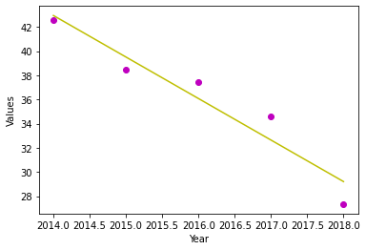
Steps 5&6
First is the scatter plot that shows the trends in male with ICT skills
The second is the Linear Regression plot showing the best fit line

Slide 16
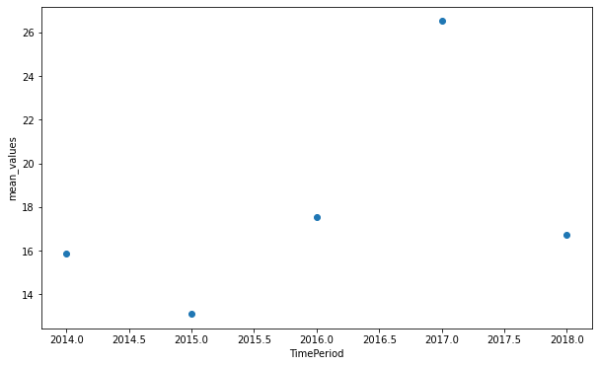
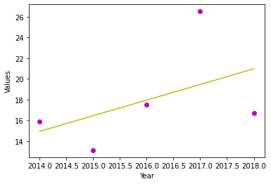
Steps 7&8
First is the scatter plot that shows the trends in female with ICT skills for the selected 10 countries.
The second is the Linear Regression plot showing the best fit line

Slide 17
Forecasting model Predictions for female with ICT skills for selected 10 countries
Slope from the regression: 1.50
Intercept: -3024.9954
Prediction for 2030: 26%

Slide 18
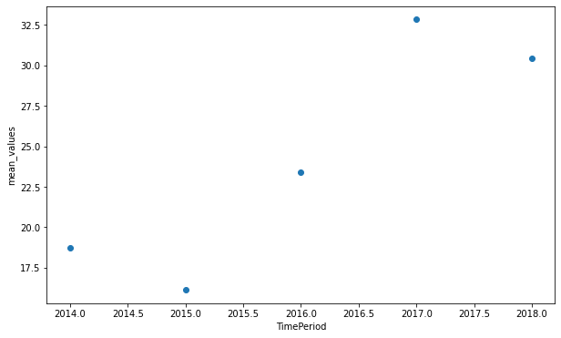
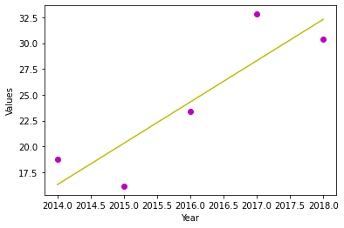
Steps 9&10
First is the scatter plot that shows the trends in male with ICT skills for the selected 10 countries.
The second is the Linear Regression plot showing the best fit line

Slide 19
Forecasting model Predictions for male with ICT skills for selected 10 countries
Slope from the regression: 4.00
Intercept: -8043.9396
Prediction for 2030: 32.5%

Slide 20
Insights and Suggestions
Decline in the number of people possessing ICT skills.
Percentage of female population with ICT skills is quite less compared to their male counterpart.
To increase the percentage of people with ICT skills more emphasis must be given on the basic digital literacy / STEM literacy
To bridge the gap for female population emphasis must be given on encouraging females to take up courses remotely if there is no access to local resources.

Slide 21

Thank you

