Slide 1
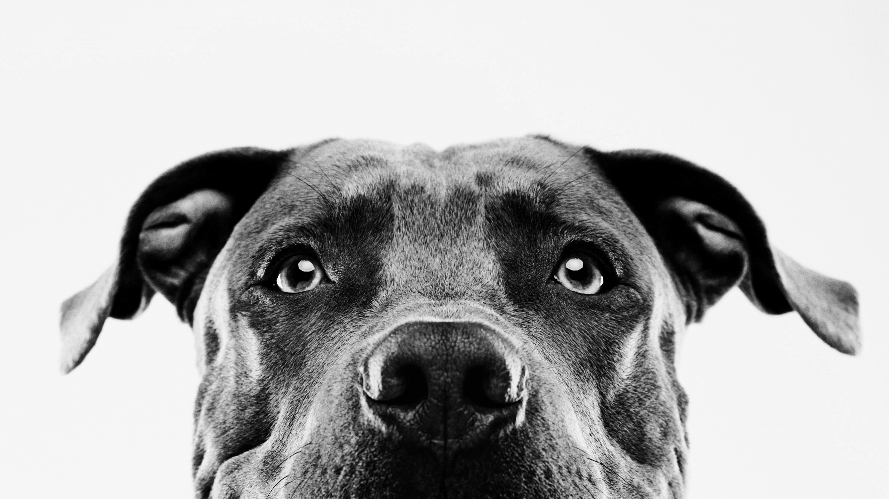
PCA-Based animal recognition
CSE 6363-001
Name:- Aparna Krishna Bhat
Id:- 1001255079

Slide 2
Motivation and goals
Working with the images for classification instead of clean and structured data.
Animal lover.
Trying to investigate the algorithms and techniques for image recognition, comparing their performance.

Slide 3
Dataset used / tried
The CIFAR-10 (Canadian Institute For Advanced Research) dataset consists of 60000 images each of 32x32x3 color images having ten classes, with 6000 images per category. The dataset consists of 50000 training images and 10000 test images. The classes in the dataset are airplane, automobile, bird, cat, deer, dog, frog, horse, ship, truck.
Animals-10 which contains about 28K medium quality animal images belonging to 10 categories: dog, cat, horse, spider, butterfly, chicken, sheep, cow, squirrel, elephant.

Slide 4
What is PCA?
PCA is a linear dimensionality reduction technique for extracting information from a high-dimensional space by projecting it into a lower-dimensional sub-space. It tries to keep the essential parts of the data that have the most variation and remove the non-essential parts that have the least variation.
Dimensions are nothing but features that represent the data. For example, A 32 X 32 image has 1024 picture elements (pixels) that are the dimensions or features which together represent that image.

Slide 5
Steps followed
Checked the maximum and minimum values of the CIFAR-10 training images and normalize the pixels between 0 and 1 inclusive.
Created a DataFrame that holds the pixel values of the images along with their respective labels in a row-column format.
Reshaped the image dimensions from three to one (flatten the images).
Created the PCA method and pass the number of components as two and apply fit_transform on the training data.
Converted the principal components for each of the 50,000 images from a numpy array to a pandas DataFrame.
Found out the amount of information or variance the principal components hold.

Slide 6
Variation per principal component
Number of principal components:- 11

Slide 7
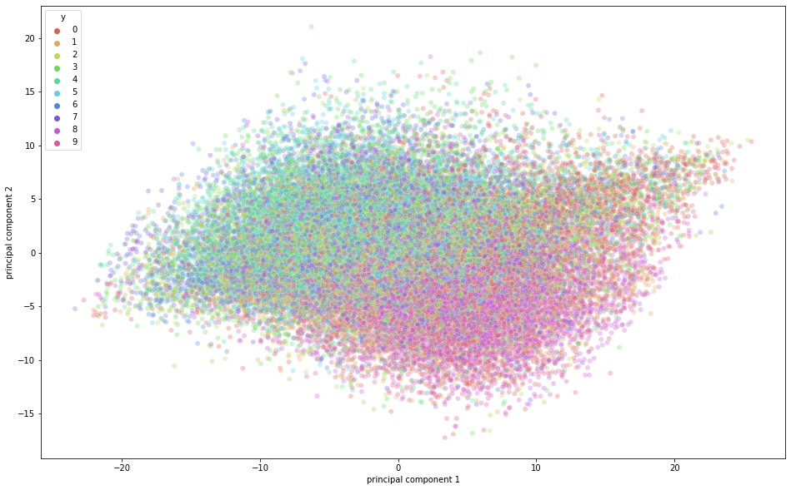
PCA visualization

Slide 8
PCA with KNN
Current accuracy is 38.34% for K=12. Applied for CIFAR-10 dataset
Consisting of 50000 training images and 10000 test images

Slide 9
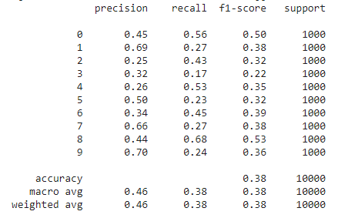
Confusion matrix and Classification report

Slide 10
PCA with deep learning model
Created an instance of the PCA model.
You may also specify how much variance you want PCA to capture. Have given PCA model a value of 0.9, which means it will keep 90% of the variance and use the number of components available to capture 90% of the variance.
To achieve 90% variance, the dimension was reduced to 99 principal components from the actual 3072 dimensions.
Deep learning hyperparameters used in the sequential model are set as batch_size = 128, num_classes = 10, epochs = 20, Activation functions of relu and softmax.
The time taken for training each epoch was just 1 second on a GPU. The model did a decent job on the training data, achieving 95% accuracy while it achieved only 56% accuracy on the test dat. This means that it overfitted the training data.

Slide 11
Animals-10 with deep learning without pca
Using VGG16-transferlearning model.
Each epoch takes around 63 seconds of GPU time.
Epochs=10, Train accuracy=0.58550, Validation accuracy=0.62100
loss='binary_crossentropy', optimizer=optimizers.SGD(lr=1e-4, momentum=0.9),metrics=['accuracy’]
Activation function used are relu and softmax.

Slide 12
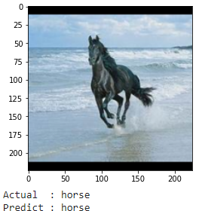
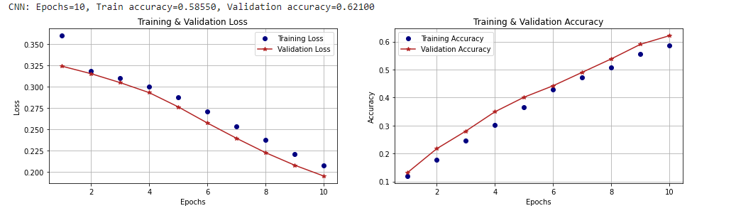
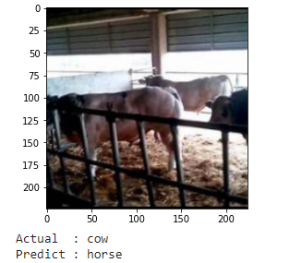
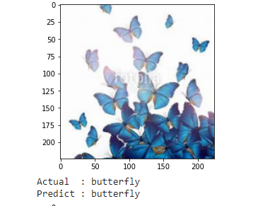
Results

Slide 13
Insights
PCA is a powerful algorithm which removes the correlated features and improves the performance of the algorithm.
PCA Reduces overfitting.
PCA with classification algorithm like KNN works well(depending upon the dataset and size of the dataset).
PCA with deep learning model gives good accuracy and performance with faster training and execution time.
Deep learning model without PCA also gives good accuracy but at a cost of very high learning/ training rate.

Slide 14
Experience and learning
When compared to clean and organized data, working with image classification is a different ball game. The data is processed and flattened as pixels. The flattened pixel collection is used to represent each pixel's details. The image quality and pixel density matrix have a significant impact on the classifier's accuracy. Since the animal data that was used was so vague. Backgrounds are used in the animal pictures. The aforementioned contributes to the classification disparity and degrades the efficiency of the classifier in use.

Slide 15

Thank you for your attention

