Slide 1

Stock prices forecasting in USA during Covid‑19 using Long Short‑Term Memory (LSTM)
Aparna Krishna Bhat:- 1001255079
Naveena Mullapudi:- 1001821645
Mirat Gajera:- 1001829052

Slide 2
Problem Statement and Goal
Problem statement:- Stock market process is full of uncertainty; hence stock prices forecasting is very important in finance and business. COVID-19 have had a significant influence on the global economy, as well as an impact on the financial markets. The challenge of this project is to accurately predict the future stock price of the given stock across a given period of time in the future considering the impact of COVID- 19 on the economy.
Goal:- In this project, we are trying to investigate the impact of COVID-19(confirmed cases data) on the stock prices of companies like Amazon, Netflix, United Airlines and Delta Airlines on NASDAQ index. We will be making use of a Long Short Term Memory networks, Regression models to predict the future stock price of these companies on the NASDAQ using a dataset of past prices.

Slide 3
Sample Data (Stock data from Yahoo Finance)
Amazon Stock Price data

Slide 4
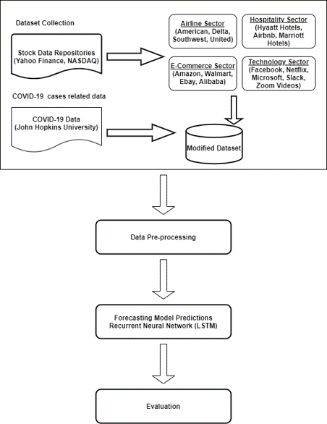
LSTM Architecture

Slide 5
Steps for preparing the data for LSTM model
1) Reading Confirmed Covid-19 cases in the US file in csv and converting it into dataframe.
2) Reading the stock prices data file in csv and converting it into dataframe.
3) Merging the Covid-19 dataset and stock dataset to get the dataset needed to train the LSTM model.
4) Taking the Average of low and high values from the merged dataset.
5) Filling the NaN values with the previous days average value.
6) Making the date column as index of the merged dataset
7) Re arranging the columns and saving it to a csv file.

Slide 6
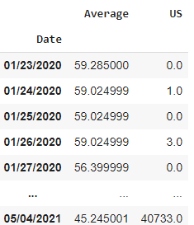
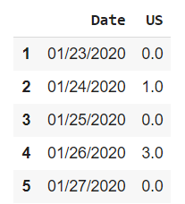
Sample merged final csv for LSTM
Sample Covid-19 confirmed cases data

Slide 7
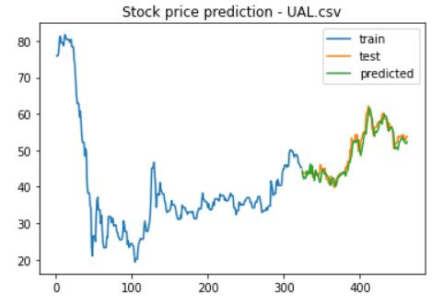
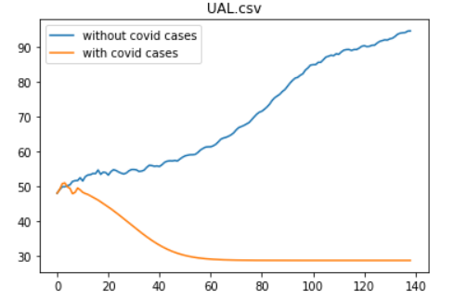
Results for LSTM (With and Without Covid-19 data)
For United Airlines dataset

Slide 8
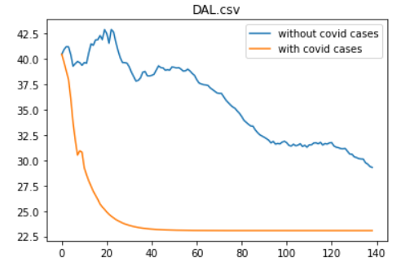
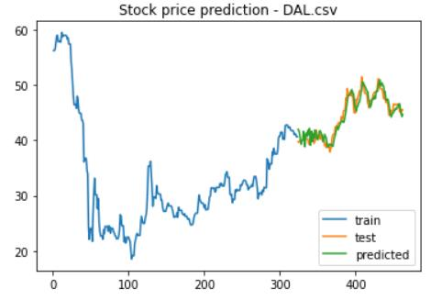
Results for LSTM (With and Without Covid-19 data)
For Delta Airlines dataset

Slide 9
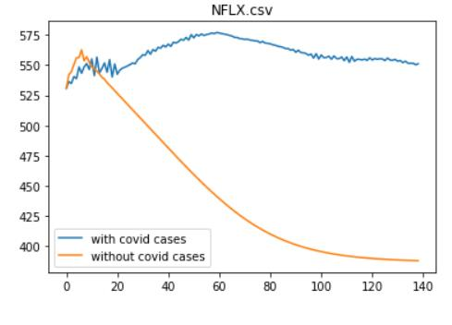
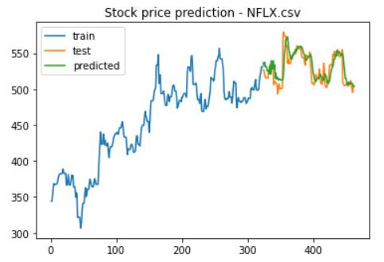
Results for LSTM (With and Without Covid-19 data)
For Netflix dataset

Slide 10
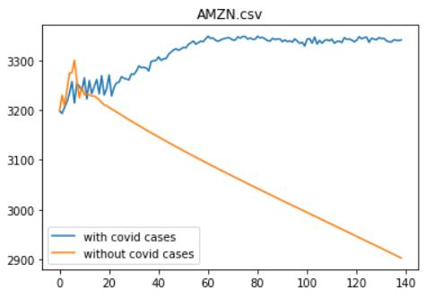
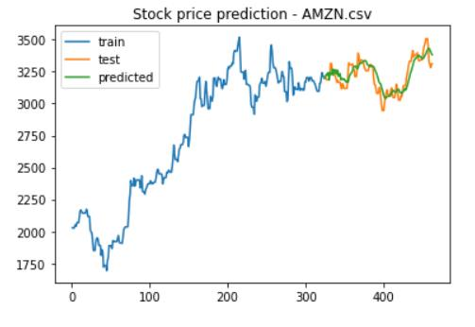
Results for LSTM (With and Without Covid-19 data)
For Amazon dataset

Slide 11
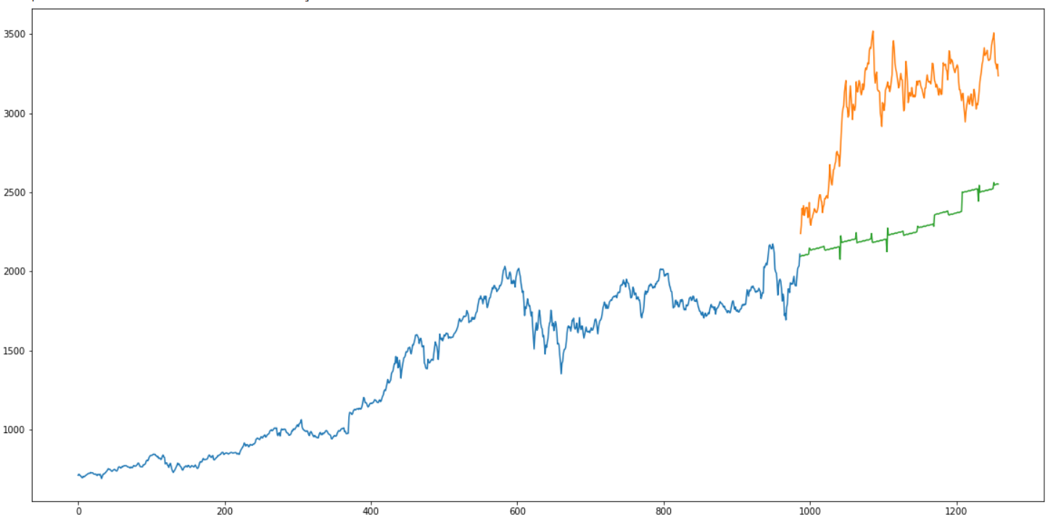
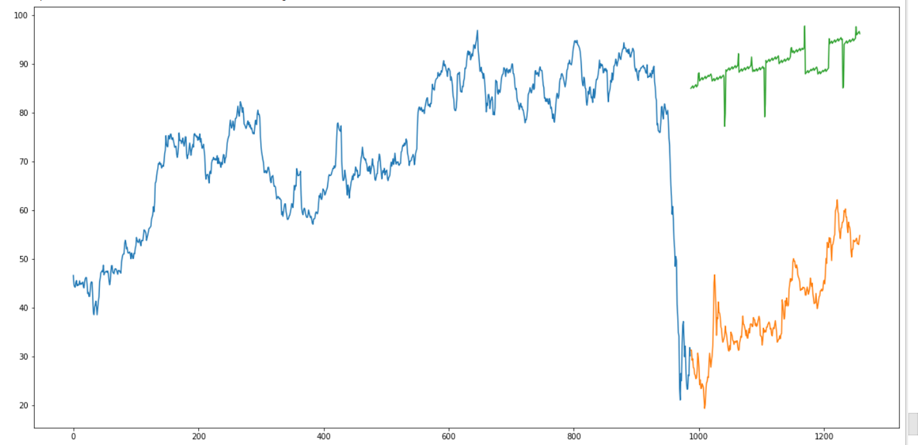
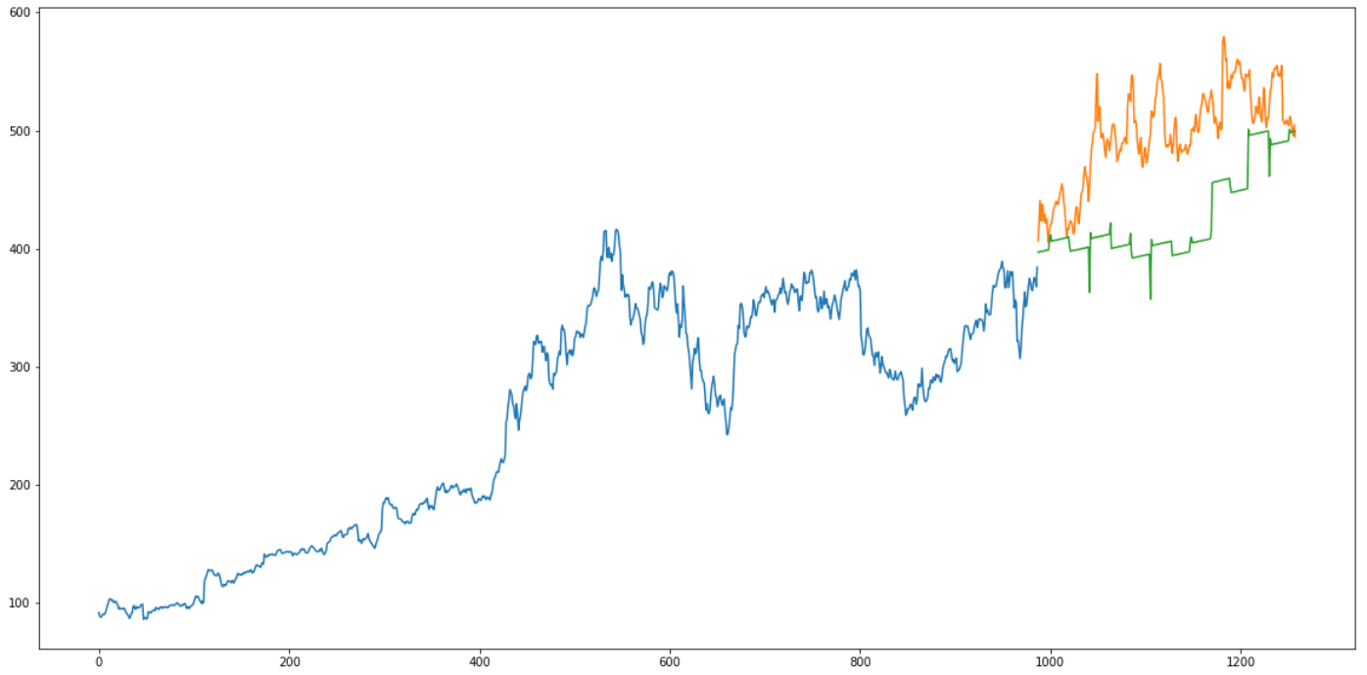
Results for Linear Regression (Without Covid-19 data)
For Amazon Dataset
For Amazon Dataset
For Netflix Dataset

Slide 12
Insights Drawn and Key Takeaways
Stacked LSTM model performs better than the linear regression model.
After comparing the graphical results obtained, we can say that Technology sector performed well during the pandemic compared to the Travel and Tourism sectors which took a very bad hit because of Covid-19.
Multivariate LSTM is better when working with multiple features.
Lesser the size of the time window while working with time series forecasting better the results(When the training data is small.
For better predictions sentiment analysis / news analysis can be added.
Stock price is affected by the news about the company and other factors like merger/demerger of the companies, economic conditions etc. There are certain intangible factors as well which can often be impossible to predict beforehand.

Slide 13
Challenges
Feature selection for the stock price prediction.
Understanding the historical CSV data obtained form Yahoo Finance.
Understanding the COVID-19 data.
Merging of the COVID-19 new cases data and stock data to generate a new dataset required to train the LSTM model.
Analyzing the obtained results/graphs to draw conclusions.
Choosing the correct hyper parameters for building better models.

Slide 14

Thank you Any Questions?

