Slide 1

Stock prices forecasting in USA during Covid‑19 using Long Short‑Term Memory (LSTM)
Aparna Krishna Bhat:- 1001255079
Naveena Mullapudi:- 1001821645
Mirat Gajera:- 1001829052

Slide 2
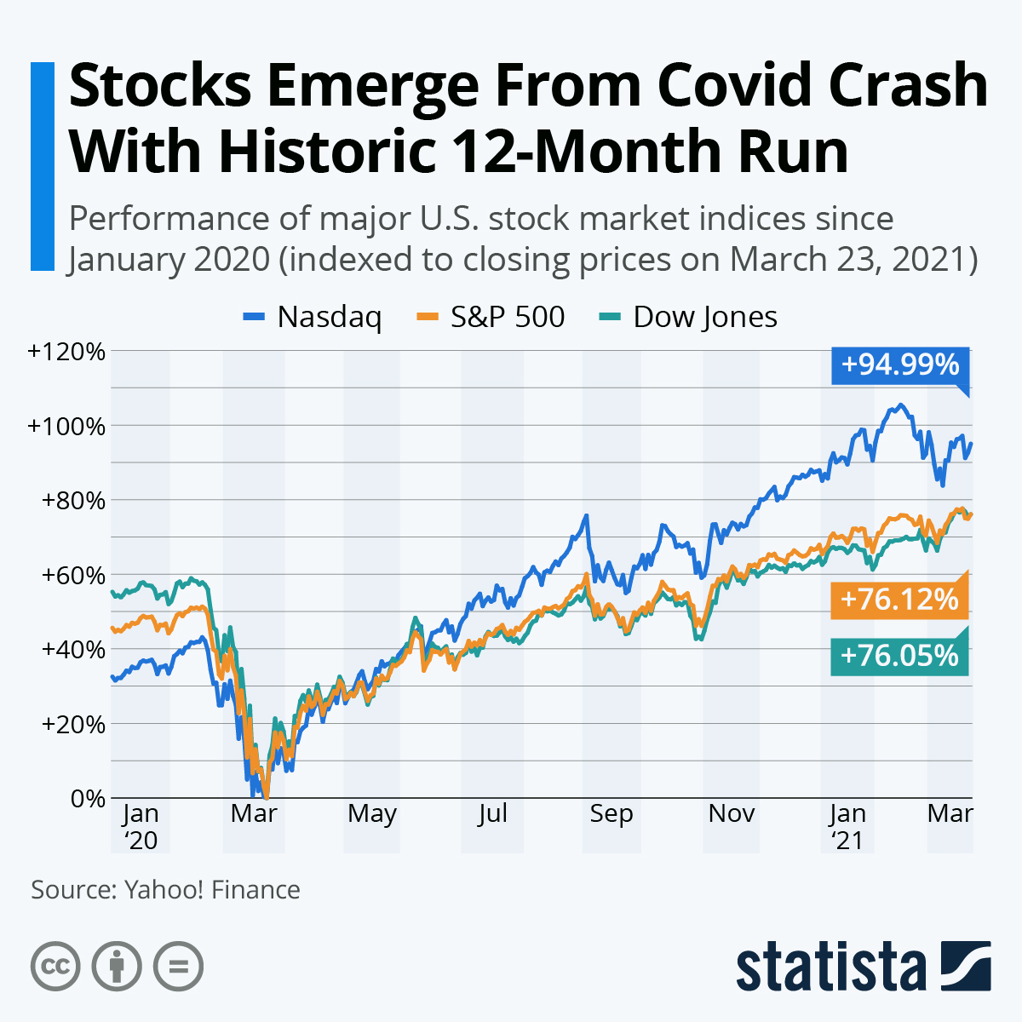
Introduction
One year ago, the U.S. stock market hit rock bottom after the coronavirus outbreak resulting in 30+ percent drops for each of the three major stock market indices from their previous peaks. But, a year later the world is still in crisis, but stock prices are near all-time highs.

Slide 3
Introduction
Investment firms, hedge funds and even individuals have been using financial models to better understand market behavior and make profitable investments and trades. In the midst of the COVID-19 pandemic and the dynamics of the global financial market during the year 2020, majority of global stock index reference indexes have experienced a significant decline. Forecasting stock prices has always been considered a challenging task due to the fact that the stock market tends to be nonstationary, nonlinear, and highly noisy. Artificial intelligence (AI) algorithms have been proven successful in solving problems such as predicting stock prices. Numerous factors influence financial market performance, and even financial experts find it complicated to make accurate predictions. This project seeks to utilize Deep Learning models, Long-Short Term Memory (LSTM) Neural Network algorithm, to predict stock prices.

Slide 4
Problem Statement and Goal
Problem statement:- Stock market process is full of uncertainty; hence stock prices forecasting very important in finance and business. COVID-19 have had a significant influence on the global economy, as well as an impact on the financial markets. The challenge of this project is to accurately predict the future stock price of the given stock across a given period of time in the future considering the impact of COVID- 19 on the economy.
Goal:- In this project, we are trying to investigate the impact of COVID-19 on the stock prices of companies like Amazon, Netflix, Airbnb, Airliners and Facebook on NASDAQ index. We will be making use of a Long Short Term Memory networks, Regression models to predict the future stock price of these companies on the NASDAQ using a dataset of past prices.

Slide 5
Datasets
1) Yahoo Finance:- Historical data of the stock prices. Yahoo Finance is the largest business and financial news site in the world, with unrivaled access to data, insights, and content.
2) NASDAQ Website:- Historical data of the stock prices.
3) Data of COVID19 confirmed cases are publicly available and operated by the Johns Hopkins University Center for Systems Science and Engineering (JHU CSSE) and supported by ESRI Living Atlas Team and the Johns Hopkins University Applied Physics Lab
4) https://researchguides.worldbankimflib.org/COVID-19/Data-Analysis-Research

Slide 6
Infrastructure
1) Google Colaboratory
2) Libraries (TensorFlow, Keras, Pandas, Numpy, Sklearn, Matplotlib)
3) GIT

Slide 7
Research paper(references)
1) Impact of COVID-19 on Forecasting Stock Prices: An Integration of Stationary Wavelet Transform and Bidirectional Long Short-Term Memory
https://downloads.hindawi.com/journals/complexity/2020/1846926.pdf
2) Data science approach to stock prices forecasting in Indonesia during Covid‑19 using Long Short‑Term Memory (LSTM).
https://journalofbigdata.springeropen.com/track/pdf/10.1186/s40537-021-00430-0.pdf

Slide 8
Long Shot-Term Memory (LSTM)
Sequence prediction problems
Recurrent Neural Networks.

Slide 9
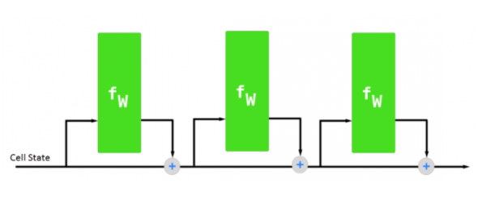
Long Shot-Term Memory (LSTM)
According to my research, best possible model to use for solution is LSTM Neural Net Model.
The input gate: The input gate adds information to the cell state
The forget gate: It removes the information that is no longer required by the model
The output gate: Output Gate at LSTM selects the information to be shown as output

Slide 10
Examples
Input Gate:
Mark knows lot about guns. He told me over the phone that he had learned about guns through multiplayer shooter video games.
Forget Gate:
Mark is a good person. On the other hand, Lisa is evil person.
Output Gate:
How are ____

Slide 11
Linear Regression
Linear Regression algorithm is a supervised machine learning algorithm to model between dependent variable and one or more independent variables to produce a best fit linear line.
Two types of Linear Regression
Simple Linear Regression
Multiple Linear Regression

Slide 12
Types of Linear Regression
1. Simple Linear Regression
Simple Linear Regression is used for finding the relationship between the independent variable and the dependent variable.
The goal of Simple Linear Regression algorithm is to obtain a line that best fits the data which is achieved by minimizing the loss function.
2. Multiple Linear Regression
In real-life scenarios, there will never be a single variable that predicts a target.
Multiple Linear Regression is used for finding the relationship between dependent variables and one or more independent.

Slide 13
Anticipated Conclusion
Visual comparison between the prediction models, i.e., Linear Regression Model and LSTM model
How the stock prices were affected and how future trends might be based on the current trends and historical data

Slide 14
Thank You !!
Any Questions?

