Slide 1

Stock prices forecasting in USA during Covid‑19 using Long Short‑Term Memory (LSTM)
Aparna Krishna Bhat:- 1001255079
Naveena Mullapudi:- 1001821645
Mirat Gajera:- 1001829052

Slide 2
Problem Statement and Goal
Problem statement:- Stock market process is full of uncertainty; hence stock prices forecasting is very important in finance and business. COVID-19 have had a significant influence on the global economy, as well as an impact on the financial markets. The challenge of this project is to accurately predict the future stock price of the given stock across a given period of time in the future considering the impact of COVID- 19 on the economy.
Goal:- In this project, we are trying to investigate the impact of COVID-19 on the stock prices of companies like Amazon, Netflix, Airbnb, Airliners and Facebook on NASDAQ index. We will be making use of a Long Short Term Memory networks, Regression models to predict the future stock price of these companies on the NASDAQ using a dataset of past prices.

Slide 3
Sample Data
Amazon Stock Price for the last 5 Days

Slide 4
Data pre-processing
Data is normalized for better prediction of data.
Dropping all the columns except for Close and Date (For Linear Regression Model).
Average of High and Low prices are calculated (For LSTM Model).

Slide 5
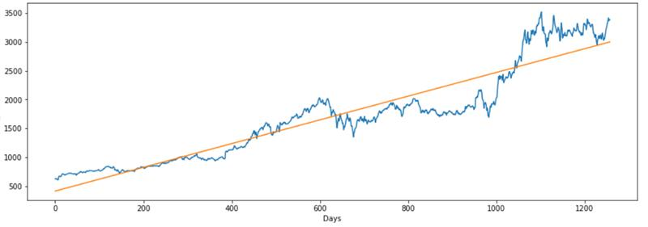
Linear Regression Model
Linear regression is an approach for predictive modeling to showcase the relationship between a scalar dependent variable ‘Y’, (in our case, we have ‘Close’ attribute) and one or more independent variables ‘X’ (‘Date’ attribute).

Slide 6
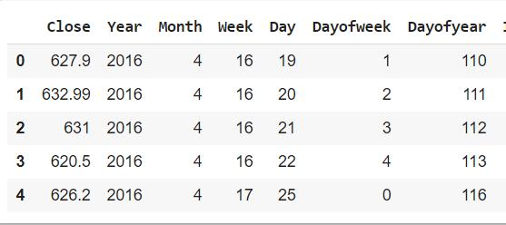
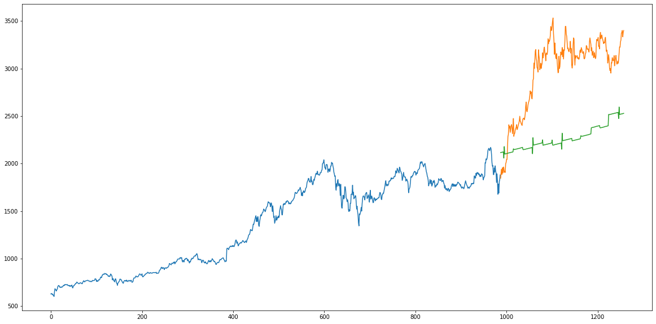
Linear Regression Model Prediction
Visualization between the actual value and the predicted value.
Blue curve:- Training Data
Orange Curve:- Test Data
Green Curve:- Predicted Data by the model
Evaluation Metric Used:- RMSE (Root Mean Square Error)

Slide 7
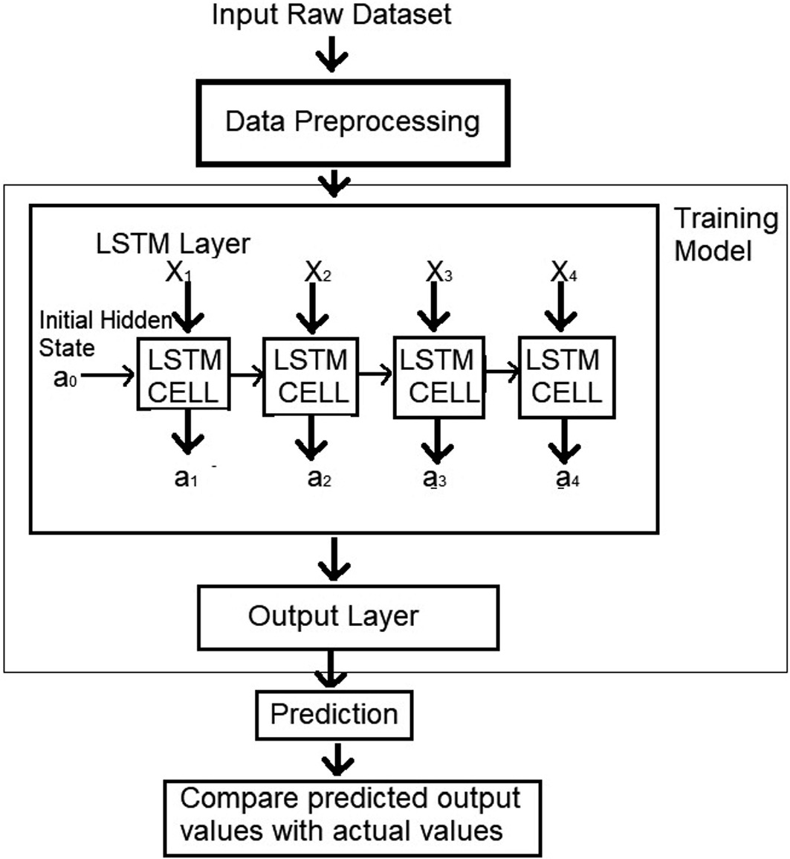
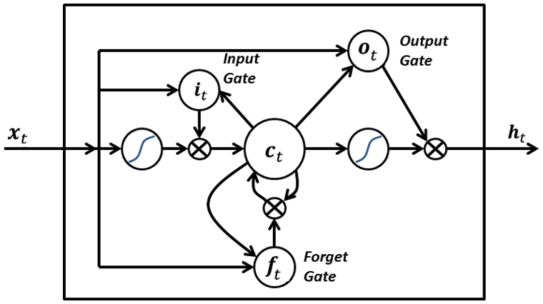
LSTM Architecture (Basic)
The Inner Working of LSTM

Slide 8
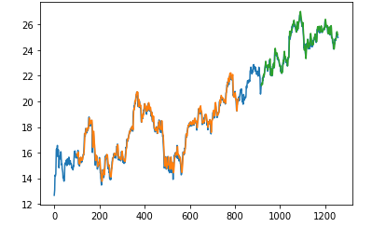
Averaging (High+Low)/2

Slide 9
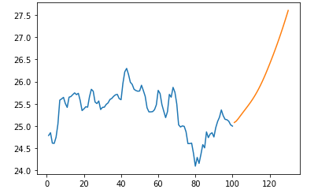
LSTM Model Prediction
Prediction for 30days time period for Amazon dataset
Model
Loss = mean_squared_error
Optimizer = adam
Epoch =100
Batch size = 64

Slide 10
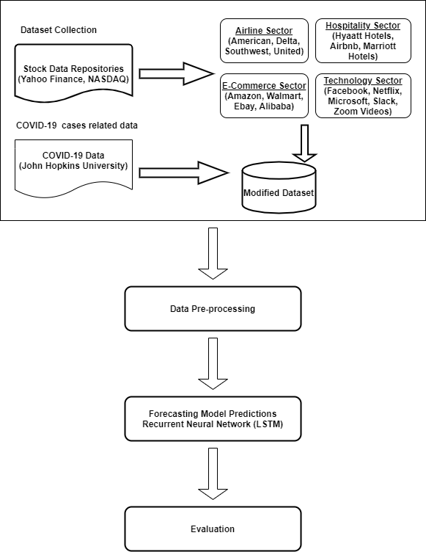
LSTM Architecture for Next Milestone

Slide 11
Challenges
Feature selection for the stock price prediction.
Understanding the historical CSV data obtained form Yahoo Finance.
Analyzing the obtained results to draw preliminary conclusions.
Modifying stacked LSTM to function better.
Choosing the correct hyper parameters for building better models.

Slide 12
Next Step(s)
Integration of COVID-19 data.
Comparing the results for LSTM and Linear Regression Models.
Drawing the insights and conclusions from the comparison.

Slide 13

Thank You!
Any Questions?

