Slide 1

Application to drive sales via social media
Aparna Bhat

Slide 2
Introduction
There was a time when we would fall in love with a pair of trendy boots or a pretty dress in the window of a shop and then buy them. In the age of online shopping, product discovery portals have become the new ‘store windows’.If e-commerce brought shoppers to the Internet, product discovery platforms and social media are changing the way they shop online.

Slide 3
Description about app
Login with any social media account.
Ask for the permissions to acces intrests,profile pic,shares,likes etc from (fb / twitter)
Then enters into home page.Display result of product based on the intrest and behaviour.
As well as recommended products from the recommendation engine(built on ML concepts).
On search results are displayed along with filtering and sorting.
Product details are displayed on tap.Eg likes,rating,customer ratings,offer price(for same products from differents portals).
Last customer:- when clicked chat room opens where you can chat on one to one (C2C) model.
View similar products based on the intrest and category wise.

Slide 4
Things to keep in mind when promoting your brand on social platforms
Identify Business Goal
Deliver Content Consistently
Every piece of your social media strategy serves the goals you set. You simply can’t move forward without knowing what you’re working toward.
One of the best ways to grow your following and increase engagement on social media is to be there consistently.
Target Website Visitors with Social Ads
Identify Ideal Customers
When you know your target audience’s age, occupation, income, interests, pains, problems, obstacles, habits, likes, dislikes, motivations and objections, then it’s easier and cheaper to target them on social or any other media.
It takes a lot of time and effort to attract visitors to your website. When you do attract relevant visitors, it’s important to maximize the potential of that visit even after they leave your website.
Research Competition
Start by compiling a list of at least 3-5 main competitors. Search which social networks they’re using and analyze their content strategy.

Slide 5
Advantages of using social media
01
More Opportunities to Convert
Every post you make on a social media platform is an opportunity for customers to convert. When you build a following, you’ll simultaneously have access to new customers, recent customers, and old customers, and you’ll be able to interact with all of them.
02
Increased Brand Recognition
Every opportunity you have to syndicate your content and increase your visibility is valuable. Your social media networks are just new channels for your brand’s voice and content.
03
Improved Customer Insights
Social media also gives you an opportunity to gain valuable information about what your customers are interested in and how they behave, via social listening.

Slide 6
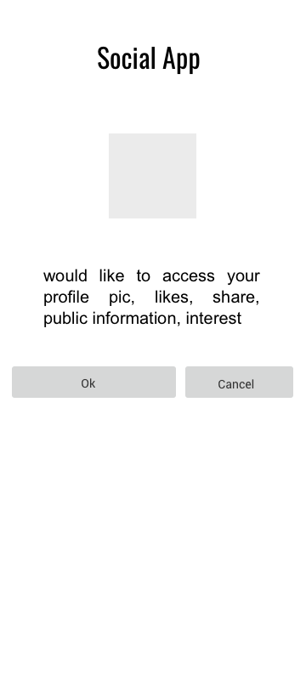
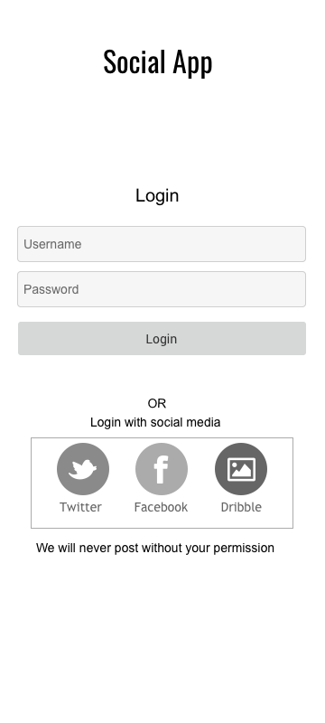
Screens

Slide 7
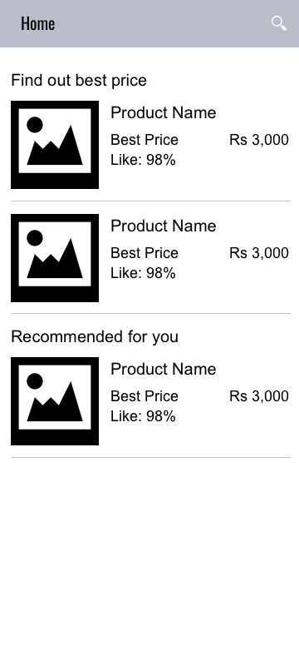
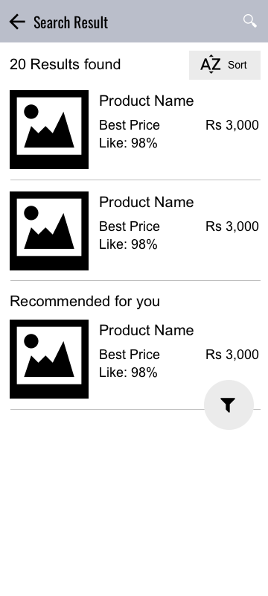
Screens

Slide 8
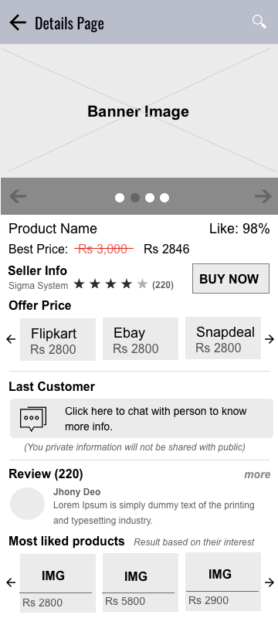
Screens

Slide 9
Data & Insights
Social media represents a low-cost way for companies to engage customers in two-way dialogue and develop deeper relationships. Relationships are a benefit that is difficult to achieve with other marketing channels. One often-overlooked opportunity is to use social media to strategically drive incremental revenue from existing customers.
Service industries can look to promote package deals for their services that bundle offerings together. In this case, the social channel is used to drive awareness of the offerings with a clear call to action, versus promoting deals or coupons like we typically see for product-based industries.
Another important element of increasing sales is to make sure customers are aware of the other types of services or products your company offers. You can do this by featuring a product or service profile of the week, which provides you with the opportunity to highlight premium services and explain what they are and why customers should care.

Slide 10
User Journey
Consumers see the social layer around a brand as one that supports their buying decision in providing engagement and information pre-purchase, then supports them after the purchase when they have questions.
If you want to convert fans on Facebook, Google+, LinkedIn, Twitter, Pinterest or any other social channel, you have to drive likely prospects and customers there with promotions or compelling content. Then you have to give them the opportunity and reason to convert. If you've attracted the right audience with the right messages in the right place and the right time, they will.

Slide 11
Best Practice
1. Know who you’re designing for.
2. Keep your content simple.
3. Avoid external links and keep users on your website as long as possible.
4. People scan websites, they don’t read them
5. Make the effort to do responsive right.
6. For long bio text or blog posts, make the text column the appropriate width.
7. Use established design patterns to avoid confusion and increase intuitive ease of use.
8. Make users excited to keep scrolling, instead of placing everything above the fold.

Slide 12
Appendix
https://www.freshconsulting.com/7-uiux-principles-fresh-web-experiences/
http://digitalvisitor.com/5-ways-to-drive-traffic-using-social-media/
http://www.socialmediaexaminer.com/turn-customers-into-increased-revenue/
https://www.forbes.com/sites/jaysondemers/2014/08/11/the-top-10-benefits-of-social-media-marketing/#77970cad1f80
http://www.bluefountainmedia.com/blog/advantages-of-social-media-marketing/
http://www.socialmediaexaminer.com/social-media-marketing-tips-pros/

Slide 13
Thank You
My Name: Aparna Bhat
Details: bhataparnak@gmail.com

