Slide 1

Disease Prediction System
Using Machine Learning & Clinical Data
Heart Disease Risk Classification • UCI Heart Disease Dataset • DAMG6105
920 Patients
15 Features
93% Recall
SHAP
UCI Dataset
Clinical Inputs
Disease Detection Rate
Explainability
Presented by:
Mansi Gaur, Amanpreet Singh Bhatia

Slide 2


The Problem
Why does early heart disease prediction matter?
Heart disease is the #1 cause of death globally - yet many cases are preventable with early detection.
Late Diagnosis
Manual Assessment
Inconsistency
Symptoms often appear only after significant cardiac damage has already occurred.
Clinicians rely on dozens of test results - easy to miss subtle patterns across variables.
Risk scoring varies by clinician and institution, leading to unequal patient outcomes.
Our answer: train a model on clinical data to flag high-risk patients automatically and explain why.

Slide 3

Dataset & Approach
UCI Heart Disease dataset - 920 patients, 15 clinical features
Age
Sex
Chest Pain Type
Resting BP
Cholesterol
Fasting Blood Sugar
Resting ECG
Max Heart Rate
Exercise Angina
ST Depression
ST Slope
# Vessels
Thalassemia
Target: Binary - 0 = No Disease | 1 = Disease Present
Pipeline
Feature Encoding
→
Train/Val/Test
split
→
KNN Imputation
→
Winsorize
→
StandardScaler
→
Model Training
→
SHAP Explainability
Key challenge: ca (66% missing) & thal (53% missing) handled with missing indicators + KNN imputation

Slide 4
Models & Performance
Four models trained and compared on the same validation set
Model | Accuracy | Precision | Recall | F1 Score | Selected?
Logistic Regression | 87.0% | 86.4% | 90.9% | 88.6% | ✔ Yes
Random Forest (Tuned) | 84.1% | 82.4% | 90.9% | 86.4% | -
Gradient Boosting (Tuned) | 82.6% | 79.8% | 92.2% | 85.5% | -
XGBoost (Tuned) | 82.6% | 79.8% | 92.2% | 85.5% | -
Final test set performance of selected model: Accuracy 87.0%, Recall 93.4%, ROC-AUC 92.0%
Why Logistic Regression?
Highest recall (90.9%) - most crucial for medical screening; missing a sick patient is costlier than a false alarm
Fully interpretable - coefficients directly show feature influence
Pairs naturally with SHAP for per-patient explanations
Threshold tuned to 0.45 to further boost recall on the test set

Slide 5

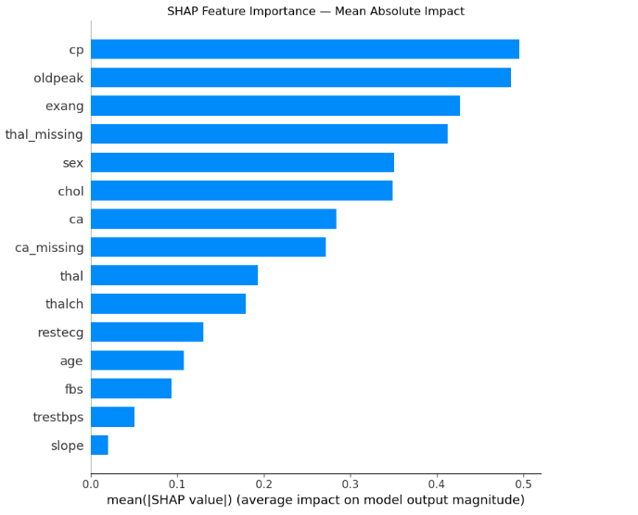
Explainability with SHAP
Which clinical features drive disease risk predictions?
SHAP (Shapley Additive Explanations) answers the black-box problem - it shows exactly how much each feature pushed a prediction toward or away from disease.
Global Insight
Chest pain type, ST depression, and exercise-induced angina are the three strongest predictors - consistent with established cardiovascular risk factors and confirmed across EDA, model coefficients, and SHAP analysis
Local Insight
For each individual patient, SHAP shows a waterfall explaining why the model predicted disease, enabling doctor-patient conversations

Slide 6





Prediction Workflow
End-to-end: raw patient data → risk score → explanation
→
→
→
→
Raw Patient
Data
Preprocessing
Pipeline
Logistic
Regression
SHAP
Explanation
Risk
Decision
Age, sex, BP, ECG…
Encode→ Impute → Scale
Threshold = 0.45
Feature contributions
At Risk/No Risk
Notes:
How our prediction model work: A patient clinical data such as age, sex, BP, cholesterol etc enters the pipeline. Missing values get imputed, categorical data gets encoded and all the values are are standardize. The logistic regression model outputs a probability score – it it exceeds the 0.45 threshold, the patient is flagged as at risk. SHAP generates a per patient explanation showing which features drove the prediction.

Slide 7
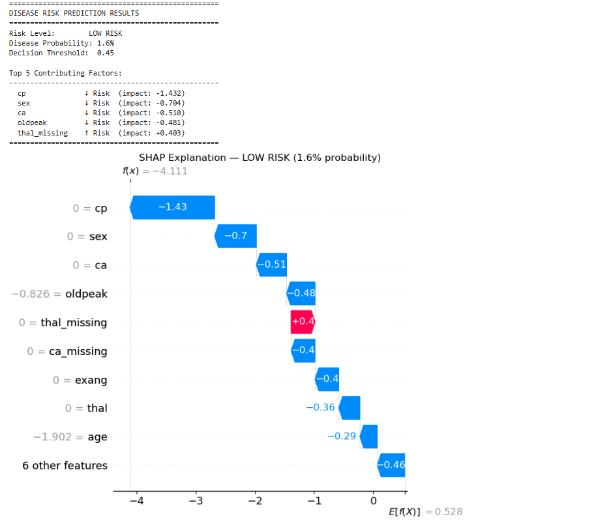
Prediction Workflow
End-to-end: Raw patient data as input → Model output
Example Patient Input
Model Output
#Test patient - Low risk profile low_risk_patient = { 'age': 35, 'sex': 'Female', 'cp': 'typical angina', 'trestbps': 118, 'chol': 195, 'fbs': False, 'restecg': 'normal', 'thalch': 170, 'exang': False, 'oldpeak': 0.0, 'slope': 'upsloping', 'ca': 0.0, 'thal': 'normal’
}
Notes:
This slide shows a concrete example of how the model works in practice. On the left, we have a sample low-risk patient — a 35-year-old female with normal vitals, no exercise angina, and normal thalassemia. When we feed this into our trained pipeline, the model outputs a low probability score — well below the 0.45 threshold — so the patient is classified as No Risk. The key point here is that the system doesn't just give a yes or no — it processes real clinical inputs through the same preprocessing, scaling, and prediction steps we discussed. This makes it practical for integration into a clinical workflow.

Slide 8






Future Enhancements
How can we make the system more accurate and useful?
Larger & Diverse Data
Advanced Feature Engineering
Ensemble & Deep Learning
Train on multi-hospital, multi-country datasets to reduce regional bias and improve generalization across demographics.
Add derived features like pulse pressure, cholesterol ratios, and interaction terms between age and exercise variables.
Combine multiple models via stacking or explore neural networks on richer datasets (e.g., ECG time-series data).
Automated Hyperparameter Tuning
Real-Time Risk Monitoring
Extend to Other Disease
Hyperparameter tuning was applied using GridSearchCV. Future work could extend this with Bayesian optimization for more efficient search and automate decision threshold selection across all models simultaneously.
Integrate with wearable devices (heart rate, SpO2) to produce continuous, updated risk scores rather than one-time predictions.
The preprocessing - training - SHAP pipeline is disease agnostic. Swap in any other disease dataset, retrain, deploy the same architecture, and make predictions.
Notes:
Looking ahead, there are six directions we can take this project. First, training on larger, multi-hospital datasets would reduce bias and improve generalization. Second, we can engineer new features like pulse pressure or cholesterol ratios. Third, ensemble methods or deep learning could improve accuracy on richer data. Fourth, automated hyperparameter tuning with Bayesian optimization would make it efficient and automate decision yhreshold selection across models. Fifth, wearable device integration could enable continuous risk monitoring instead of one-time predictions. And finally — and this is important — our entire pipeline is disease-agnostic. The same preprocessing, training, and SHAP explanation architecture can be reused for diabetes, lung cancer, or any other disease — just swap in a new dataset, retrain, and deploy.

Slide 9
Key Takeaways
01
Simple beats complex
02
Data quality is everything
Logistic Regression outperformed Random Forest & Gradient Boosting on recall - the metric that matters most for medical screening.
Two features with 50-66% missing values were saved using missing indicators + KNN imputation, preserving clinically critical signals.
03
Explainability builds trust
04
Threshold matters
SHAP transforms the model from a black box into a clinical tool, surfacing chest pain type, ST Depression, and Exercise Angina as top drivers.
Tuning the decision threshold from 0.5 → 0.45 improved recall without sacrificing overall accuracy - a small tweak with real clinical impact.
Questions? We're happy to walk through the code, model choices, or SHAP outputs.
Notes:
Four key takeaways from our project. First, simple models can beat complex ones — Logistic Regression outperformed Random Forest and Gradient Boosting on recall, which is what matters most in medical screening. Second, data quality is critical — we saved two features with over 50 percent missing data using KNN imputation and missing indicators, preserving clinically important signals. Third, explainability builds trust — SHAP transforms the model from a black box into something a doctor can actually discuss with a patient, highlighting exercise angina, ST depression, and chest pain as top drivers. Fourth, small tuning decisions matter — lowering the threshold from 0.5 to 0.45 improved recall without hurting overall accuracy.
Happy to take any questions about the code, model choices, or SHAP outputs.

Slide 10
Demo Time…

