Slide 1
Summary: These slides describe each of the five Functions included in the Cybersecurity Framework.
Audience: These slides are intended for an audience who is somewhat familiar with the components and high-level objectives of the Framework, but is seeking to gain an increased understanding of its content.
Learning Objectives:
Discern the five Functions of the Framework
Understand the purpose of Functions within the Core
Gain awareness of outcomes associated with each Function

Slide 2

The Five Functions
of the Cybersecurity Framework
July 2018
cyberframework@nist.gov

Slide 3
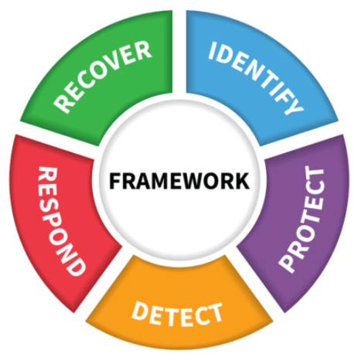
The Five Functions
Highest level of abstraction in the core
Represent five key pillars of a successful and wholistic cybersecurity program
Aid organizations in expressing their management of cybersecurity risk at a high level
Notes:
The five Functions included in the Framework Core are:
Identify
Protect
Detect
Respond
Recover
The Functions are the highest level of abstraction included in the Framework. They act as the backbone of the Framework Core that all other elements are organized around.
These five Functions were included in the Core because they represent the five primary pillars for a successful and holistic cybersecurity program. They aid organizations in easily expressing their management of cybersecurity risk at a high level and enabling risk management decisions.

Slide 4
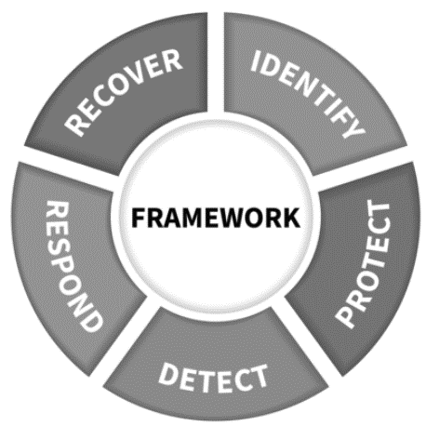

The Identify Function
The Identify Function assists in developing an organizational understanding of managing cybersecurity risk to systems, people, assets, data, and capabilities
Example Outcomes:
Identifying physical and software assets to establish an Asset Management program
Identifying cybersecurity policies to define a Governance program
Identifying a Risk Management Strategy for the organization

Slide 5

The Protect Function
The Protect Function supports the ability to limit or contain the impact of potential cybersecurity events and outlines safeguards for delivery of critical services
Example Outcomes:
Establishing Data Security protection to protect the confidentiality, integrity, and availability
Managing Protective Technology to ensure the security and resilience of systems and assists
Empowering staff within the organization through Awareness and Training

Slide 6
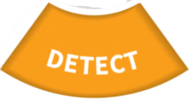
The Detect Function
The Detect Function defines the appropriate activities to identify the occurrence of a cybersecurity event in a timely manner
Example Outcomes:
Implementing Security Continuous Monitoring capabilities to monitor cybersecurity events
Ensuring Anomalies and Events are detected, and their potential impact is understood
Verifying the effectiveness of protective measures

Slide 7

The Respond Function
The Respond Function includes appropriate activities to take action regarding a detected cybersecurity incident to minimize impact
Example Outcomes:
Ensuring Response Planning processes are executed during and after an incident
Managing Communications during and after an event
Analyzing effectiveness of response activities

Slide 8

The Recover Function
The Recover Function identifies appropriate activities to maintain plans for resilience and to restore services impaired during cybersecurity incidents
Example Outcomes:
Ensuring the organization implements Recovery Planning processes and procedures
Implementing improvements based on lessons learned
Coordinating communications during recovery activities

Slide 9
Resources Where to Learn More and Stay Current
Framework for Improving Critical Infrastructure Cybersecurity and related news, information:
www.nist.gov/cyberframework
Additional cybersecurity resources: http://csrc.nist.gov/
Questions, comments, ideas: cyberframework@nist.gov
9

