Slide 1

Notes:
#

Slide 2

1st Slide - Team Intro
Team details:
Title | AI-Powered Size Chart Generator for Apparel Sellers - Software Development Track
Team Name | Manbhatia007
Team ID | U301BPS9
Team Member | Manik Bhatia
College | National Institute of Technology, Hamirpur (H.P.) 177001
Date | 25th August 2024
Title: Title of the Solution/PS Name + Track name
Team Name: Name of the Team
Team Members: List of Team Members with their Roles
College/University: Name of the Institution
Date: Date of Submission

Slide 3
Executive Summary
Problem statement:
User-Centric Analysis: Employs advanced algorithms to integrate and process user body metrics (height, weight, chest, waist, hip, etc.) for precision in size recommendation.
Seller Customization: Offers a customizable AI framework for apparel sellers, aligning size charts with specific sizing standards using scalable algorithms.
Dynamic Size Chart Generation: Generates AI-powered, adaptive size charts with probabilistic confidence scores for different apparel sizes.
Proposed Solution:
Convert the cleaned dataset into Gaussian curves to accurately model the distribution of body measurements.
Train the AI model using cross-validation techniques to avoid overfitting and ensure generalizability across diverse datasets.
A hybrid AI model architecture using TensorFlow, combining supervised learning for size classification to group similar body types.
Generate a confusion matrix to evaluate model performance, specifically focusing on precision, recall, and F1-score for each size category.

Slide 4
Methodology:
Imported and cleaned the dataset using pandas, performing data integrity checks with df.info() and null value assessment using df.isnull().sum(), particularly focusing on missing data imputation in gender-specific attributes.
Engineered features by converting height from a mixed unit format (feet inches) to inches using a custom conversion function applied via lambda in pandas for consistent measurement scaling.
Conducted exploratory data analysis (EDA) using Seaborn and Matplotlib to visualize the distribution of critical features like height and weight, identifying and addressing non-Gaussian distributions through graphical analysis.
Normalized and standardized numerical features using MinMaxScaler and StandardScaler from sklearn, ensuring consistent feature scaling to accelerate the convergence of the deep learning model.

Slide 5
Tools and Technologies:
TensorFlow: Utilized for constructing and training deep learning models using the Sequential API, defining architecture with layers like Dense and Dropout.
Scikit-Learn: Employed for data preprocessing, including scaling with MinMaxScaler and normalization with StandardScaler to prepare data for the neural network.
Seaborn: Deployed for advanced visualizations, including count plots and histograms, to explore the distribution of features like height and body shape index.
Matplotlib: Utilized for plotting model performance metrics over epochs, such as accuracy, F1 score, and loss, aiding in the assessment of the model's training process.

Slide 6
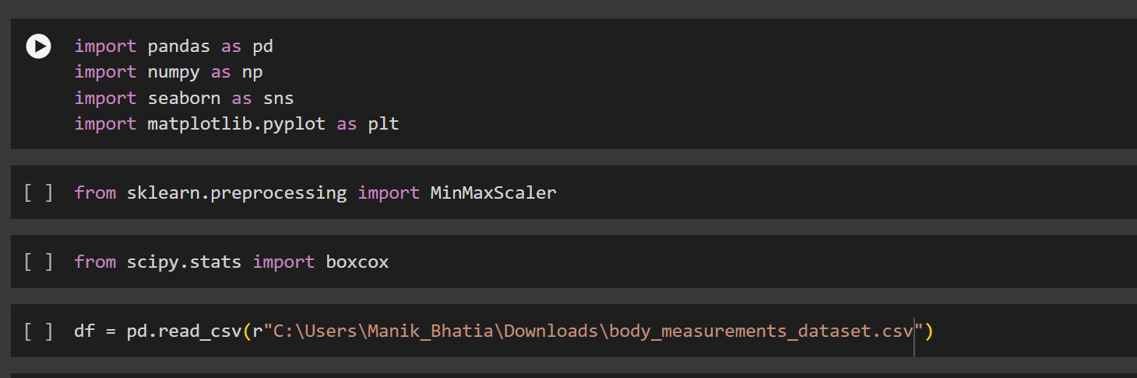
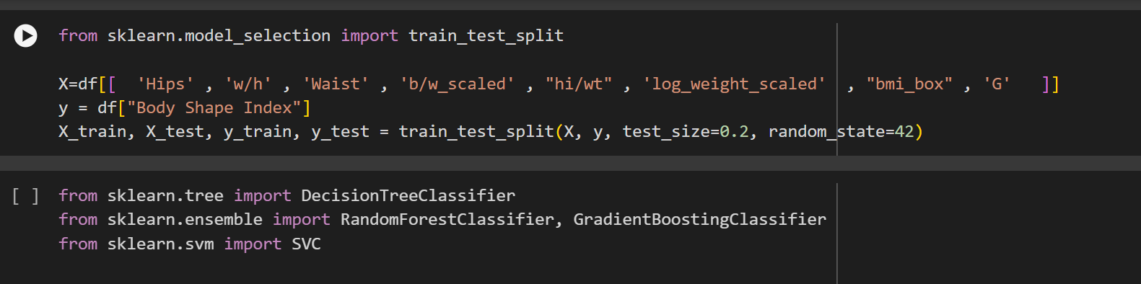

Slide 7
Algorithm/Logic:
Data Loading and Initial Inspection
Load Dataset: The data is loaded using pandas and inspected using functions like df.head() and df.info() to understand its structure and identify missing values.
Data Cleaning
Missing Value Handling: Identify columns with missing values, particularly focusing on gender-specific attributes like "cup size," and decide on the appropriate strategy (e.g., leaving them as is due to data specifics or imputing missing values).
Feature Conversion: Convert non-numeric data into numeric where necessary. For instance, convert height from a mixed format (feet'inches) into a single unit (inches).
Feature Engineering
Height Conversion: Convert the height from a string format (e.g., "5'8"") to a numeric format (inches) using the custom function convtheight().
Weight Log Transformation: Apply logarithmic transformation to the weight data to reduce skewness, making it more suitable for modeling.
BMI Calculation: Calculate BMI using the formula BMI = (Weight in kg) / (Height in m)^2 and add it as a new feature.

Slide 8
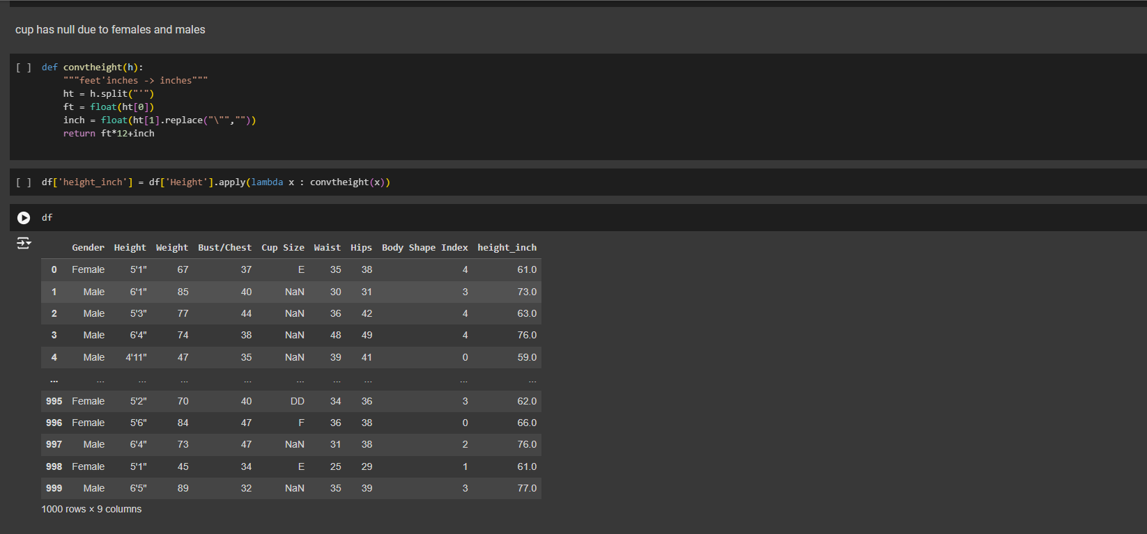

Slide 9
Algorithm/Logic:
Exploratory Data Analysis (EDA)
Distribution Visualization: Use Seaborn and Matplotlib to visualize the distribution of features like height and weight, identifying any non-Gaussian distributions.
Correlation Analysis: Analyze correlations between features using a heatmap, determining which features are highly correlated and may be redundant.
Model Construction
Neural Network Architecture: Construct a Sequential neural network model using TensorFlow:
Input Layer: Define the input shape based on the number of features.
Dropout Layers: Introduce Dropout layers to prevent overfitting by randomly dropping units during training.
Output Layer: Add a Softmax layer to handle multi-class classification tasks.
Model Compilation
Loss Function: Use Categorical Cross-Entropy as the loss function since the task is multi-class classification.
Metrics: Include evaluation metrics such as accuracy, F1 score, and AUC for the precision-recall curve (prc), which are particularly useful for imbalanced datasets.

Slide 10
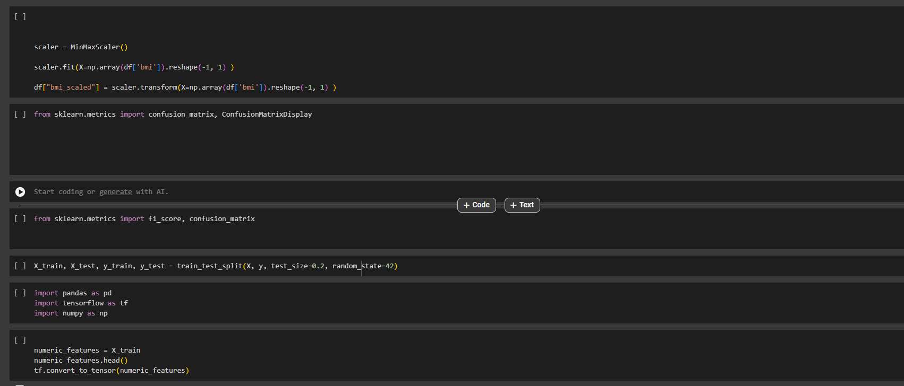

Slide 11
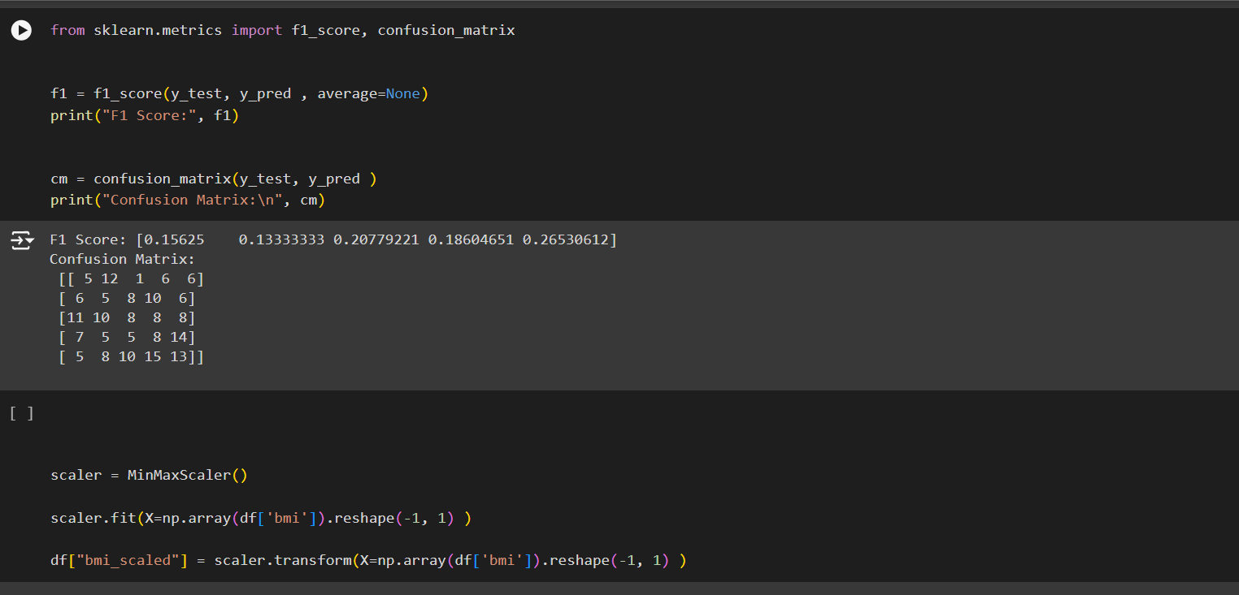

Slide 12
Algorithm/Logic:
Model Training
Fit Model: Train the model on the dataset using a specific number of epochs (e.g., 200) and a batch size (e.g., 64), monitoring both training and validation performance.
Callback Mechanisms: Implement callback functions, such as early stopping, to halt training when the model stops improving, preventing overfitting.
Model Evaluation
Performance Metrics: After training, evaluate the model using the test set, calculating the accuracy, F1 score, and AUC.
Confusion Matrix: Generate and visualize a confusion matrix to understand the classification performance across different classes.

Slide 13
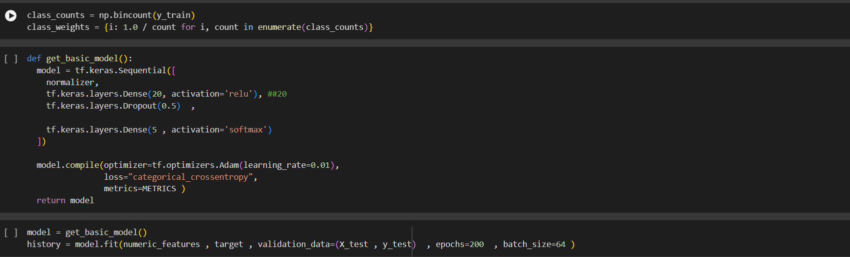

Slide 14
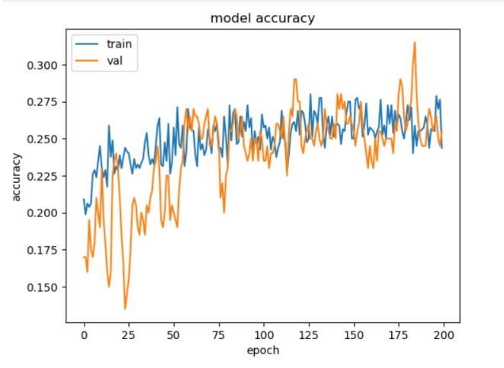
Results and Analysis:
Model Accuracy:
Training Accuracy: The training accuracy fluctuates, with an initial value around 0.18. It generally increases over the epochs, stabilizing around 0.25 to 0.27, with occasional spikes above 0.27, indicating variability in the learning process.
Validation Accuracy: The validation accuracy starts below 0.15, showing high fluctuation initially. It eventually stabilizes around 0.23 to 0.26, closely following the training accuracy but still with considerable variability.

Slide 15
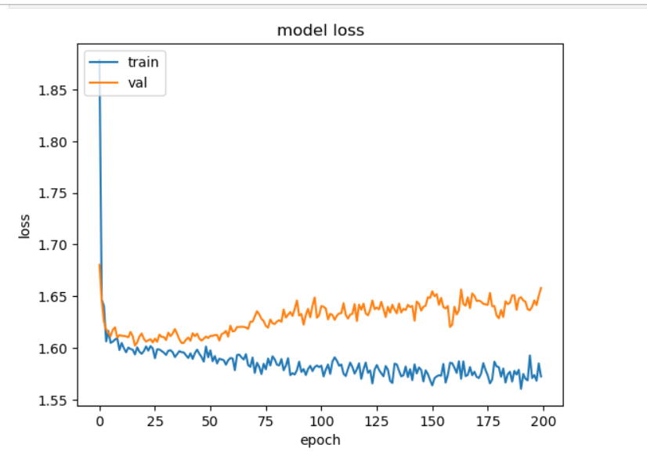
Results and Analysis:
Model Loss:
Rapid Drop: There is a steep decline in both training and validation losses within the first 10 epochs. The training loss drops to approximately 1.60, while the validation loss also decreases but with more fluctuation.
Overall Loss: Despite the fluctuations, the model maintains a relatively low loss (around 1.55 for training and slightly higher for validation), but the lack of further significant decrease suggests that the model has reached its learning capacity under the current setup.

Slide 16
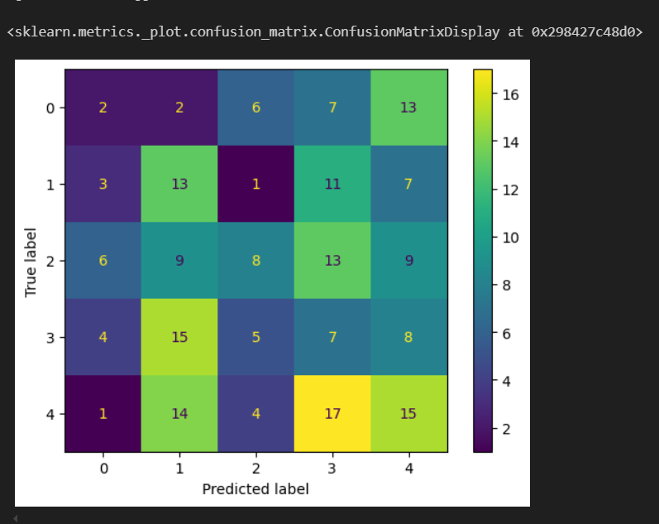
Results and Analysis:
Confusion Matrix:
High Misclassification Between Classes 3 and 4: There is substantial confusion between classes 3 and 4, with a large number of instances being misclassified between these two classes.
Moderate Success in Class 4 Predictions: Class 4 had the highest correct predictions (17 instances), but it still experienced notable misclassifications, particularly into class 3, indicating room for improvement.

Slide 17
Challenges and Limitations:
Handling Missing Data: The dataset contains missing values, particularly in gender-specific attributes (e.g., cup size). Deciding on the appropriate strategy (imputation, removal, or leaving as is) without introducing bias is a complex challenge.
Feature Engineering Complexity: Converting height from a mixed unit format (feet'inches) to inches and properly encoding categorical variables (e.g., Body Shape Index) requires careful feature engineering, which could introduce errors or inconsistencies if not done correctly.
Data Dependency: The model's performance is heavily dependent on the quality and quantity of the input data. If the data is noisy, contains outliers, or is not representative of the real-world scenarios, the model's predictions may be unreliable.

Slide 18
Recommendations and Future Work:
Making the Model Easier to Understand:
Explain Predictions: Use tools that show which features most influenced the model’s decisions, making it easier to understand why it made certain predictions.
Simple Explanations: Implement methods that explain the model's behavior in a way that non-experts can easily understand.
Combining Models:
Use Multiple Models: Combine the outputs of different models to create a more accurate and robust final prediction.
Boosting Performance: Try advanced techniques that can improve the model’s predictions by focusing on the harder-to-predict examples.
Improve Data Quality:
Data Cleaning: Regularly clean the dataset to remove outliers, correct errors, and handle missing values, ensuring the model is trained on the highest quality data.
Data Enrichment: Augment the existing dataset with additional, relevant data points to provide a richer context for the model to learn from.

Slide 19
Appendices:
TensorFlow: TensorFlow is an open-source machine learning framework by Google, designed for building and deploying models, especially deep neural networks. It operates using computation graphs, supports automatic differentiation, and offers flexible APIs like Keras.
F1 score: The F1 score is a metric used in classification to measure a model's accuracy, balancing precision and recall. It is the harmonic mean of precision (the proportion of true positive results among all positive predictions) and recall (the proportion of true positive results among all actual positives). The F1 score is especially useful when the dataset is imbalanced, as it accounts for both false positives and false negatives.
Scikit-Learn: Scikit-Learn is a popular open-source machine learning library for Python. It provides simple and efficient tools for data mining and data analysis, including algorithms for classification, regression, clustering, and dimensionality reduction. It is built on top of other scientific libraries like NumPy, SciPy, and matplotlib, and is known for its ease of use and integration with other data analysis tools.
Seaborn: Seaborn is an open-source Python library used for statistical data visualization. Built on top of Matplotlib, Seaborn provides a high-level interface for drawing attractive and informative statistical graphics. It includes functions for creating a wide range of plots, such as bar plots, scatter plots, and heatmaps, and offers additional functionality for visualizing and understanding complex datasets. Seaborn is known for its ease of use and its ability to produce aesthetically pleasing and informative plots with minimal code.

