Slide 1
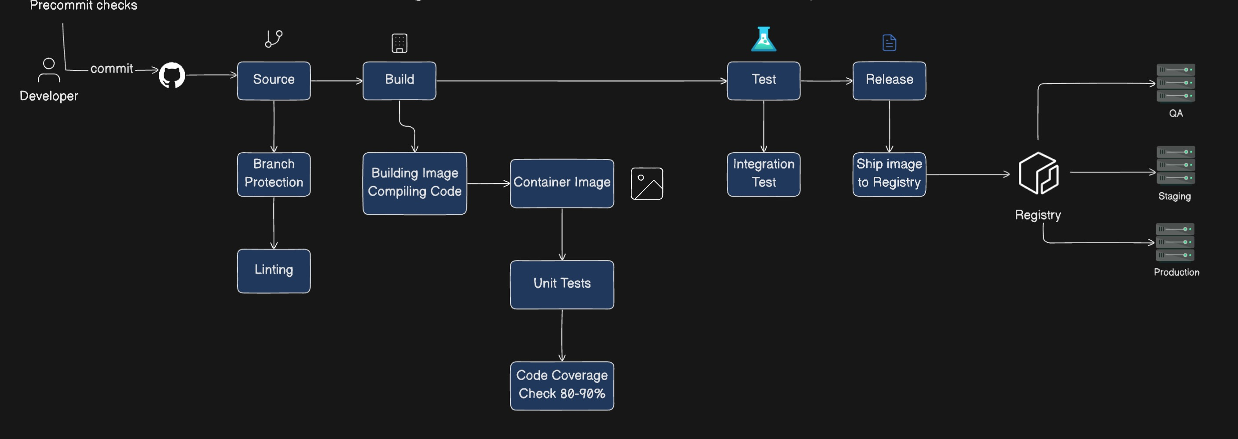

Slide 2
Flow
Trigger: Jenkins pipeline is triggered on every code commit to a specific branch.
Build Docker Image: Create a Docker image that provides a consistent environment for building and testing.
Get Source Code: Retrieve the latest source code from a Git repository.
Build Application: Use the Docker image to compile and package the application.
Test Application: Execute unit tests using the same Docker image.
Build Hosting Docker Image: Create Docker images that will host the application.
Run Terraform Scripts: Use Terraform to provision infrastructure and deploy Docker images.
Database Upgrades & Seeding: Apply schema migrations and seed data.
Integration Tests: Validate the entire application using integration tests.
Notify Interested Parties: Inform stakeholders about the build result via email or messaging tools.

Slide 3
Library Management System Infrastructure Workflow
.

Slide 4
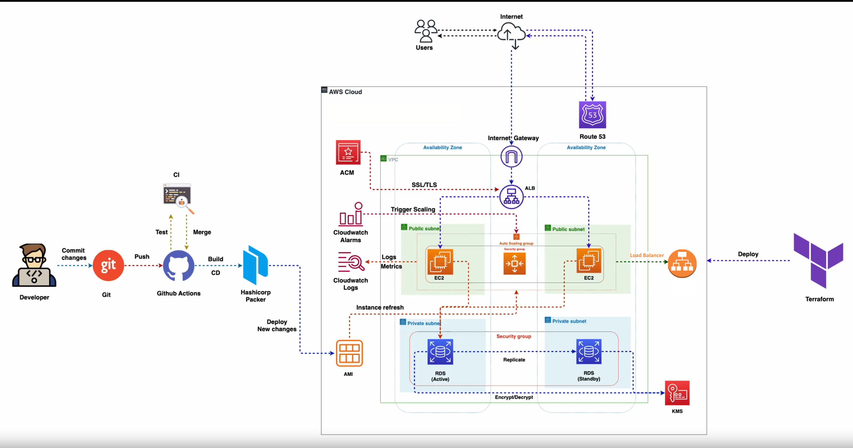

Slide 5
Serverless Computing Flow
.

Slide 6
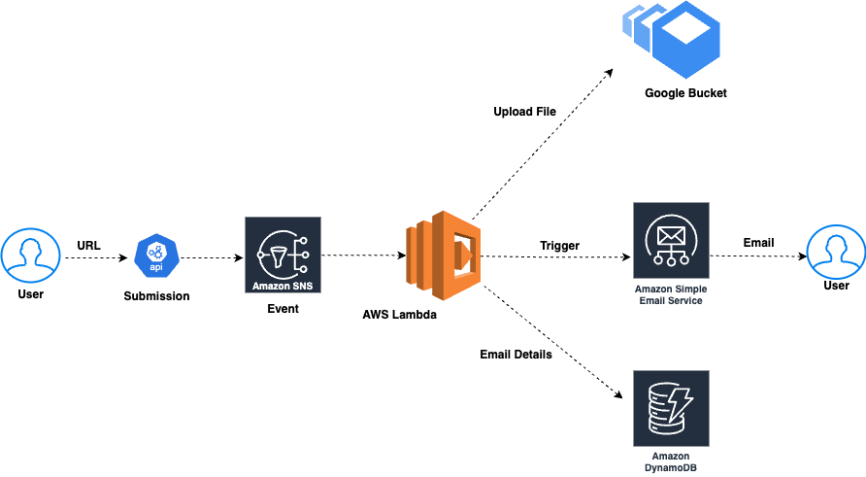

Slide 7
USCIS Case Status Lambda - SNS
.

Slide 8
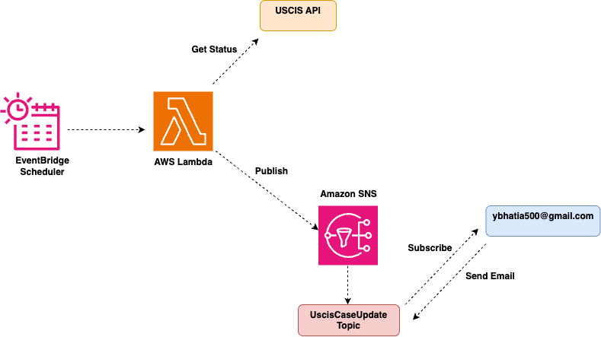

Slide 9
DevSecOps Pipeline
.

Slide 10
