Slide 1
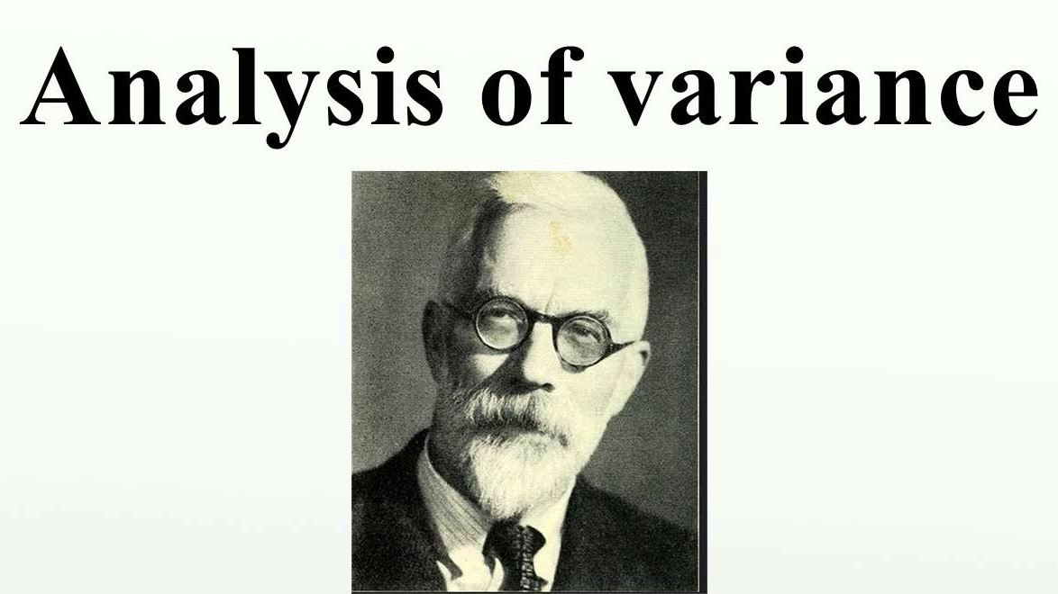
Presented by :
Saumya Bhatnagar

Slide 2
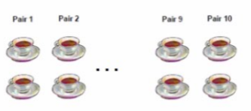
Fisher’s exact test
Lady Bristol’s claim
H₀ = her ability to distinguish the teas is mere chance
In Fisher’s approach, no Ha
8 cups, p= 0.014 (=1/⁸C₄ = 1/70) <0.05 (association is random = reject H0)
Lady tasting tea
two-alternative forced choice
Increase the #observations in each group
How these groups are varied?
. | . | … | . | .
. | . | … | . | .
. | . | … | . | .

Slide 3
Table of Content
Fisher’s exact test
Anova
Anova & t-test
Anova Designs
One way Anova
Assumptions Anova
Computing F score & Anova table
Anova in R
Why Anova

Slide 4
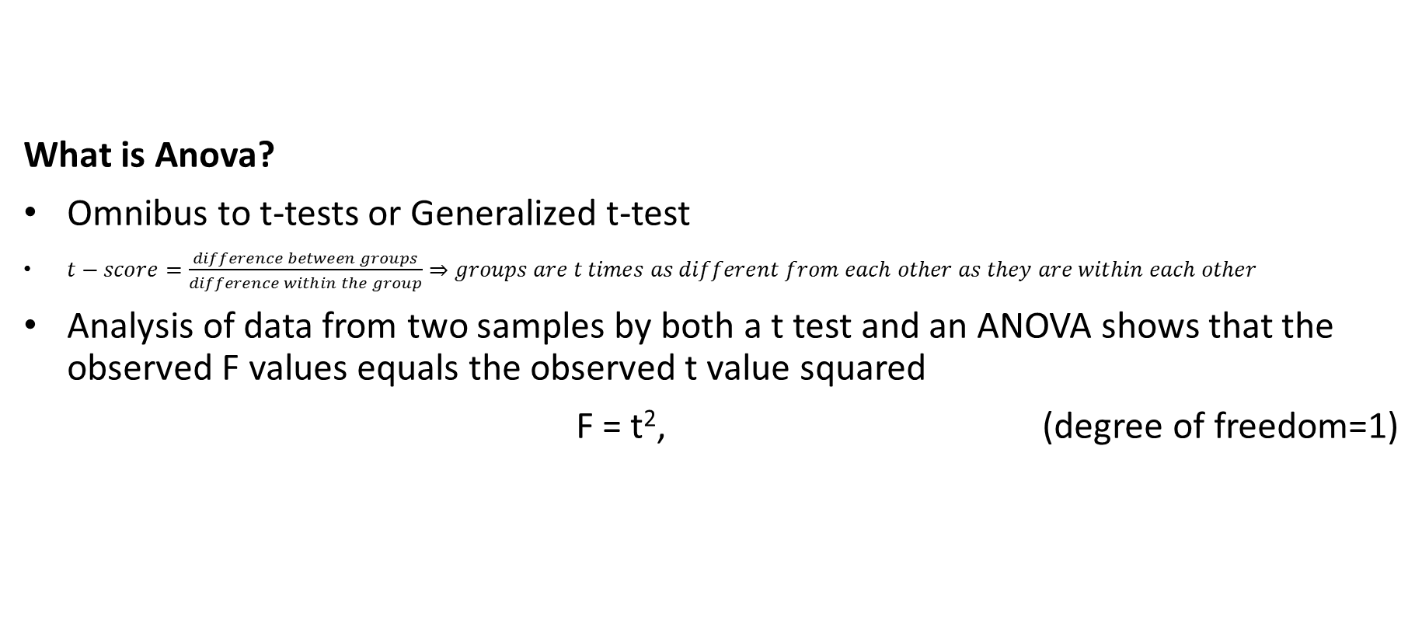
Anova & t-test
What is Anova?
Omnibus to t-tests or Generalized t-test
$t−score=\frac{difference between groups}{difference within the group}⇒groups are t times as different from each other as they are within each other$
Analysis of data from two samples by both a t test and an ANOVA shows that the observed F values equals the observed t value squared
F = t², (degree of freedom=1)

Slide 5
AN-O-VA
designs
_{One way Anova}
_{Two or more samples}
One factor or independent variable
_{One dependent variable}
e.g. Tea taste is being tested at one level – what was poured first?
_{Factorial Anova}
_{Two or more samples}
_{Multiple independent variable}
_{One dependent variable}
e.g. Tea taste is being tested at various levels - sugar, tea content etc.
_{Repeated Measures Anova}
_{Same sample}
e.g. Tea being poured to the same set thrice a day and tested
_{M-AN-O-VA}
_{Two or more samples}
_{Multiple independent variable}
_{Multiple dependent variables}
e.g. Tea being tested for color + taste at various levels

Slide 6
One-way Anova
Do differences exist between two or more groups on one DV?
a priori vs. post-hoc (a posteriori) tests
Post hoc is the multiple comparison test of groups. it compares all possible pairs of means.

Slide 7
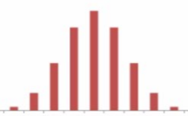
Assumptions One-way Anova
One way ANOVA is based on the following assumptions:
Normal distribution of the population
Two or more than two categorical independent groups in an independent variable.
Independence of samples
σ₁² = σ₂² = σ₃² = ….

Slide 8




Computing F-score
ANOVA is computed with the three sums of squares
Total – Total Sum of Squares, a measure of all variations in the dependent variable, SST
Treatment (Between) – Sum of Squares Treatments (Between), SSC
Error (Within) – Sum of Squares of Errors; yields the variations within treatments (or columns), SSE
SST = SSC + SSE

Slide 9
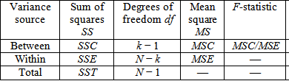
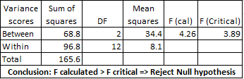
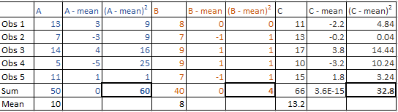
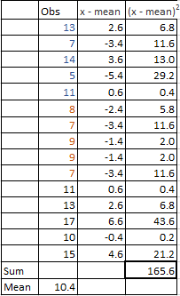
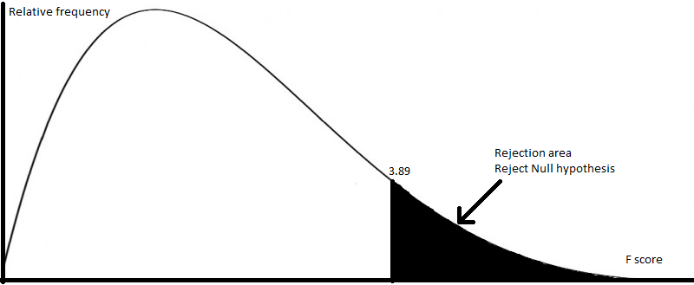
Anova Table
The table is as follows:

Slide 10
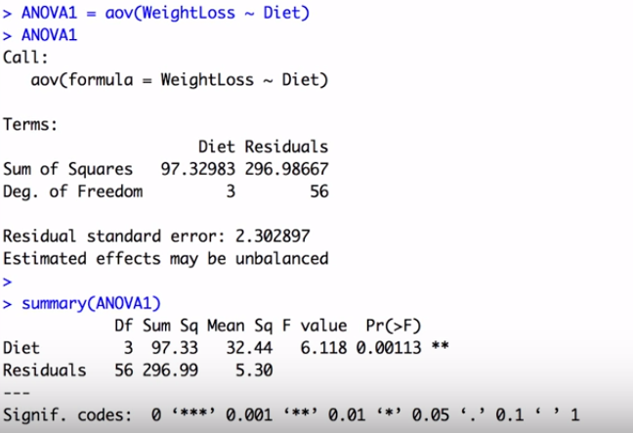
Anova in R
One way Anova
Import data set
Check null values and mine data
Plot box-plots
Run aov
Save in another variable
Export the summary

Slide 11
Anova in R
One way Anova
(where y = dependent variable, A=independent variable)
fit <- aov(y ~ A, data)
Factorial Anova
(For two way Anova)
fit <- aov(y ~ A + B + A:B, data)
fit <- aov(y ~ A*B, data)
MANOVA
(Considering two dependent variables Y & Y’)
fit <- manova(cbind(Y, Y’) ~ A*B, data)

Slide 12
Why Anova?
Gives an exploratory data analysis
Effect of many variables at once
Generates ‘F’ statistics : allows testing of a nested sequence of models
organization of an additive data decomposition,
sums of squares indicate the variance of each component of the decomposition (or, equivalently, each set of terms of a linear model).
Analysis of a variety of experimental designs.
Handles experimental error
Reduces chances of Type 1 error
The more statistical tests run, the greater likelihood that the researcher will obtain seemingly significant effects due to chance alone. (ANOVA determines whether the amount of variance between the groups is greater than the variance within the groups)

Slide 13
What next?
Tuning MPI runtime Parameter Setting
Objectives:
Improve performance of MPI programs

Slide 14
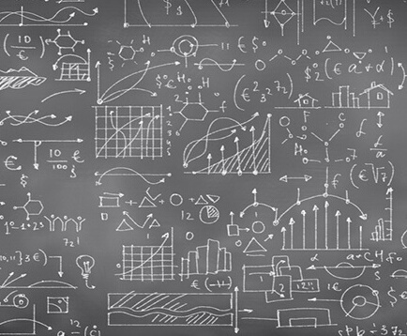
Thank you

Slide 15
MPI runtime Parameter

Slide 16
References:
Wikipedia
https://www.stat.berkeley.edu/~stark/Teach/S240/Notes/ch3.htm
http://keydifferences.com/difference-between-one-way-and-two-way-anova.html

Slide 17
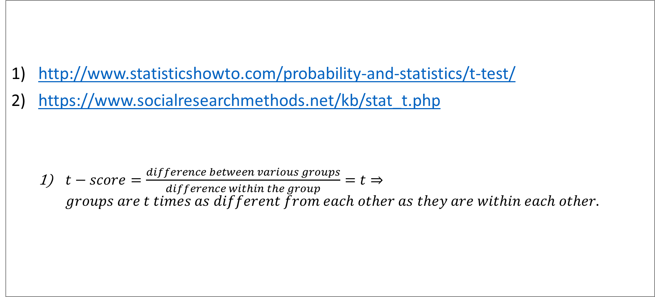
Computing T-test
http://www.statisticshowto.com/probability-and-statistics/t-test/
https://www.socialresearchmethods.net/kb/stat_t.php
$t−score=\frac{difference between various groups}{difference within the group}=t⇒groups are t times as different from each other as they are within each other.$

Slide 18
Factorial Anova
More than one independent variable
Two way Anova, Three way Anova.
The two-way ANOVA tests to see if the factors are important (significant) either separately (called main effects) or in combination (via an interaction).

Slide 19
Multivariate Analysis of Variance
There is more than one response variable

Slide 20
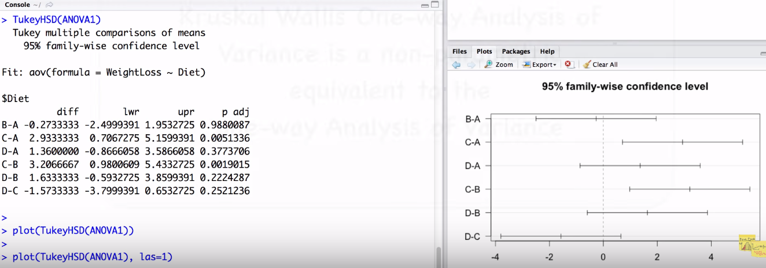
Posthoc

Slide 21
T-test & type of errors
Null Hypothesis & errors
T-test
t-score
p-value(probability that results are by chance)
An Independent Samples t-test compares the means for two groups.
A Paired sample t-test compares means from the same group at different times
A One sample t-test tests the mean of a single group against a known mean
Decision | H0 = True | H0 = False
H0= reject | Type 1 error, (false positive) Denoted as α Aka “significance level of a test” | Correct inference (True Positive)
H0 = Fail to reject | Correct inference (True Negative) | Type II error (False Negative) Denoted as β

