Slide 1
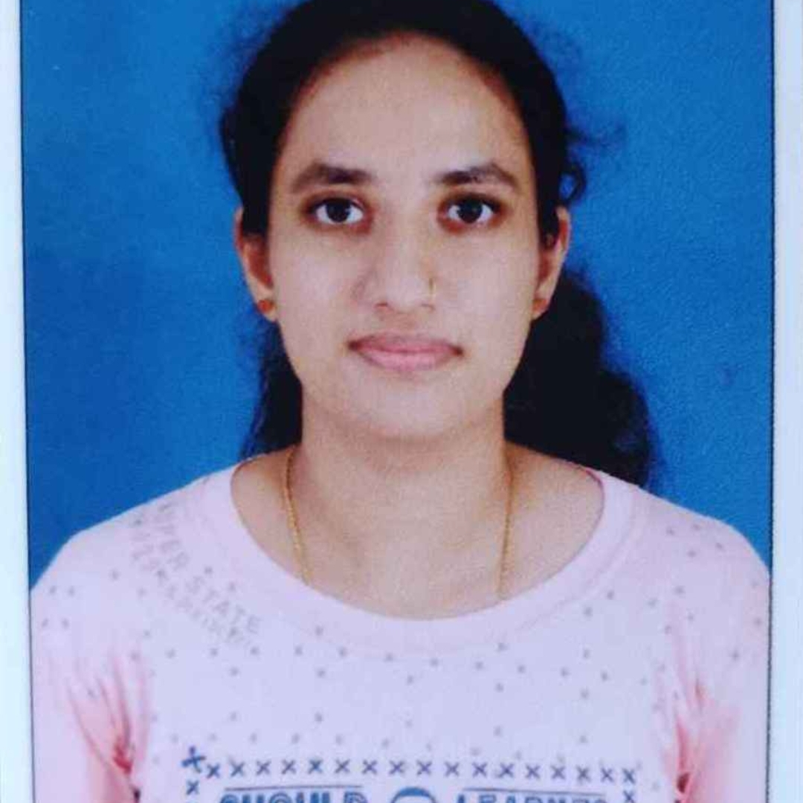

Shivani S Bhat
Senior Analyst/Software Engineer
Bachelor of Engineering
Information Science : 2018 - 2022
Skills
Java 8 /J2EE | Java Basics, OOPS, Generics, Collections, Arrays, Loops, Lambda Exp, Stream API Junit, Mockito, Servlets
Spring core | IOC & Dependency Injection, Autowire
Spring REST | REST controllers, Implementation of GET, POST, PUT & DELETE, Exception Handling, Testing Services
Spring Boot Microservices | Spring Boot Starters, annotations
Spring Cloud | Eureka server and discovery client
Angular | Components, Services, Modules, Routing, Forms & Validation
Database | MongoDB
UI Tech | HTML 5 & CSS 3,JavaScript, Angular
Tools | Git, Postman, Maven, IDE
Bangalore
shivani-s.bhat@capgemini.com
+91 6362215619
A5
Full Stack Developer
Proficient in creating microservices using spring boot, Eureka server
Proficient in creating Single page Web Application in Angular with Angular forms, angular routing
Proficient in unit testing using Junit and Mockito
Proficient in creating databases using MongoDB.
Book Rental System
Completed end to end case study of Book Rental System using Spring boot , mongo DB database and unit testing using Junit and Mockito. Used Angular in creating the user interface.

