Slide 1

K. S. INSTITUTE OF TECHNOLOGY, BANGALORE-560109
DEPARTMENT OF COMPUTER SCIENCE & ENGINEERING
PROJECT PHASE 1 + SEMINAR (15CSP78)
Batch Number : 21
“STOCK MARKET PREDICTION USING DAILY NEWS ARTICLES”
Under the Guidance of :
Dr. Rekha B Venkatapur
Head Of The Department
Dept of CSE, KSIT
Presented By:
Shravan Bhat
Siddhanth M
Shashank Kavur
Sampath Kumar

Slide 2
Contents:
Overview of Project
Project Goals
Project Applications
Requirement Specification
References
1

Slide 3
Overview of project
This project proposes a machine learning model to predict stock market price using enews articles.
Stock market prediction is the act of trying to determine the future value of a company stock or other financial instrument traded on a financial exchange. The successful prediction of a stock's future price will maximize investor's gains.
This project involves extracting daily news articles, performing sentiment analysis on the extracted data to find its polarity(positive or negative)
We then correlate the data to the stock market prices and hence generate an optimized machine learning model.
Finally, the model predicts the stock market prices in real time.
2

Slide 4
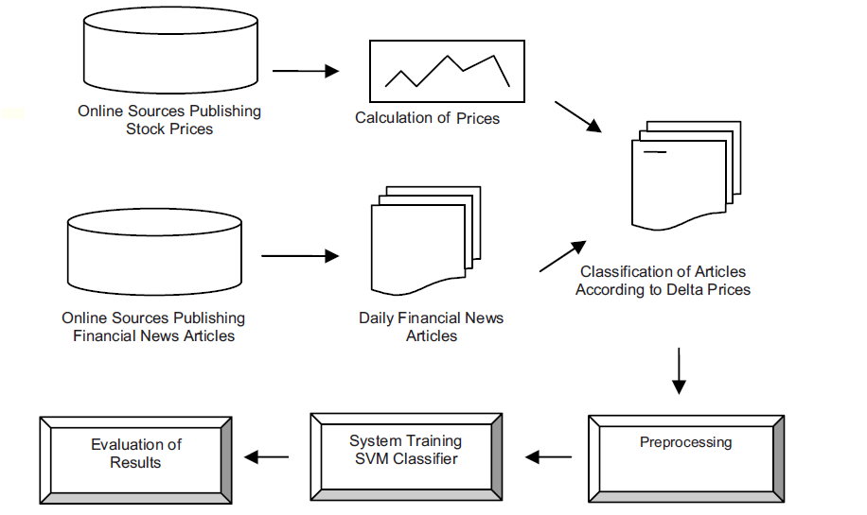
3

Slide 5
Project Goals
What we are doing is to analyze the current day-to-day news and see how it impacts the stock market due to the news.
We can analyze and predict how the stock market will behave according to the real time news.
Application should be scalable to be expanded to several other platforms and markets.
Easily understandable and simple to use.
4

Slide 6
Project Applications
Helps us analyze and predict how the stock market will behave according to the real time news.
We can help simulate various news and see how it will affect the various stocks of the companies.
Serves as a platform for investors and stock market traders to have an informed decision before investing.
Will help further research into the variations of stocks in stock market.
5

Slide 7
Requirement Specification
Software Requirements
Python 3
BeautifulSoup for extracting text from news articles.
NLTK, TextBlob for Sentiment Analysis
Sklearn, Pytorch for Machine Learning
Numpy, Pandas, MatPlotlib for plotting graphs and analysis.
6

Slide 8
References
[1] Stock Price Prediction Using Financial News Articles - M. Yasef Kaya, M. Elif Karslgil - Yldz Technical University, Istanbul, Turkey , miykaya@yahoo.com, elif@ce.yildiz.edu.tr
[2] Predicting the Effects of News Sentiments on the Stock Market - Dev Shah , Haruna Isah, Farhana Zulkernine - Queens University , Kingston, ON, Canada
[3] A Data mining algorithm to analyse stock market data using lagged correlation - Cicil Fonseka, Liwan Liyanage, University of Western Sydney Campbelltown, Australia l.liyanage@UWS.edu.au
[4] NLTK 3.4.5 documentation - https://www.nltk.org/
[5] PyTorch Documentation - https://pytorch.org/docs/stable/index.html
[6] BeautifulSoup4 - https://www.crummy.com/software/BheautifulSoup/bs4/doc/
7

Slide 9
THANK YOU

