Slide 1
🔥
AI-Enabled Fire/Smoke Detection and Automated Emergency Response System
Using Deep Learning and IoT · Phase-2 Project Review
M R Varun · M H Mayur Gowda · Kedar Lokesh Vandith
Guides: Dr. Janhavi V · Dr. Ayesha Taranum
Department of Computer Science and Engineering, Vidyavardhaka College of Engineering, Mysuru

Slide 2
Introduction
1

Slide 3
Background and motivation
Fire is a leading cause of property loss and casualties; the gap between ignition and human detection drives escalation.
Point-type smoke/heat sensors are slow in open or high-ceiling spaces and cannot localise an event.
CCTV is already installed almost everywhere, but humans cannot watch feeds reliably over long shifts.
Deep learning (YOLO family) now runs in real time on commodity hardware — the camera itself can become the detector.
Detection alone is not safety: alerts need confirmation, evidence, logging and a monitoring interface.
seconds
typical delay that decides escalation
0 → 1
cameras reused: no new sensors needed for vision

Slide 4
Objectives and scope
1
Real-time detector
2
Robust dataset
3
Temporal confirmation
YOLOv11n fire/smoke detector that runs on a laptop CPU, usable with existing CCTV/USB cameras.
Stratified indoor + outdoor corpus with explicit negatives; augmentation for scale, lighting and scene variation.
Convert noisy per-frame boxes into NORMAL → WARNING → CONFIRMED → RECOVERY states; never trigger on one frame.
4
Alerts and evidence
5
Backend and dashboard
6
Evaluation
Snapshots, event database, buzzer, multi-channel notifications, acknowledgement and emergency stop.
REST API + SQLite + live web dashboard for monitoring, history and device health.
Precision, recall, F1, mAP, false-alarm rate on negatives, CPU latency; fail-safe integration tests.
Scope: academic prototype with isolated low-voltage outputs — not certified fire-safety equipment.

Slide 5
Proposed solution and expected outcome
Camera
Dataset
YOLO detector
Real-time inference
Decision engine
IoT verification
Alerts / response
Dashboard
What we build
Expected outcome
Vision-first detection on existing cameras · temporal confirmation with hysteresis · optional ESP32 gas/temperature fusion · evidence + events + notifications · live dashboard with acknowledge and emergency stop.
Alert within seconds of a sustained flame/smoke, far fewer false alarms than single-frame or colour-rule detectors, a complete audit trail (who acknowledged, when, with evidence), and a reproducible model build with documented metrics.

Slide 6
Problem Statement
2

Slide 7
Problem definition and existing gaps
Problem
Build a system that is simultaneously accurate on real CCTV-like footage, fast enough for live streams on commodity hardware, and embedded in a complete confirmation–alerting–monitoring pipeline.
1
Benchmark ≠ field
2
Accuracy vs latency
3
Detection ≠ safety
Published detectors are evaluated on curated images, not noisy, variably lit multi-angle CCTV — accuracy does not transfer.
Deeper nets and Transformer blocks gain accuracy at a latency cost that is unacceptable when seconds matter.
A raw bounding box cannot be operationalised without temporal confirmation, alerting, evidence and logging.
Our approach
Lightweight YOLOv11n fine-tuned on a stratified corpus with hard negatives → time-windowed state machine with separate enter/clear thresholds → IoT fusion → evidence, API, dashboard, fail-safes.

Slide 8
Literature Survey
3

Slide 9
Review of relevant research
Method | Core technique | Year | Focus
YOLOv8/v7 fine-tuned (Saleh et al.) | single-stage detector | 2024 | wildfire smoke, flame
Improved YOLOv8s (Kong et al.) | light backbone + attention | 2024 | coal-mine fire/smoke
Improved YOLOv5s (Dou et al.) | feature-fusion refinement | 2024 | general fire
FS-YOLO (Wang et al.) | joint fire–smoke head | 2024 | fire and smoke
YOLOv11 (Khanam & Hussain) | C3k2, SPPF, C2PSA | 2024 | general detection
Shallow guide deep net (Li et al.) | lightweight CNN | 2024 | early-stage fire
Fire-ViT (Liu & Mariano) | Vision Transformer | 2025 | tunnel fire
CN2VF-Net / FireNet-KD (Ahmad et al.) | hybrid CNN–ViT, distillation | 2025 | complex scenes, wildfire
SmokeSeger (Jing et al.) | Transformer–CNN segmentation | 2023 | urban smoke
CAS-ViT (Zhang et al.) | additive self-attention ViT | 2024 | mobile vision

Slide 10
Comparison of methods and research gap
Two-stage (Faster R-CNN)
Research gap identified
Highest localisation accuracy, but 5–17 fps: too slow for multi-camera live monitoring.
Reviewed work stops at per-frame metrics.
Rarely specified: how a detection becomes a verified alert; how steam, fog and lighting false alarms are suppressed over time; what happens when a camera, sensor or network fails.
Our contribution: robust false-alarm reduction + multi-stage automated response — not a new architecture.
SSD / classic CNN classifiers
Fast, but frame-level only; weak on thin smoke and small flames.
YOLO family (v5 → v8 → v11)
Best accuracy-per-millisecond; anchor-free head and C2PSA attention help diffuse smoke. Chosen backbone.
ViT / hybrid (Fire-ViT, CN2VF-Net)
Strong in-domain accuracy; heavier inference, reduced robustness outside training domain.

Slide 11
System Requirements
4

Slide 12
Hardware and software requirements
Hardware | Specification / role
Development laptop | Intel i5-1340P (12 cores), 16 GB RAM, no GPU — training and inference
Camera | USB webcam / IP / RTSP CCTV, 720p–1080p
ESP32 | Sensor gateway + low-voltage actuator controller
MQ-2 gas, temperature sensor | Environmental evidence for fusion
Buzzer, relay, LED | Local alarm, isolated low-voltage prototype load
Software / tool | Use
Python 3.10+ | all modules
PyTorch (CPU) + Ultralytics 8.4 | YOLOv11n training/inference
OpenCV | capture, preprocessing, overlay
FastAPI + Uvicorn, SQLite | backend API, event database
HTML/CSS/JavaScript | dashboard (no framework)
Requests, SMTP, Telegram Bot API | notifications
pytest | 23 unit + API tests
Git/GitHub, VS Code | version control, development

Slide 13
Dataset, API and other dependencies
Split | Images | Fire | Smoke | Both | Negative
Train | 3,000 | 988 | 988 | 723 | 301
Validation | 600 | 189 | 187 | 164 | 60
Test (held-out) | 600 | 203 | 202 | 135 | 60
Backend API (FastAPI)
GET /health · GET /status
GET /devices · /devices/{id}
POST /sensors (ESP32)
POST /detections (AI)
GET /events · /events/{id}
POST /events/{id}/ack
POST /control/estop
GET /stream/{id} (MJPEG)
Config in YAML: thresholds, device, model, notifications; secrets in .env.
Sources: Hugging Face fog_fire_detection (40.9k, CC-BY-4.0, outdoor + CCTV) and ISFire-4 (7.4k, MIT, indoor); 4 fine classes mapped to fire / smoke.
Stratified per source and split; no video leakage between train and test; dataset register documents licence and mapping.

Slide 14
System Design
5

Slide 15
System architecture and workflow
Capture & inference
Camera (USB / RTSP)
OpenCV capture, letterbox, reconnect
YOLOv11n → class, conf, box
Decision & response
Temporal decision engine
Sensor fusion + zone filter
Evidence, buzzer, notifications
Backend & presentation
FastAPI REST + MJPEG
SQLite: devices, readings, events
Web dashboard: live, ack, e-stop
IoT node
ESP32: MQ-2 gas + temperature
HTTP POST /sensors, polls commands
Buzzer, isolated relay, fail-safe

Slide 16
Modules and their functionalities
1
Dataset builder
2
Trainer & evaluator
3
Camera & inference
training/prepare_dataset.py — stratified sampling from two zips, class remapping, data.yaml, manifest + register.
training/train.py, evaluate.py — YOLOv11n fine-tuning; per-class P/R/F1/mAP, FP/FN images, latency.
vision/, inference/run_live.py — webcam/video/RTSP/folder, reconnect, overlay, evidence snapshots, keys.
4
Decision engine
5
Backend & database
6
Dashboard, alerts, IoT
decision_engine/ — time-window state machine, hysteresis, fusion, zone, ack, e-stop; 15 unit tests.
backend/ — FastAPI + SQLite; devices, sensors, detections, events, notifications; command queue; 8 API tests.
dashboard/, notifications/, iot/ — live UI, Telegram/e-mail, ESP32 firmware + sensor simulator.

Slide 17
Algorithm: temporal decision engine
NORMAL
WARNING
CONFIRMED
RECOVERY
≥ 3 hits ≥ 0.35 in 3 s
≥ 10 hits ≥ 0.55 over ≥ 2 s (≥ 6 if sensors elevated)
nothing ≥ 0.25 for 4 s
Sliding 3 s window of best-detection confidences; a single frame can never trigger.
Separate enter (0.35 / 0.55) and clear (0.25) thresholds = hysteresis, no flapping.
Sensor fusion: elevated gas/temperature lowers the confirmation bar; sensor-only evidence → SENSOR_WARNING.
Stale sensor readings (> 15 s) ignored; acknowledge → RECOVERY; emergency stop blocks all physical outputs.
RECOVERY → NORMAL after 10 s stable; re-appearance re-confirms immediately.
Also used
YOLOv11n (anchor-free, C2PSA) · IoU matching at 0.5 · NMS · mosaic/HSV/flip/scale augmentation · AdamW, seed 42 · precision/recall/F1/mAP@0.5/0.5:0.95.

Slide 18
Implementation and Demonstration
6

Slide 19
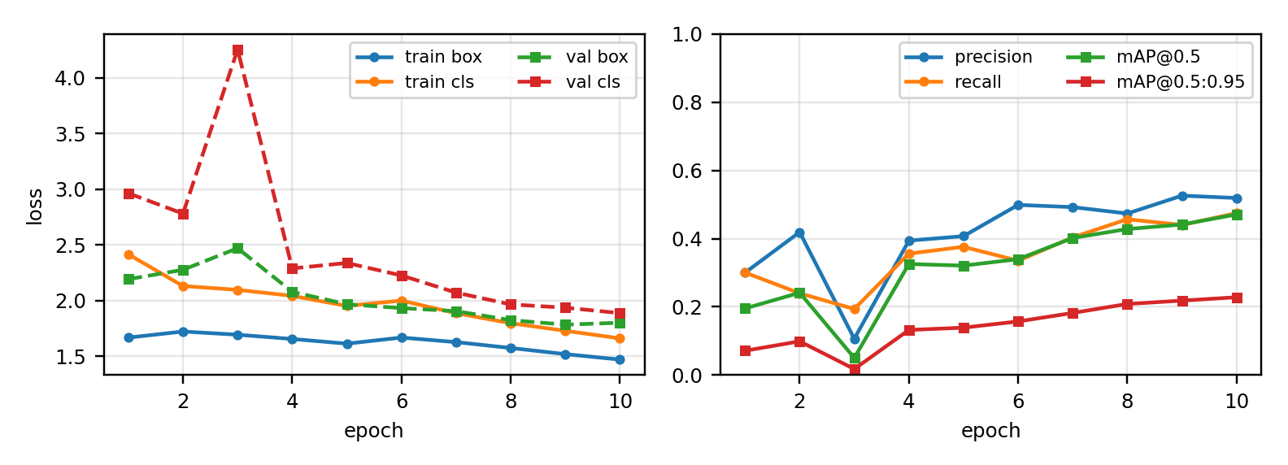
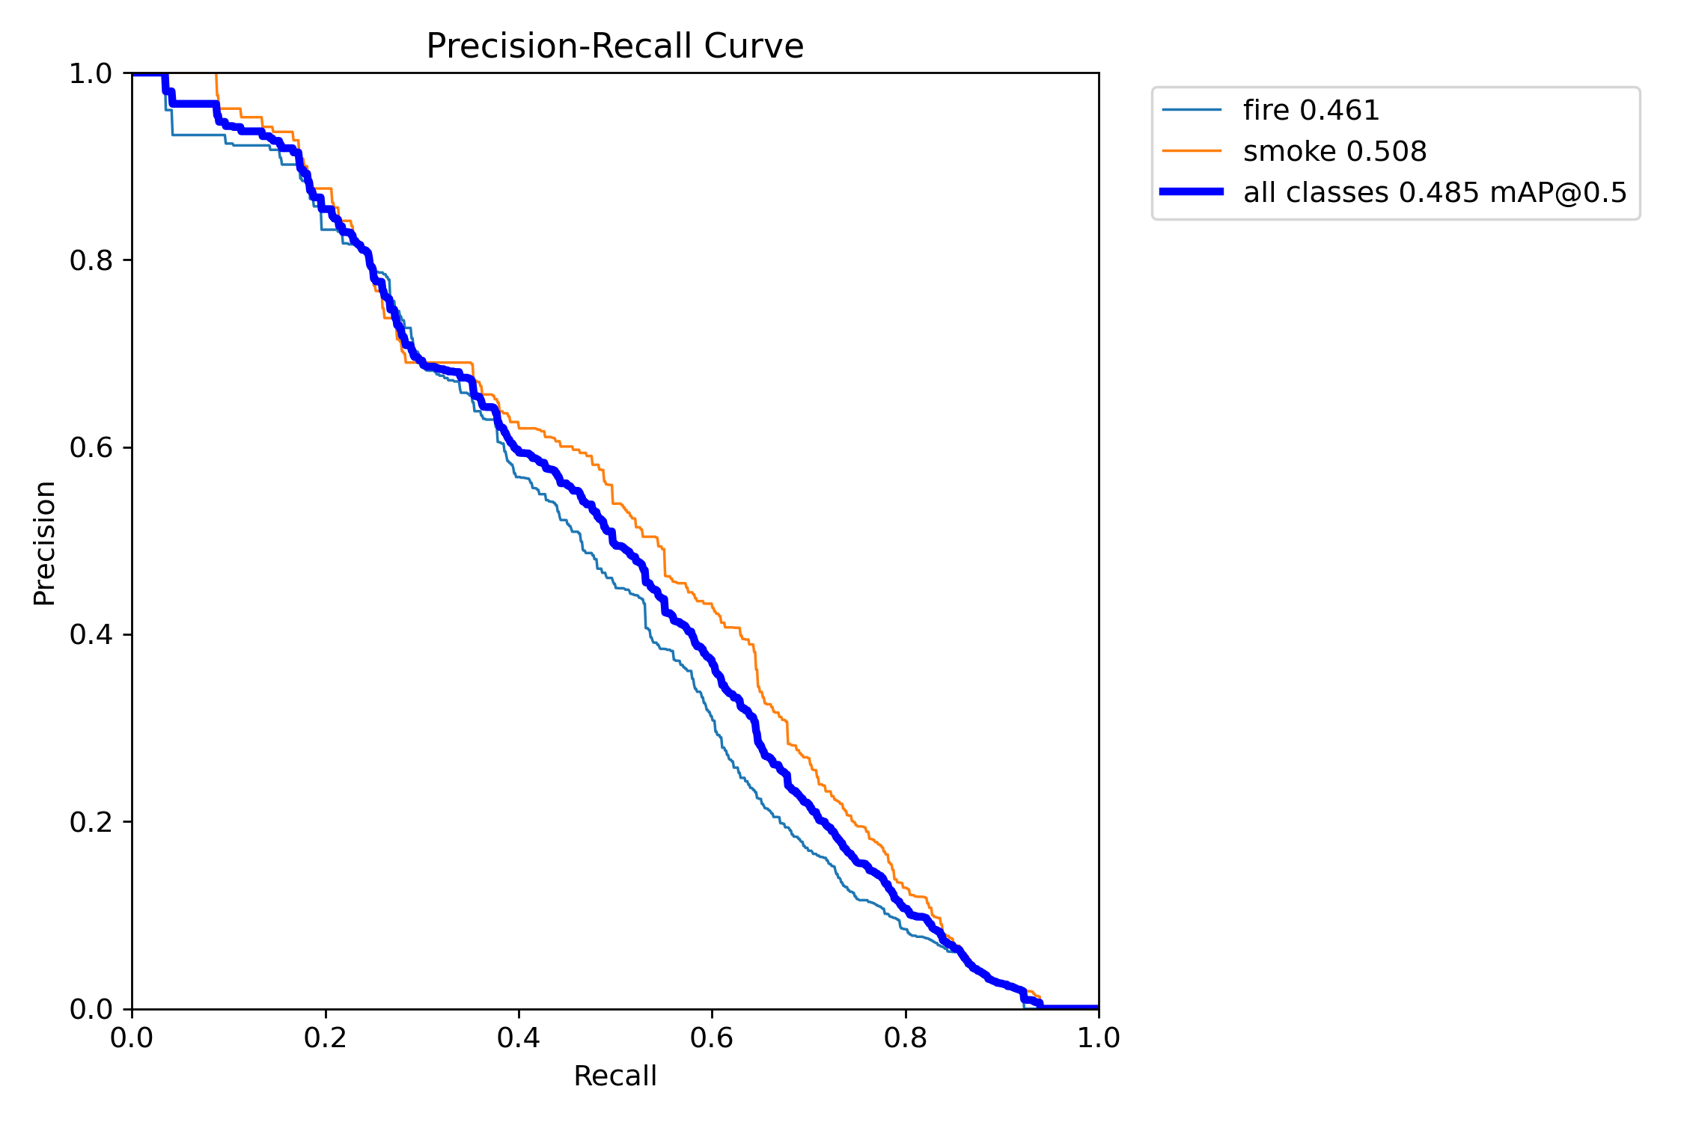
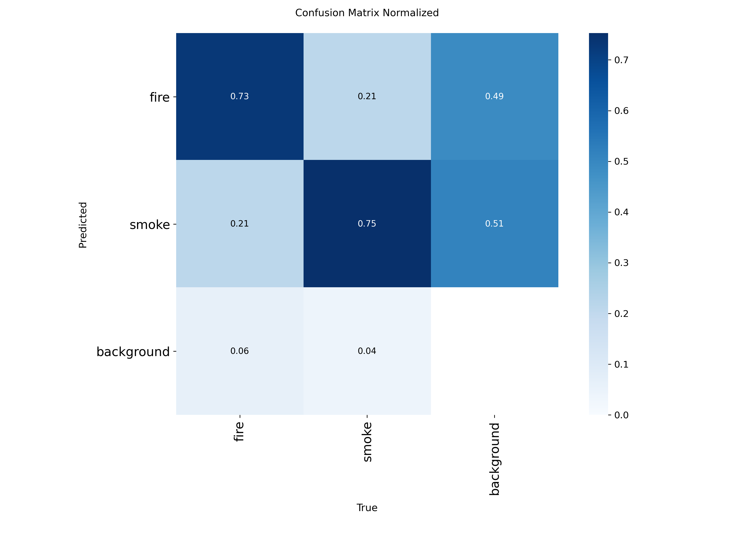
Module 1 implemented: AI fire/smoke model
Downloaded and merged two public datasets; stratified 3,000 / 600 / 600 split with 15 % negatives.
YOLOv11n fine-tuned from COCO weights: 416 px, batch 16, 10 epochs, AdamW, seed 42 — on CPU (94.9 min).
Evaluation script: per-class precision / recall / F1 / mAP, FP/FN example images, false-alarm rate on negatives, latency.
Artifacts: models/best.pt, training_config.json, eval_report.md, PR curves, confusion matrix, dataset register.
Training/validation loss and validation metrics per epoch
PR curves · normalised confusion matrix (test split)

Slide 20
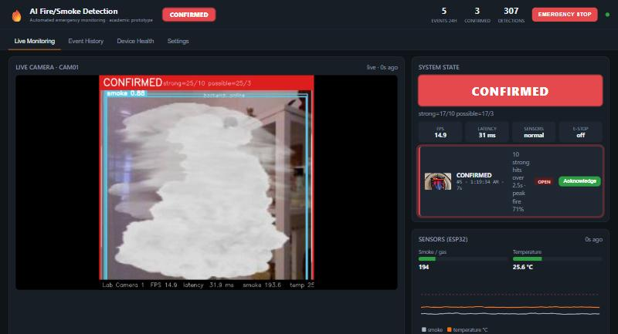
Module 2 implemented: real-time pipeline
Camera → YOLO → filters → time-window engine → overlay, evidence, buzzer, notifications.
FastAPI + SQLite backend with the full required endpoint set; MJPEG live stream.
Dashboard: NORMAL / WARNING / CONFIRMED, sensor gauges + chart, timeline, acknowledge, history, device health, e-stop.
ESP32 simulator + firmware for sensor fusion; fail-safes for camera, sensor and network loss.
23 automated tests pass (engine + API); one-click setup/run scripts for any laptop.
Live dashboard: annotated feed, state, sensors, latest detections, events

Slide 21
Demonstration plan (two modules)
1
Model artefacts
2
Live NORMAL
3
Single-frame test
4
WARNING → CONFIRMED
Dataset register → training config → eval report, PR curve, confusion matrix, FP/FN examples.
Room only: green state, FPS/latency, sensors normal, device online.
Flash a fire video < 1 s: boxes appear, state stays NORMAL.
Hold fire: WARNING in ~1 s, CONFIRMED after 2 s — buzzer, evidence, event, notification.
5
Acknowledge / recovery
6
Hard negative
7
Sensor fusion
8
Fail-safes
Dashboard Acknowledge → RECOVERY → NORMAL after 10 s; event closed with duration + peak.
Steam / white cloth / torch: no alarm.
Simulator smoke → SENSOR_WARNING; smoke+heat + fire → faster confirmation; disconnect → stale.
Cover camera → CAMERA LOST + auto-reconnect; stop backend → inference continues; EMERGENCY STOP.

Slide 22
Results on the held-out test split
Class | Precision | Recall | F1 | mAP@0.5 | mAP@0.5:0.95
Fire | 0.448 | 0.503 | 0.474 | 0.461 | 0.229
Smoke | 0.590 | 0.476 | 0.527 | 0.508 | 0.265
All | 0.519 | 0.490 | 0.504 | 0.484 | 0.247
0.484
mAP@0.5 (600 images, 10-epoch CPU model)
60/60
Operating point (conf 0.35, IoU 0.5): TP 346, FP 159, FN 681; the temporal engine filters isolated boxes before any alert.
Engine verified by 15 unit tests; backend by 8 API tests; live fail-safe scenarios executed on the demo laptop.
Numbers are a lower bound: 4,200-image subset, 10 epochs, no GPU — same scripts scale to the full 48k corpus.
negative images with zero false alarms
31.4 fps
CPU only, 31.9 ms per frame at 416 px

Slide 23
Challenges encountered
No GPU
Dataset mismatch
False alarms
CPU-only training limited us to a 4,200-image subset and 10 epochs (~7 min/epoch); mitigated with YOLOv11n, 416 px, RAM caching, stratified sampling.
Public sets are wildfire-heavy; indoor demo flames looked different. Merged an indoor set and balanced fire/smoke/both/negative.
Reflections, torch light and steam produce single high-confidence boxes; solved by time-windowed confirmation and hysteresis, not by lowering thresholds.
Robustness
Shared CPU
Reproducibility
Camera disconnects, stale sensors and backend outages had to be handled explicitly (reconnect, staleness check, local buffering).
Running live inference while training slowed both 10×; sequenced the work and added a headless/test mode.
Config in YAML, fixed seed, dataset register, committed small weights so any laptop runs the demo without retraining.

Slide 24
Paper Status
7

Slide 25
Paper title, target and current status
Title
AI-Based Fire and Smoke Detection System Using Deep Learning for Real-Time Emergency Monitoring
Target
Current status
IEEE-sponsored international conference (IEEE Xplore indexed); prepared in the IEEE conference (IEEEtran) two-column format, 7 pages.
Authors: M R Varun, M H Mayur Gowda, Kedar Lokesh Vandith; Dr. Janhavi V, Dr. Ayesha Taranum.
Full draft complete with measured results, literature table (12 works), architecture/workflow figures, algorithm and 28 references.
Next: guide review → final numbers from extended training → submission.

Slide 26
Thank you
Questions?
Repository: github.com/bhatspranav7/AI-Enabled-fire-Smoke-detection-systeem-using-Deep-learning-Emergency-Monitoring

