Slide 1
GGPLOT2
These notes are for (my) personal use and fetched from paid tutorial websites. None of this is mine, all rights go to the content creators

Slide 2
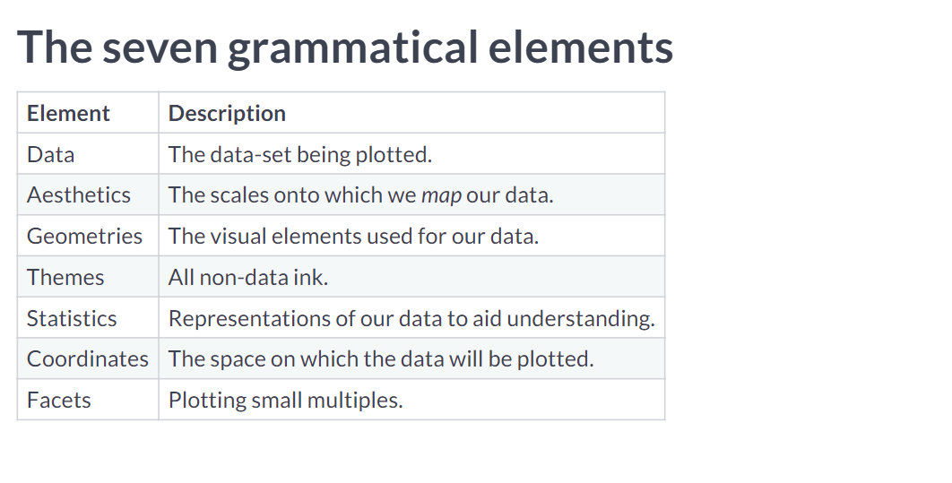

Slide 3
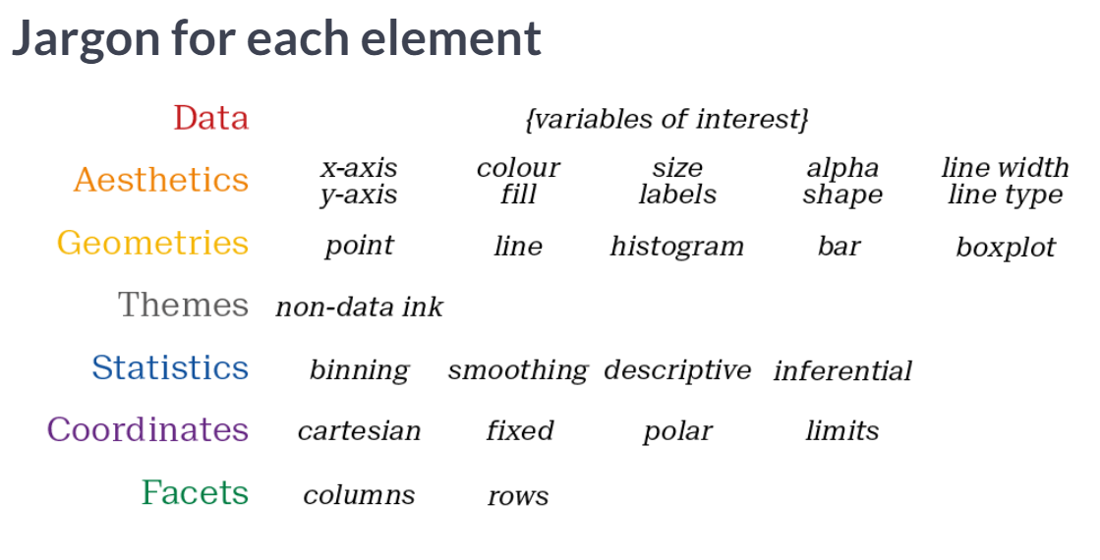

Slide 4
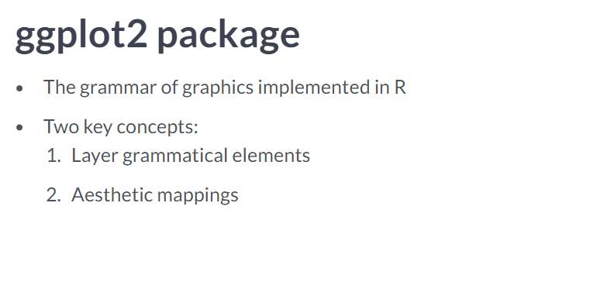

Slide 5
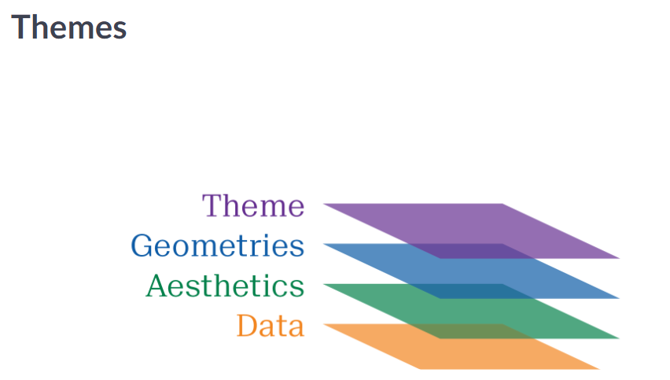

Slide 6


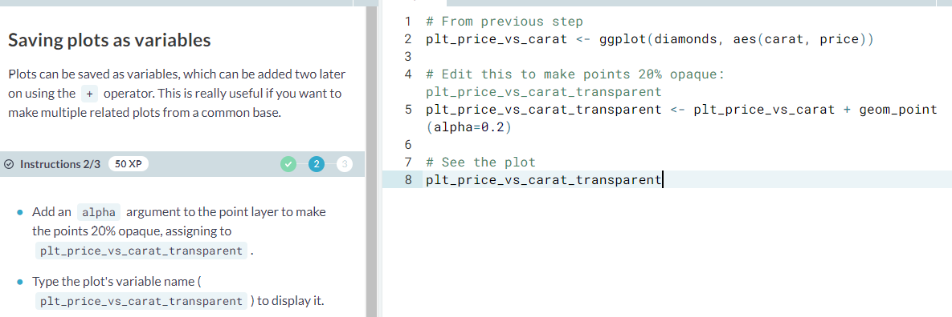

Slide 7


Slide 8
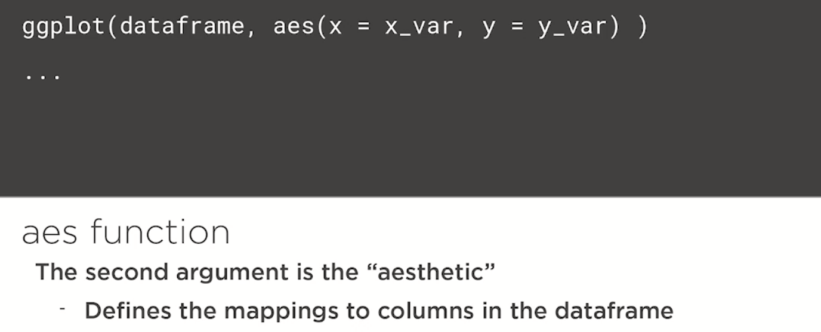

Slide 9
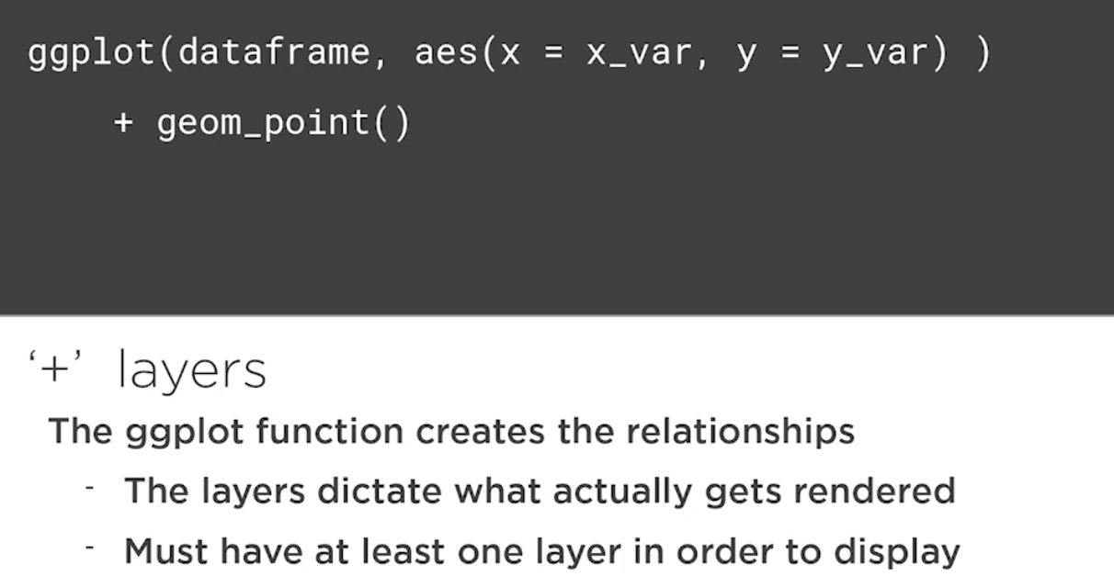
Scatterplot. Without this geom_point there will be nothing to show. Aes just creates mappings

Slide 10
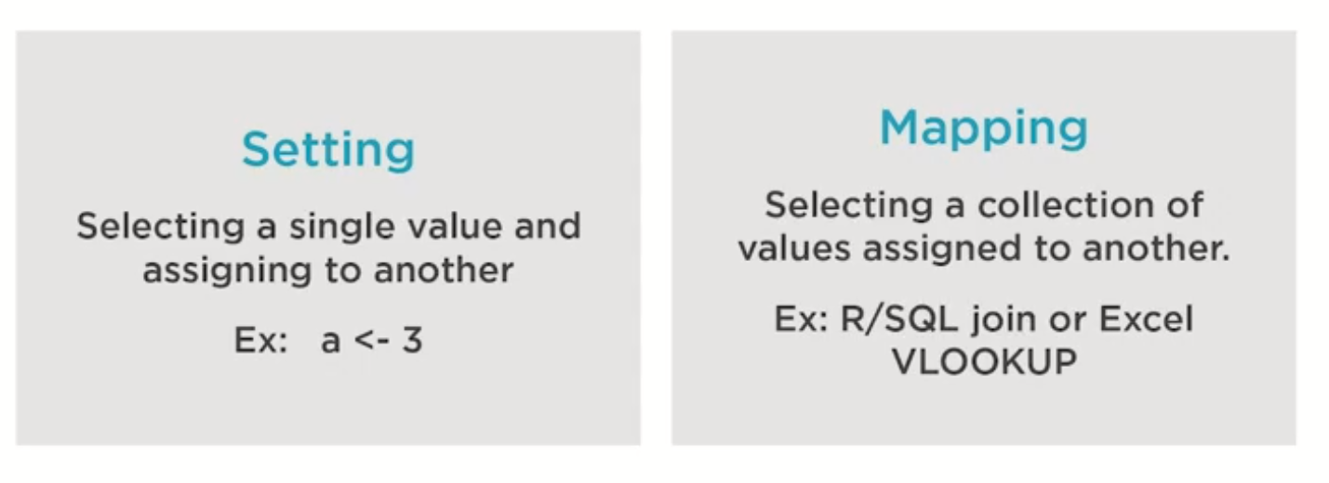
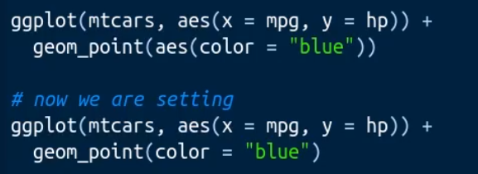


Slide 11
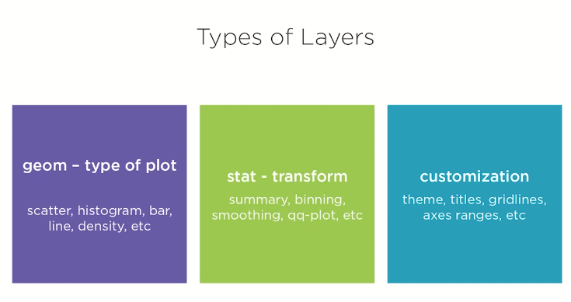
Can layer as many layers on
top of each other

Slide 12
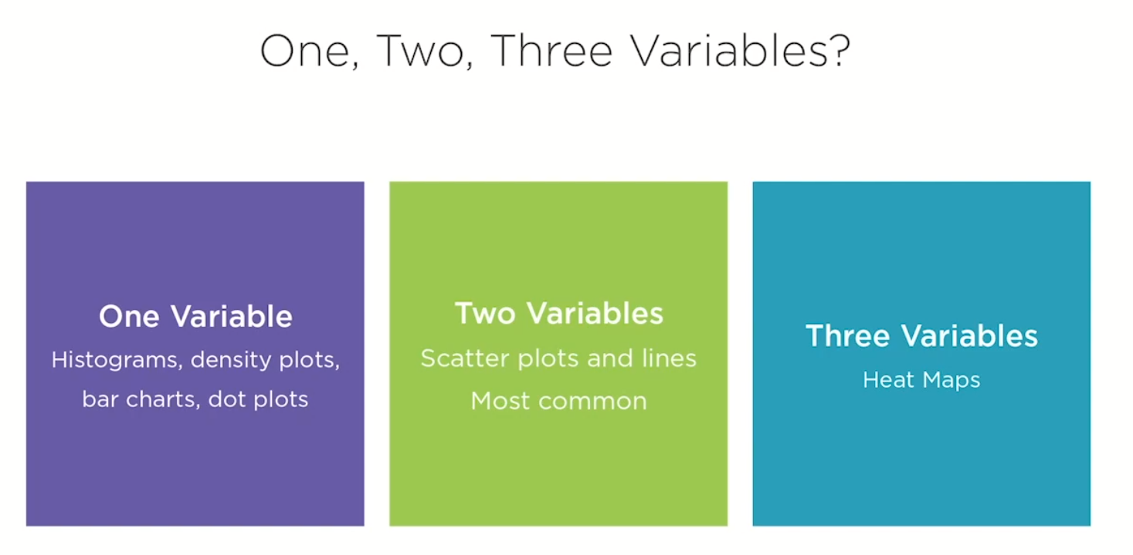

Slide 13
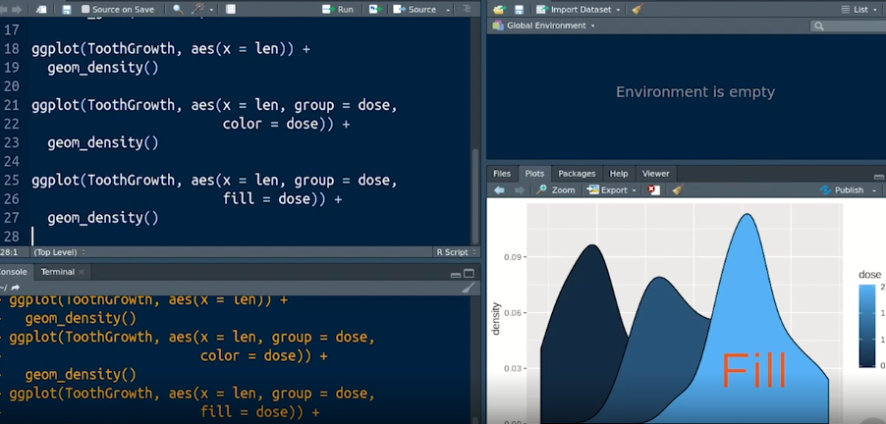
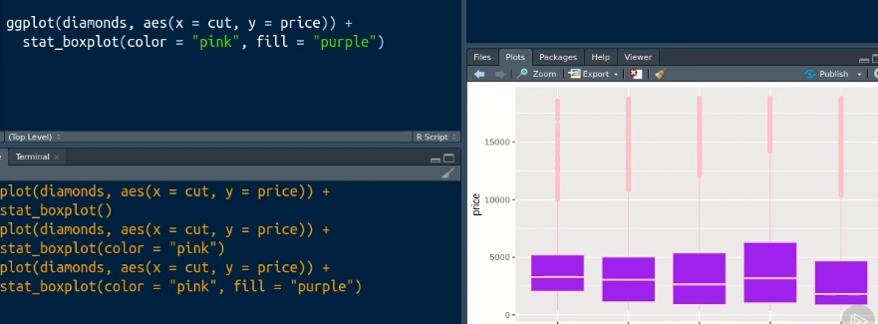
Color is the color of the line, whereas Fill tell how is it filled inside the lines

Slide 14
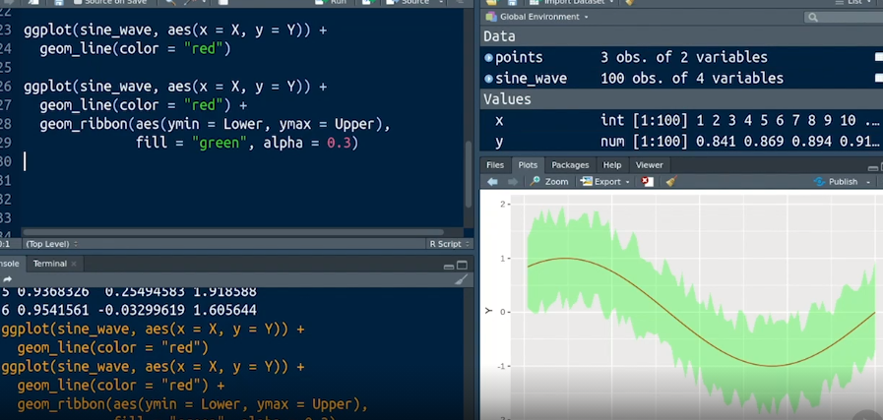
Good for showing error
on your time series data

Slide 15

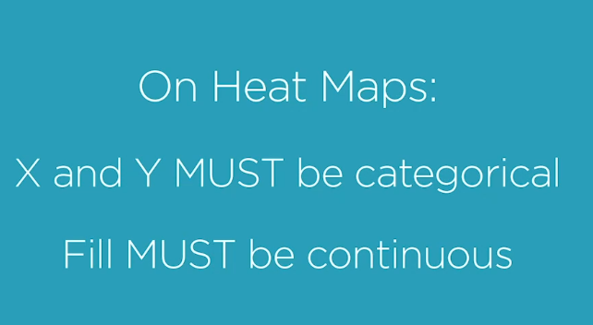
3 variables = Heat Map
If you put a continuous var in the x or y, there will
be too many gaps and the data will not be displayed properly

Slide 16
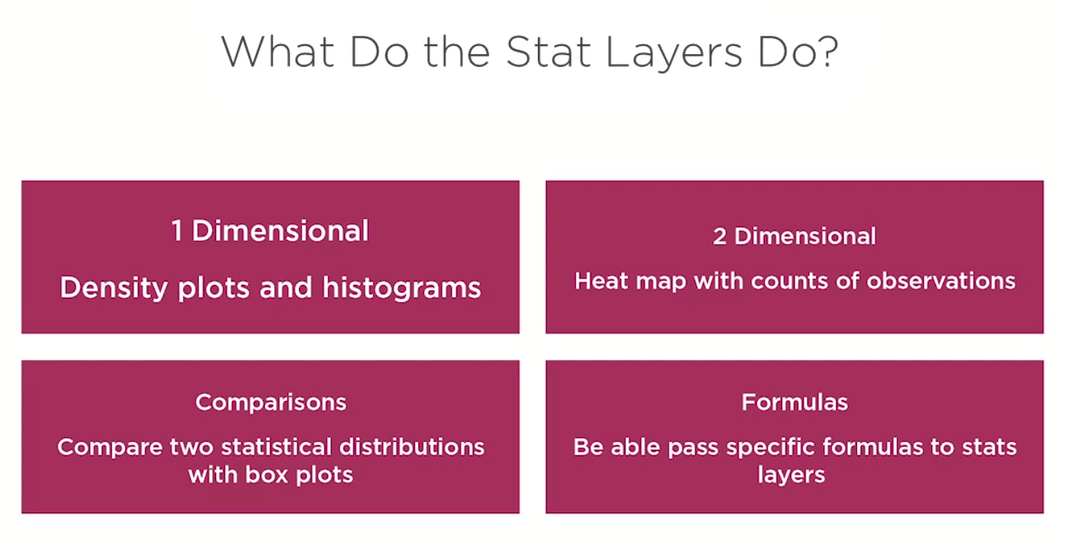

Slide 17
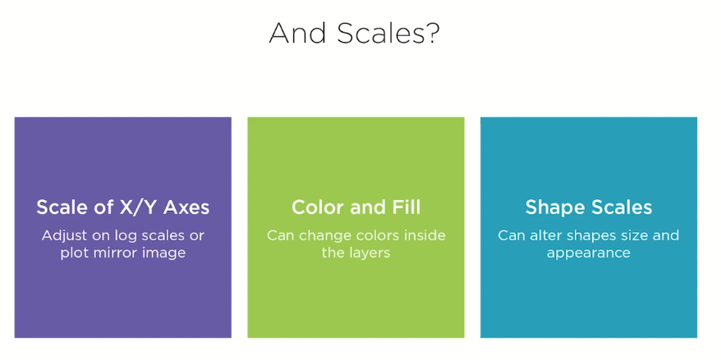
Useful for showing grouping vars

Slide 18
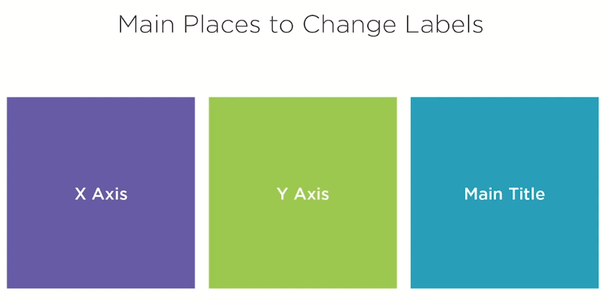

Slide 19
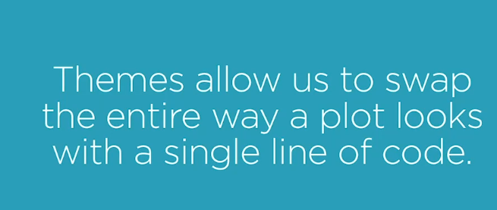

Slide 20
