Slide 1
WHAT ARE THE POTATO EATERS EATING?
Keshav Bhatt

Slide 2
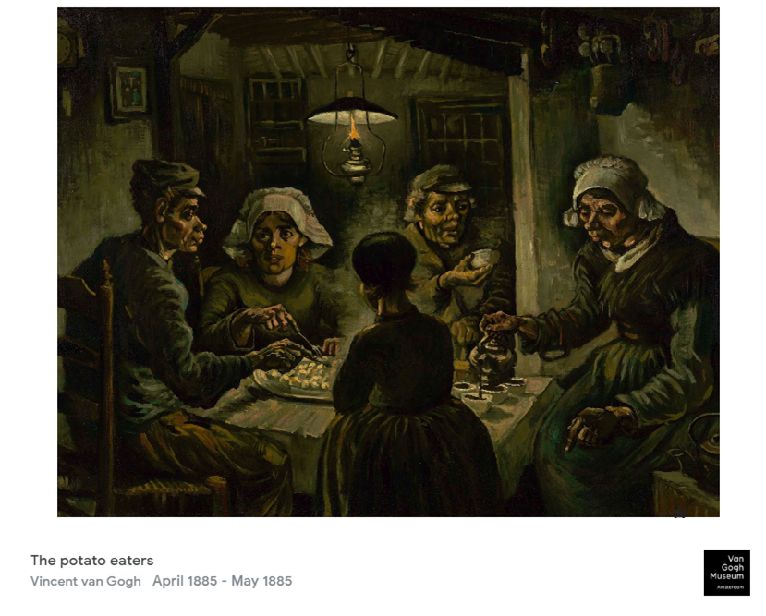
Notes:
Good morning everyone. I am Keshav a Dutchman, yes maybe my accent tells another story but I have 5 minutes. So another story.
This is a story about food and stereotypes. Like the one you maybe made about me.
When one thinks of the Dutch, this is the image that comes to their mind. Eating potatoes
But this is not really true

Slide 3
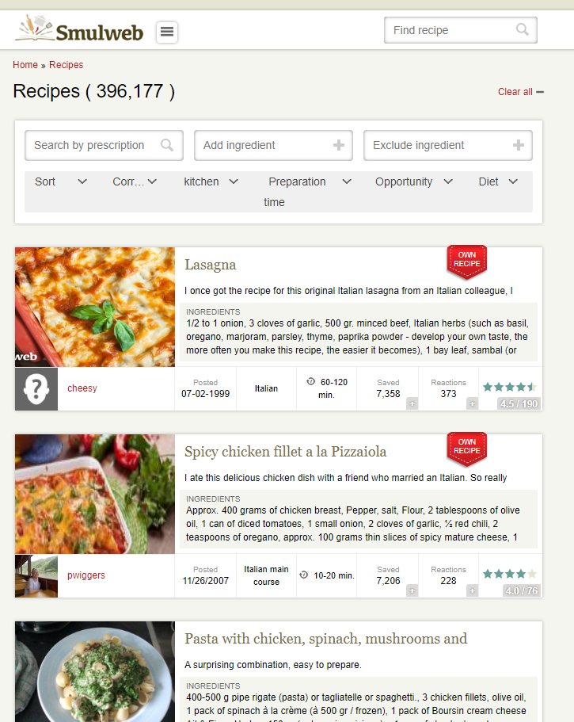
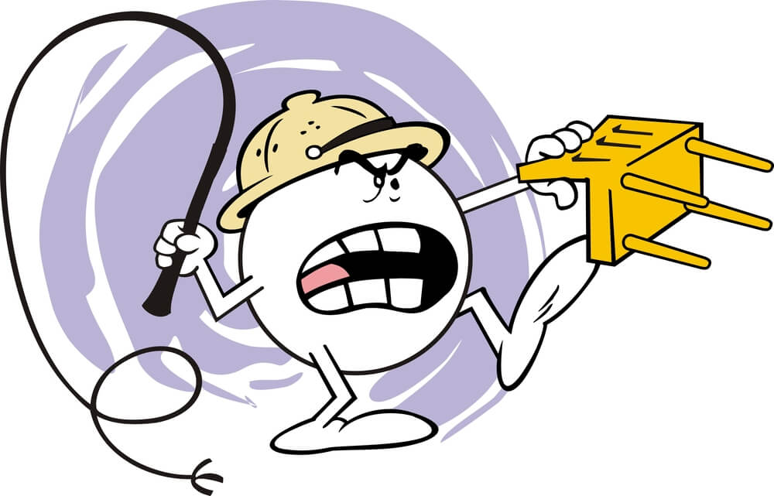
1
Notes:
If you go to a Dutch food website like smulweb.nl, the #1 recipe is lasagna
#2 and #3 is pasta with chicken. I know this is blasphemy in Italy
This made me curious what are the Dutch eating and if the Dutch are Italian food what are the Italians eating? Dutch food?
As they say in Italy when in doubt go to giallozaferrano and that is where I went

Slide 4
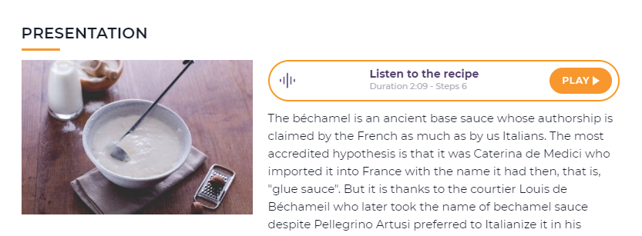
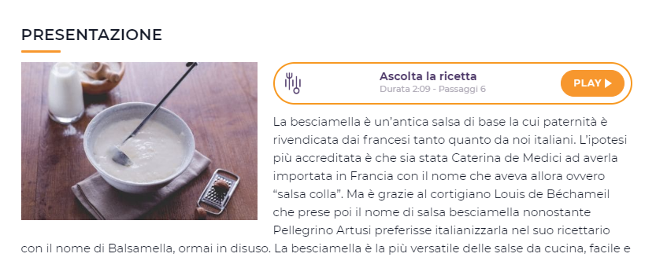
Notes:
The Italians I observed are definitely not eating Dutch food
But everything is Italian for instance: Beschamel

Slide 5
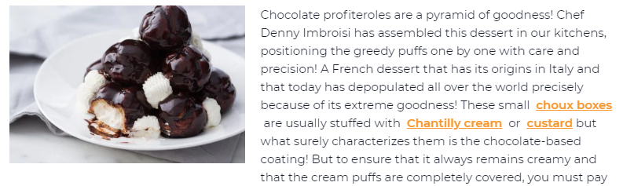
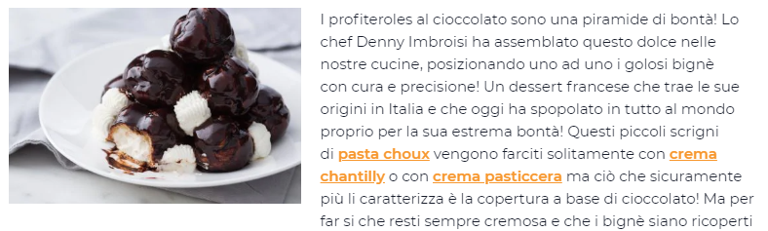
Notes:
Or soesjes

Slide 6
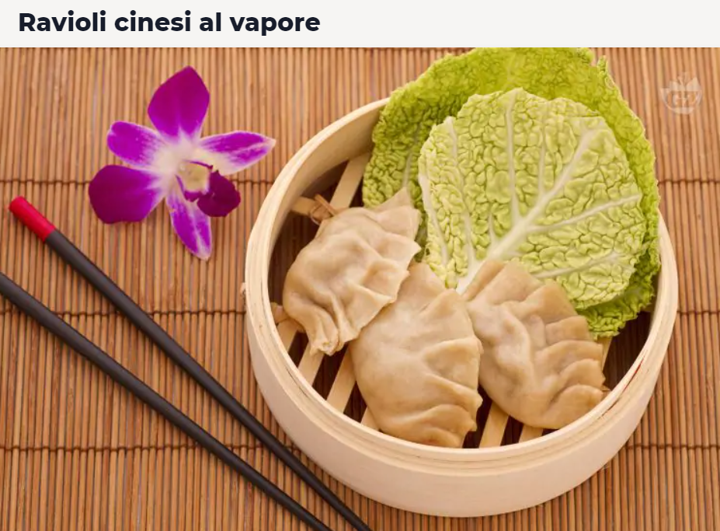

Notes:
Even Chinese dumplings are Ravioli Chinese al vapore
But this a R conference and you want to see some R stuff not screnshots
ok here it is
I started with stereotypes and the first stereotype is that Dutch are big potato eaters and the Italians tomato eaters, right?

Slide 7
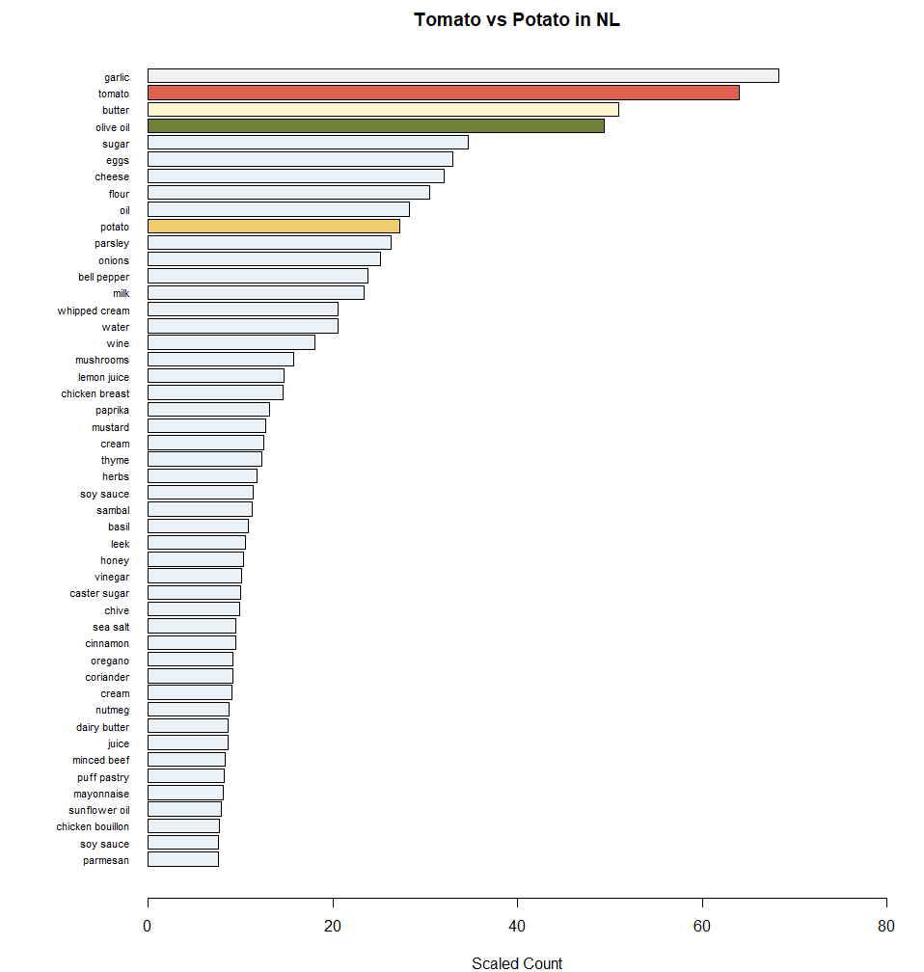
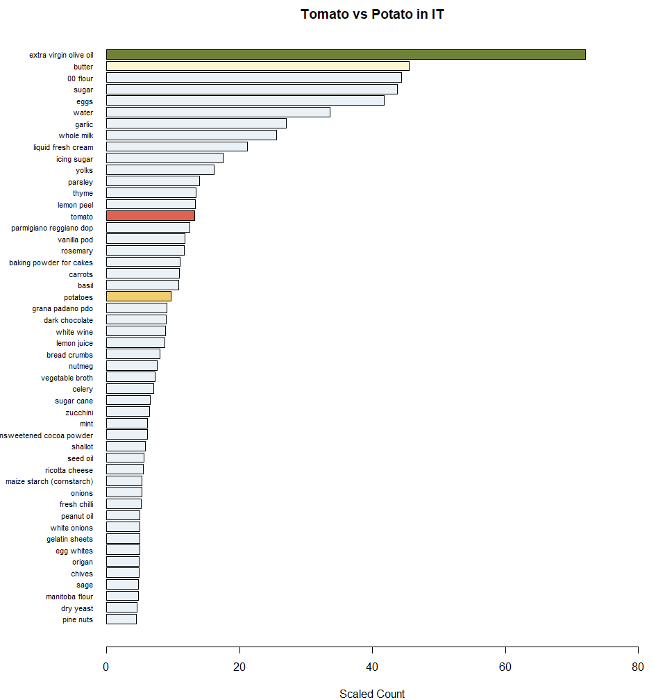
Notes:
Well booyah the most consumed ingredient is tomato and way below is potato
We apparently eat a lot of garlic too and Olive oil!
And if you look at the Italians, it seems you guys are just surviving on olive oil, tomato is not at all a priority
STEREOTYPE BUSTED!

Slide 8
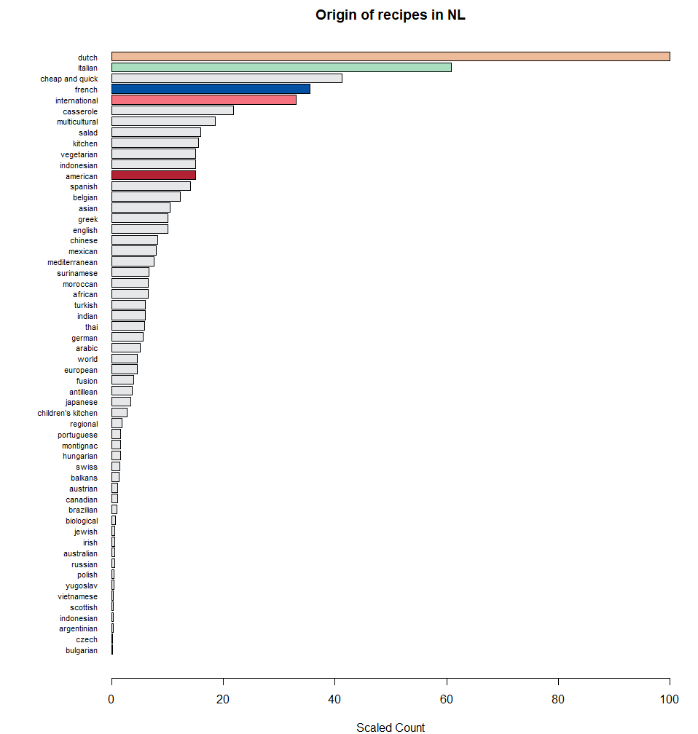
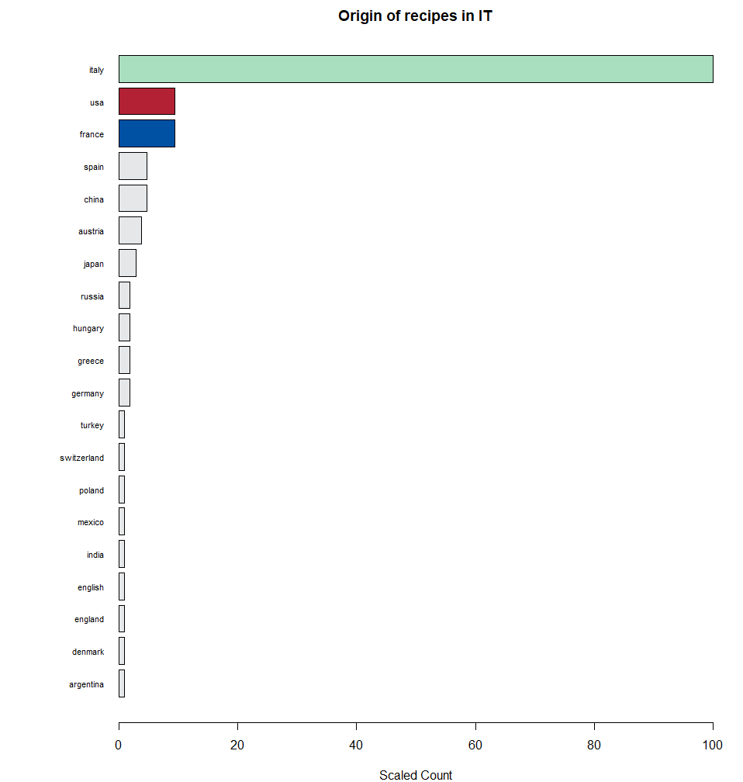
Notes:
And if you look at the origin, there is definitely nationalism but the Dutch are eating much more international cuisine than the Italians

Slide 9
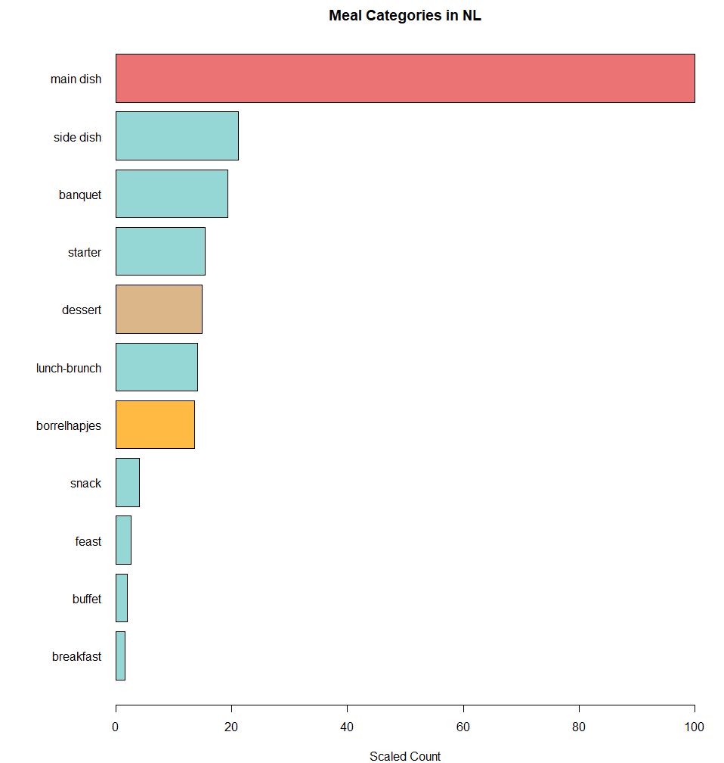
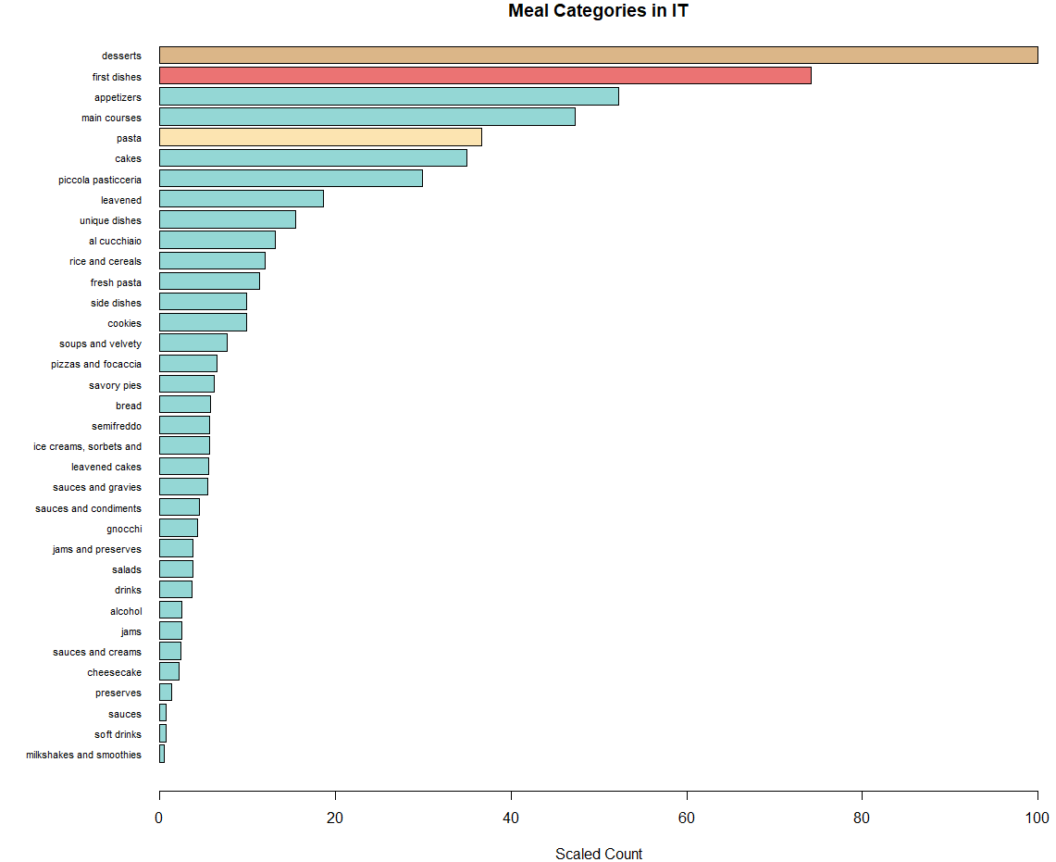
Notes:
Alright there has been some Italy bashing,
let’s break some Italian stereotypes apparently the Italians have a big sweet tooth
They are not eating just pizaa and pasta
Borrelhapjes are a very Dutch thing, they are drink snacks

Slide 10



FIN.
https://twitter.com/bhatt_keshav
https://www.linkedin.com/in/bhattkeshav
https://github.com/bhatt-keshav/TomatoPotato
Notes:
Well I hope I have broadened more of what you know and lessened your stereotypes. And since y’all now love me and wanna be BFFs
You can catch me always at

