Slide 1
Getting Started

Slide 2
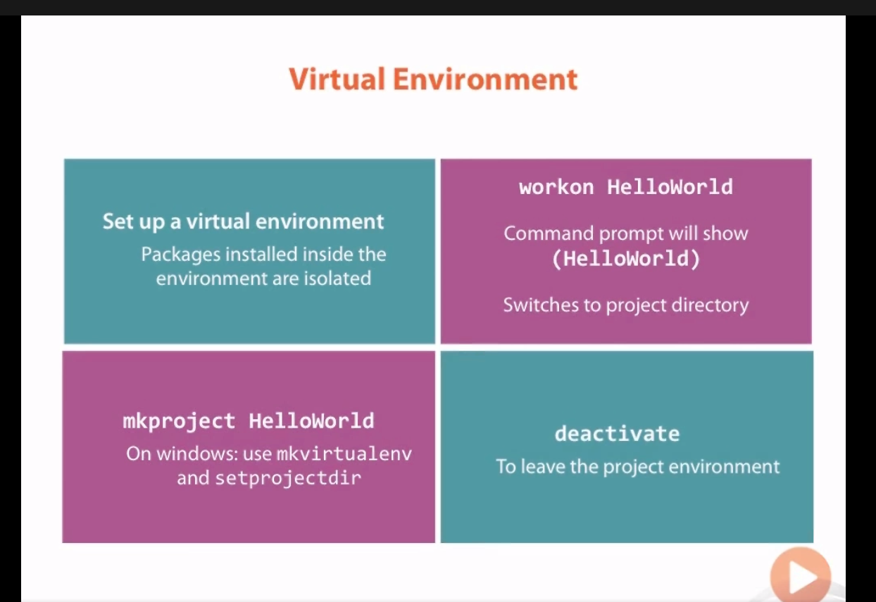

Slide 3
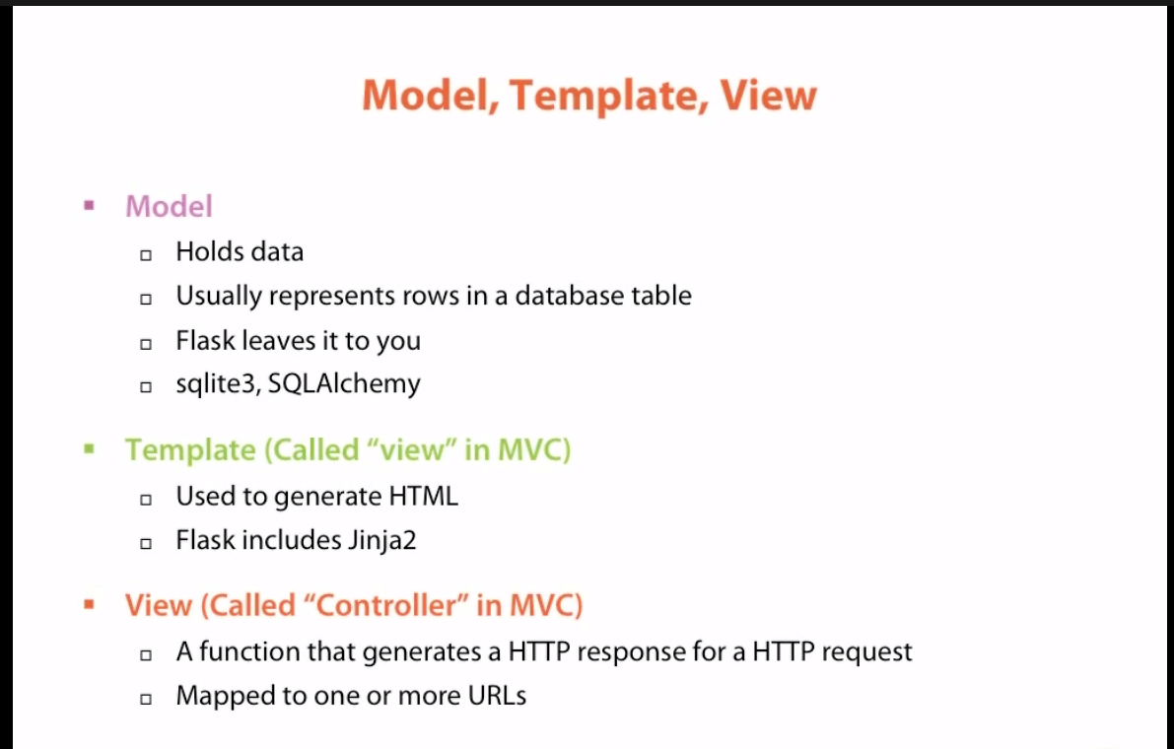
A python function that generates an http response for an http request

Slide 4
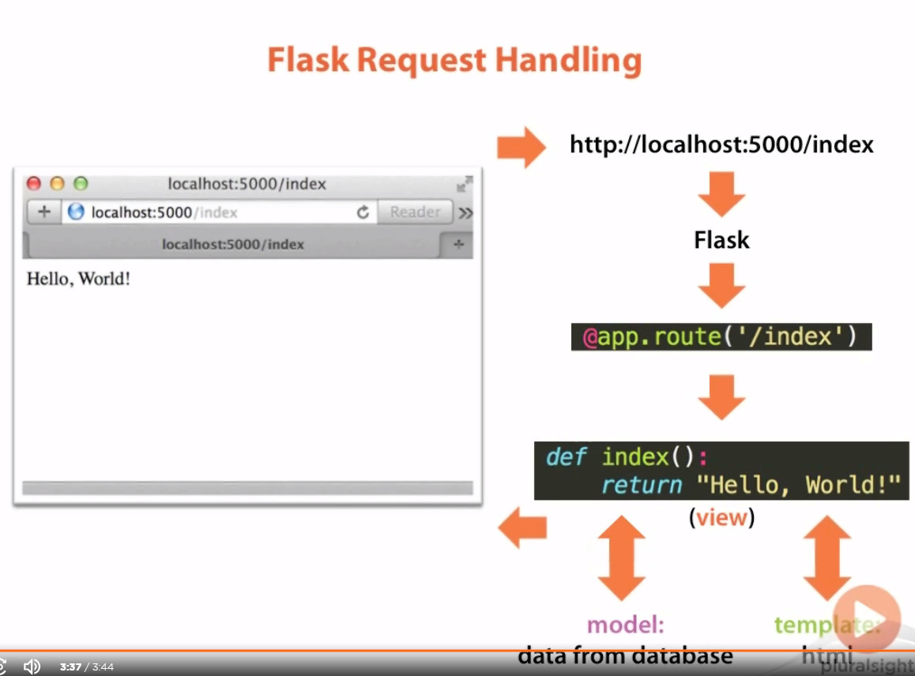

Slide 5
Basic Templates and Views

Slide 6
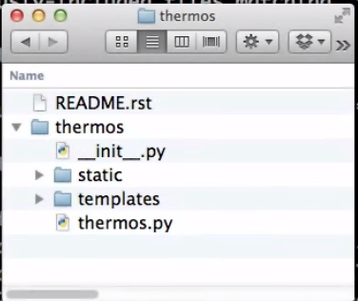
File structure
Parent
Another thermos, which holds our project
Because this is a packages, should have a .init file
Has static files: CSS/HTML/JS etc.
Has templates for generating HTML pages
Contains the flask project

Slide 7
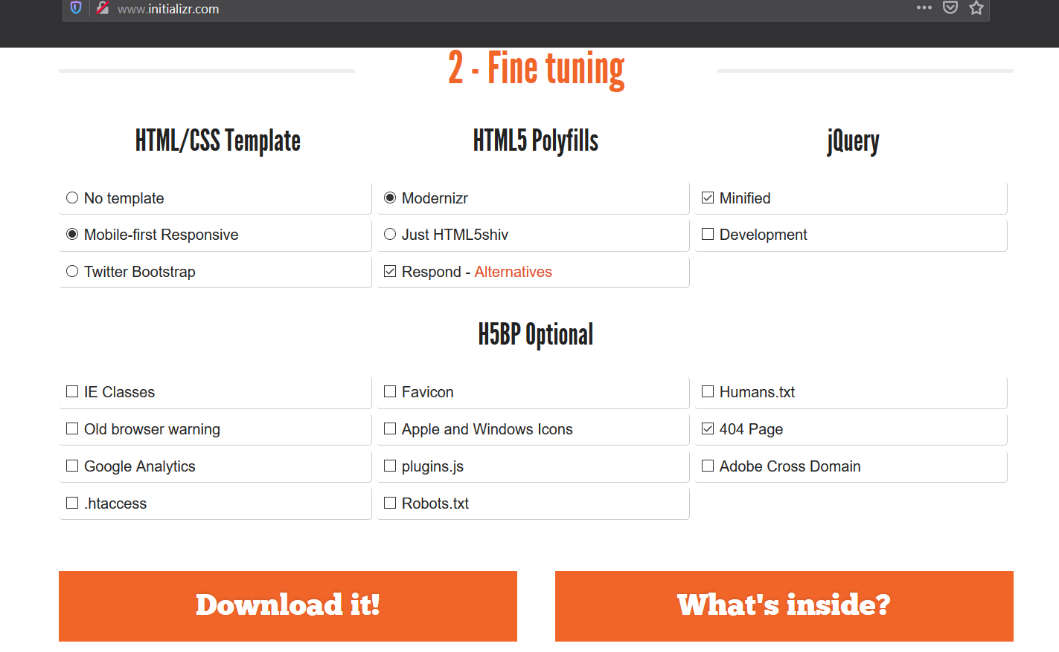
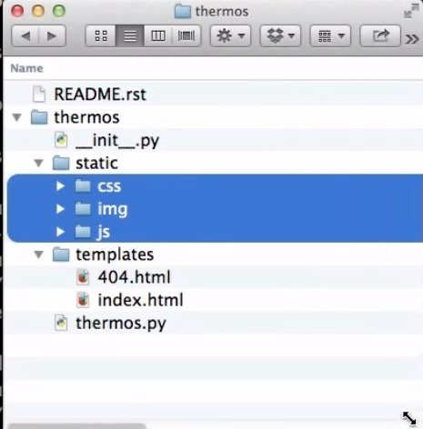

Slide 8
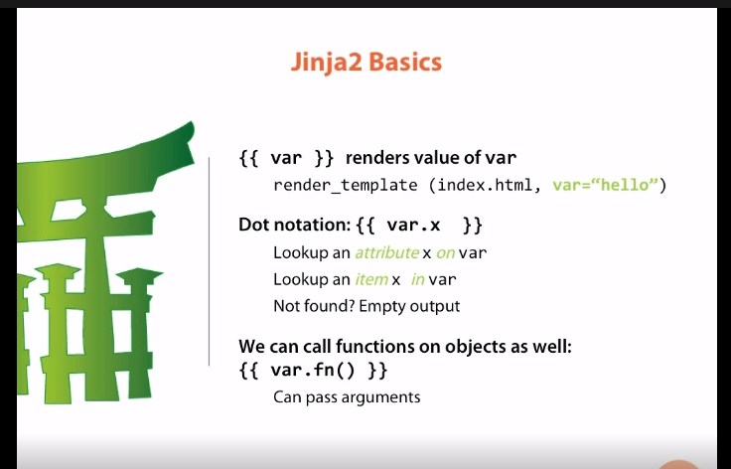
Jinja stuff

Slide 9
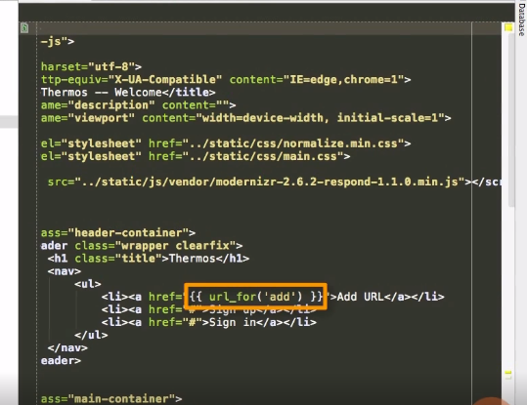
url_for is a jinja function available in all flask templates and takes the view passed in as the argument and returns its url
{{ }} double curly braces are used when we want to output the value from a variable or function to the HTML page

Slide 10
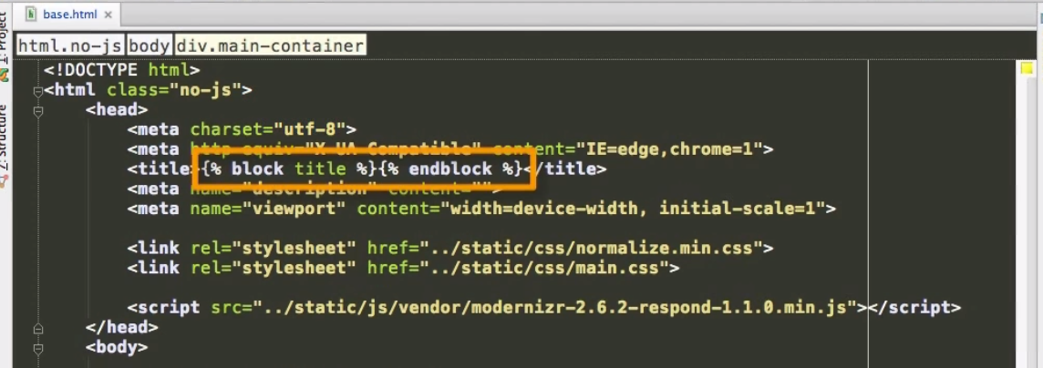
Template inheritance
All other logic like for loops and if-else statements go in curly braces + % sign = block.
Syntax:
{% block nameOfBlock %}{% endblock %}

Slide 11
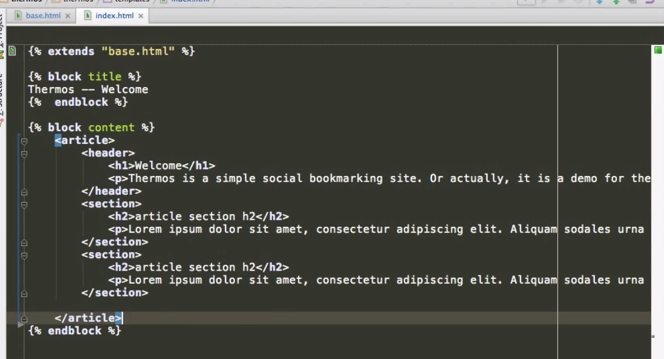
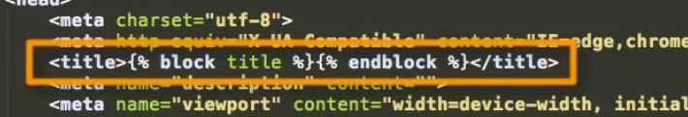
The block title in the base template will be replaced by jinja to the one in index.html i.e. Thermos – Welcome. Everything else will be copied/inherited from the base
By creating a base template page, all other pages now refer to this base.html page. Making other pages quite clean. Everything that is not marked as blocks is inherited from the parent

Slide 12
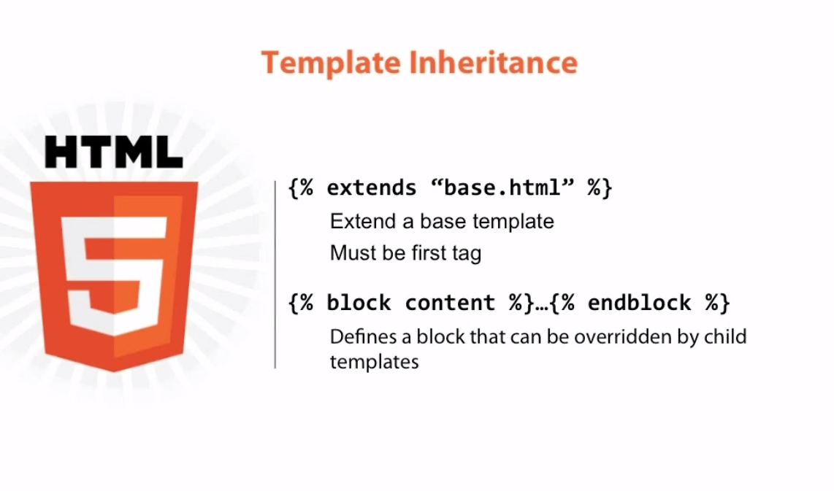

Slide 13
url_for can also be used to replace fixed links of static links in the html, so that if the app is to be deployed to the web or any other source, links can easily be changed from python = aintainable
endpoint
Any keyword argument that can be passed to the view function

Slide 14
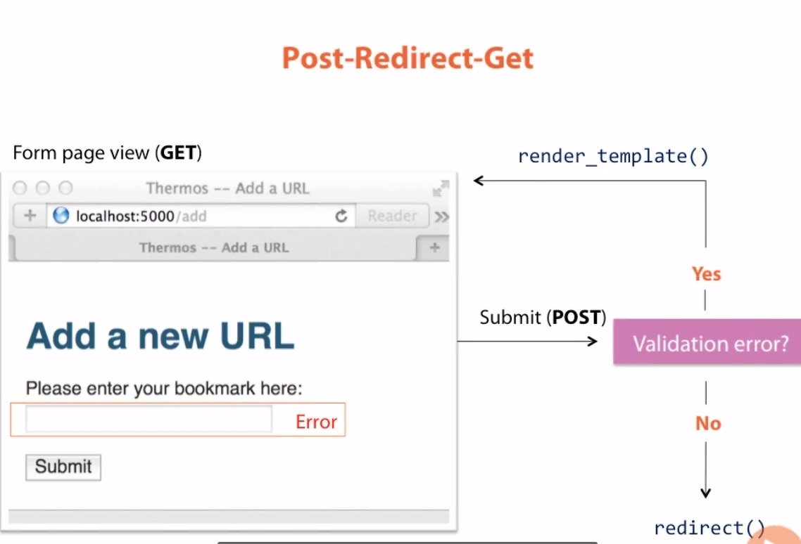

Slide 15
