Slide 2
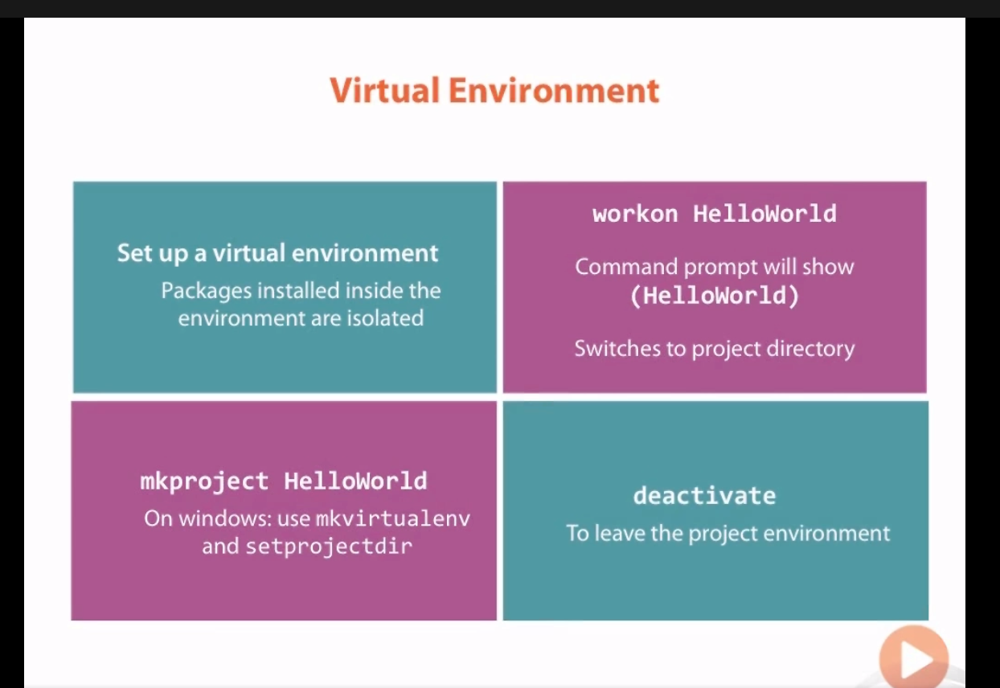

Slide 3
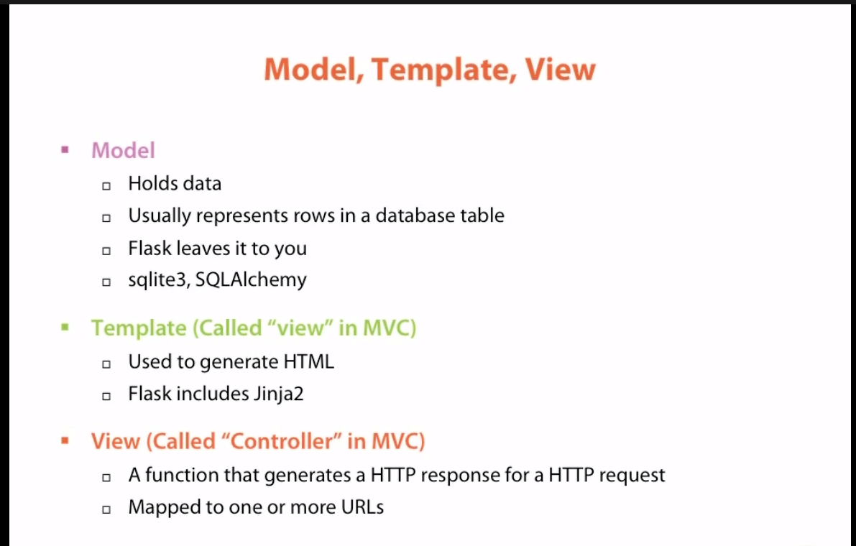
A python function that generates an http response for an http request

Slide 4
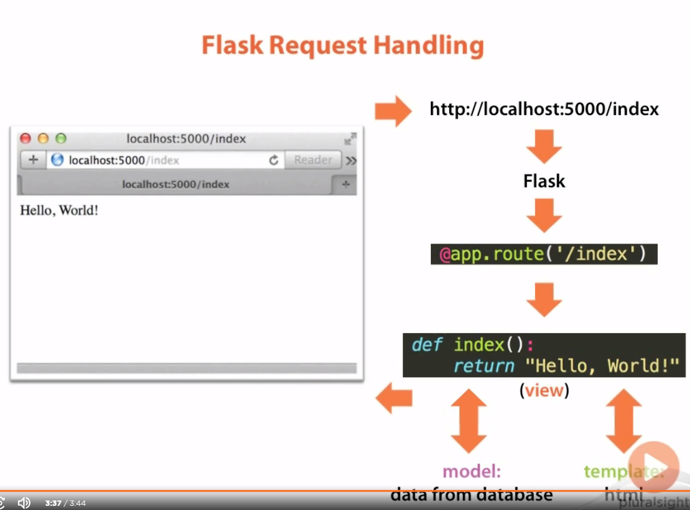

Slide 5
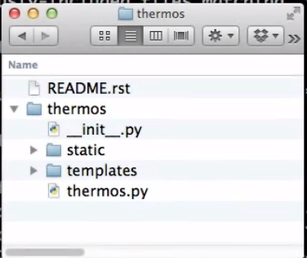
File structure
Parent
Another thermos, which holds our project
Because this is a packages, should have a .init file
Has static files: CSS/HTML/JS etc.
Has templates for generating HTML pages
Contains the flask project

Slide 6
