Slide 1
Getting Started

Slide 2
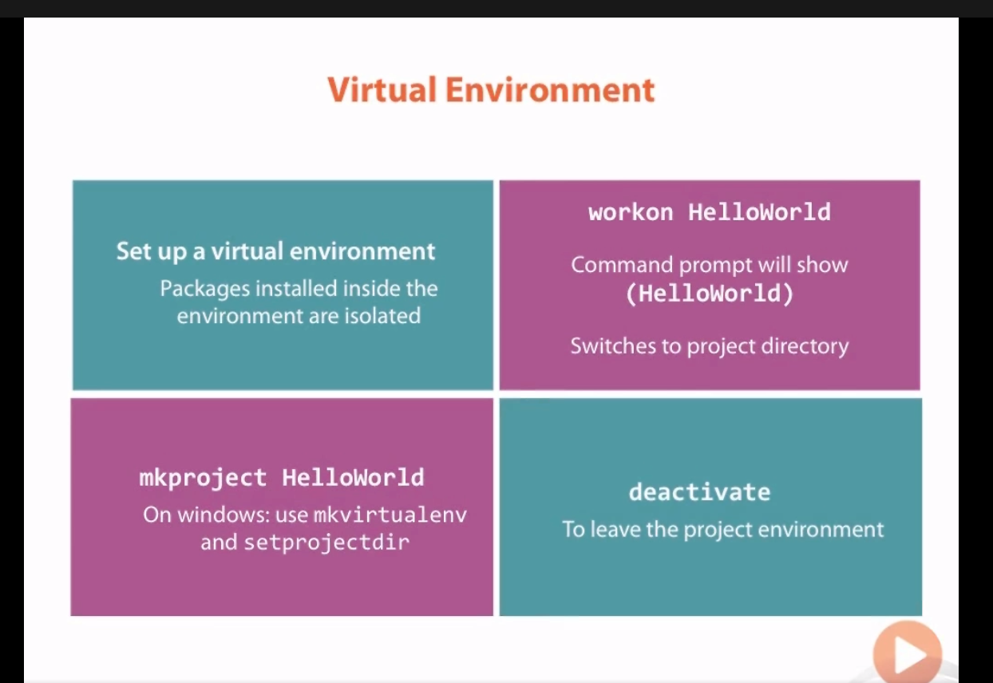

Slide 3
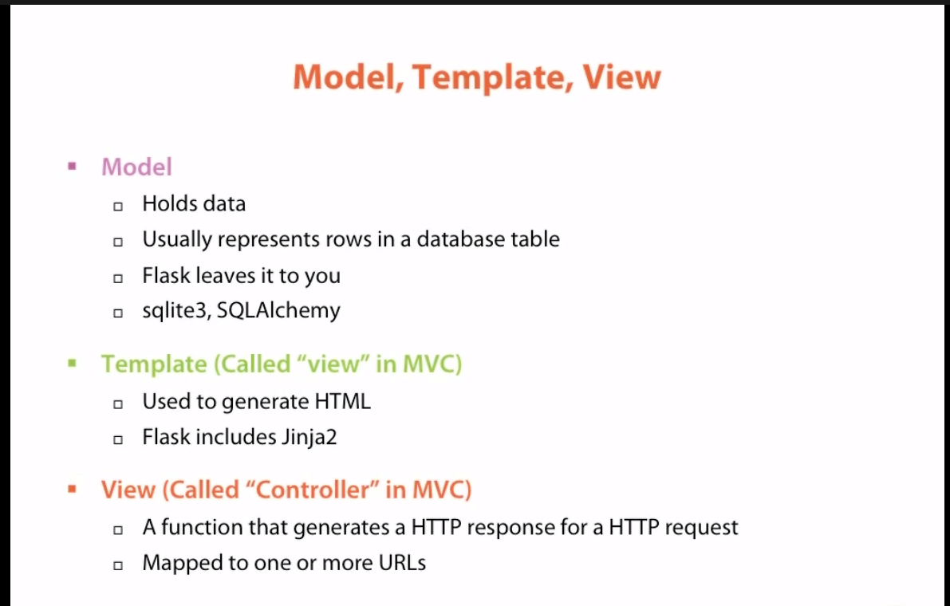
A python function that generates an http response for an http request

Slide 4
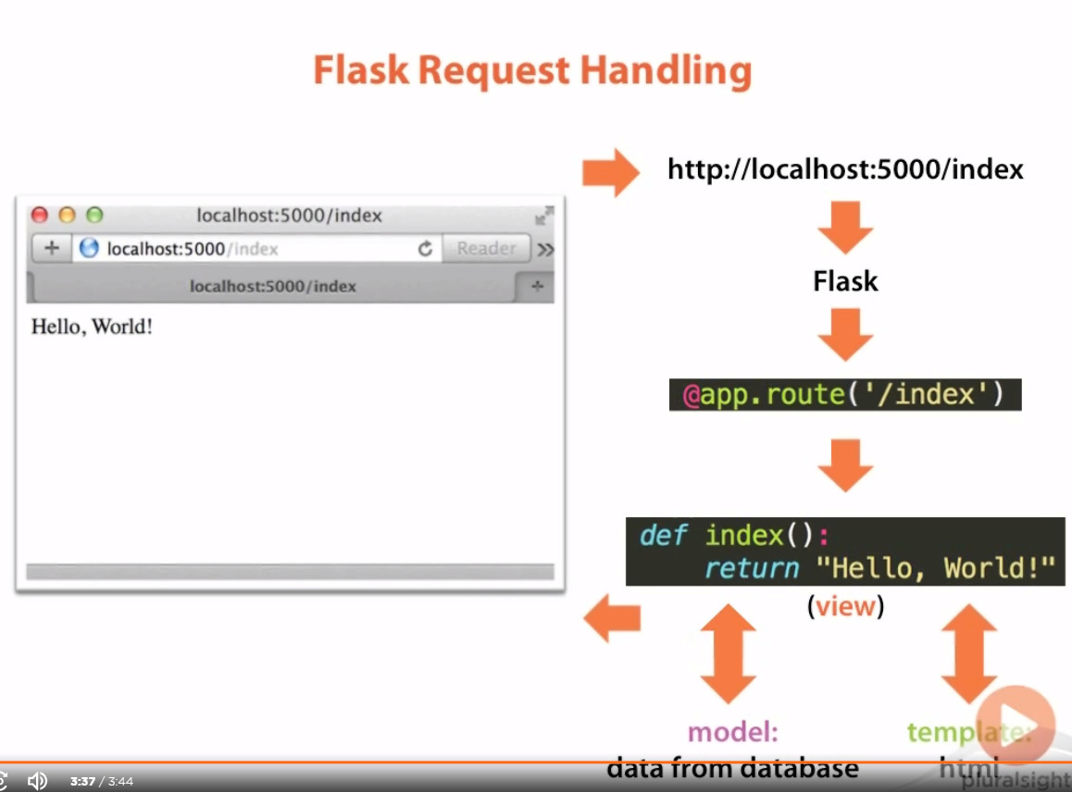

Slide 5
Basic Templates and Views

Slide 6
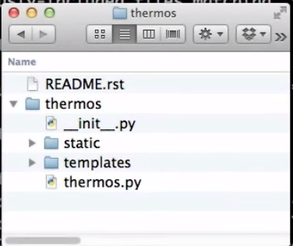
File structure
Parent
Another thermos, which holds our project
Because this is a packages, should have a .init file
Has static files: CSS/HTML/JS etc.
Has templates for generating HTML pages
Contains the flask project

Slide 7
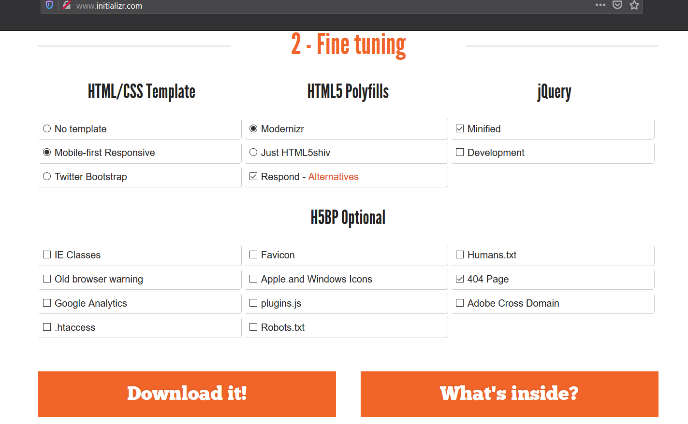
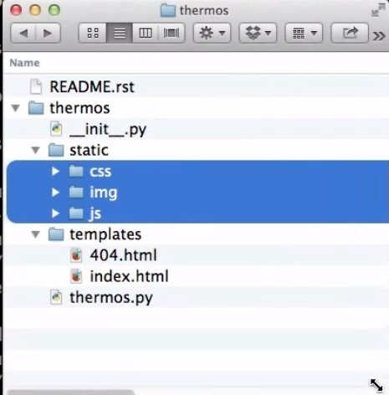

Slide 8
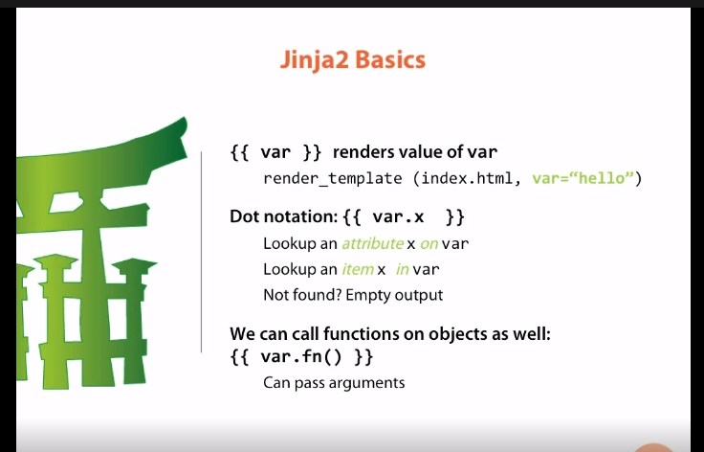

Slide 9
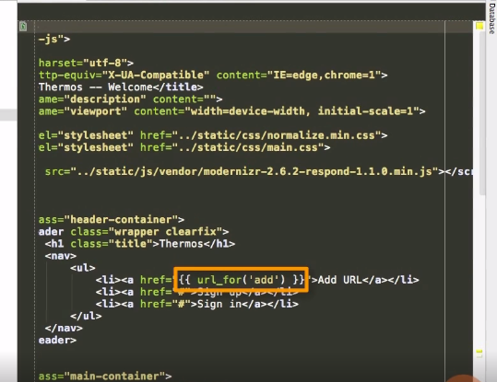
url_for is a jinja function available in all flask templates and takes the view passed in as the argument and returns its url

