Slide 1
PL SQL
Salient Features
Keshav Bhatt

Slide 2
Pros Cons
Powerful
Fast
Executable on cmd
Makes you think
Creates strict control over what goes in your db
Gets your concepts correct
Much powerful than vanilla SQL, can do a lot
Written by a committee not programmers
Code similar to Java
Written by a committee not programmers
Code similar to Java
Specific for Oracle
For Oracle db developers
Not the best error messages
Not elegant code]
Lot of result handling must be done explicitly

Slide 3
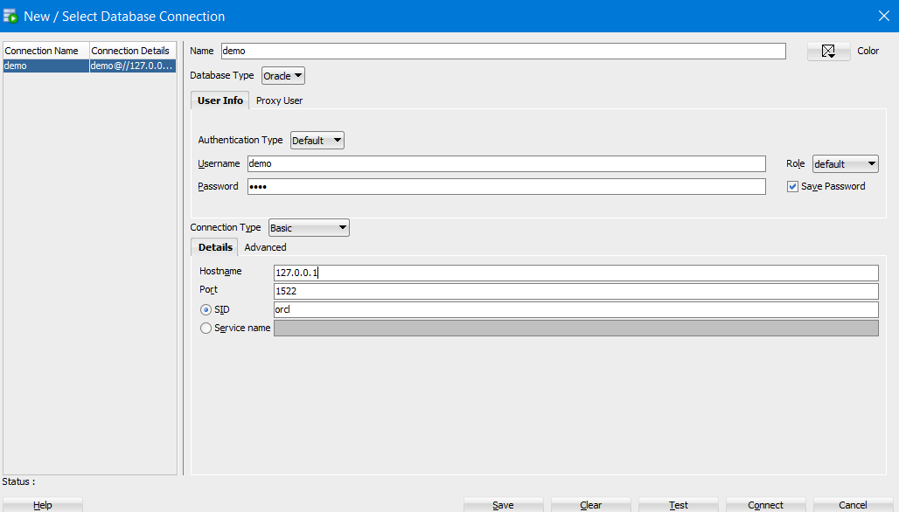
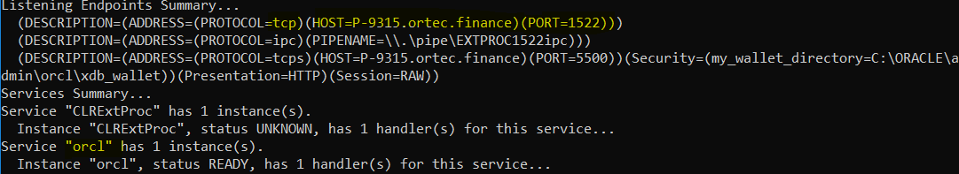
Installing
Install oracle 19c by following instructions on https://www.youtube.com/watch?v=KDu_VF9xaGk&t=870s
Stop at 14:30, the instructions are good till
Go to cmd and type lsnrctl status
Host is different now for some reason, but earlier it was 127.0.0.1

Slide 4
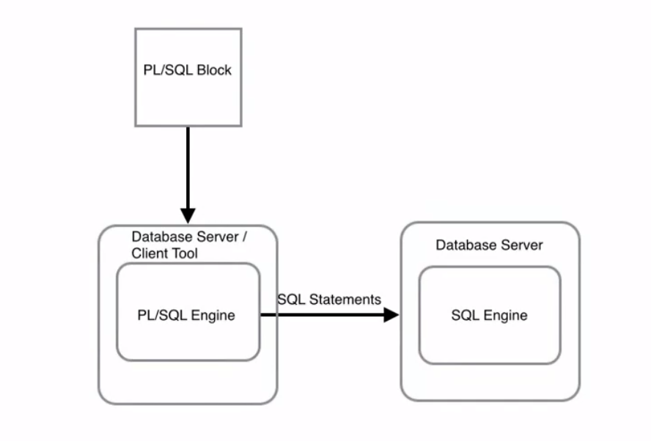
Architecture
Performs checks and calculations on the PL SQL engine not DB
Clumps multiple statements and processes them
Reduces nr of server calls to the db and latency

Slide 5
Idiosyncrasies
Char are defined by ‘ ’ and not “ ”
:= is assignment operator = is comparison operator
Case insensitive, can use a SQL formatter to prettify
Space insensitive
End statement (not line) with ; and args with , (but not always consistent)
Instead of print(), DBMS.PUT_LINE(…)

Slide 6
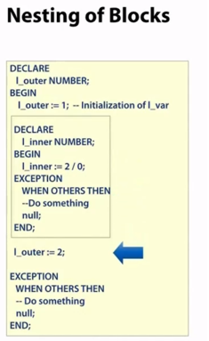
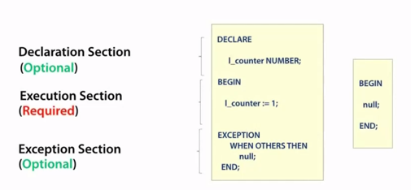
Anonymous Block
Basic unit
Only known to me (or to this is shared with)
Used for one-off purposes like testing or fixing something
Notes:
:= is assignment operator = is comparison operator
Case insensitive, can use a SQL formatter to prettify

Slide 7
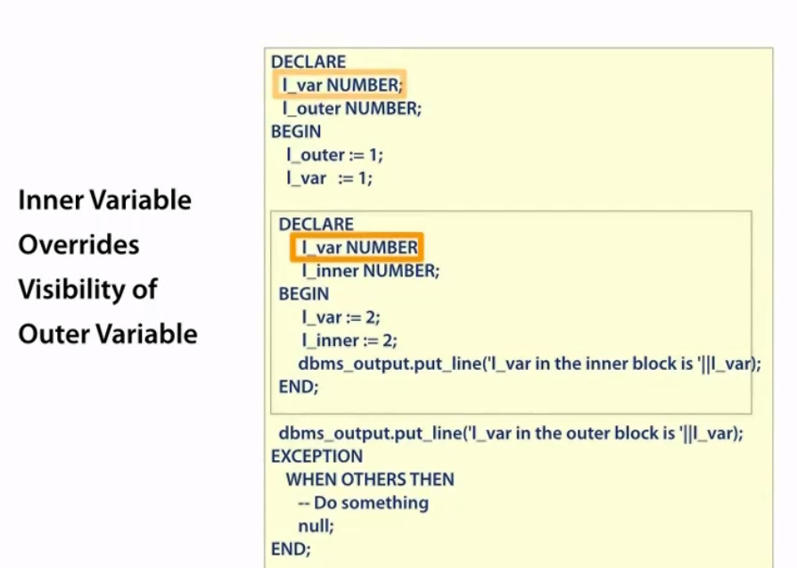
Scoping

Slide 8
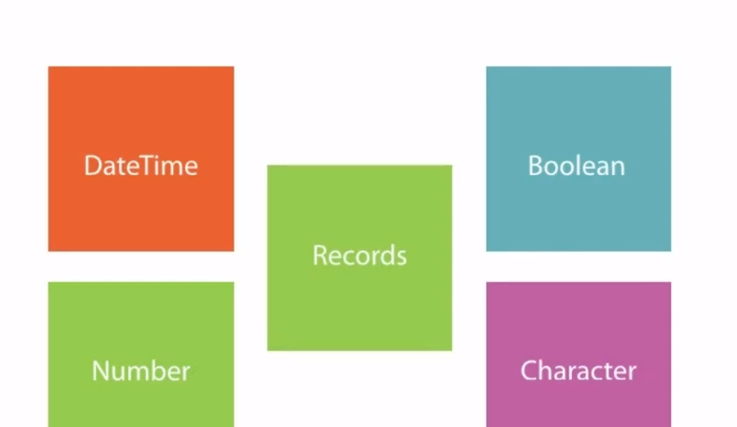
Datatypes
Popular
Scalar: Don’t have internal components
Composite: have internal components e.g. record/collections. Can be accessed by . notation
Reference: Cursors
Other:
For images etc. (BLOB = Binary
BFILE = Stores files outside db as link

Slide 9
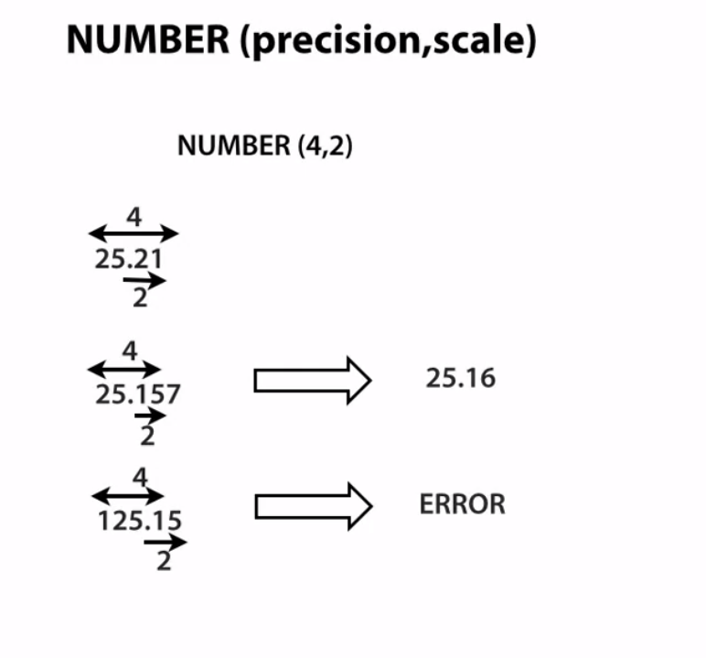
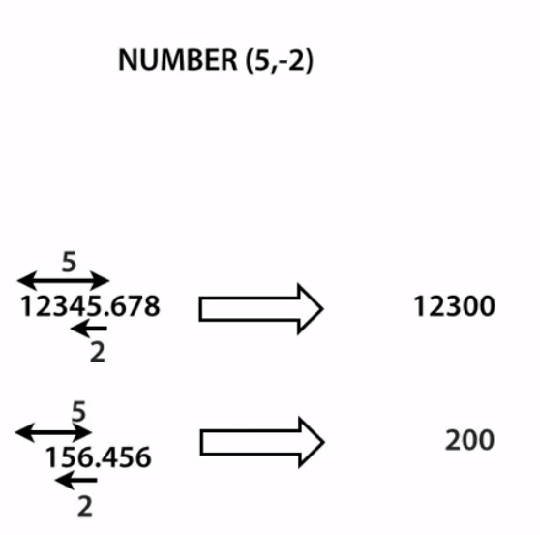
Need a precision of 5 with scale 2 to round the numbers after the decimal point
Precision = significant digits
Notes:
Example of strictness

Slide 10
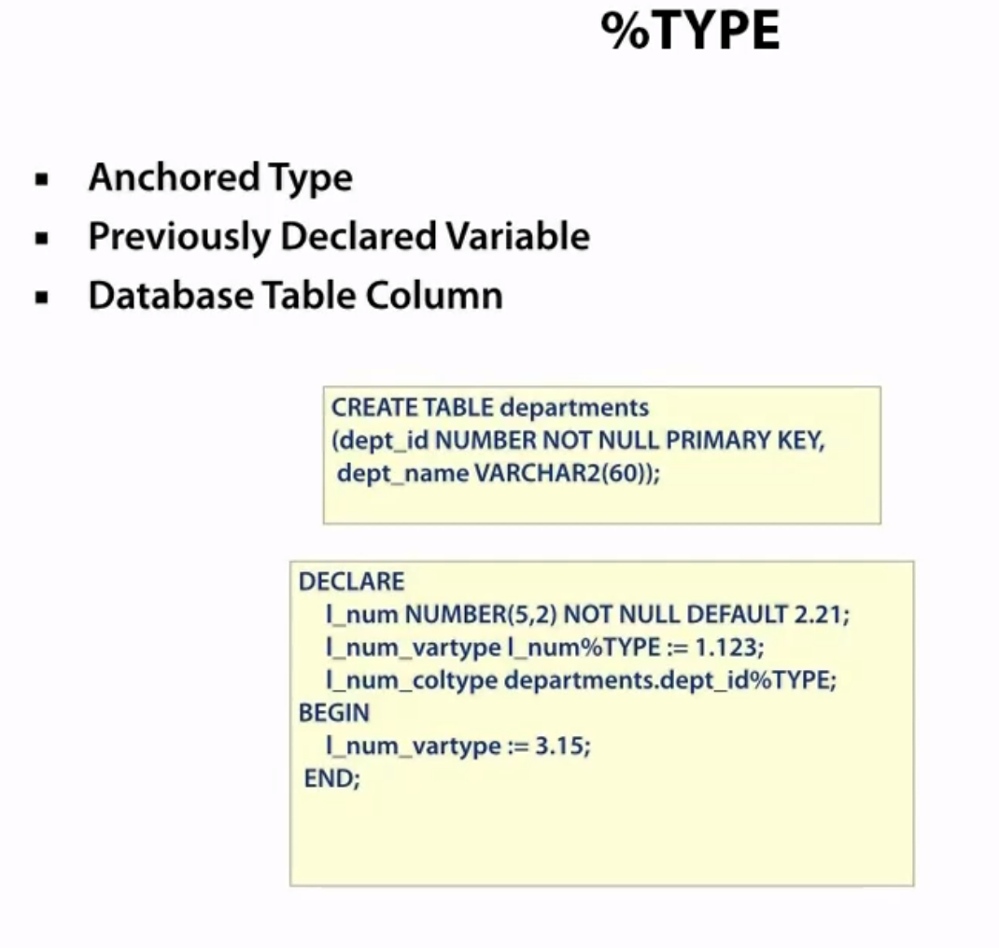
Type inheritance
Good when a variable is dependent on another column of another table
NULL constraints and data type constrains are both inherited in the same block only

Slide 11
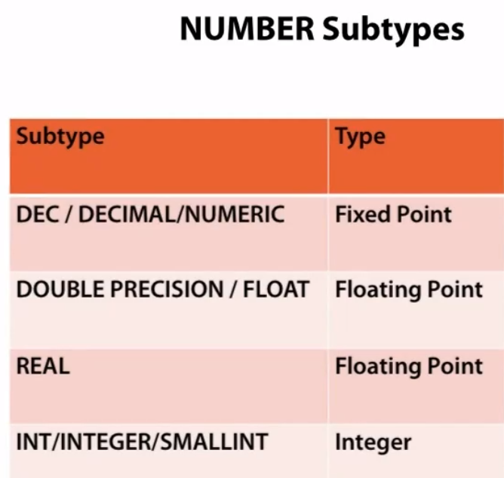
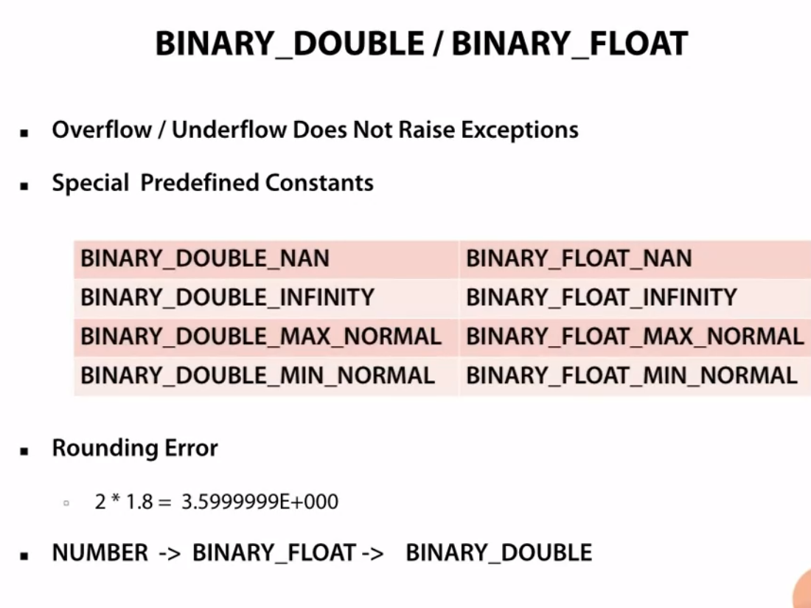
Numeric types
Notes:
Binary data types are even more efficient since they are in base 2, but be careful as numeric calculations may not be very accurate (e.g we get 3.599 instead of 3.6. So for nrs with a small range or where precision is not important use binary. Also, take into account numeric precedence, if an operation involves number and binary double, the result will be converted to binary double
Also this datatype does not result in numerical overflow/underflow errors, divby0 error

Slide 12
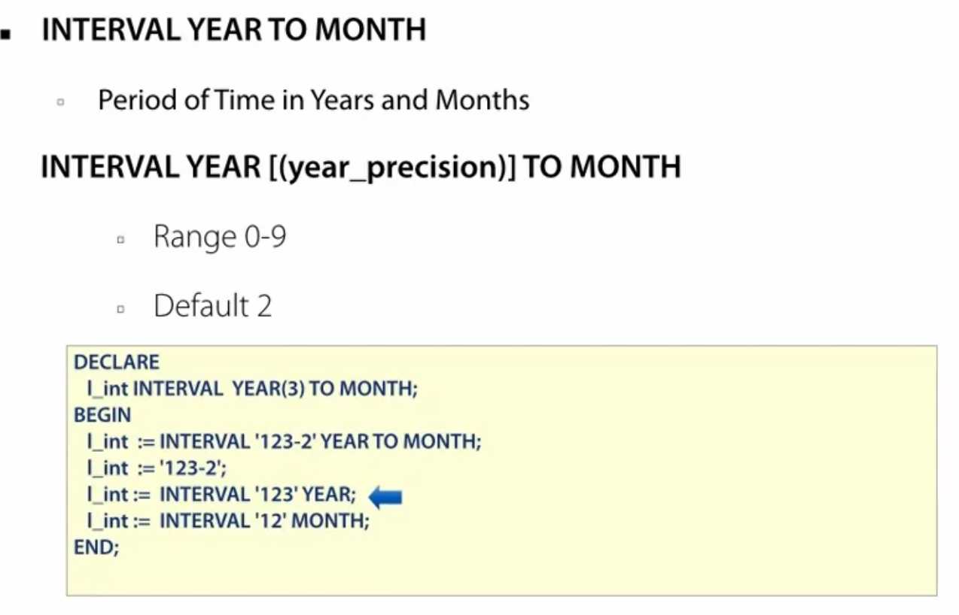
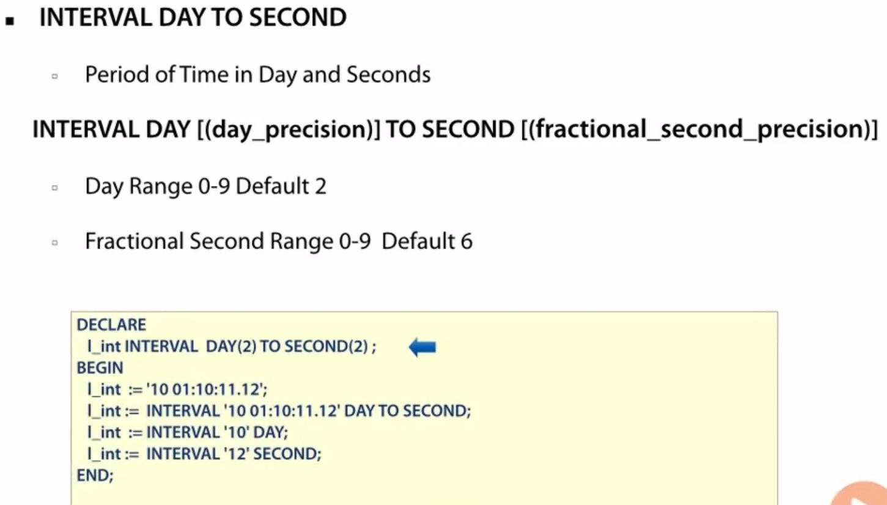
Datetime
INTERVAL YEAR TO MONTH – which records a duration of years and months
INTERVAL DAY TO SECOND – which records a duration of days, hours, minutes and seconds.

Slide 13
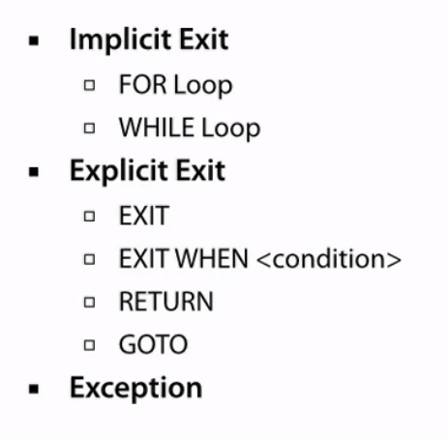
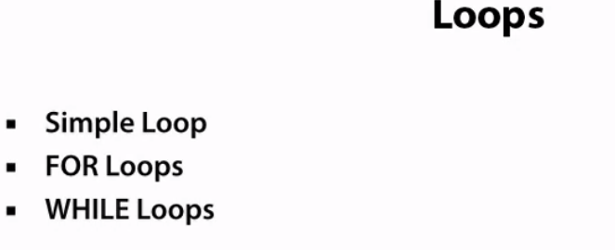
FOR loops

Slide 14
Cursors
Implicit
Area in memory to hold the results for a SELECT, INSERT, UPDATE statement
Managed by Oracle
Exact 1 row commands
Single use
Explicit
Most common mode. Oracle executes your query but gives you control to open, fetch and execute cursor
Must self-manage, but more control
For multiple rows, but must use a loop
Multiple use

Slide 15
