Slide 2
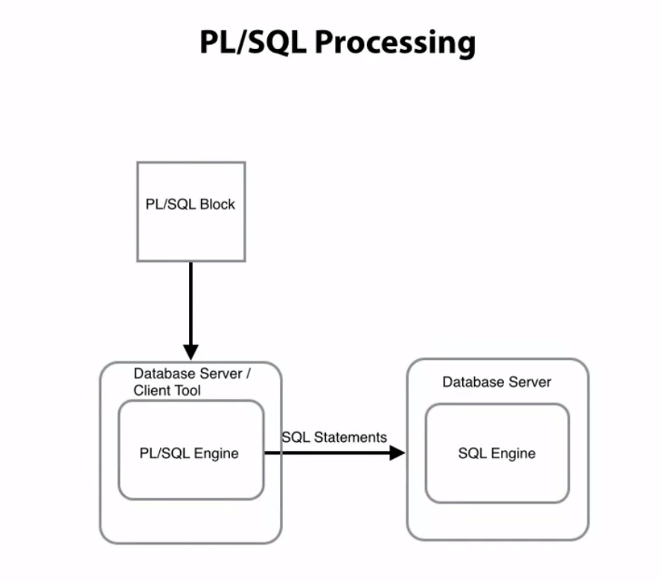
PL SQL performs checks and calculations on the PL SQL engine. (It clumps multiple statements and processes them). This reduces nr of server calls to the db and latency

Slide 3
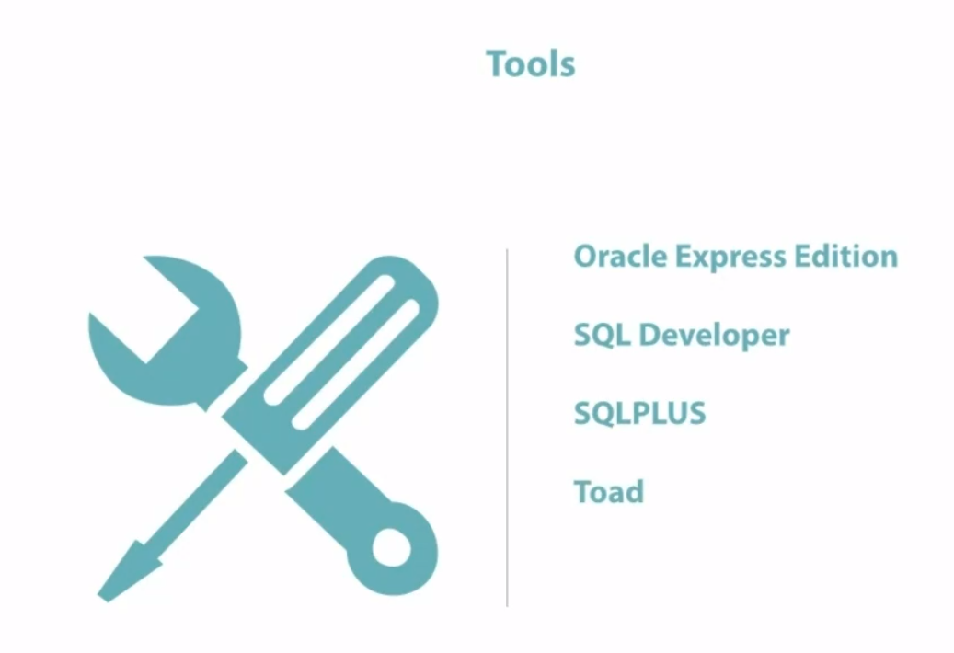

Slide 4
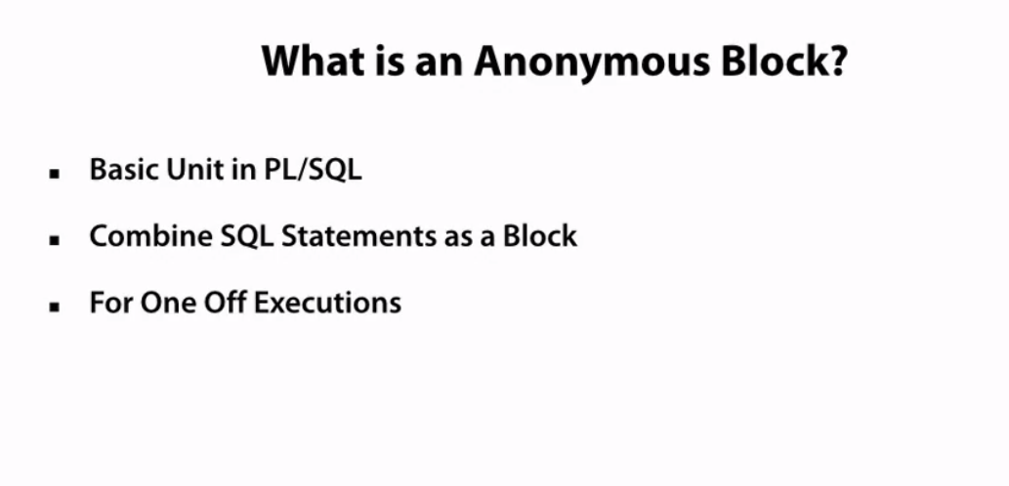
Only known to me (or to this is shared with) and used for one-off purposes like fixing something in prod

Slide 5
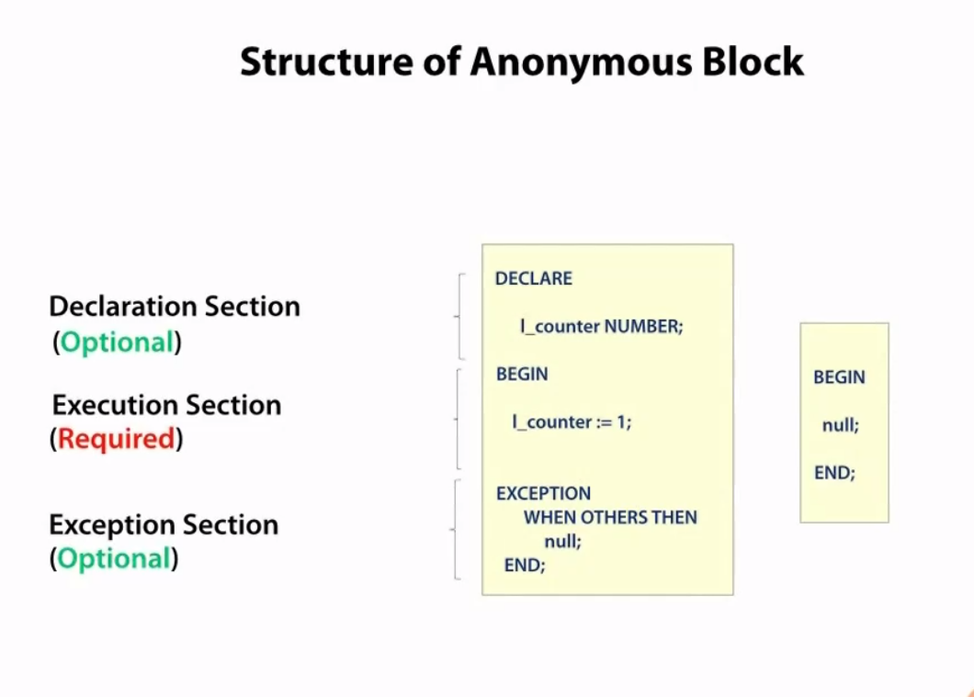

Slide 6
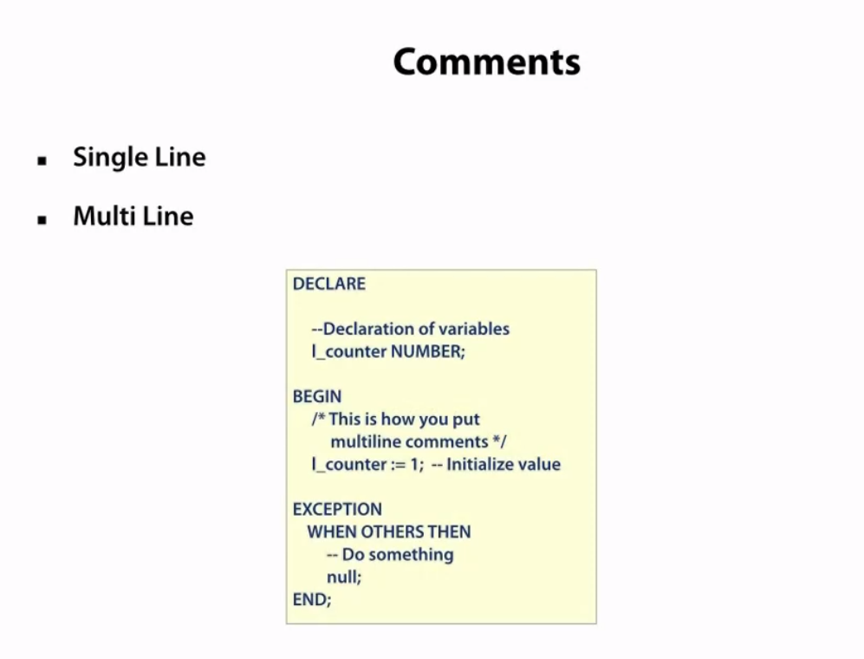
Good practices
Local vars: start with l_
Cursors: start with cur
Exceptions: start with e_

Slide 7
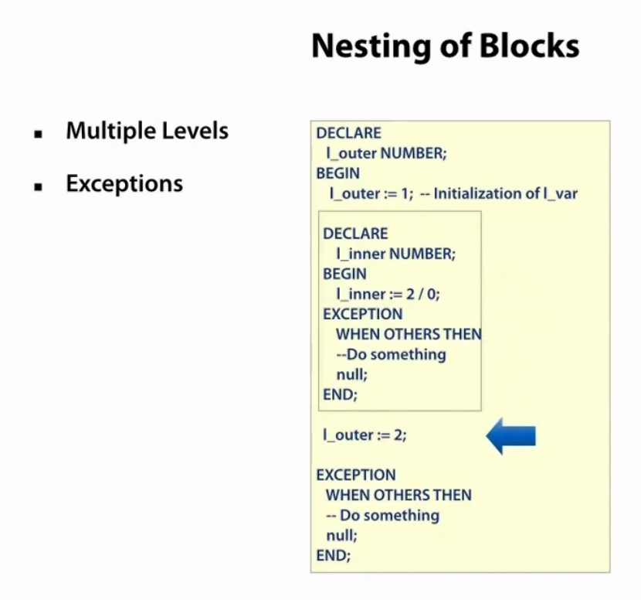

Slide 8
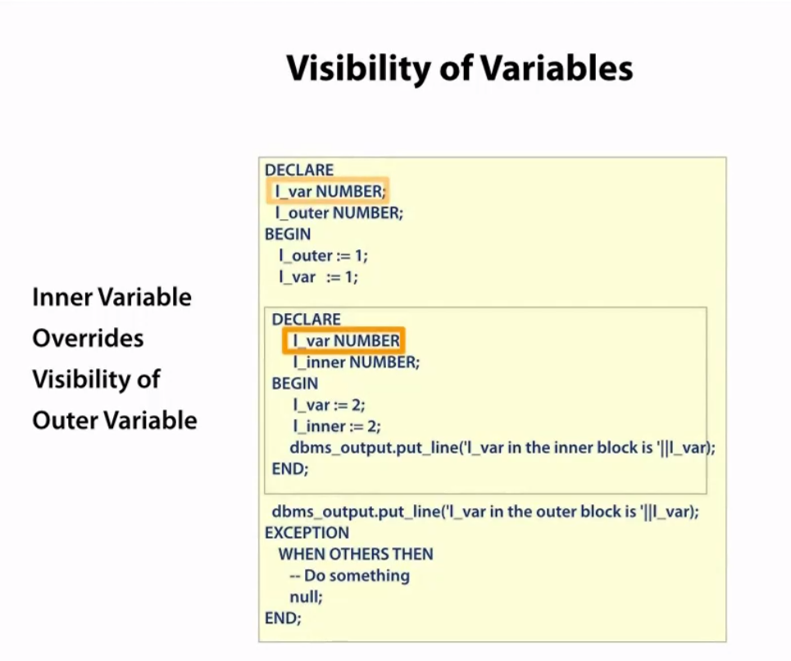

Slide 9
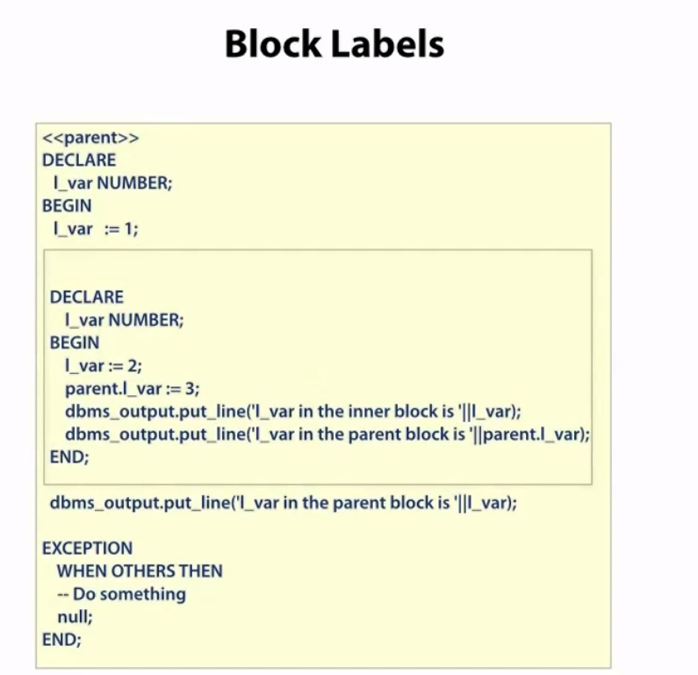
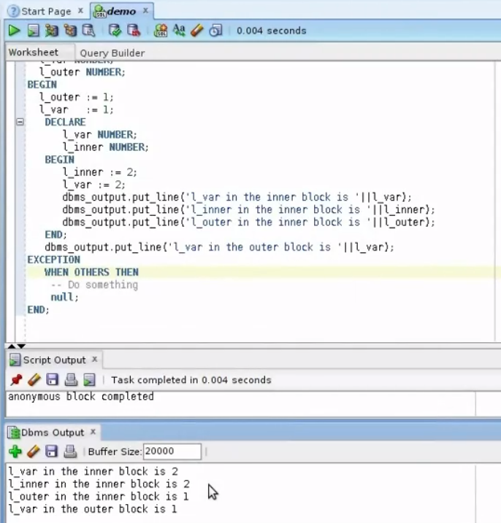

Slide 10
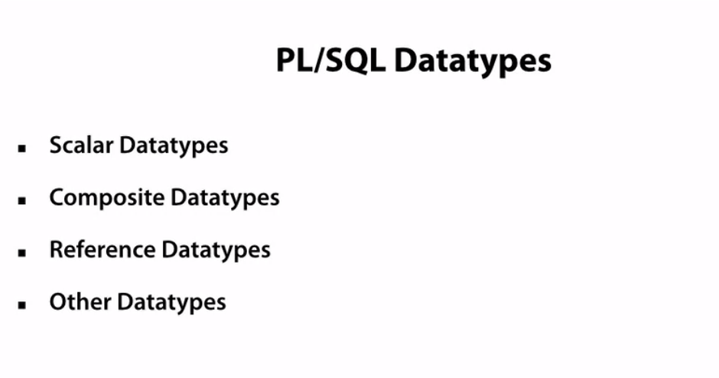
Scalar: Don’t have internal components
Composite: have internal components e.g. record/collections. Can be acesed by . Notation
Ref: Cursors
Other: For images etc

Slide 11
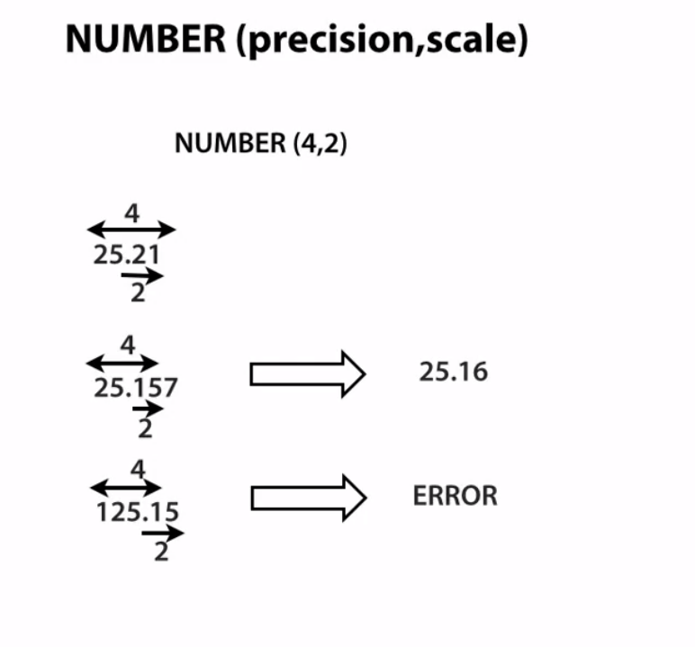
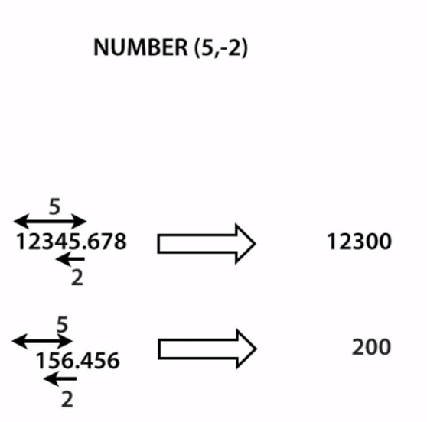
Need a precision of 5 with scale 2 to round the numbers after the decimal point
Precision = significant digits

Slide 12
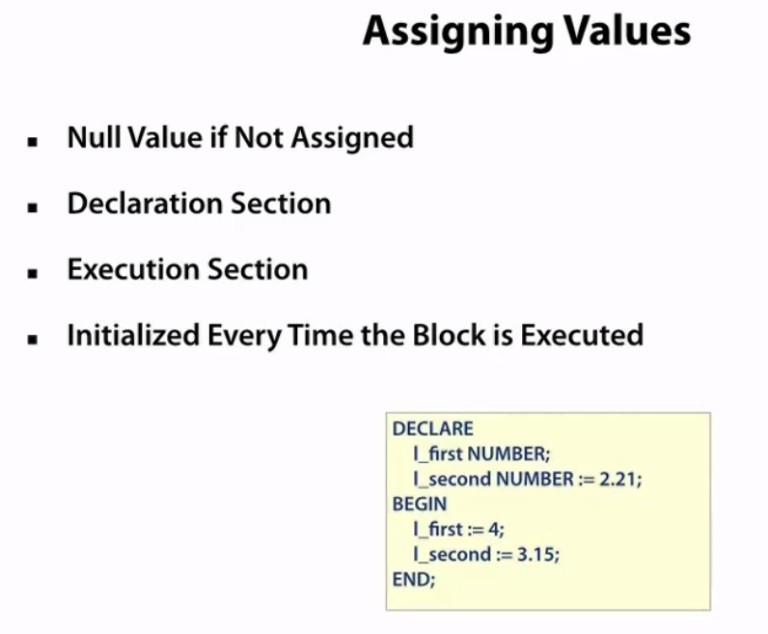
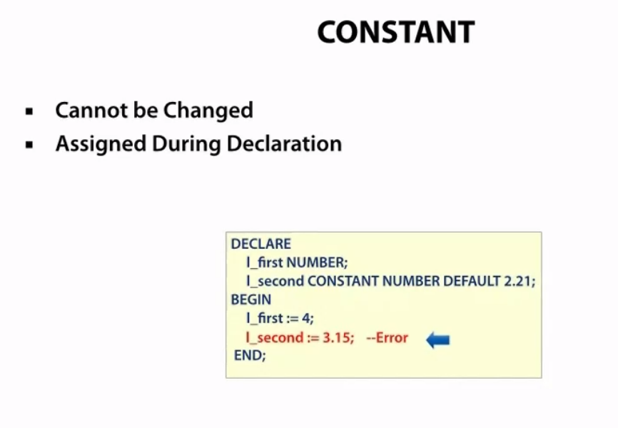

Slide 13
