Slide 1


Slide 2
Brief Synopsis
In creating the recommendation system, I had multiple challenges/issues:
Finding the market bias between two categorical variables.
Processing on large datasets was resulting in crashing the session of the runtime so I had to optimize the data by removing records which were not valuable.
I decomposed dataset using SVD for dimensionality reduction.
Then, I used user based collaborative filter technique which recommends products based on users ratings.
Used correlation technique to find the similar items based on ratings.
After that, I created a GUI using Tkinter package to take the user input as item id(The item user purchased) and recommend other items to that user which others purchased.

Slide 3
Problem Being Solved
The problem was of recommending related items based on the user's purchase.
The datasets contained data about clothing and electronics items.
Also, another problem to solve was detecting if there is market bias in the datasets.
In modcloth dataset, the market bias was to detect on basis of size attribute and in Electronics dataset, the market bias was to detect on basis of gender attribute.

Slide 4
Technology/Tool/Stack
Technologies:
Language – Python.
Tool – jupyter notebook.
Libraries – Pandas, Numpy, scipy.stats, sklearn.decomposition, tkinter.
Algorithms/techniques – correlation coefficient, collaborative filtering, Singular Value Decomposition.

Slide 5
Solution Architecture
Detecting market bias using chi2, I found that there is market bias in both of attributes gender and size.
The solution of this project is the GUI window which asks for input as item Id of purchased product and recommends similar product ids which were purchased by similar users.
If there is above 65% correlation between users then the items are recommended to each other.

Slide 6
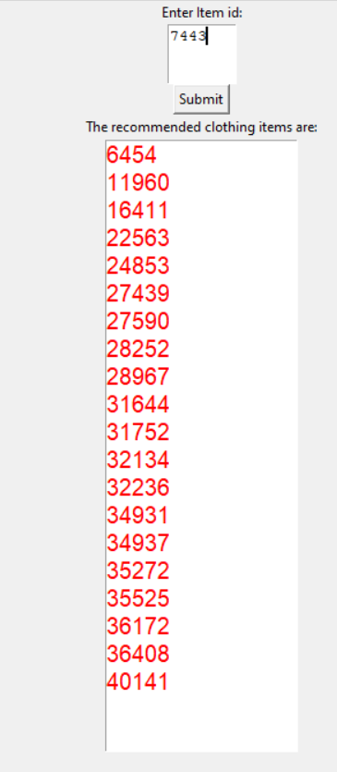
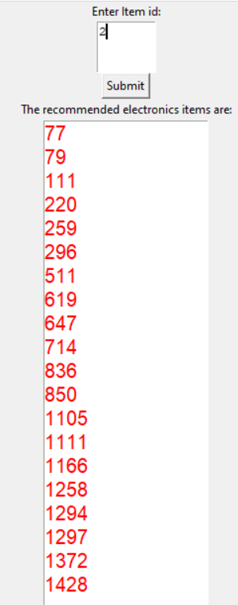
Prototype/ MVP Demo Video/Screenshots

Slide 7
Challenges Faced
Optimizing large dataset was a challenge as the runtime was keep crashing the executing the code.
Figuring out what recommendation technique to use was a challenge.

Slide 8
Future enhancements
1
Processing Larger Datasets
Building Recommendation system using all the data is again a challenge and that would increase the efficiency of the system.
Removing Market bias
2
Removing market bias from the datasets to avoid underrepresentation would increase correctness in the recommendation.

Slide 9
Thank You

