Slide 1




CAPSTONE PROJECT
Digital Media Content
Analysis Using
Netflix Dataset
PRESENTED BY
STUDENT NAME: Bhatt Zeel Pareshbhai
COLLEGE NAME: L. D. College of Engineering
DEPARTMENT: Electronics & Communication (EC)
EMAIL ID: bhatt.zeel.20@gmail.com

Slide 2
OUTLINE:
Problem Statement (Should not include solution)
Proposed System/Solution
System Development Approach (Technology Used)
Algorithm & Deployment
Result (Output Image)
Conclusion
Future Scope
References

Slide 3
PROBLEM STATEMENT:
The entertainment and media industry has undergone a massive digital transformation with the rise of streaming platforms like Netflix. However, this rapid growth has introduced several critical challenges:
• Content Overload: Millions of movies and shows are uploaded daily, making it difficult to understand content patterns and user preferences.
• Audience Sentiment: Understanding how audiences perceive content descriptions is complex due to diverse tastes and rapidly changing trends.
• Content Classification: Identifying the type and category of content based on available metadata is a major analytical challenge for platform optimization

Slide 4
PROPOSED SOLUTION:
The proposed system analyzes user behavior, sentiment, and content popularity on Netflix using a multi-technique data analytics approach
• Data Collection & Cleaning:
• Collected Netflix titles dataset (8,807 records) and performed complete data cleaning and preprocessing.
• Exploratory Data Analysis:
• Performed EDA to identify content distribution patterns, genre trends, and country-wise production analysis.
• NLP Sentiment Analysis:
• Applied TextBlob NLP library to analyze sentiment of Netflix content descriptions — Positive, Negative, Neutral.
• Machine Learning Model:
• Built a Random Forest Classifier to predict content type (Movie vs TV Show) with 71.02% accuracy.
• Power BI Dashboard:
• Developed a 5-page interactive Power BI dashboard to visualize all insights and findings.

Slide 5
SYSTEM APPROACH:
System Requirements
Libraries Used
Python 3.x
Google Colab
Power BI Desktop
Netflix Titles Dataset (CSV)
pandas, numpy
matplotlib, seaborn
textblob
scikit-learn
Data Flow
Tools & Platform
Raw CSV → Clean Data →
EDA → Sentiment Analysis
→ ML Model → Dashboard
Google Colab (Python)
Power BI (Dashboard)
GitHub (Code Repository)

Slide 6
ALGORITHM & DEPLOYMENT:
Algorithm Selected: Random Forest Classifier
A supervised ML algorithm that builds multiple decision trees and combines their results for better accuracy.
Data Input Features:
release_year, rating_encoded
Training Process:
80% data used for training, 20% for testing. train_test_split() with random_state=42.
Prediction Process:
Model predicts whether a Netflix title is a Movie (1) or TV Show (0) based on the 2 input features.
Deployment:
Model trained and evaluated in Google Colab. Results and insights deployed via 5-page Power BI Dashboard.

Slide 7
RESULT - ML Model:
71.02%
1,250
510
1,760
Model Accuracy
Correct Predictions
Wrong Predictions
Total Tested
Feature Importance — What helped the model predict?
Rating encoded
65%
Release year
35%

Slide 8
RESULT - Sentiment Analysis:
Sentiment analysis was performed on 8,807 Netflix content descriptions using the TextBlob NLP library:
Positive
Negative
Neutral
51.61%
30.24%
18.15%
4,543 titles
2,662 titles
1,598 titles
Key Finding: Over 51% of Netflix content descriptions use positive language, indicating Netflix intentionally crafts upbeat and engaging content summaries to attract viewers.

Slide 9
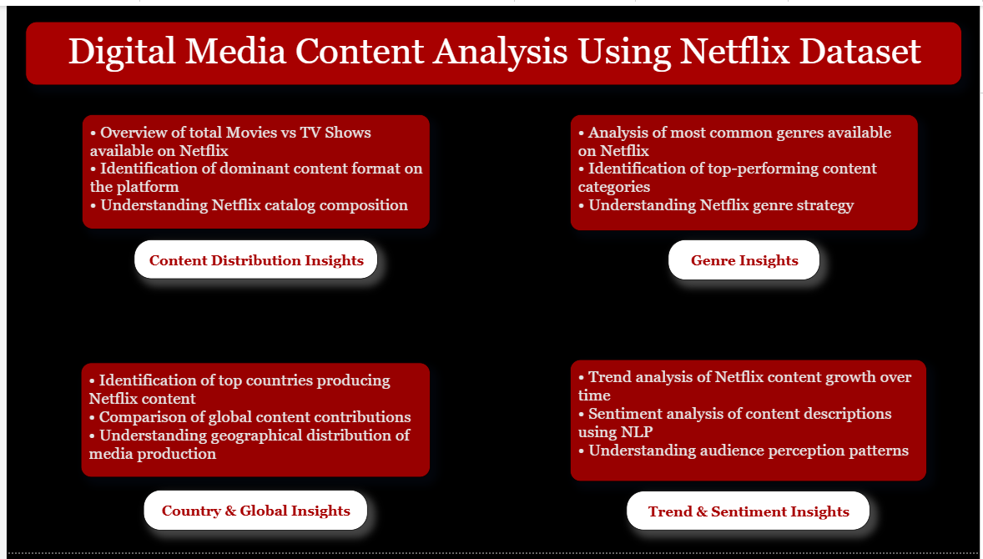
RESULT - Power BI Dashboard:

Slide 10
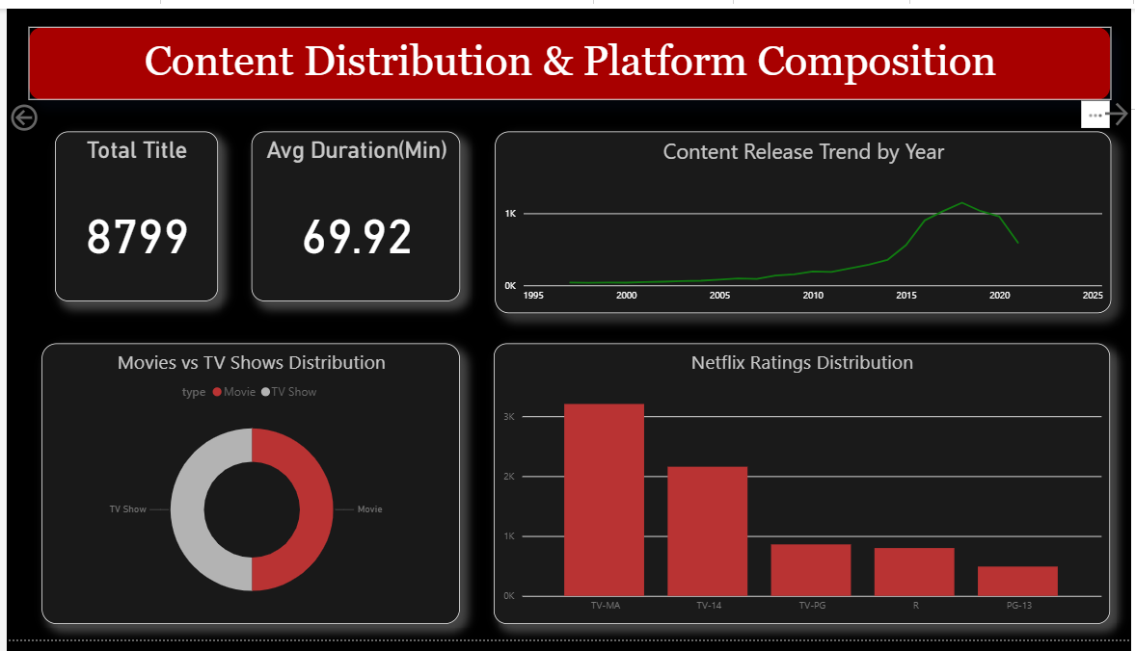
RESULT - Power BI Dashboard: Page 1

Slide 11
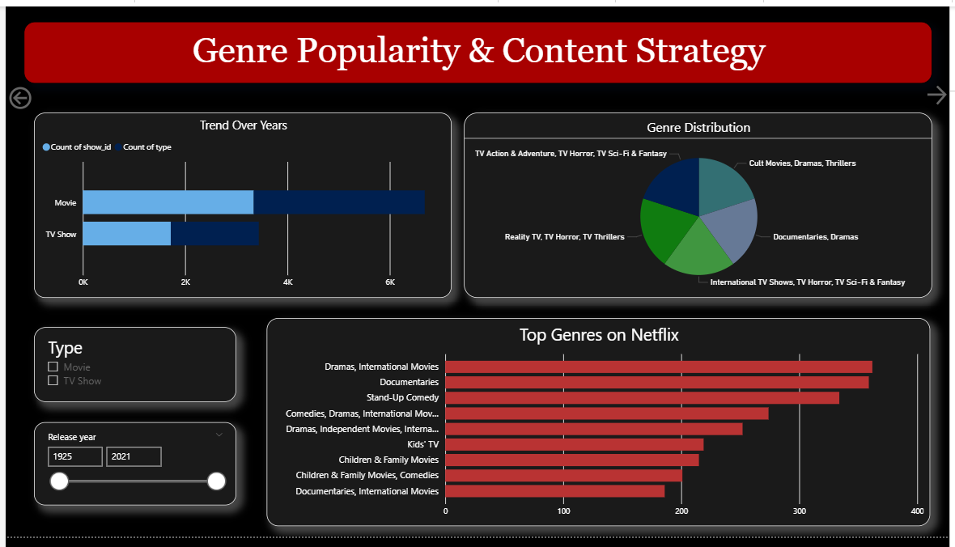
RESULT - Power BI Dashboard: Page 2

Slide 12
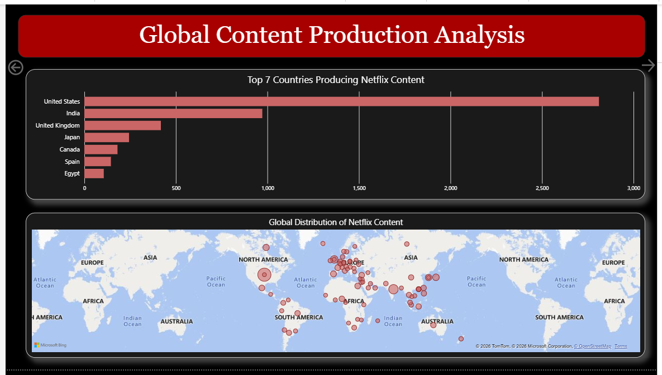
RESULT - Power BI Dashboard: Page 3

Slide 13
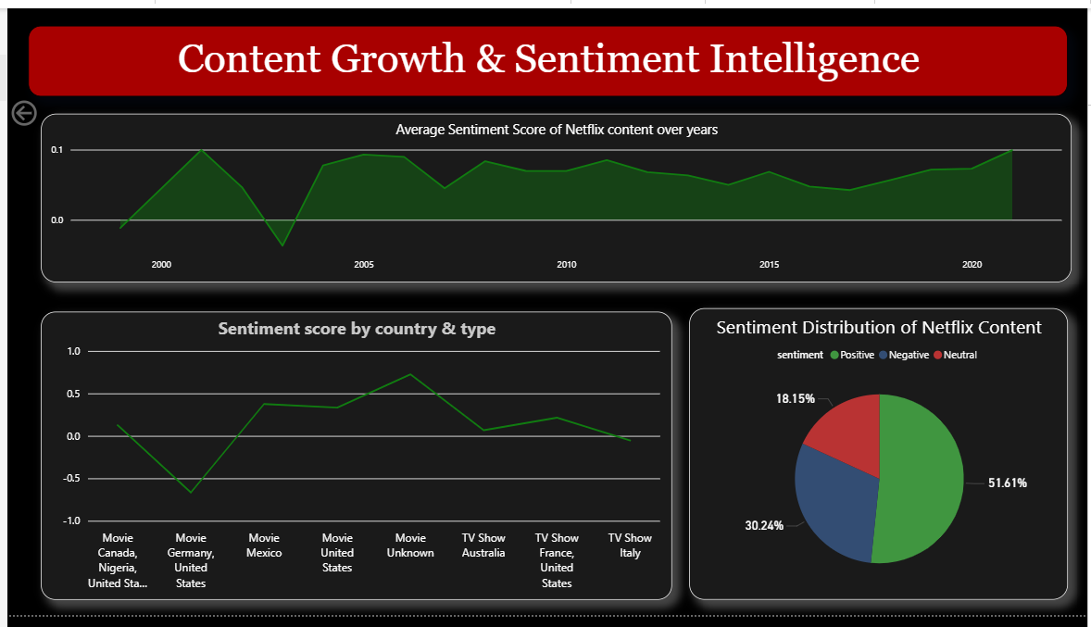
RESULT - Power BI Dashboard: Page 4

Slide 14
CONCLUSION:
This project successfully analyzed user behavior, audience sentiment, and content patterns on Netflix using multiple data science techniques:
• The EDA revealed that the USA dominates Netflix content production (3,690 titles) and Dramas are the most popular genre.
• NLP Sentiment Analysis showed that 51.61% of Netflix descriptions are positive, reflecting Netflix's strategy of using engaging language.
• The Random Forest ML model achieved 71.02% accuracy in predicting content type.
• The 5-page Power BI dashboard provides a comprehensive, interactive view of all insights supporting data-driven decision making in the entertainment domain

Slide 15
FUTURE SCOPE:
• Real-time Data Integration
• Connect live Netflix API or social media data for real-time sentiment and trend analysis.
• Deep Learning Models
• Replace Random Forest with LSTM or BERT-based models for more accurate content classification and sentiment analysis.
• Recommendation System
• Build a collaborative filtering recommendation engine to suggest content based on user viewing patterns.
• Multi-Platform Expansion
• Extend analysis to other platforms like YouTube, Amazon Prime, and Disney+ for comparative media analytics

Slide 16
REFERENCES:
Dataset:
Netflix Movies and TV Shows Dataset - Kaggle (netflix_titles.csv)
Libraries:
pandas, numpy, matplotlib, seaborn - Python Data Analysis Libraries
TextBlob - NLP Sentiment Analysis Library (https://textblob.readthedocs.io)
scikit-learn - Machine Learning Library (https://scikit-learn.org)
Tools: Google Colab - Cloud-based Python IDE
Microsoft Power BI - Business Intelligence Dashboard Tool
GitHub Link: https://github.com/bhattZeel20/Media_Content_Analysis_Project

Slide 17
Thank You

