Slide 1
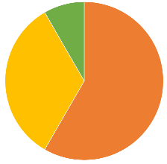
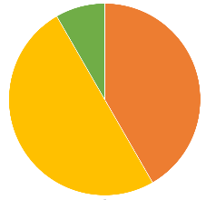

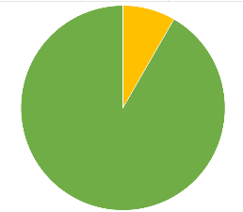
Likert Scale
Correct
Minor Mistake
1 2 3 4 5
Wrong
Find number of fiber bundles from volume rendering of data set1
Find number of fiber bundles from the color-mapped eigenvector of hessian matrix
Hessian based visualizations perform better than DV rendering
Find number of fiber bundles from MetaTracts fiber bundles
MetaTracts visualizations perform better than DV rendering
MetaTracts 2D slices visualizations perform better than 2D slices of original data
Find largest fiber bundle from set of MetaTracts fiber bundles
Find smallest fiber bundle from set of MetaTracts fiber bundles
Find most similar fiber bundle to given fiber bundle, from MetaTracts extracted bundles
MetaTracts visualizations perform better in finding largest, smallest and similar looking bundles than DV rendering
Meshes generated from MetaTracts provide better spatial context than volume rendering

