Slide 1
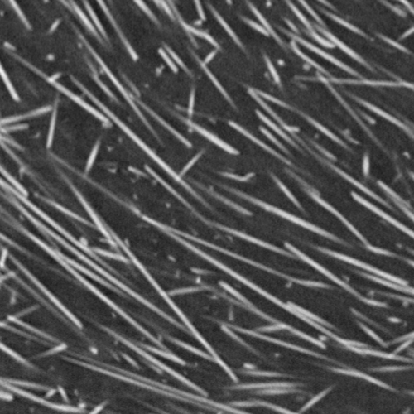
B
Single slice
A
Glass fibers
C
MetaTracts

