Slide 1

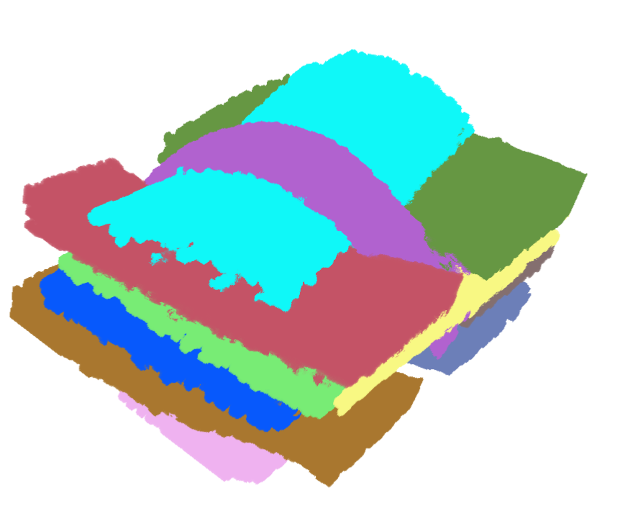
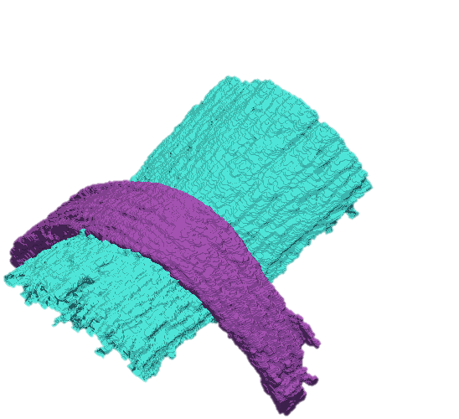
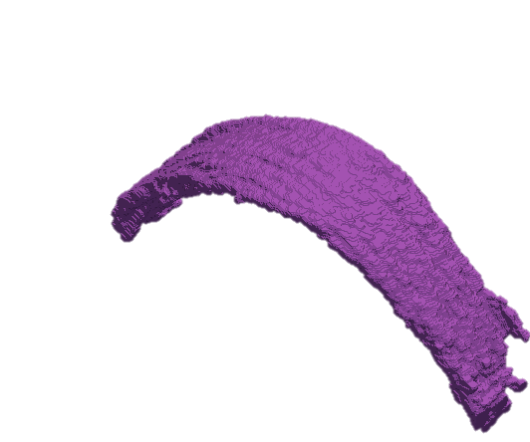
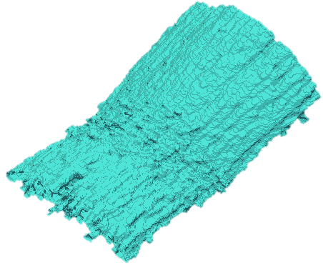
A
B
Fiber bundles Volume
Single Slice of Volume
7
7
C
D
Combined Mesh
Individual Mesh
7
7

Slide 2
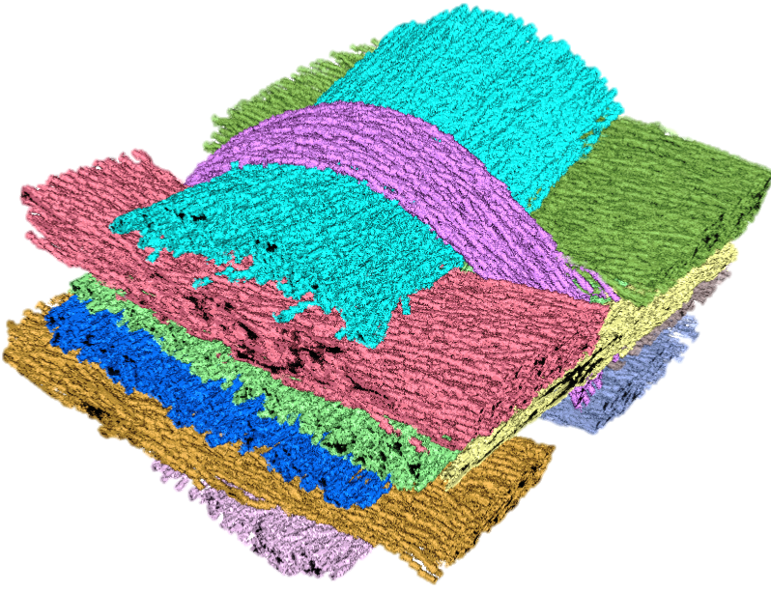
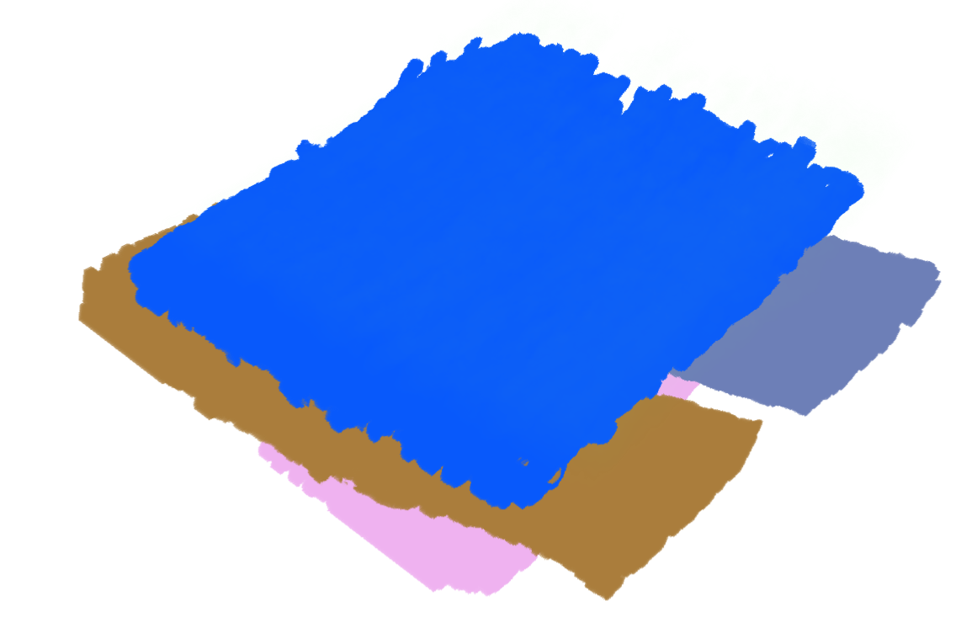
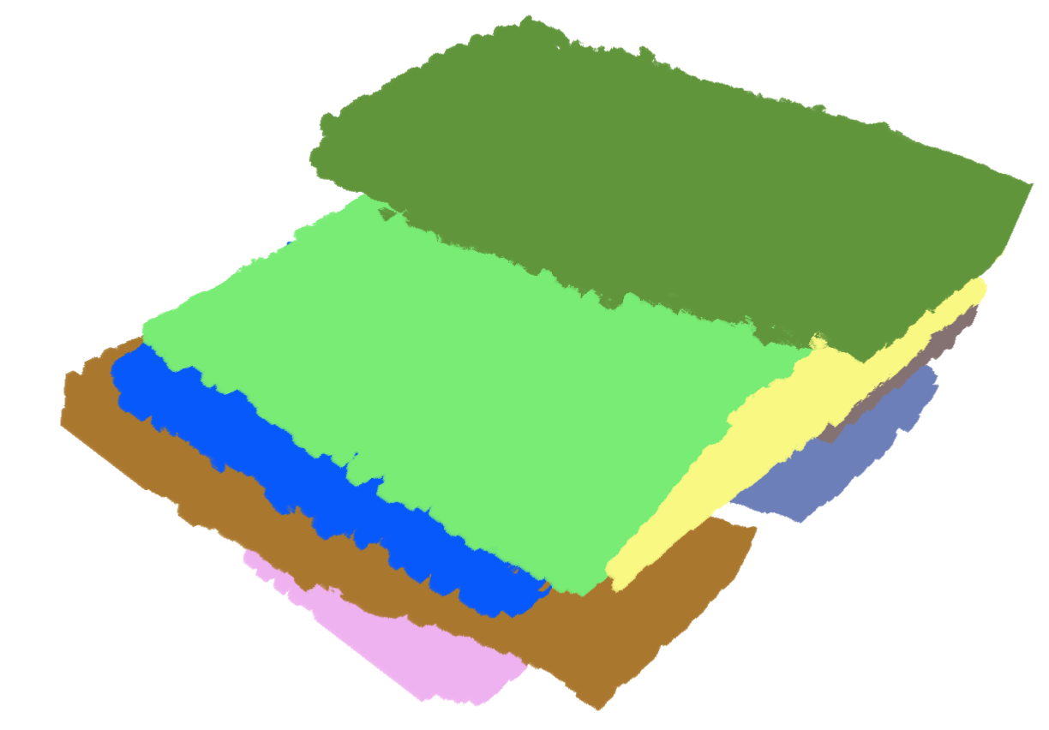
A
B
MetaTracts
Fiber Bundles Volume
1
6
3
2
C
Interaction between bundles

